Slide 1
Analysis HXN, March 2018
CdTe system

Slide 2
Outline
HXN convention
Geometry of the experiment
Effect of strain and tilt in the position of the Bragg peak
Results:
Rocking curve 1
To do: realign the diffraction maps and check the effect on the strain and tilt
Rocking curve 7:
To do: choose a better mask and redo the analysis
Rocking curve 9-10
Analysis of data: how to extract strain and tilt maps from a rocking curve
Rocking curve 11
Analysis of data: effect of alignement in the strain and tilt maps
Rocking curve 12

Slide 3
HXN conventions
Mounting of the sample:
zero of th_motor is perpendicular to the sample:
example: th_motor value of 82 deg in the log book, corresponds to a rocking angle of 90 – 82 deg
th_motor = 0 -> direct beam
th_motor = 82 deg/ th_rock = 90- 82 deg

Slide 4

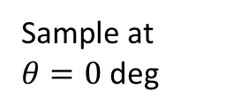

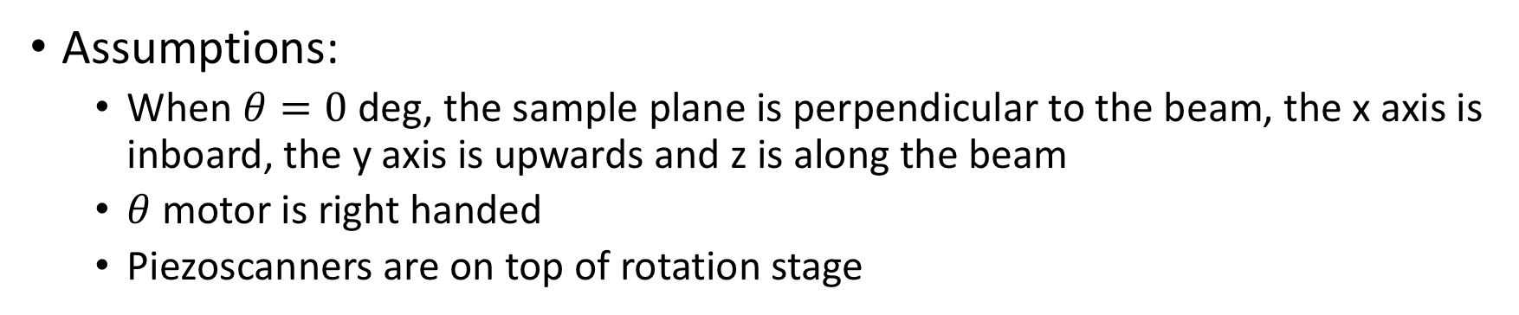

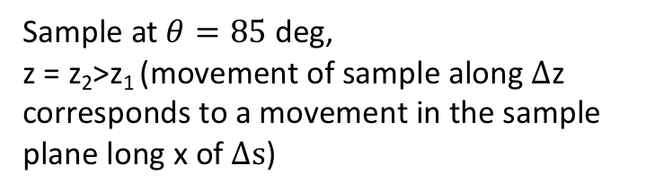
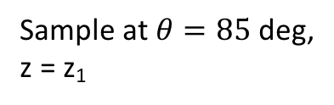

HXN geometry
Assumptions:
When $θ=0$ deg, the sample plane is perpendicular to the beam, the x axis is inboard, the y axis is upwards and z is along the beam
$θ$ motor is right handed
Piezoscanners are on top of rotation stage
Top view
Sample at $θ=0$ deg
Sample at $θ=85$ deg,
z = z₁
Sample at $θ=85$ deg,
z = z₂>z₁ (movement of sample along $∆$z corresponds to a movement in the sample plane long x of $∆s$)
x
x
y
z
$$∆s=∆z ×tan⁡(θ)$$
z
x
$$θ$$
y
z
$$∆z$$
$$θ$$
y
Incident beam
Incident beam
Incident beam
Sample

Slide 5


Geometry of the scattering
detector
rows
theta
columns
Q_{Bragg}
Incoming beam
Outgoing beam
$$θB$$
$$θB$$
z
sample frame
x
y

Slide 6
Effect of strain and tilt on the Bragg peak centroid position
Tilt of planes around y produces Q_{out-of-plane}
Tilt of planes around x produces Q_{azhimutal}
Combination of strain and tilt produces a 3D vector
Strain: displacement of planes along z produces Q_{radial}
out-of-plane
radial
Q_{centroid}
out-of-plane
radial
azhimutal
Q_{Bragg}
azhimutal
z
Q_{Bragg}
z
z
Q_{Bragg}
Q_{centroid} (Q_{rad},Q_{azhi}, Q_{out})
sample frame
y
x
y
x
y
x

Slide 7
Calculation of the centroids
Row and column centroids
y real space (pixels)
y
x real space (pixels)
x
where (x,y) are pixels in the ccd (i.e. in reciprocal space) and P(x,y,theta) is the diffracted intensity in each pixel of the ccd at given theta angle

Slide 8
Centroid maps:
Calculation of the Xcentroid and Ycentroid for each pixel of the real space map provides a 2D map in real space
y real space (pixels)
x real space (pixels)
(Xcentroid,Ycentroid)

Slide 9
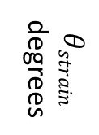

Xcentroids and Ycentroids are converted to radial components and to Strain maps
Strain:
displacement of planes along (111)
Q_{centroid}
$$θstrain$$
degrees
detector frame
average d_space
rows
theta
sample frame
strained d_space
z
columns
x
y
strain $\frac{∆d}{\overline{d}}$

Slide 10
Xcentroids and Ycentroids are also converted in azhimutal tilt
Tilt: = azhimutal component – mean value of azhimutal
$$θstrain$$
degrees
degrees

Slide 11
Rocking curve centroid are converted in out-of-plane tilt
Tilt: = ThCentroid – mean value of Thcentroid
Thcentroid
degrees
degrees

Slide 12
The two tilts are the two components of the total tilt around the mean tilt value
degrees
y
(Xcentroid,Ycentroid)
Thcentroid
X
theta (degrees)
tilt_total = sqrt(tilt_around_x^2 + tilt_around_y^2)
degrees
degrees
degrees

Slide 13
Summary of Maps of the Bragg peak centroid position of rock curve 9-10 combined
y real space (pixels)
ccd pixel vertical
ccd pixel horizontal
y real space (pixels)
x real space (pixels)
x real space (pixels)
angle (deg)
y real space (pixels)
y real space (pixels)
x real space (pixels)
x real space (pixels)

Slide 14

Summary of Maps of strain, tilt and XBIC!!! of rock curve 9-10 combined
displacement of planes along (111)
total tilt (degrees)
strain $\frac{∆d}{\overline{d}}$
XBIC maps

Slide 15
Lattice spacing along 112 direction
Looking for lattice spacing maps, and its correlation with the shape of the grain and the concentration of Cd and Te
Calculation of contours of lattice spacing using the diffraction intensity as a weighted sum:
6 – 7 %
10 – 20 %
6 – 7 %
10 – 20 %
60 -70 %
60 -70 %
1 – 2 %
1 – 2 %

Slide 16
Lattice spacing versus contours of diffracted intensity
Grain 7
Grain 9/10
Grain 1
Color code:
1 – 2%
6 – 7 %
10 – 20 %
60 – 70 %
Grain 11
Grain 12

Slide 17
Total tilt

