Slide 1
Ground truth
Objective: Dimensionality reduction of participant responses into a 2D space interpretable as Valence and Arousal (based on Russell's Circumplex).
Goal: Extract a subjective Ground Truth (GT) for each individual participant.

Slide 2
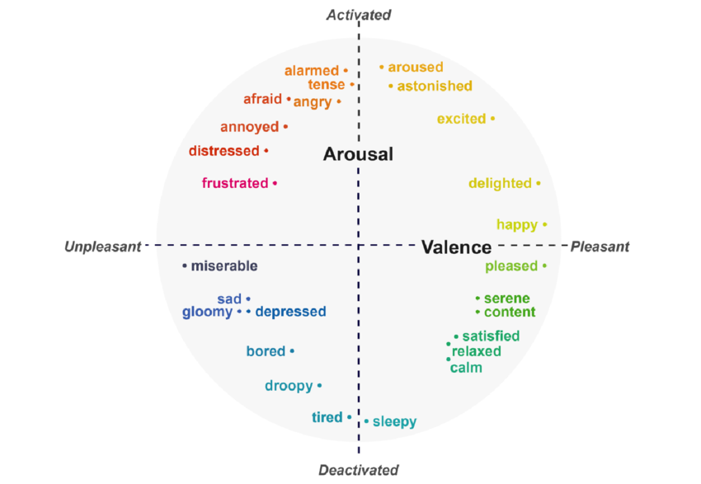
INDSCAL (old method)
Description: is a multi-way model designed to find a common hidden space (like the Valence/Arousal axes) shared by all participants, while accounting for individual variations through simple importance weights (axis scaling).
Issues: participant GT is computed as a weighted copy of the group mean.
Critical Flaw: If a stimulus is perceived as positive by the majority, it remains positive for everyone. It fails to capture cases where an individual's perception is the opposite of the group trend.

Slide 3
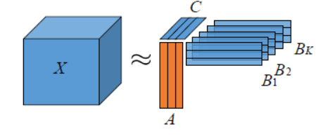
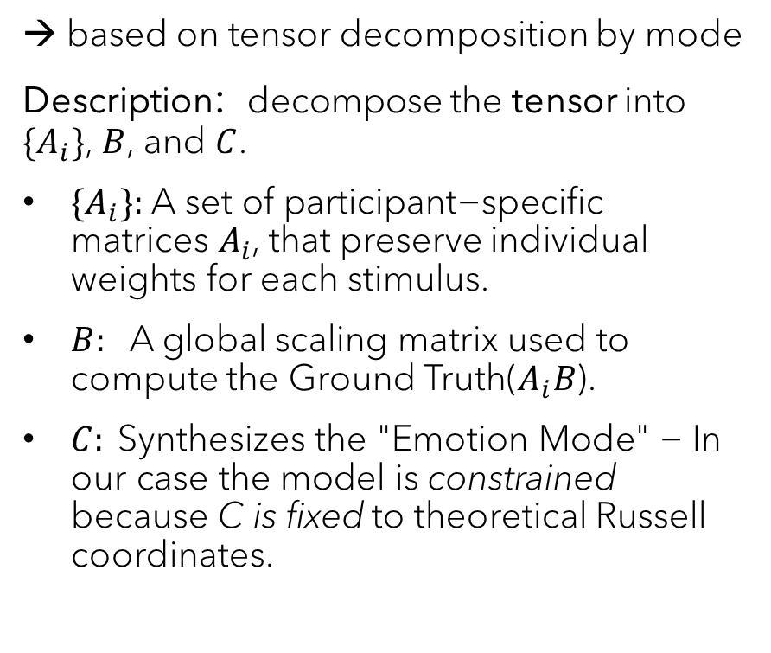
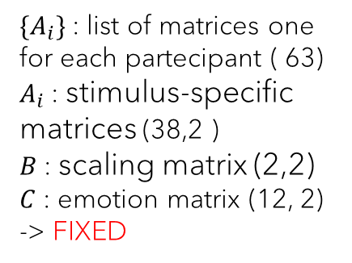
Constrained PARAFAC2 (Proposed Method)
B
stimuli
→ based on tensor decomposition by mode
Description: decompose the tensor into $\{A_{i}\}$, $B$, and $C$.
$\{A_{i}\}\text{: }\text{A} \text{set} \text{of} \text{p}\text{articipant}\text{−}\text{specific} \text{matrices} A_{i}$, that preserve individual weights for each stimulus.
$B:$ A global scaling matrix used to compute the Ground Truth($A_{i}B$).
$C: \text{Sy}\text{nthesizes} \text{the} \text{"}\text{E}\text{motion} \text{M}\text{ode}\text{" − }\text{In} \text{our} \text{case} \text{the} \text{model} \text{is} \text{constrained} \text{because} \text{C} \text{is} \text{fixed}$ to theoretical Russell coordinates.
partecipants
Ak
emotions
A2
A1
C
Mode0: participants (I=63)
Mode1: stimulus (J=38)
Mode2: emotions (K=12)
Tensor: (63, 38,12)
$\{A_{i}\}$: list of matrices one for each partecipant ( 63)
$A_{i}$: stimulus-specific matrices (38,2 )
$B$: scaling matrix (2,2)
$C$: emotion matrix (12, 2)
-> FIXED

Slide 4
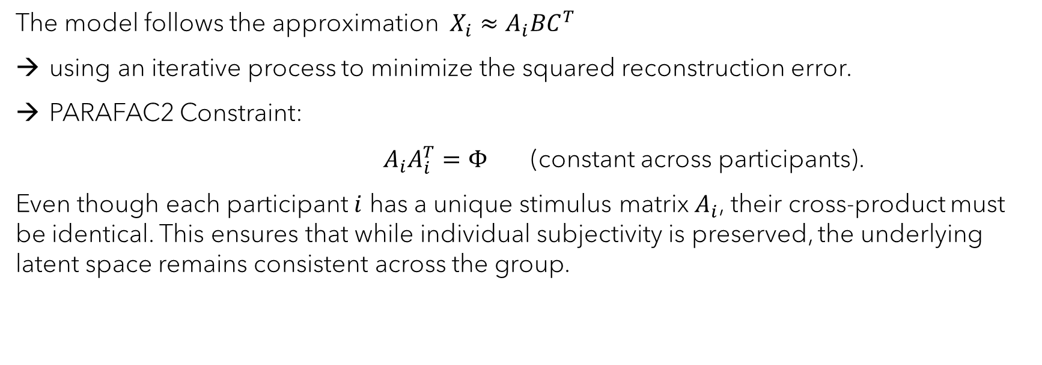
Estimation Method: Alternating Least Squares (ALS)
The model follows the approximation $X_{i}≈A_{i}BC^{T}$
using an iterative process to minimize the squared reconstruction error.
PARAFAC2 Constraint:
$A_{i}A_{i}^{T}=Φ$ (constant across participants).
Even though each participant $i$ has a unique stimulus matrix $A_{i}$, their cross-product must be identical. This ensures that while individual subjectivity is preserved, the underlying latent space remains consistent across the group.
Notes:
Structural Constancy: The product $AA_{i}^{T}must$result in a matrix $Φ (rank=2, rank=2)$ that does not depend on the index $i$
Rotational Freedom: This means that each $A_{i} can$be considered a «rotated» version of a common base. Mathematically, $A_{i}^{ }=P_{i}^{ }H$where $P_{i}^{ }$is an orthogonal matrix specific to the participant and$H$is a common matrix.
THEORETICAL INTERPRETATION
Invariance of the Emotional Space: Theoretically, $Φ$represents the covariance between latent dimensions. Imposing that $Φ$is the same for everyone means assuming that, although individuals react differently to stimuli, the fundamental structure of emotions (such as the relationship between Valence and Arousal) remains the same for the entire group.
Handling Subjectivity: This constraint allows the model to manage participants who perceive stimuli in unique ways. For example, if one participant associates a certain stimulus with a very strong emotion and another does not, PARAFAC2 can capture this via $A_{i}^{ }$, provided that the underlying "grammar" of the responses (defined by , $Φ )$is respected.
Resolution of Indeterminacy: In many tensor models, there is the problem of arbitrary rotation. The $Φ$constraint is what allows for the unique identification of factors, ensuring that the extracted dimensions have a constant physical and psychological meaning (in this case, aligned with Russell's circumplex model through the fixed matrix $C$).

Slide 5
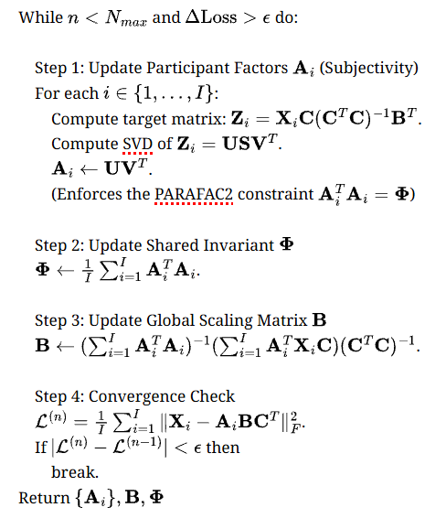

Step 1:
Estimate ${\{A}_{i}\}$ while keeping $B$ fixed.
The algorithm solves an Orthogonal Procrustes problem via SVD.
Notes:
Zi
What it is: It represents the data of participant $i (X_{i})$ after being "filtered" through the lens of emotions ($C$) and global scaling ($B$).
Why it is called projected: Since $C$ is fixed (Russell), we are projecting the raw variance of the participant's data onto the two-dimensional Valence/Arousal space. The result $Z_{i}$ is a matrix that indicates where the participant's data "would like" $A_{i}$ to be located to minimize error.
SVD (Singular Value Decomposition)
SVD is a matrix decomposition that factorizes a matrix (in your case, the target $Z_{i}$) into three parts: $U, S, V^{T}.$
$U$Represents the principal directions (orthogonal vectors) in the participant's stimulus space.
$S:$A diagonal matrix of "singular values" indicating the importance of each direction.
$V^{T}$: Represents the directions in the latent space.
The Orthogonal Procrustes Problem -> consists of finding the orthogonal matrix that best "fits" one matrix to another.
The link to your model: The fundamental constraint of PARAFAC2 is that $AA_{i}^{T}=Φ .$This means that all $A_{i}$ matrices must have the same basic structure (constant cross-product), but they can be rotated differently for each participant.

Slide 6

Step 2:
Update the shared invariant matrix $Φ$(the mean of ${A_{i}^{T}A}_{i}$). This represents the "common space" linking all participants.

Slide 7

Step 3:
Estimate the global scaling $B$while keeping${ \{A}_{i}\}$ fixed.
It defines how the extracted latent dimensions map onto the $C$ dimensions (Valence/Arousal).

Slide 8
Step 4:
Convergence check via Mean Squared Error (MSE).
Notes:
Finally, the MSE is computed between original data and reconstructed ones.
If the the current loss, in comparison from the of the previous iteration is lower than the tolerance the algorithm stops

Slide 9
Empirical Analysis:
Classic vs. Constrained PARAFAC2

Slide 10
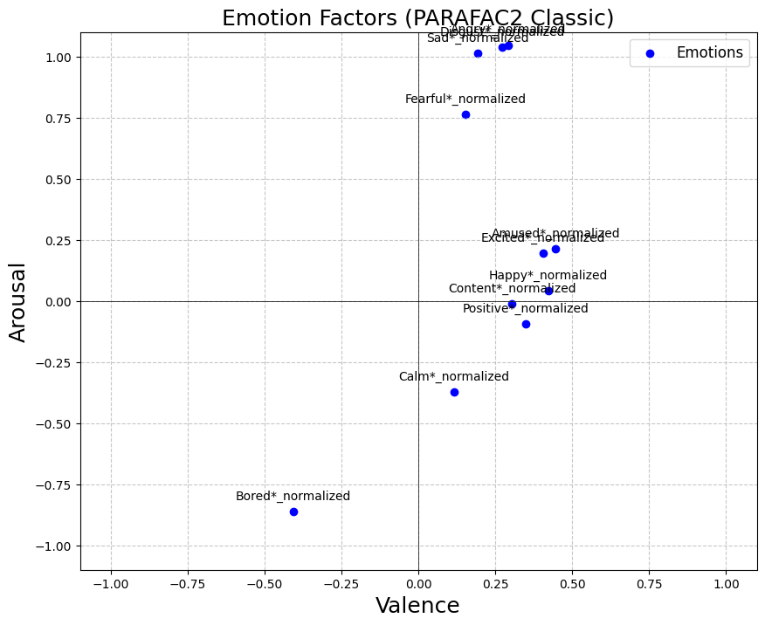
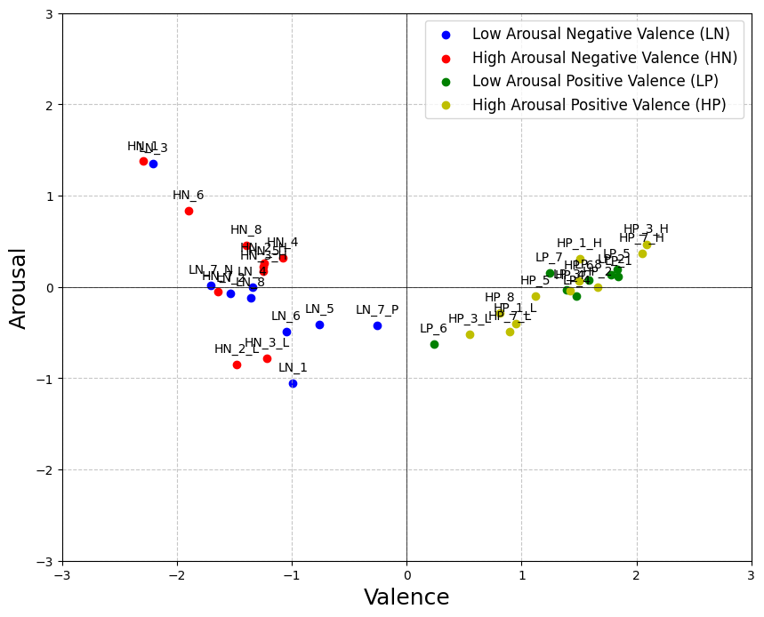


Why use the constrained model with a fixed $C$?
$C computed with$ classic PARAFAC2
mean gt
→ Classic PARAFAC2: Matrix $C$ is estimated freely. Result: The dimensions are often not interpretable as Valence and Arousal, losing the link to Russell’s Circumplex.

Slide 11
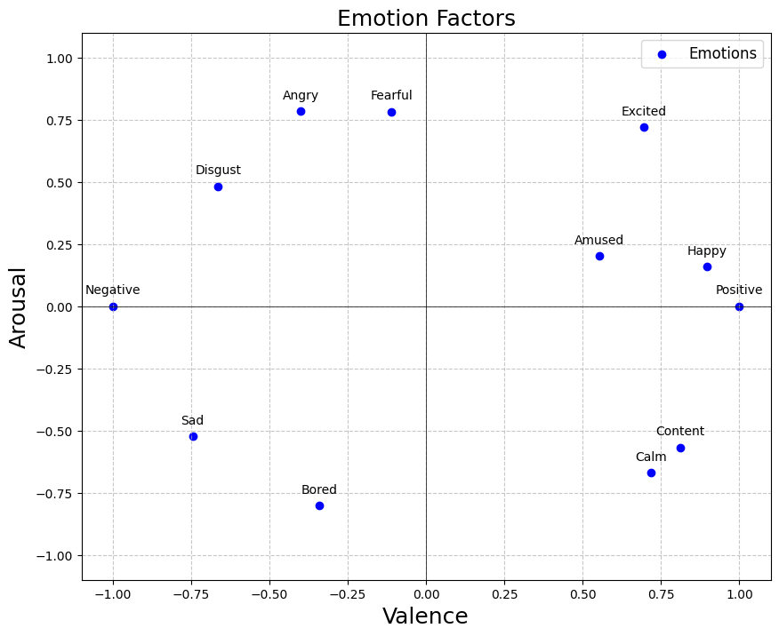
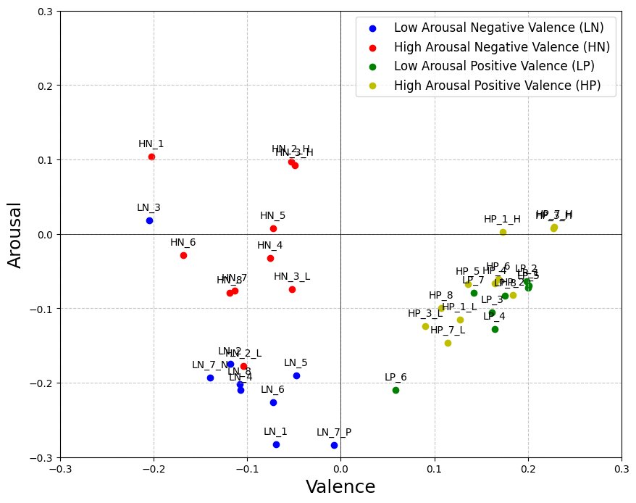
Constrained model
fixed Matrix C
mean gt
→ Constrained Model: By fixing $C,$the results are immediately interpretable and consistent with psychological theory.

Slide 12
Results
Does Constrained PARAFAC2 Respect Subjectivity?

Slide 13
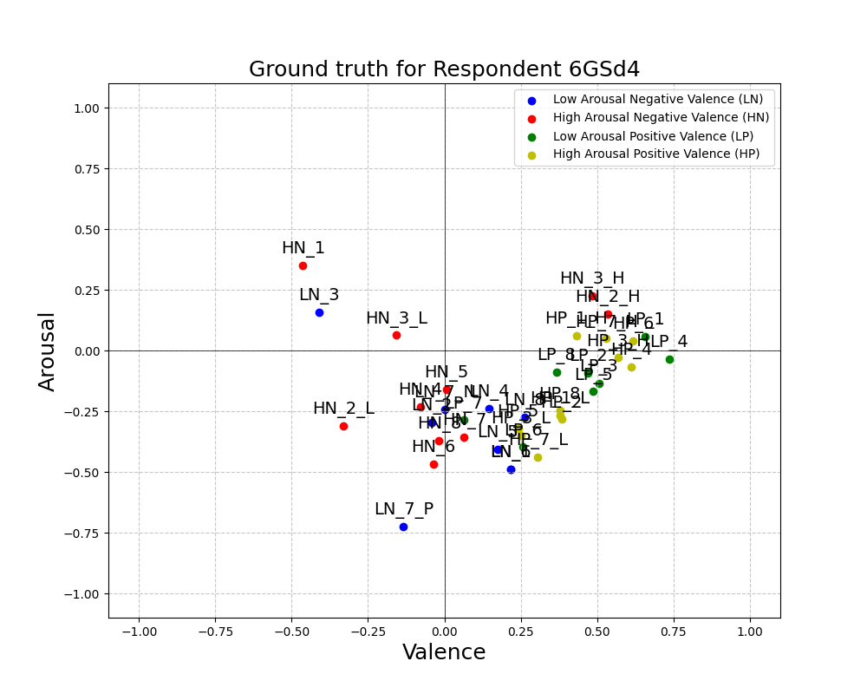
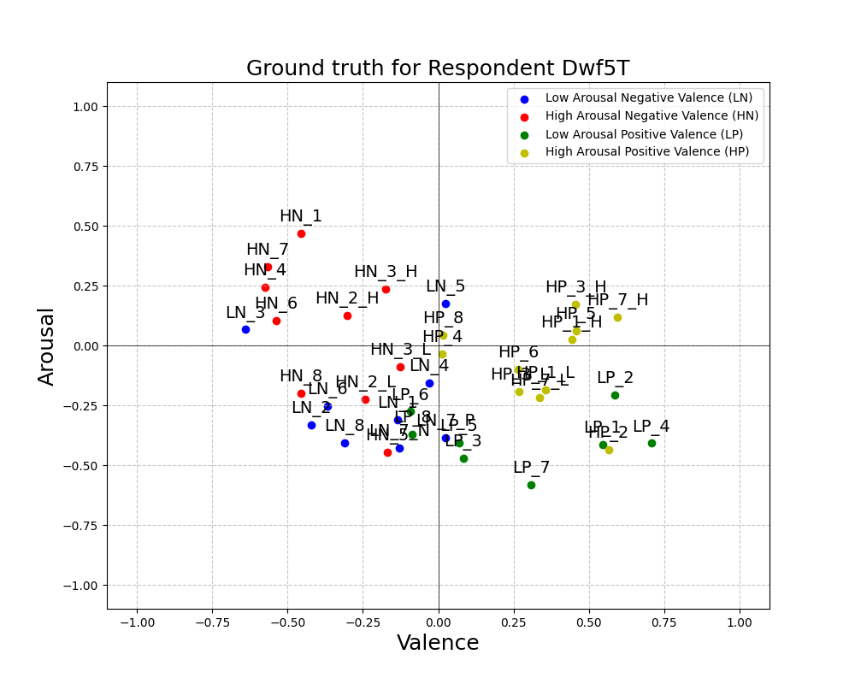
Comparing participants
To validate the model, I selected two participants with highly contrasting perceptions:
Respondent 6GSd4: Tends to perceive most stimuli with positive valence.
Respondent Dwf5T: Experiences a wider and more varied range of emotions.
13

Slide 14
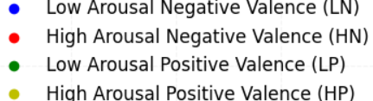
Some samples:
6GSd4
Dwf5T
STIMULI
HN_4
HN_5
HP_5
LN_4
LP_8
Dominant Emotion | Valence | Arousal
Calm (-0.20) | -0.078 | -0.230
Calm (1.00) | 0.007 | -0.159
Calm (1.00) | 0.241 | -0.322
Calm ( 0.20) | 0.147 | -0.241
Positive (0.71) | 0.366 | -0.089
Dominant Emotion | Valence | Arousal
Angry (1.00) | -0.575 | 0.245
Bored (1.00) | -0.169 | -0.445
Amused (1.00) | 0.457 | 0.061
Sad (1.00) | -0.029 | 0.158
Calm (0.11) | -0.086 | -0.372

Slide 15
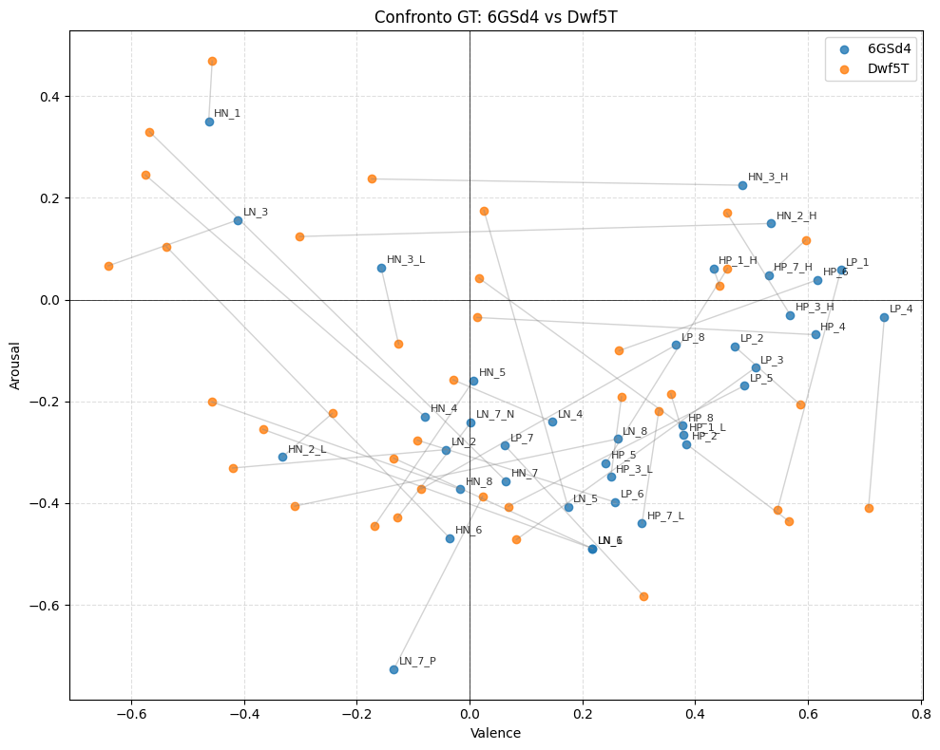
Comparative Analysis and Conclusions
The comparison of specific samples demonstrates how the same stimulus is mapped into different quadrants depending on the individual's subjective experience.
Fragility: While PARAFAC2 is highly flexible and excels at capturing individual subjectivity, it may introduce noise into the model by absorbing participants' imprecise responses and varied judgment scales directly into the subjective factors

Slide 16
Grazie

