Slide 1
CYBER BULLYING DETECTION
IRENE BETSY D
21-PDS-013
Guide: Dr.P.Manikandan

Slide 2
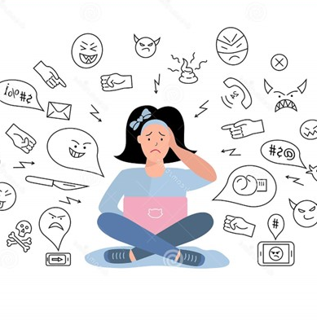

ABSTRACT
This project seeks to detect bullying-related texts. To achieve this, the GRU, RNN, BiLSTM, and BERT models are trained and tested on the tweets in the Twitter database and comments from Instagram database acquired through web scraping, which is considered as the dataset.

Slide 3
Literature review
Theory-1:
Mitushi Raj . Samridhi-Singh . Kanishka Solanki . Ramani Selvanambi, Vellore Institute of Technology; 26 July 2022, An Application to Detect Cyberbullying Using Machine Learning and Deep Learning Techniques: SPRINGER NATURE.
Theory-2:
Andrea Pereraa . Pumudu Fernando, formatics Institute of Technology; 01-2021, Accurate Cyberbullying Detection and Prevention on Social Media: ELSEVIER Procedia.

Slide 4
Problem Statement
Some young people harass other young people, publish humiliating photos, divulge sensitive information, or send threatening messages through anonymous applications, video games, texting, social media, or other means.
Natural Language Processing will be a great solution on detecting textual contents.
NLP models like BILSTM, BERT, XLNET, ERNIE can be used to detect bullying related texts on social media.

Slide 5

Objectives
To Collect the twitter tweets and Instagram comments using snscrape library and Apify which is fed as the dataset
To compare text blob and vader used to label the texts or sentences.
Remove duplicate, undesirable symbols, punctuations, links, mentions, stopwords, emojis, special characters, Stemming and Lemmatization,.
To compare BiLSTM, BERT, RNN, GRU.

Slide 6

INTRODUCTION
Cyberbullying can take the form of text, images, or videos and can happen anywhere there is online social interaction. For instance, some young people harass other young people, publish humiliating photos, divulge sensitive information, or send threatening messages through anonymous applications, video games, texting, social media, or other means.

Slide 7
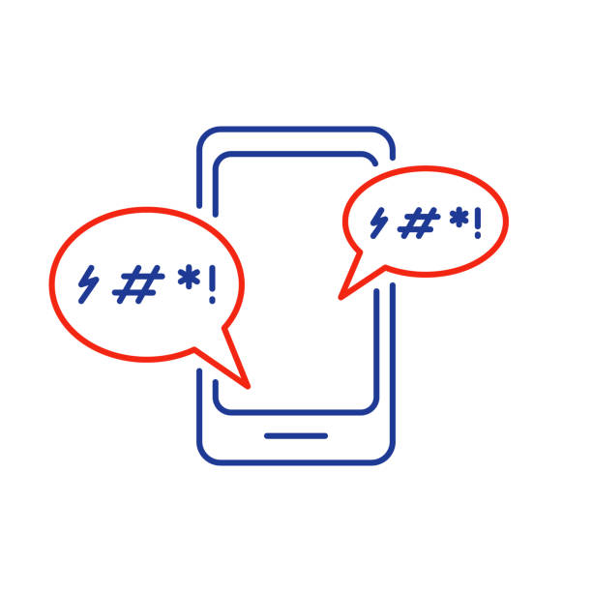
Methodology
WebScrape
Snscrape, Apify
Duplicates, emojis, stopwords, special charecters, stemming, Lemmatization.
Pre-processing
Cyber Bullying Detection
Label
Polarity score
Models
BiLSTM, BERT, RNN, GRU

Slide 8
DATASET DESCRIPTION
The cyberbullying dataset that was acquired from the twitter database and Instagram database through web scraping contains 84121 records and 4 features. There were 6531 duplicates and after removing it the dataset contains 77588 records.

Slide 9



Preprocessing Steps
Data Cleaning
EDA
Tokenization
eliminating all the undesirable symbols, punctuations, links, mentions, stopwords, emojis and special characters from data. Stemming and Lemmatization. Remove duplicates. Length of sentences greater than 100.
Analysis of classification column. Word cloud to check the frequency of the words (bullying word with highest frequency).
The “text” and “CB_Classification” feature of the dataset contains tweets, thus the variable is tokenized where each word is given a token.

Slide 10

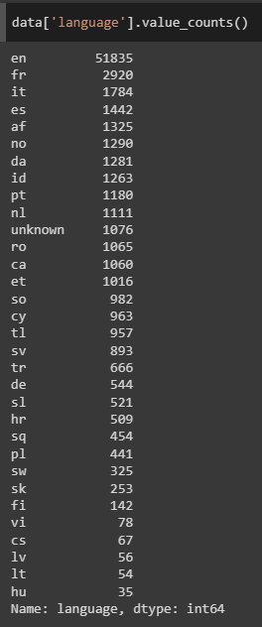
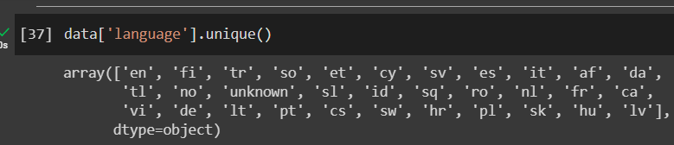
LANGUAGE DETECTION
Multilingual

Slide 11
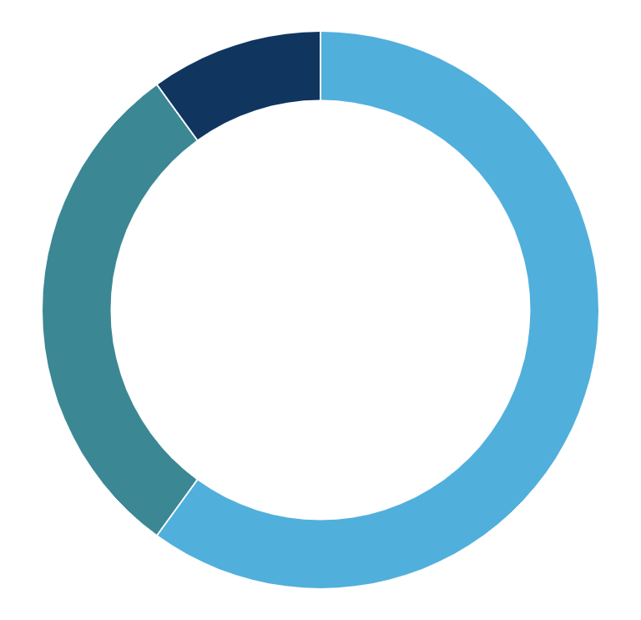
Analysis of dependent variable
Comment
Bullying
Non-Bullying
27%
35%
CB_Classification
38%

Slide 12
Model Performance
88%
98%
75%
BiLSTM
BERT
GRU
82%
RNN
Bi-directional Long Short Term Memory
Bidirectional Encoder Representations from Transformers
Recurrent Neural Network
Gated Recurrent
Unit

Slide 13
CONCLUSION
The BiLSTM, BERT, RNN and GRU models have been trained on the tweets from Twitter database and comments from Instagaram database acquired through web scraping, of which the BERT has the highest accuracy and would be used for deployment.

Slide 14
Upcoming plans
To Train ERNIE and XLNet.
To use other features.
To include some more bullying hashtags.

Slide 15
Schedule
Dec | Jan | Feb | Mar | April | May
Task | Description |  | Date |  | Status
Task 1,2 | Scraping data, polarity, models |  | Dec 26– Feb 5 |  | Completed
Task 1 | Ernie, XLNet |  | Feb 6- Mar 22 |  | In progress
Task 3 | Deployment |  | Mar 23 onwards |  | Delayed
TASK 1
To collect and preprocess the data
TASK 2
Work on various NLP models
TASK 3
Deployment

Slide 16
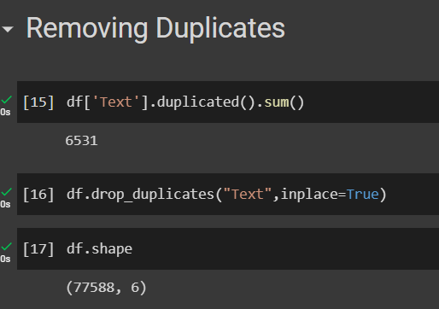

SOURCE CODE
Web Scrape
Duplicates

Slide 17

Data Labelling

Slide 18
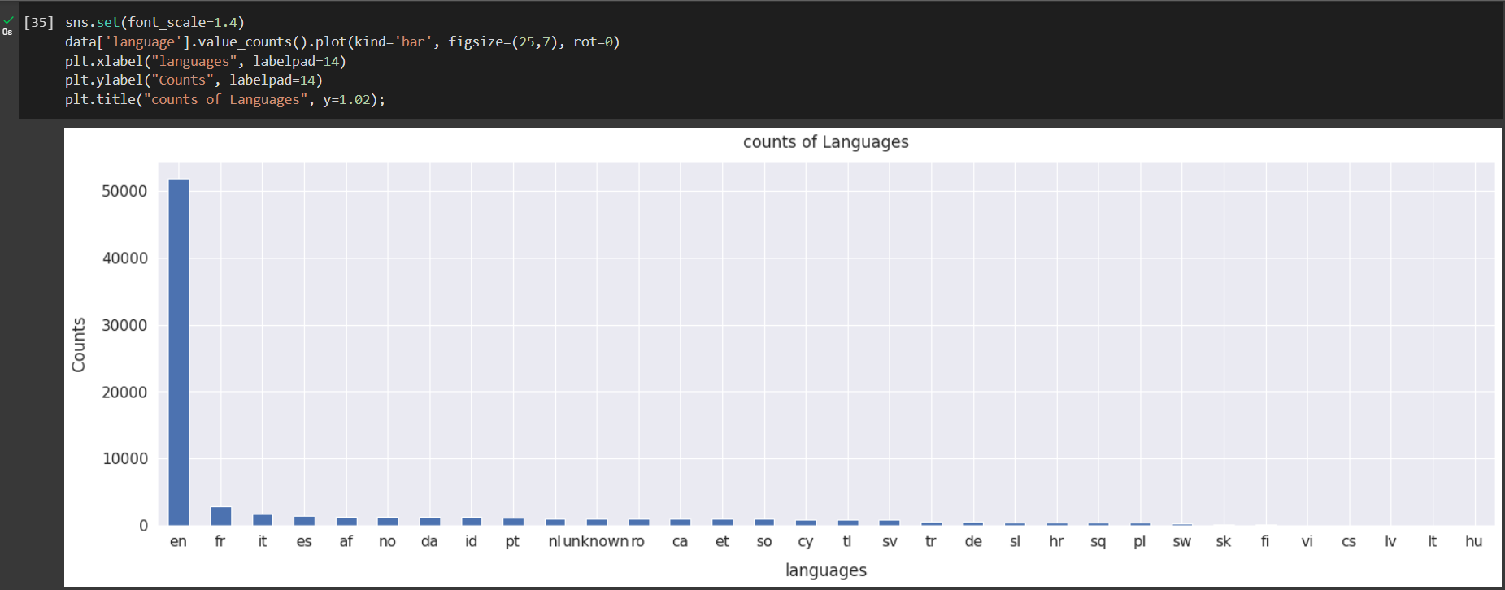

Slide 19
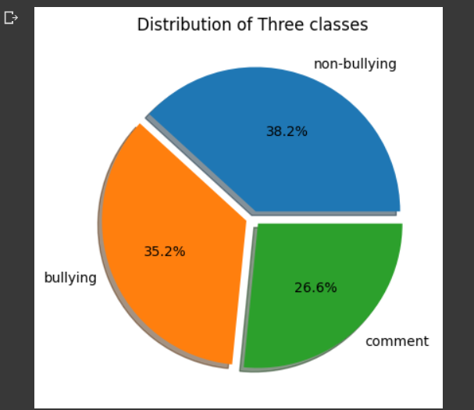
Visualization

Slide 20
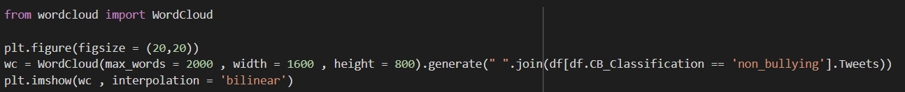
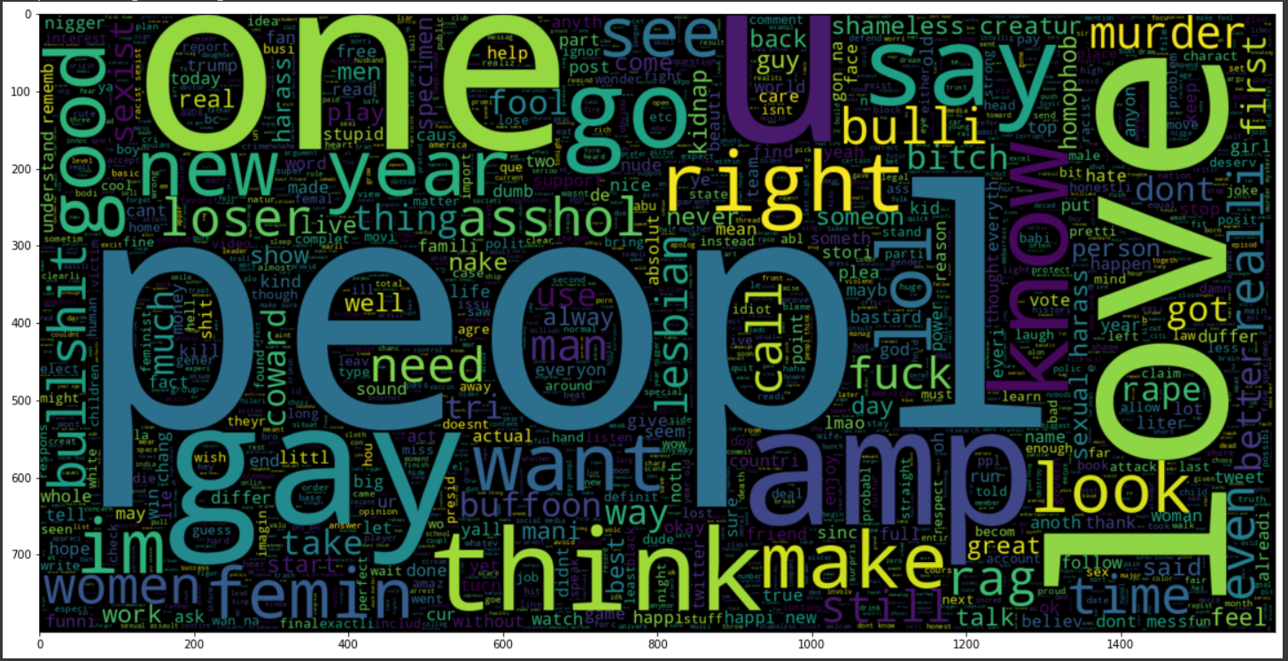

Slide 21
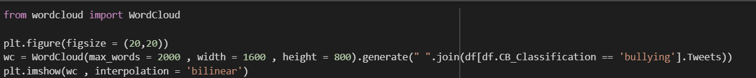
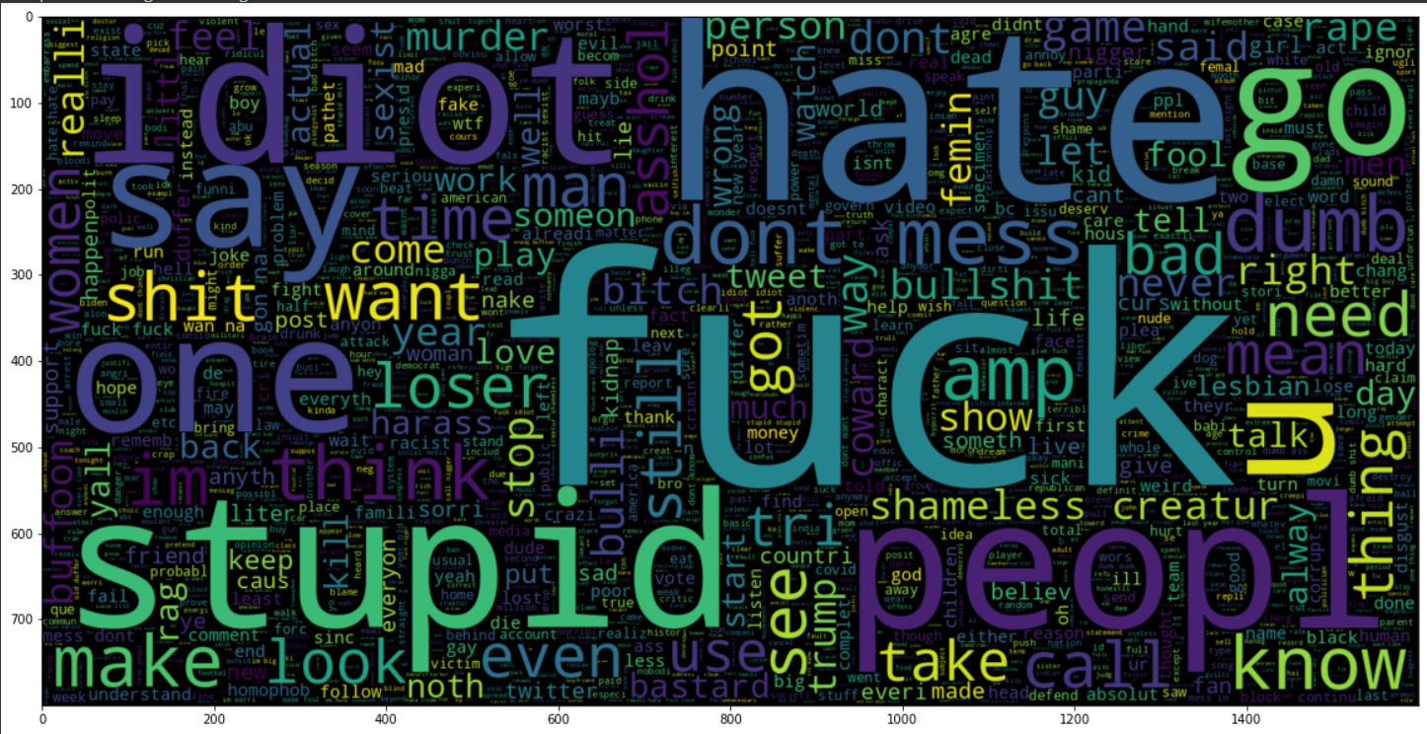


Slide 22
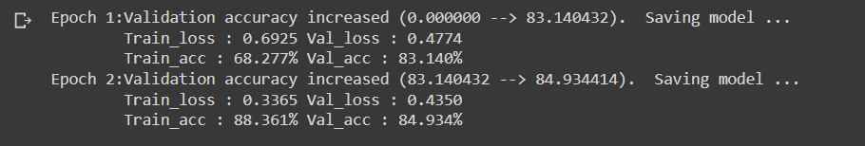
BiLSTM

Slide 23
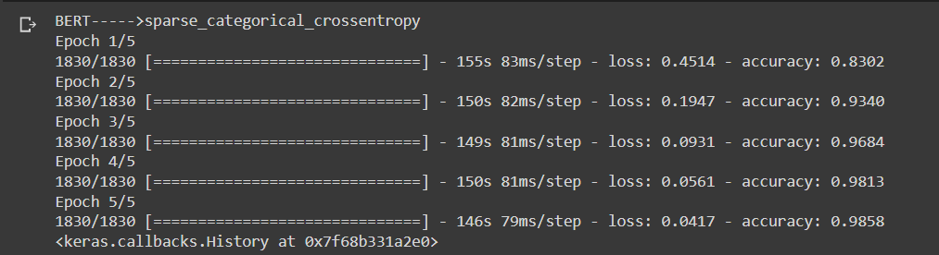
BERT

Slide 24
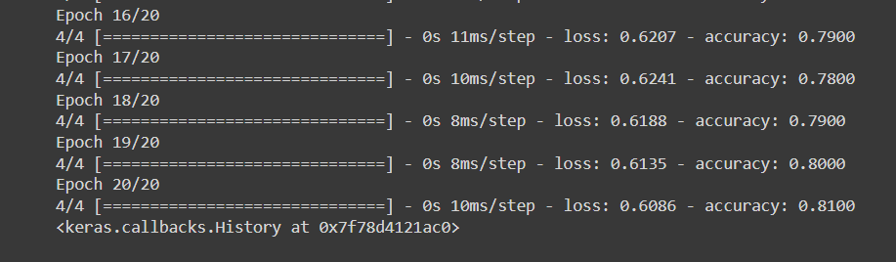
RNN

Slide 25
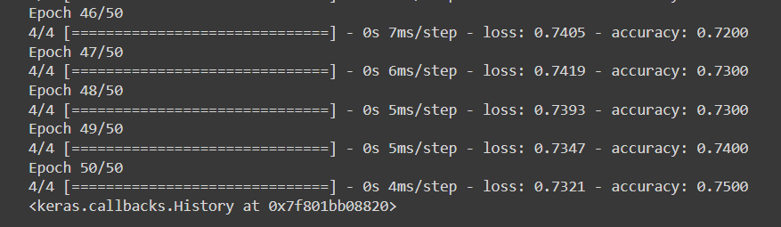
GRU

Slide 26
THANK YOU!

