Slide 1

AIgnosis
Intelligent Anamnesis, Personalized Care

Slide 2
Why the need?
Target Audience: Patients & Healthcare Apprentices
Problem: Limited time/possibilites for detailed medial history and diagnosis
Interaction: Conversational, AI-assisted VH
Notes:
Patients often hold back details; a VH helps improve disclosure and understanding before doctor visits. Or can replace the need to go see the doctor at all​.

Slide 3
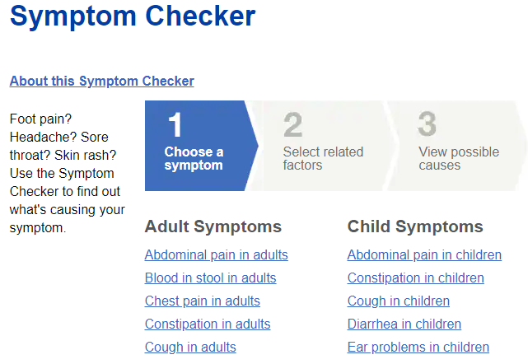
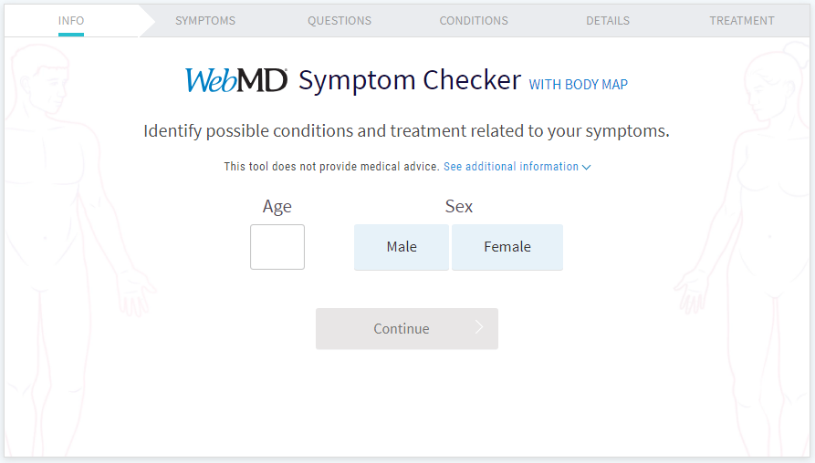
Related Work
Existing Solutions
WebMD
Babylon Health)
Difference
Real-time VH + AI for deeper medial history and diagnosis
Appealing Interface
Feeling of an actual conversation
Explanation
AIgnosis offers a more human-like, conversational approach compared to current tools.
https://www.mayoclinic.org/symptom-checker/select-symptom/itt-20009075
https://symptoms.webmd.com/

Slide 4
Solution
Dialog System: Fine-tuned LLM (on GPT4-o mini model) for realistic conversations
Diagnosis Conversation Tree: Make use of a clinically approved conversation tree to collect all necessary data for a reasonable diagnosis
Different Models: Test different models to check which delivers the best results
Immersive Environment: Make use of a virtual doctor to create a more personal experience

Slide 5
Challenges & Results
Challenges: Natural interaction, seamless AI integration
Goals: Functional VH, reliable patient data summary, Visual cues for engagement
Limitations: Advanced emotional recognition might be basic
Notes:
Explanation: We aim to ensure smooth conversations, even if complex medical cases are not fully covered yet.

Slide 6

Thank you for listening!
AIgnosis

