Slide 1
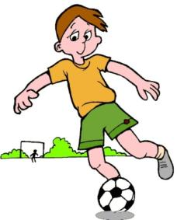

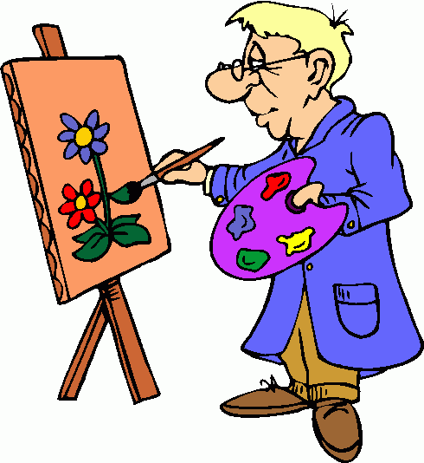
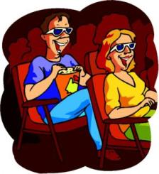

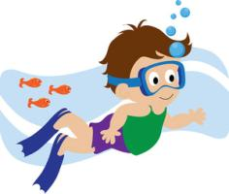
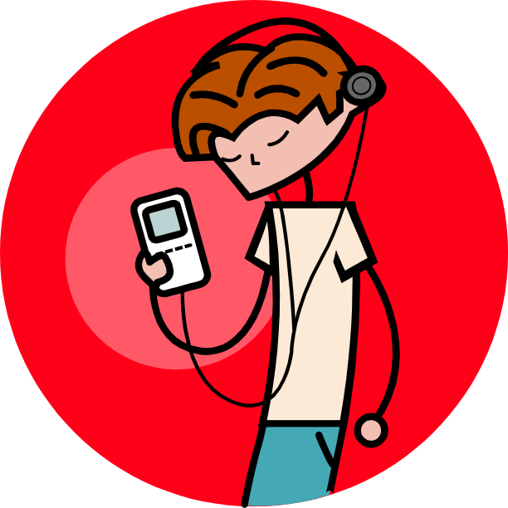
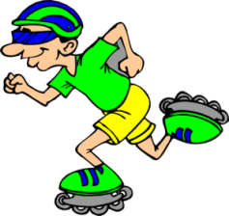
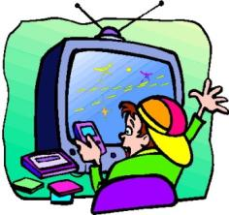
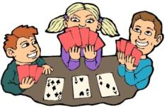
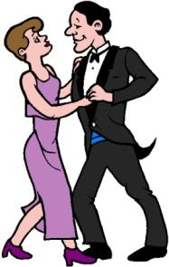
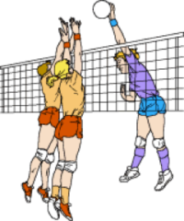
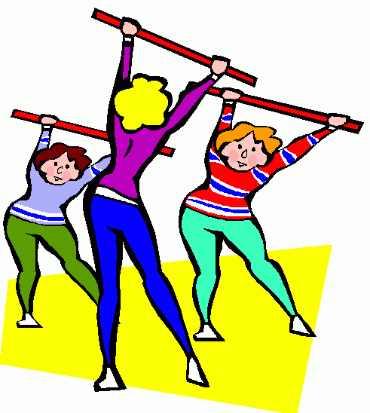
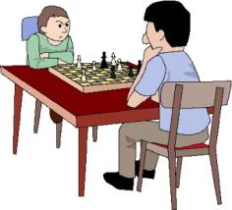
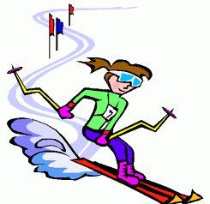
HOBBIES

Slide 2
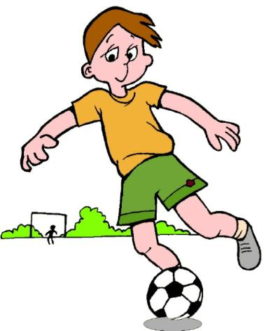

1
John … football every afternoon.
play
plays
goes
go

Slide 3
2
Mary …………… a bike at the weekend.
rides
ride
reads
read

Slide 4
3
Mr Wilson .… pictures in his free time.
plays
rides
does
paints

Slide 5

4
Tom and Tina … to the cinema on Saturdays.
goes
do
go
listen

Slide 6
5
George …… the guitar every afternoon.
plays
paints
listens
does

Slide 7

6
Joe …… in the sea in summer.
dances
swims
play
swim

Slide 8
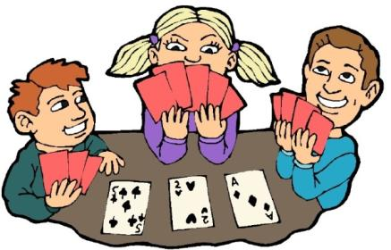
7
Mary, Mike and Nick … cards on Fridays.
plays
does
have
play

Slide 9
8
Robin ………… to music in his free time.
listens
does
goes
dance

Slide 10

9
Daniel …… rollerblading at the weekend.
does
plays
goes
has

Slide 11
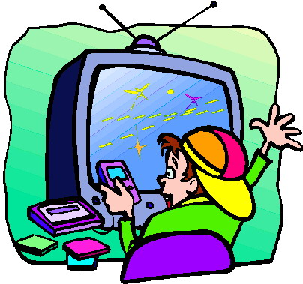
10
Cliff … computer games every evening.
has
does
plays
listens

Slide 12

11
Martin and Richard … chess on Fridays.
plays
do
does
play

Slide 13

12
Mr and Mrs Norton …… on Saturdays.
dance
play
dances
plays

Slide 14
13
Mary, Jill and Tina … aerobics on Mondays.
play
do
does
plays

Slide 15
14
Jackie … skiing every winter.
does
plays
makes
goes

Slide 16

15
They … volleyball at the weekend.
plays
play
do
goes

Slide 17
Thank you.

