Slide 1
Mini-project4
Irene Choi

Slide 2
Goals
Automating the loan eligibility based on customer details
Customer details include:
Gender, marriage, dependents, education, self employed, applicant income, co-applicant income, loan amount, term, property area etc.

Slide 3
Hypothesis Who is likely get a loan?
1. Applicants having a credit history
2. Applicants with higher applicant and co-applicant incomes
3. Applicants with higher education level
4. Properties in urban areas with high growth perspectives
+5. Applicants with higher income per person in the family (considering #of dependents)
+6. Applicants with lower loan amount in application
+7. Applicants with high savings (data not provided here)

Slide 4
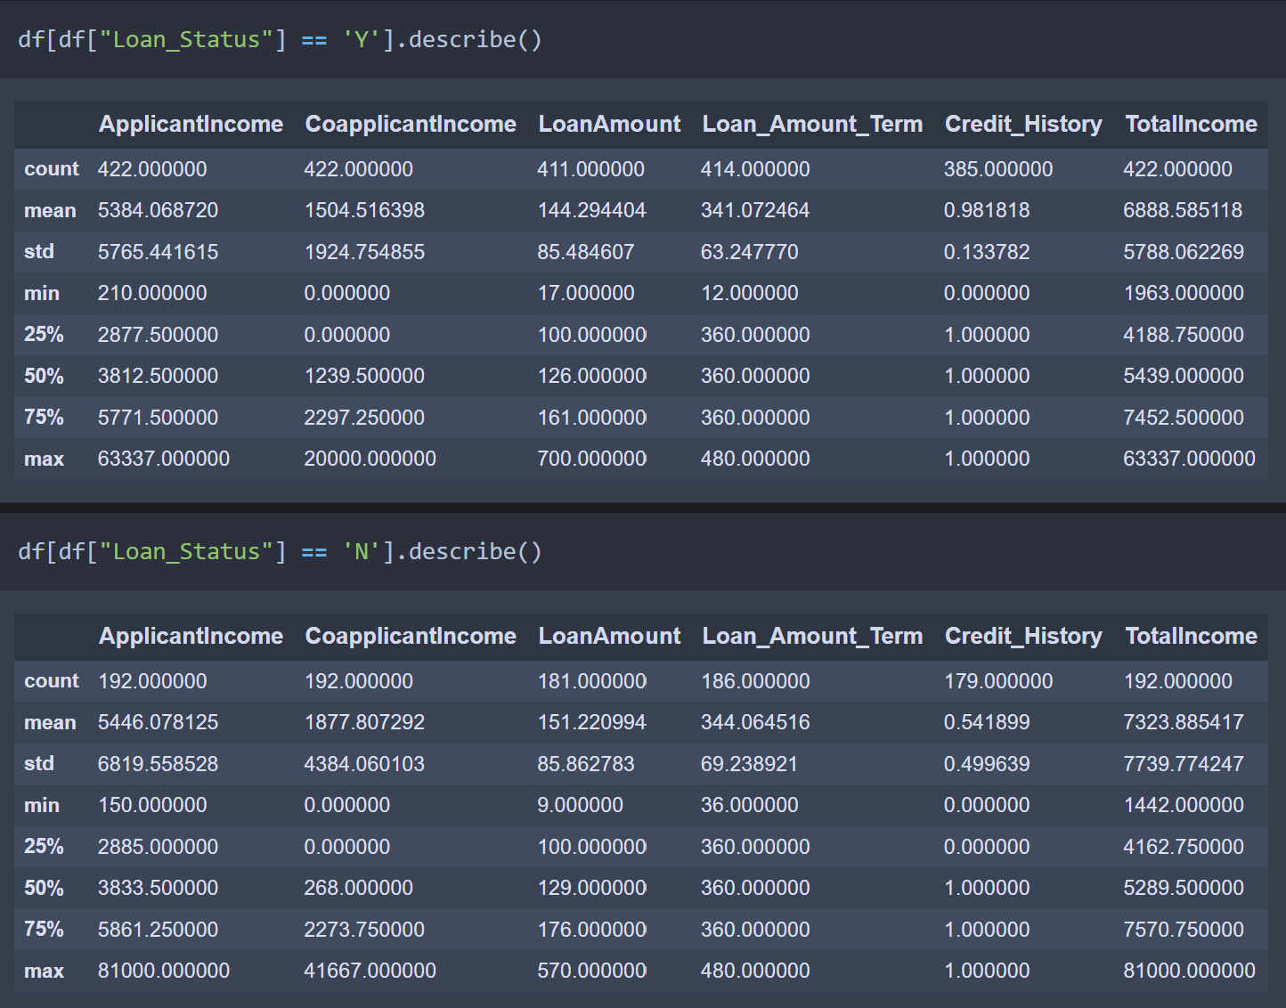
EDA

Slide 5


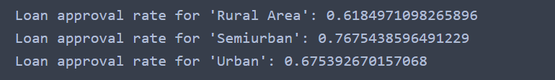
EDA
1. Loan approval with education level
2. Loan approval with self_employed/not
3. Loan approval with property_area

Slide 6
Process
Data cleansing:
numerical values – mean()
Categorical values – mode()
Feature engineering:
Total income = applicant income + co-applicant income
Modeling:
LogisticRegression(), KNeighborsClassifier(), GaussianNB(), DecisionTreeClassifier(), SVC()

Slide 7
Modeling result
Used precision_recall_fscore_support for metric
 | Precision | Recall | F1_score (‘weighted avg’)
Logistic Regression | 0.7612 | 0.7582 | 0.7380
K-Neighbors | 0.7931 | 0.7908 | 0.7786
Naïve bayes | 0.7489 | 0.7516 | 0.7348
Decision Tree | 1.0 | 1.0 | 1.0
SVM | 0.7677 | 0.7647 | 0.7463

Slide 8
Pipeline
Pipeline order
Preprocessing
1. Creating a new column 'Total income'
2. Missing value fill in
3. Log transformation
Main pipeline
Preprocessing
Numerical & Categorical value split and One Hot Encoding for Categorical values
classifier
After pipeline
grid search
pickling

Slide 9
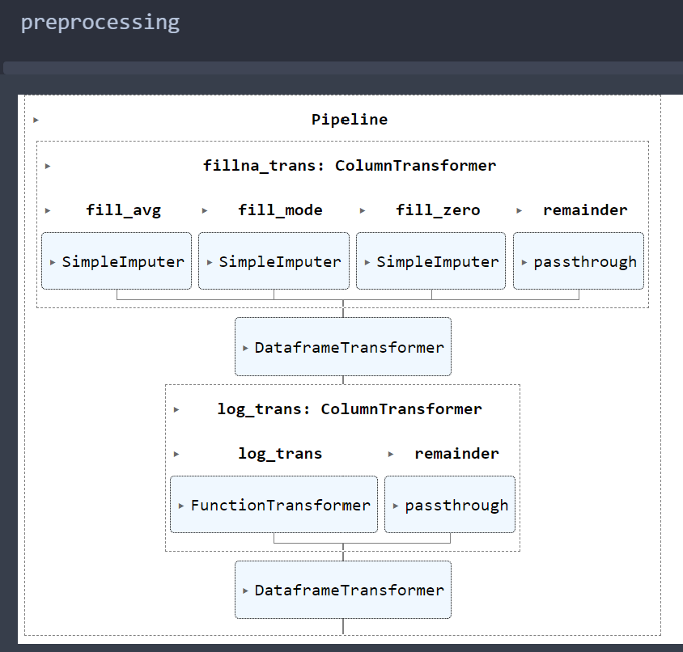
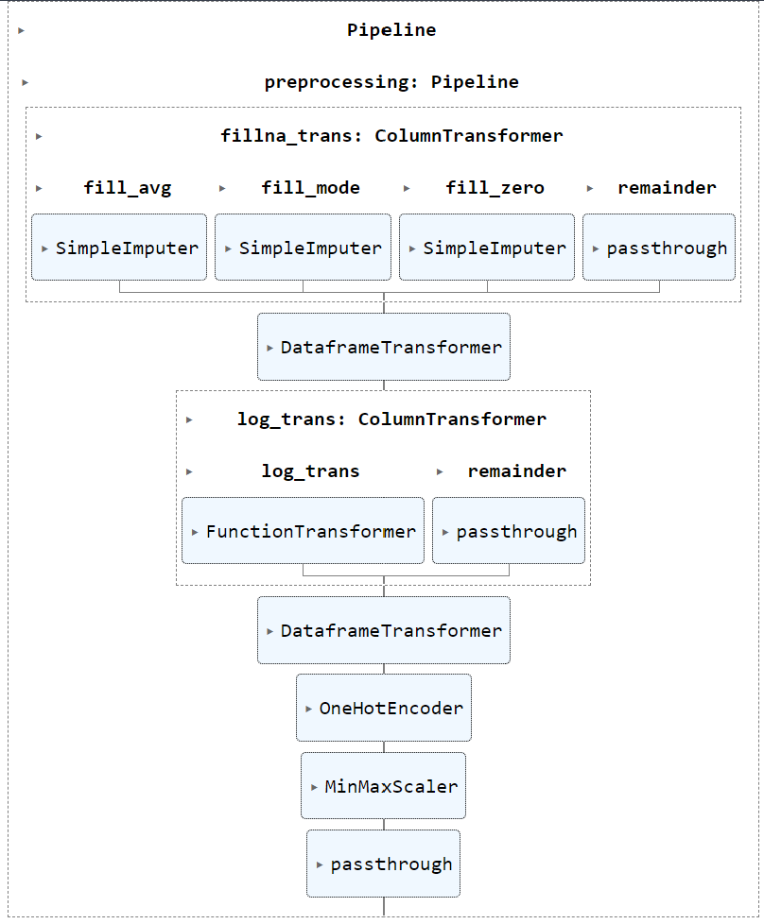

Slide 10
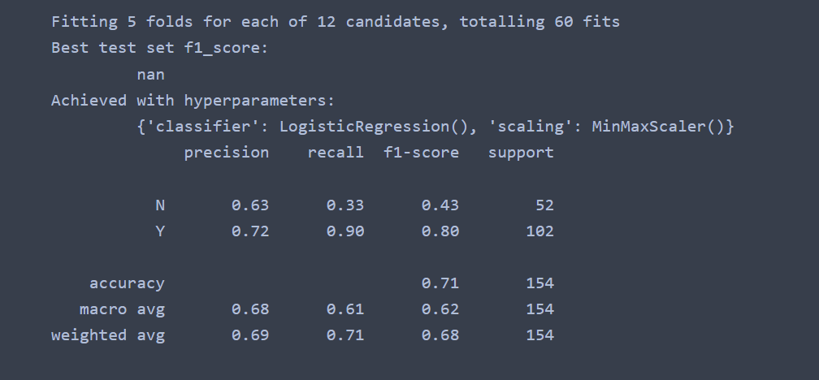
Grid search result

Slide 11
Challenge & Future goal
Pipeline error
Easy to follow the steps, however once I get an error, it is hard to find where to fix it
Even though I set a simpleimputer to replace null values, it didn’t work(!)

