Slide 1
Mini-project-2 Foursquare vs Yelp
Irene Choi

Slide 2
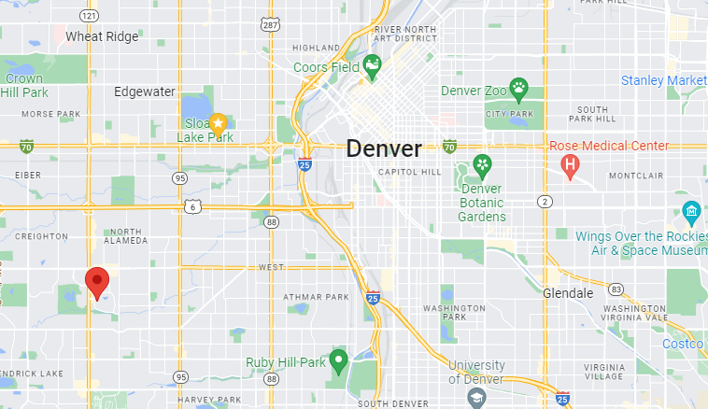
Steps
1) Selecting location : 39°42'10.9"N 105°04'43.7“W
Small city next to Denver, CO, USA

Slide 3
Steps
2) Getting relevant data using Postman(term: restaurant, park, pet store, etc.) and save them as json file.
3) Open the file in python and print the information I wanted by using json_normalize function and select columns that I wanted to see for comparison purpose (name, address, category, rate, number of reviews, etc.)
4) Save it in SQL database

Slide 4
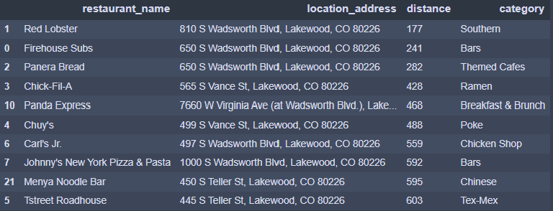
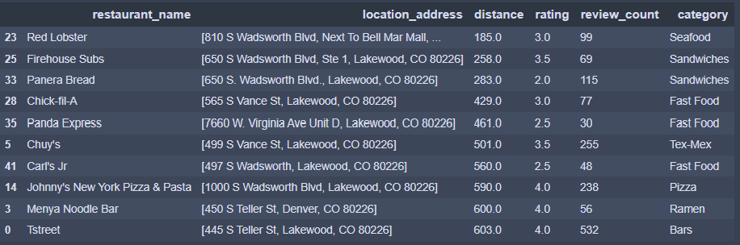
Restaurants
Foursquare
32 restaurants
Yelp
50 restaurants
(max return 50)

Slide 5
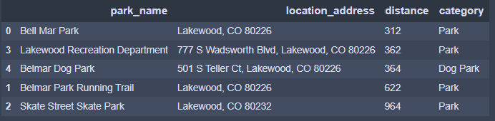
Parks
Foursquare
yelp

Slide 6

Pet stores
Foursquare
yelp

Slide 7
Overall Comparison
Yelp gives better/more accurate category information. (i.e. Chick-fil-a (fast food for Chicken sandwich) : Ramen(Foursquare)/fast food(yelp))
Yelp has a rating and number of reviews information, so it generally gives better information for decision making.
In Park information, Foursquare listed more parks (5), but the addresses were not shown accurately.

Slide 8
Challenges
Breaking up subset (nested dictionary) under ‘Category’
Solution: take ‘category’ column out and pull the first category only and added it back to the dataframe using concatenate function.
Improvement made from week1
Easier to check data what I needed -> json_normalize / pprint (library)

Slide 9
Thank you ☺

