Slide 1
Common Artefacts in MRI
Irene Vavasour
Feb 7, 2024
UBC MRI Research Monthly Analysis Meeting

Slide 2
Disclaimers
I’m not an expert in imaging artefacts
I took some of my material from an artefact presentation made by Laura Barlow
She’s much more of an expert
I also raided a 2023 ISMRM educational session on artifacts

Slide 3
Artefacts
Definitions:
findings that are due to things outside the patient that may obscure or distort the image
a feature that does not correlate with the physical properties of the subject being imaged and may confound or obscure interpretation of that image

Slide 4
Artefact categories
Motion related
Tissue related
Technique related

Slide 5
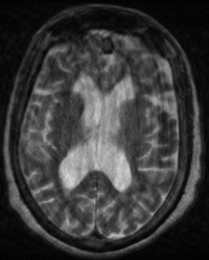
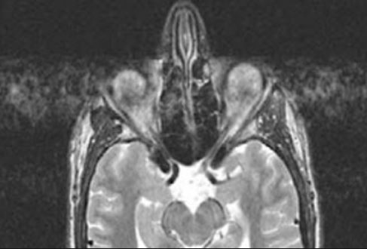
Motion Artefacts
Manifests as blurring or ghosting along the phase encoding axis…”duplication of anatomy”
Also know as aliasing
Movement of eyes
Patient motion
https://www.ajnr.org/content/33/1/77 https://mriquestions.com/motion-artifact-direction.html

Slide 6
Motion Artefacts
Unfortunately most of the ways we can fix it involve altering the sequence parameters!
Swap phase and frequency encoding directions
Use a less motion sensitive acquisition (propeller)
Make the sequence faster
Use multiple concatenations/packages
All we can do in research is:
Counsel the patient, add more comfort &/or immobilization aids

Slide 7
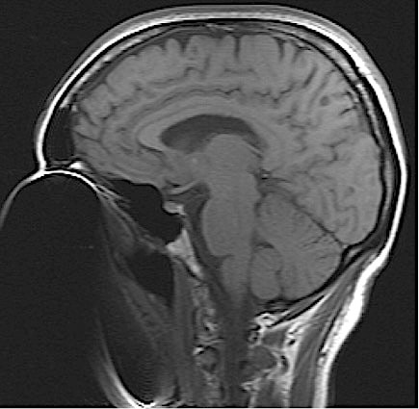
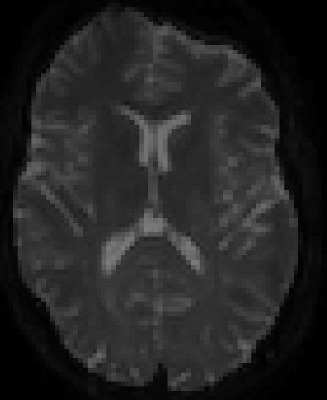
Susceptibility Artefacts
Magnetic field inhomogeneities caused by large changes in susceptibility manifest as signal voids, distortion.
The size of the effect depends on field strength, the type and amount of para/ferromagnetic substance present
https://mriquestions.com/susceptibility-artifact.html

Slide 8
Susceptibility Artefacts
Unfortunately most of the ways we can fix it involve altering the sequence parameters!
Swap phase and frequency encoding directions
Use a less sensitive acquisition (SE not FFE, MARS)
Increase receive bandwidth
Increase frequency encoding steps
Use a lower magnetic field
Do better shimming or add field mapping
All we can do in research is:
Remove the offending item/device if possible
There are some post-processing techniques such as topup

Slide 9
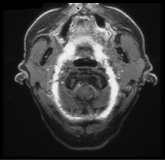
Phase Wrap Artefact
Occurs in the phase direction when the object being imaged is larger than the field of view.
The phase frequencies occurring outside of the field of view are mis-mapped into the same positions within the field of view as the desired anatomy.
https://mriquestions.com/wrap-around-artifact.html, Biogen Protocol 221AD305 (CLARIO),

Slide 10
Phase Wrap Artefact
Unfortunately most of the ways we can fix it involve altering the sequence parameters!
Swap phase and frequency encoding directions
Turn on oversampling (phase and slice)
Increase FOV
All we can do in research is:
Position the FOV such that it avoids out of volume anatomy

Slide 11
Gibbs Ringing Artefact
Data collection limited in frequency range can lead to ringing (dark bands) at sharp edges
Use low pass filter to remove the offending high frequency components

Slide 12
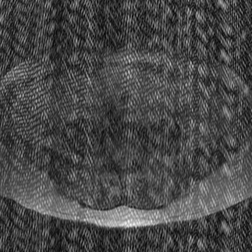
Data Error Artefacts
Due to spikes of noise in raw data (ie k-space). Image is Fourier Transformed into bars/stripes
Try and reprocess the raw data
Is there a noise source that could be responsible (hardware)
https://mriquestions.com/data-artifacts.html

Slide 13
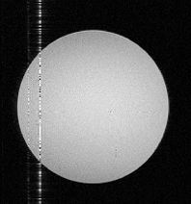
Zipper Artefacts
Line or lines occurring in the frequency encoding direction that propagate through the entire FOV
Usually due to RF interference/noise picked up by the receiver coil and encoded into the image
Close the scanner room door
Remove possible sources from scanner room
Test Faraday cage for leaks
https://mriquestions.com/zipper-artifact.html

Slide 14
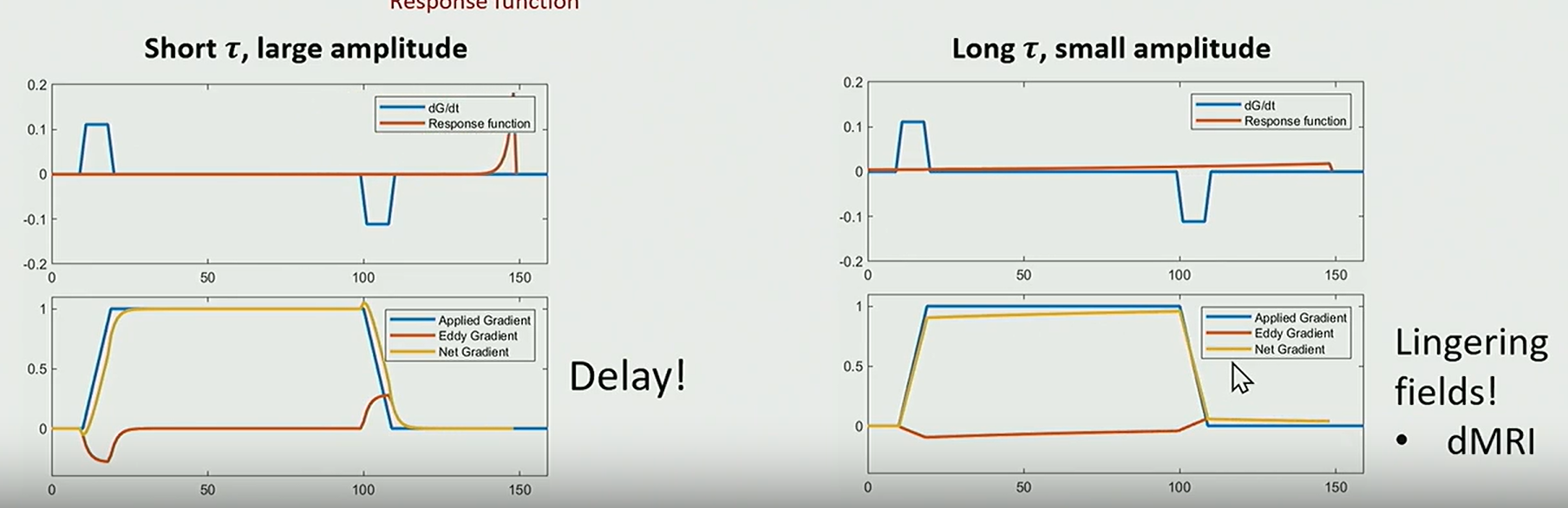
Eddy Current Artefacts
Short τ, large amplitude
Currents are generated in a nearby conductor whenever a changing magnetic field is present
Can lead to
delay in the gradient form
lingering gradient form tail
Often arises from diffusion gradients
distortions are affine so fixed with registration
Fixes
pre-emphasis
crusher gradients
Long τ, small amplitude
C Baron ISMTM 2023

Slide 15
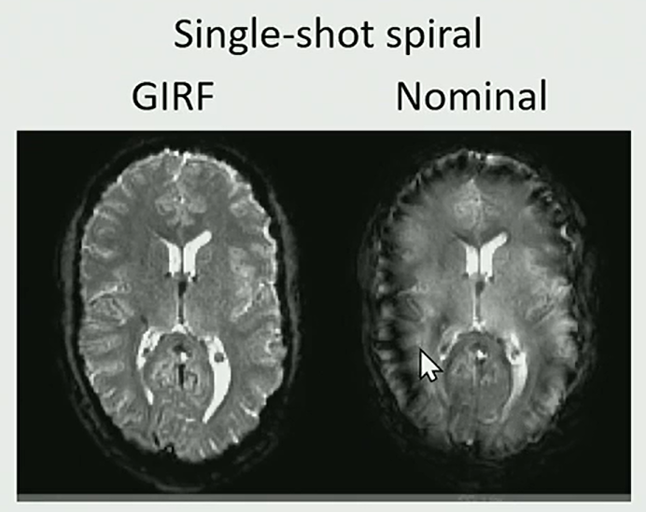
Eddy Current Artefacts
In non-cartesian data collection, eddy currents can lead to image blurring
needs to be corrected during reconstruction
can use gradient impulse response function (GIRF)
or even better with concurrent field monitoring
Vannesjo MRM 2016

Slide 16
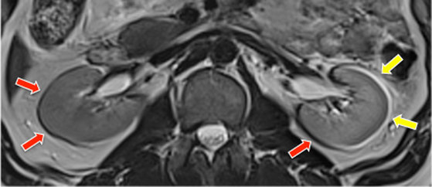
Chemical Shift Artefacts
Fat and water resonate at slightly different frequencies
The signal from fat will be displaced relative to its actual location towards the lower frequency side of the encoding axis
https://mriquestions.com/chemical-shift-artifact.html

Slide 17
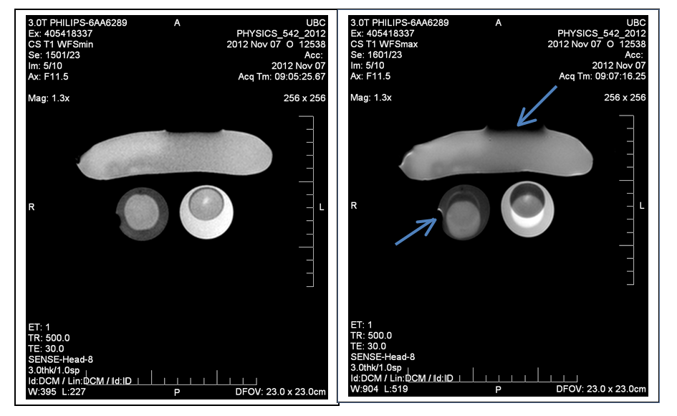
Chemical Shift Artefacts
Unfortunately most of the ways we can fix it involve altering the sequence parameters!
Use a higher receive bandwidth
Swap phase and frequency encoding directions
All we can do in research is:
Plan our sequences better
https://mriquestions.com/chemical-shift-artifact.html

Slide 18
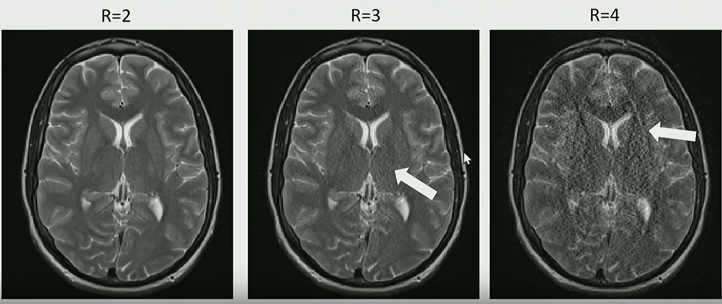
Image Reconstruction Artefacts
Artefacts arise due to
finite scan time
acquire discrete points
leads to aliasing and phase wrap
limited bandwidth
leads to blurring and Gibbs ringing
Parallel imaging
noise amplification
residual aliasing
G Cruz ISMTM 2023

Slide 19
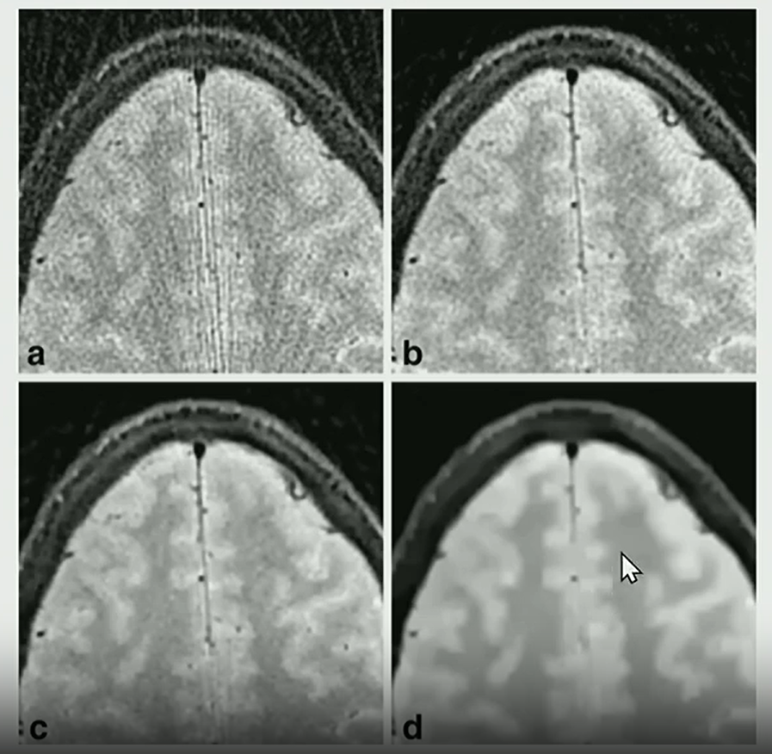
Image Reconstruction Artefacts
No regularisation
Under-regularised
Compressed sensing requires a regularisation factor
If it is not optimised then can get
under regularised = noise
over regularised = blurring
Conventional reconstruction
well characterised linear operations and can be simply solved
Deep learning reconstruction
includes non-linear operations
depends on loss function, hyper-parameters, training data
can also be very dependent on noise level (ie works well at low noise but breaks down at high noise)
Well-regularised
Over-regularised

Slide 20
Artefacts: Conclusions
Can definitely be a problem
There are some solutions but really you need to take care to set up your study carefully to avoid them
Otherwise you may need to discard data

Slide 21
Next Meeting
When: Mar 6th
Time: 3:15-4:15pm
Topic: ASL

