Slide 1
Types of scans available and what they’re good at
Irene Vavasour
Sep 6th 2023
Monthly Analysis meeting for UBC MRI Research

Slide 2
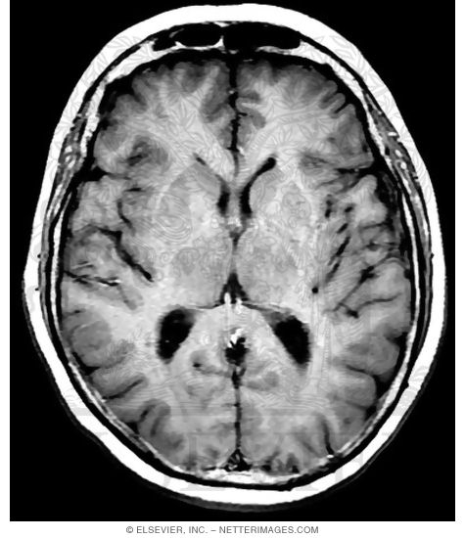
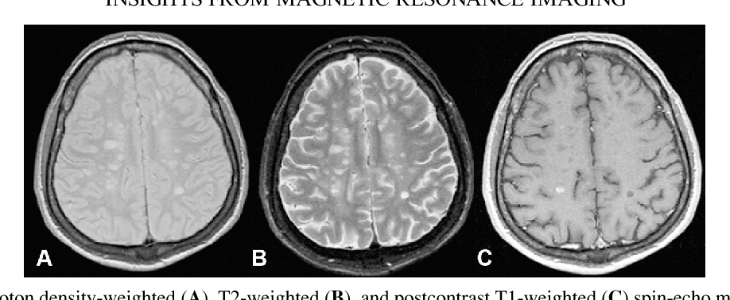
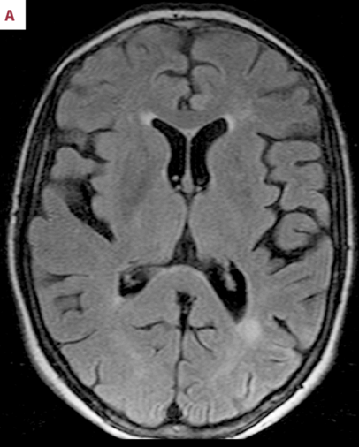
Conventional Imaging for Brain
T₁-weighted
- Good for tissue (WM/GM/CSF) contrast
Proton Density weighted
- Areas of increased water content appear bright (e.g. MS lesions)
T₂-weighted
- Areas of increased water content appear bright (e.g. MS lesions)
Contrast Enhancing
- Bright areas indicate breakdown of blood brain barrier
FLAIR
- Fluid Attenuation Inversion Recovery
- Very sensitive to tissue abnormality

Slide 3
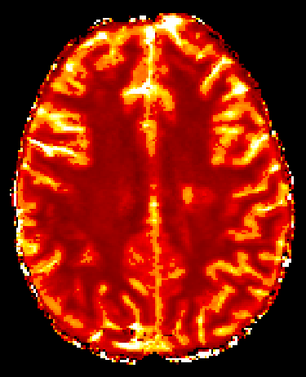
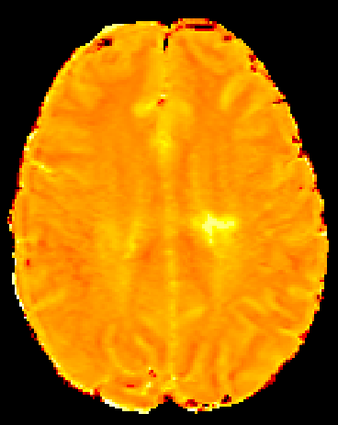
Quantitative Relaxation Times
T₁ relaxation
Measured with either inversion recovery or saturation recovery using several images
Sensitive to water mobility
Correlated with water content
T₂ relaxation
Measured using multi-echo datasets
Sensitive to water mobility and tissue microstructure
Not a single relaxation time in white matter, i.e. there’s more than 1 water compartment
Myelin water (related to myelin content)
Intra/extracellular water (related to inflammation and edema)

Slide 4
Myelin Sensitive Imaging
Our Recommendation
Myelin Water Fraction, MWF
Uses multi-echo T2 relaxation to separate water pools based on T2 time
Short T2 pool is assigned to water within myelin bilayers
Magnetisation Transfer Ratio, MTR
Sensitive to the transfer of magnetisation between water and macromolecules (more macromolecules = more magnetisation transfer)
Myelin contributes to the macromolecules
But MTR is also affected by changes in water content
Inhomogeneous Magnetisation Transfer Ratio, ihMTR
Similar to MTR but thought to be more sensitive to the lipid chains within bilayers
Myelin is mainly composed of lipids
Macromolecular Pool Fraction, MPF
Also uses MT effect but uses a two pool model (water and macromolecules) to fit the proton fraction in each pool
Not yet available to us

Slide 5
Myelin Water Fraction techniques
48-echo GRASE
METRICS
CALIPR
Uses extra gradient echoes to speed up data acquisition
Collects 48 echoes at 8ms spacing
Acquired at 2x2x5mm³ but reconstructed to 1x1x2.5mm³
7.5 min for 20/40 slices
Uses compressed sensing to speed up acquisition
Collects 48 echoes at 8ms spacing
Acquired at 2x2x5mm³ but reconstructed to 1x1x2.5mm³
5-6 min for 20/40 slices
Uses compressed sensing and subspace constrained reconstruction
Collects 56 echoes at 6ms spacing
Acquired at 1.7x1.7x1.7mm³ but reconstructed to 1x1x1mm³
7.5 min for 100 slices
Requires offline image reconstruction
Not quite ready for primetime

Slide 6
Diffusion Tensor Imaging
Measures the movement of water molecules
Using 1 b-value (700 or 1000)
Use Hardi60 sequence
Best distribution of angles over the sphere
Takes about 6min
Tractography
Uses the direction of principle diffusion to define axon direction
Can trace along these directions to create fibre maps
Can be done with both single and multi-shell diffusion acquisitions
Using multi-shell b-values
Recommend 98 or 128 directions and 3 b-values (500,1000,2000)
Takes 8/10min
Can be modeled to account for crossing fibres and remove effects of edema
DBSI
NODDI
Jeurissen 2019 NMR in Biomed

Slide 7
DTI Measurements
Fractional Anisotropy
Decreases when tissue is damaged
Mean Diffusivity
Equals the average diffusion of water and increases with water mobility
Axial Diffusivity
Diffusivity along axon
Decreases with acute axonal damage but increases after debris has been removed
Radial Diffusivity
Diffusivity perpendicular to axon
Modulated by myelin (but not a specific myelin marker)
Restricted Fraction
Isotropic diffusion that is restricted so assigned to water within cells
Increases with inflammation
Non-restricted Fraction
Isotropic diffusion that is more free so assigned to intra/extracellular water as well as CSF
Increases with edema
Neurite Density Index
Measure of the density of neurites within voxel
Orientation Dispersion Index
Measures how aligned the neurites are within a voxel (0=non-aligned, 1=perfectly aligned)
Measured with DBSI
Measured with NODDI

Slide 8
Perfusion Imaging
Defined as the steady-state delivery of blood to an element of tissue
Two main methods: using an exogenous (Gadolinium) or an endogenous (labeled blood water) contrast agent
Exogenous methods
Dynamic Susceptibility Contrast Enhancement (DSC)
Measures the change in susceptibility due to the perfusion of gadolinium into the tissue with T2 or T2*-weighted images
Dynamic Contrast Enhancement (DCE)
Measures the change in signal due to gadolinium using a series of T1-weighted images
Uses pharmacokinetic modeling to extract measurements
Endogenous methods
Arterial Spin Labeling (ASL)
Uses the body’s own arterial blood as a diffusible tracer
Pseudocontinuous ASL (pCASL) is the method of choice
Measured values include
Cerebral Blood Flow
Cerebral Blood Volume
Mean Transit Time

Slide 9
Functional Imaging
Task based fMRI
Uses block design with a task and rest
Resting state fMRI
Continuous data collection for at least 8min
Related to brain connectivity
Multi-echo fMRI
Some groups are using 3-5 echoes
More robust than single echo
May take slightly longer than single-echo
Functional ASL
Erin’s hope for the future
Used to measure task related to CBF changes
Based on BOLD signal

Slide 10
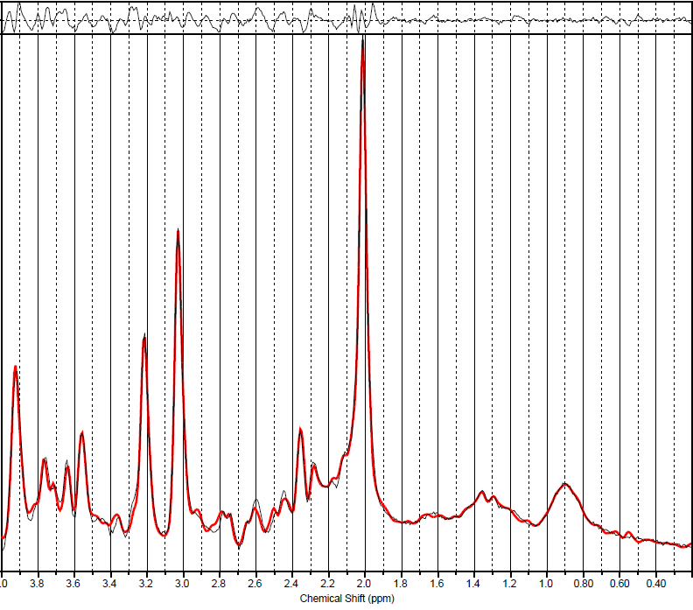
Metabolic Imaging
Magnetic Resonance Spectroscopy (MRS)
Chemical Exchange Saturation Transfer (CEST)
Used to measure metabolites at very low concentration
The metabolite must be able to exchange protons with surrounding water
Uses MT to measure a specific molecular frequency
Measured functional groups are
Amide: amide proton transfer (APT)
Used in tumour grading and acute ischemic stroke
Amine: glutamate (Glu-CEST)
Hydroxyl protons: mI, glucose
Proton (¹H)
Measures hydrogen atoms on metabolites that are mobile and of sufficient concentration
Most common metabolites
NAA: n-acetyl aspartate, measure of neuronal health
Cr: creatine, measure of energy usage
Cho: choline, measure of membrane turnover or damage
mI: myo-inositol, measure of gliosis
Glu: glutamate and Gln: glutamine
More sketchy metabolites include GABA, GSH
Positron Emission Tomography (PET)
Detects location of positron emission after injection of radiolabeled tracer
Used in Parkinson’s, Alzheimer’s, cancer
X-nuclei (²³Na/³¹P)
As of 2024, we will have the capability of measuring nuclei other than hydrogen, namely ²³Na and ³¹P

Slide 11
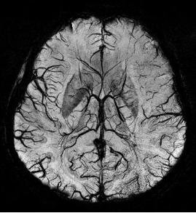
Susceptibility Imaging (T2* or R2* imaging)
Used to detect distortions in the local magnetic field
Susceptibility weighted imaging (SWI) is sensitive to venous blood and iron
Used in
TBI: detect micro-hemorrhage
Stroke or hemorrhage
MS: central vein sign
Quantitative Susceptibility Mapping (QSM) quantifies the underlying magnetic susceptibilities from the field distortions
Both SWI and QSM have very high spatial resolution

Slide 12
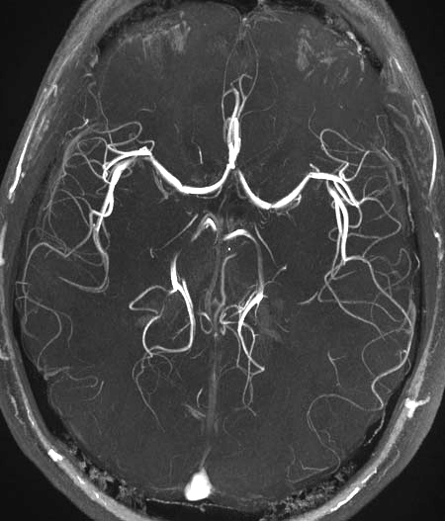
MR Angiography
Used to measure vasculature, usually arteries but can also include veins
Techniques include
TOF: time of flight, uses movement of blood to measure flow
contrast enhanced MRA, uses contrast agent to shorten T1 of blood and enhance TOF signal differences
phase contrast MRA, measures difference in phase from moving blood vs stationary tissue

Slide 13
Multimodal Imaging
Available now
Transcranial magnetic stimulation
Electroencephalogram
Galvanic vestibular stimulation
Focused ultrasound
Transcranial direct stimulation
Possibly in future
Deep brain stimulation
High intensity focused ultrasound

Slide 14
Other?
Let us know if you have other types of sequences that you would like to try. We’ll see what we can do.

