Slide 1
Magnetisation Transfer
Irene Vavasour
Apr 3, 2024
UBC MRI Research Monthly Analysis Meeting

Slide 2
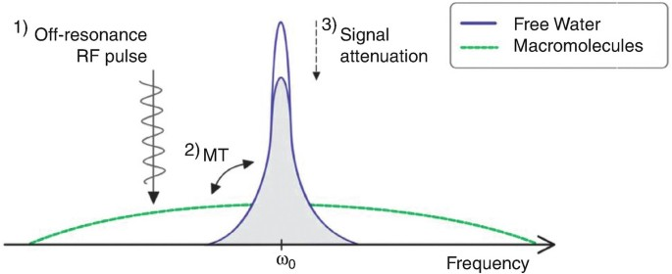
What is Magnetisation Transfer?
MR visible protons
Water
Macromolecules
(e.g. proteins and lipids)
MR invisible protons
Wolff and Balaban, 1989

Slide 3
What is Magnetisation Transfer?
MR visible protons
MR invisible protons

Slide 4
What is Magnetisation Transfer?
MR visible protons
MR invisible protons

Slide 5
What is Magnetisation Transfer?
MR visible protons
MR invisible protons

Slide 6
Magnetisation Transfer Ratio

Slide 7
Magnetisation Transfer Ratio
Calculated from 2 images
MT off (no MT pulse)
MT on (off resonance MT pulse or on resonance binomial MT pulse)
MT_{off} - MT_{on}
MTR =
x 100%
MT_{off}

Slide 8
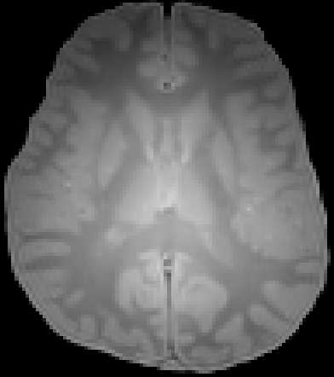
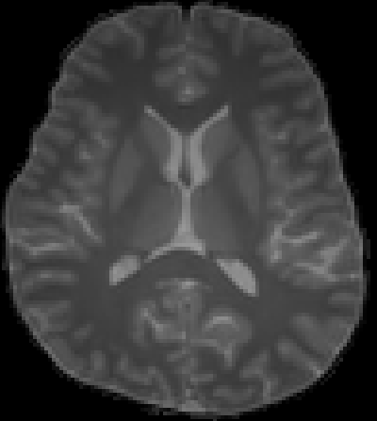
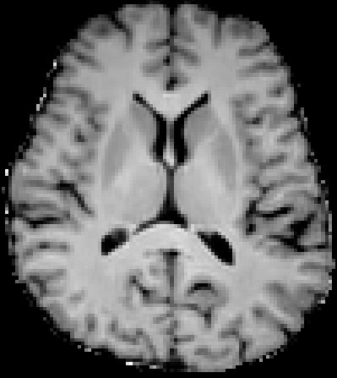
Magnetisation Transfer Ratio
-
=
x 100%

Slide 9
Use of MTR
Measure of “myelin” in white matter disorders
MTR decreases in multiple sclerosis lesions - thought to be loss of myelin
Has shown a gradient decrease towards the ventricles
Measure of cartilage integrity
decreases with damage
But MTR is affected by changes in water content
so an MTR change in non-specific for pathology
Has low correlation with myelin water fraction

Slide 10
MTR varies between scanners
Siemens
GE
Philips

Slide 11
Magnetisation Transfer Saturation

Slide 12
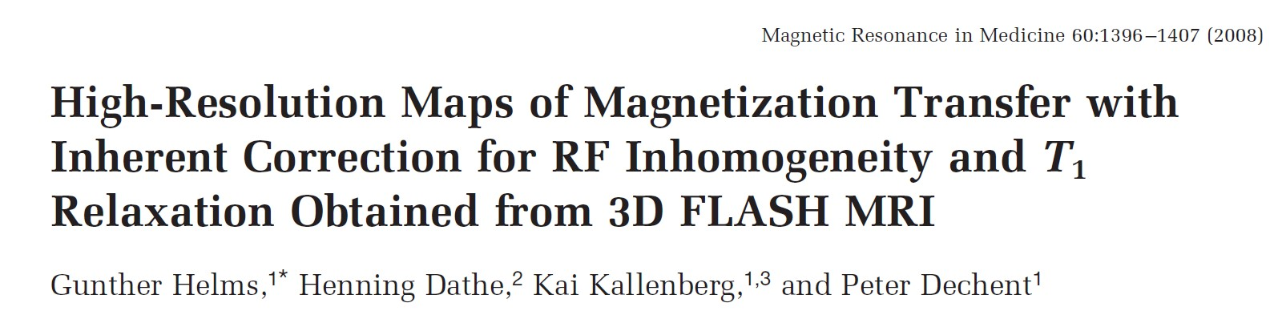
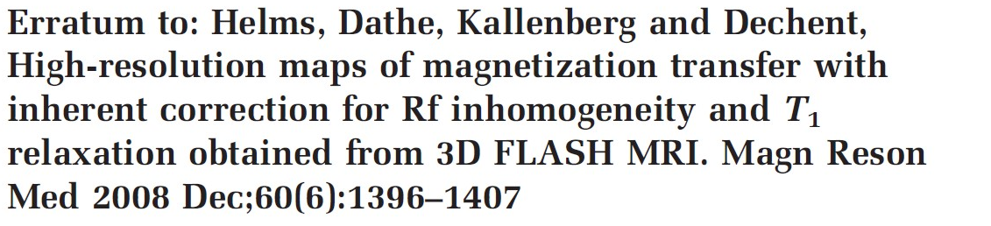
MT Saturation (MTsat)
Compensates for inhomogeneities in RF and flip angles
Separates T₁ relaxation component from MT effect
Original Paper

Slide 13
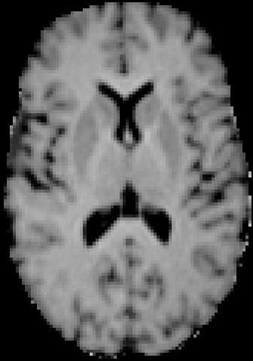
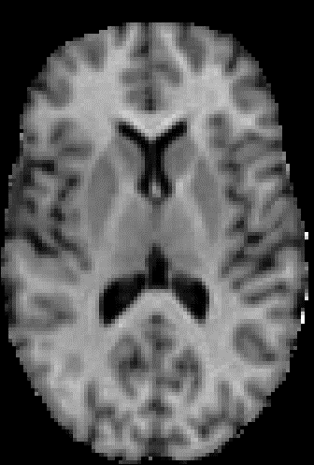

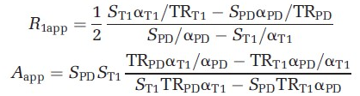
MTsat
MTR MTsat
Requires acquisition of 3 images
PD image (no MT), S_{PD}
PD image (with MT), S_{MT}
reference T1 image (no MT, but different TR and α), S_{T1}
S=signal intensity
α=flip angle
MTsat
To calculate Mtsat I use sct_compute_mtsat from the Spinal Cord Toolbox.

Slide 14
Use of MTsat
Originally proposed to be insensitive to inhomogeneities but looks like it still is
therefore B₀ map collection is suggested
Mainly used in multi-parametric mapping protocols
Large variability in values between vendors

Slide 15
Inhomogeneous Magnetisation Transfer

Slide 16
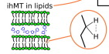
Inhomogeneous MT (ihMT)
Arises due to coupled protons in the hydrocarbon chain of lipids
Water protons interacting with methylene protons leads to an asymmetric MT effect
dipolar-coupled methylene = spin-1 system

Slide 17
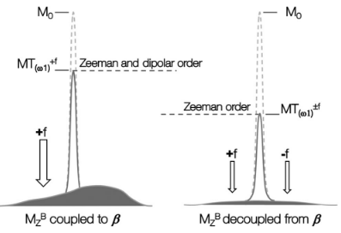
ihMT
off-resonance pulse on one side of water
couples the Zeeman magnetization to the dipolar order
thus making the bound pool line asymmetric and reducing the saturation efficiency
off-resonance pulse on both sides of water
decouples Zeeman magnetization and dipolar order leading to efficient saturation

Slide 18
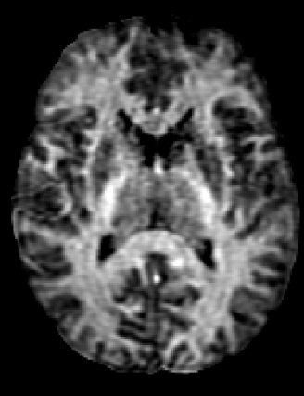
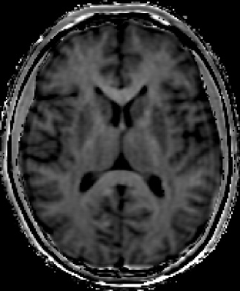
ihMTR¹
ihMTR MTR
more specific for lipids and hence myelin
requires 5 images
No MT, M₀
MT pulse positive, M₊
MT pulse negative, M₋
Dual MT pulses (positive, negative), M₊₋
Dual MT pulses (negative, positive), M₋₊
M₊ + M₋ - M₊₋ - M₋₊
ihMTR =
2M₀
¹G Varma Magn Reson Med 2015; 73: 614–622.

Slide 19
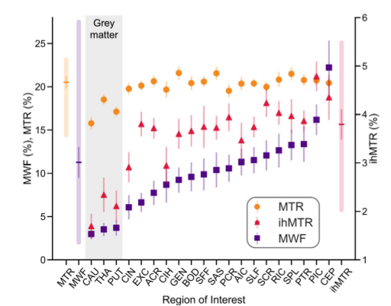
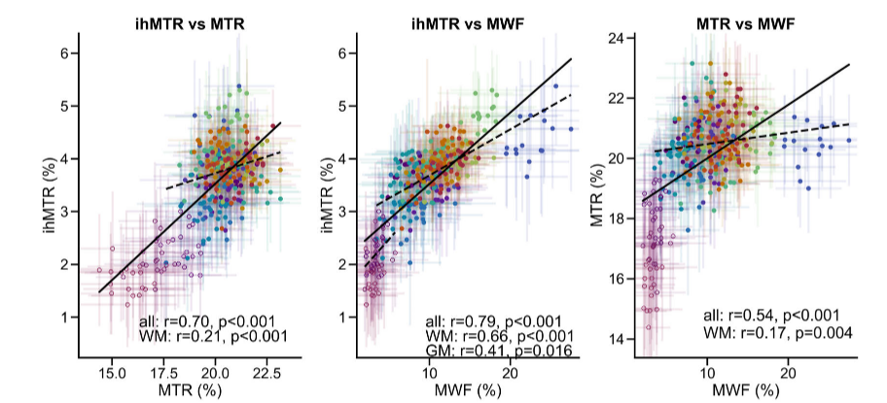
Use of ihMT
ihMTR is reduced in areas of demyelination
Shows more consistency with MWF than does MTR
values vary for different brain regions just like MWF
Newest of the MT techniques so still under development
SR Morris MRM 2022

Slide 20
Quantitative Magnetisation Transfer

Slide 21
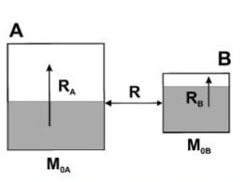
Quantitative MT (qMT)
uses multiple acquisitions at different off-resonance frequencies to model tissue using the Two-Pool Model
R_{A}, R_{B}: longitudinal relaxation rates
R: exchange rate
M_{0A}, M_{0B}: net magnetisation
shaded area is saturated protons
aqueous
non-aqueous
includes the myelin protons
Henkelman MRM 1993, Henkelman NMR in Biomed 2001

Slide 22
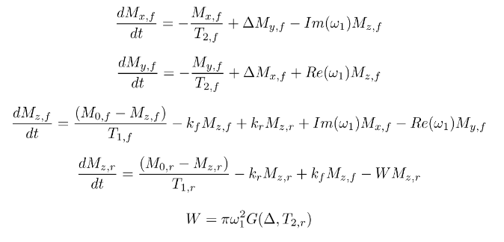
qMT
Magnetisation Transfer Signal Equations
Solve for
R_{A}
R_{B}
S_{A}
S_{B}
R
M_{0A}/M_{0B}
myelin measure
Can use software such as qMRLab
https://github.com/qMRLab
Sled and Pike 2000

Slide 23
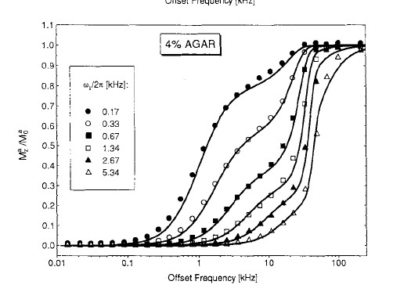
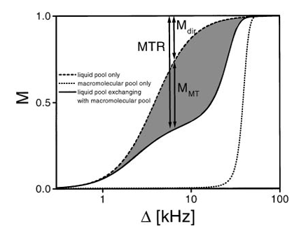
qMT
Z-spectrum
t
So MTR is a combination of true MT effect and direct saturation of the aqueous protons by the off-resonance pulse
Henkelman MRM 1993, Henkelman NMR in Biomed 2001

Slide 24
Use of qMT
used to calculate pool size ratio (or molecular proton fraction) which is attributed to myelin
can measure exchange rates between pools which might be a potential biomarker for tissue damage
also used to measure T₁ and T₂ relaxation times, so good for multi-parametric mapping
quicker versions are available with only a few offset frequencies

Slide 25
Technique considerations
MTR | MTsat | ihMT | qMT
easy to collect data and calculate | slightly more complicated equation | easy to calculate | complicated equations to solve
requires only 2 images | requires 3 images | requires 5 images | requires multiple images so long acquisitions
affected by water content | affected by water content | more specific for lipids (can be modulated with T_{1D}) | can model many parameters
variable between scanners | still requires B0 mapping | requires extra scanner programming | Not done at UBC
Specific Note for Philips data: make sure that you apply the scaling factor correctly when converting your data into NIfTI format. Some older versions of dcm2niix do not do it properly. (Intensities should be in the hundreds of thousands not the thousands.)

Slide 26
Next Meeting
When: ?? Maybe Apr 24th or May 22nd
Where: CBH 3502 or zoom
Topic: TBA

