Slide 1
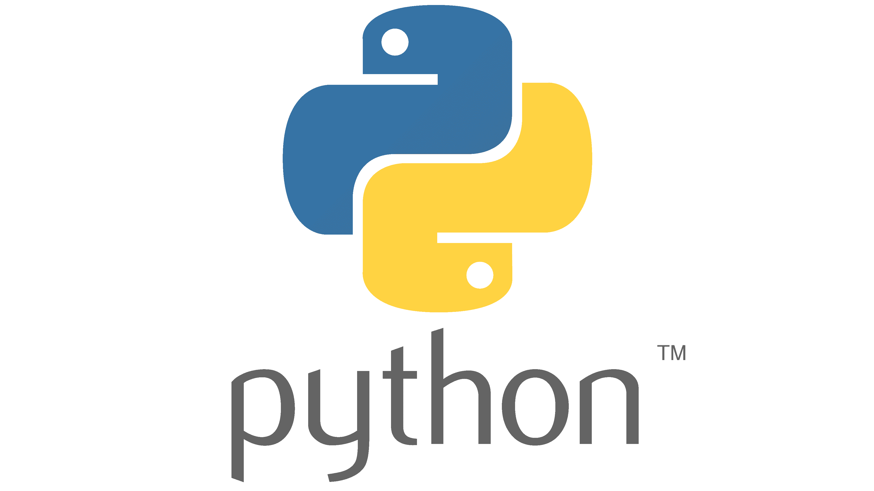

MRI Analysis meeting: Introduction to Streamlit
Oct 2, 2024
Alex Ensworth, MSc
PhD Candidate, Medical Physics
Department of Physics and Astronomy
International Collaboration on Repair Discoveries
Notes:
Need an IDE (integrated development environment) to write a python script.
Visual studio code, pycharm, spyder, etc.
Can use a text editor, although it is a poor choice compared to any IDEs.

Slide 2


The plan for today
Overview of Streamlit
How to access Streamlit
Write a small Streamlit app
Publish our app with GitHub

Slide 3
What is Streamlit?
An open source, python-based toolbox
Creates interactive web-based applications of python scripts
Share your data analysis
Let’s look at an example
Notes:
Just like python, Streamlit is open source. It is completely free and run by the community.
This is extra nice, because that means a lot of the things you will want to do is VERY google-able.
Streamlit allows you to turn your python code into an interactive app that is very easily shareable by a URL
There are so many things you can do with it, but the main reason why I’m here at the analysis meeting is for the concept of open science. Streamlit gives you an easy way to allow other people to view your analyzed data.

Slide 4
What is your experience with python?
I’m a pro!
I’m comfortable with it
I’ve used it a few times before
I’ve never used python, but code in other languages
I’ve never coded before
Notes:
I would say I fall in category 2. I’m definitely not a pro, I understand the concepts of python, but I am self-taught and only started learning about 2 years ago. I have not taken any formal classes. I still use google a lot while I’m coding.
But since I’m the one conducting this, that should tell you just how easy this is to use! Anyone can do it.

Slide 5
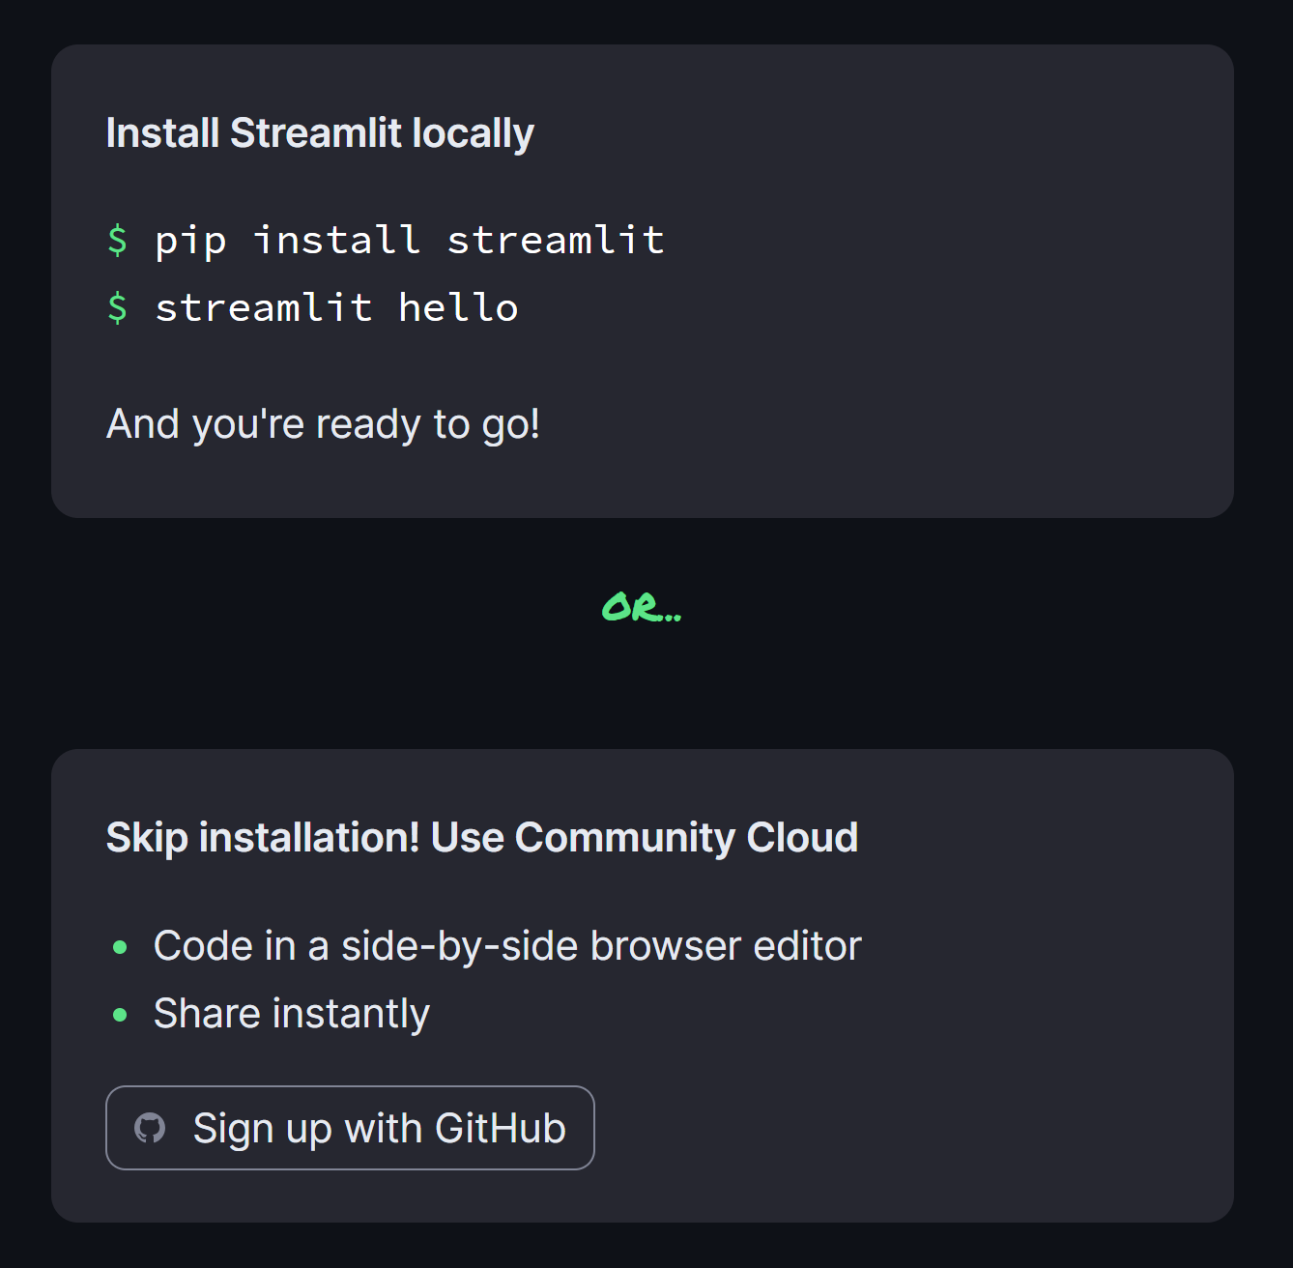
Access streamlit
There are multiple ways to access Streamlit
Both have advantages and disadvantages
Let’s take a quick look at how to do this
https://streamlit.io/
https://streamlit.io/#install
Notes:
Community cloud:
Pro - don’t need to install python and visual studio code, don’t need to upload your code after!
Con – really slow, need internet connection,
your work in progress code, is automatically uploaded
Not all packages seem to be supported – lose freedom
Local install:
Pro – Fast feedback, can work offline
Con – More initial installation is required

Slide 6
Community cloud tutorial:

Slide 7
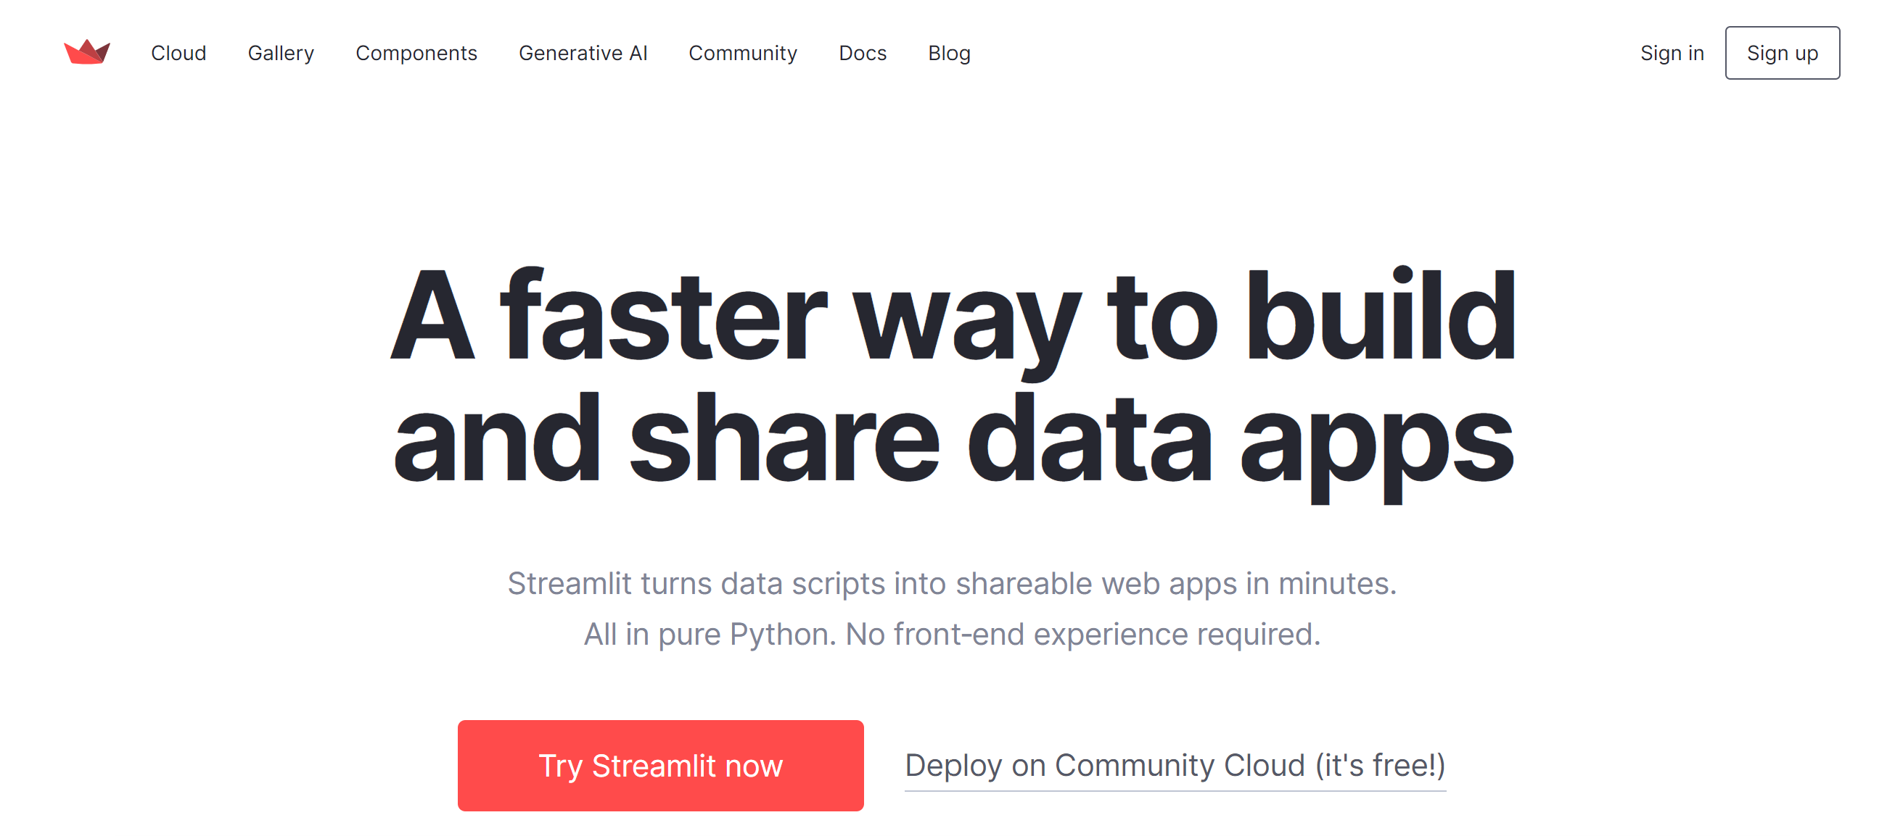
Access streamlit – Community Cloud
Sign up on Streamlit → https://streamlit.io/

Slide 8
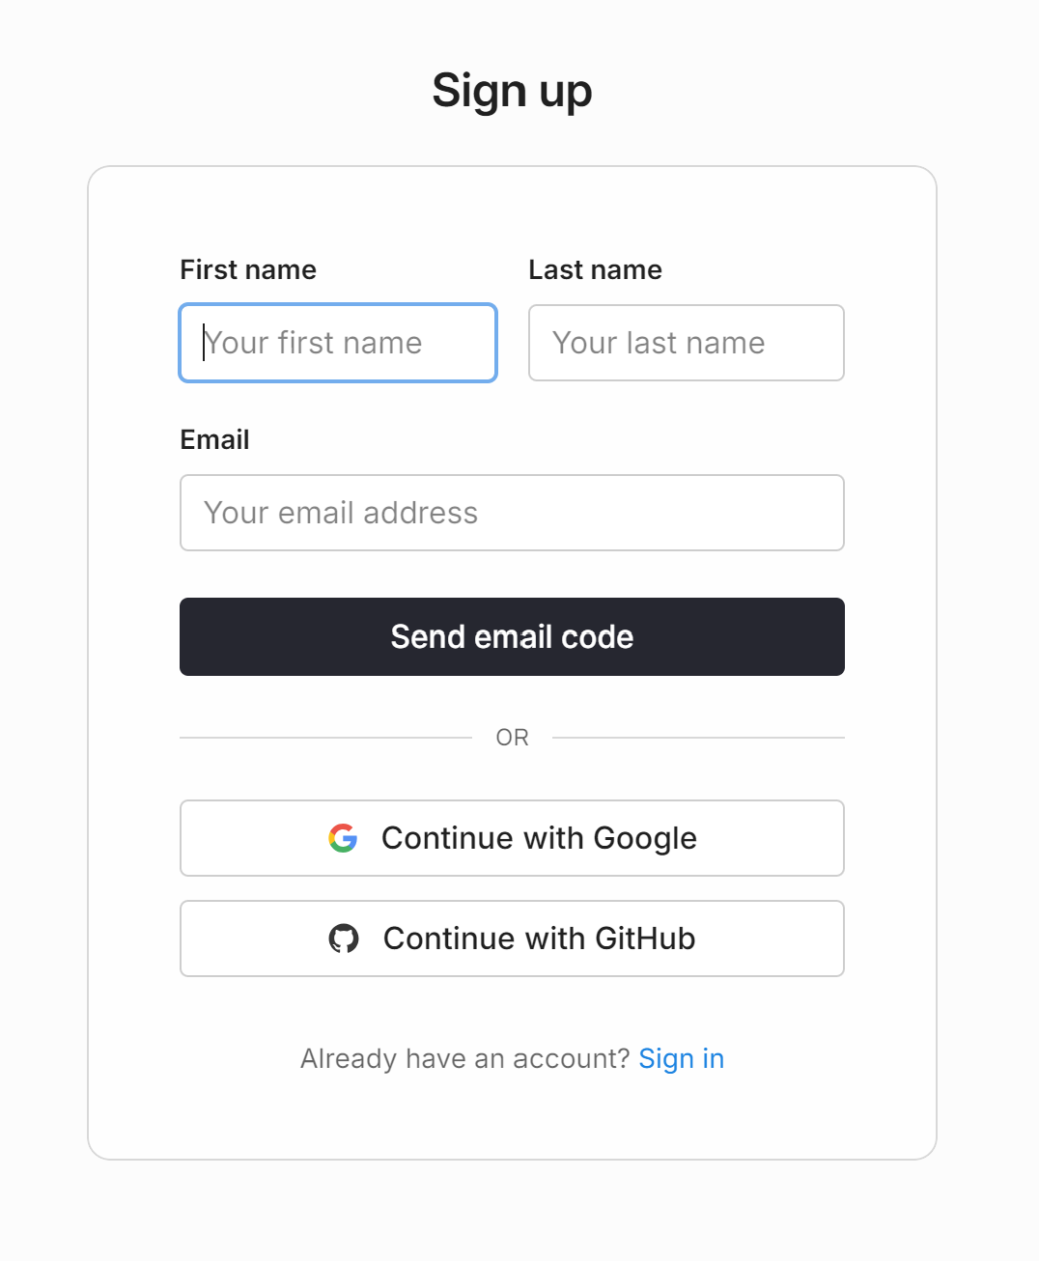
Access streamlit – Community Cloud
Easiest way is to connect with your GitHub account
Follow the prompts on the screen

Slide 9
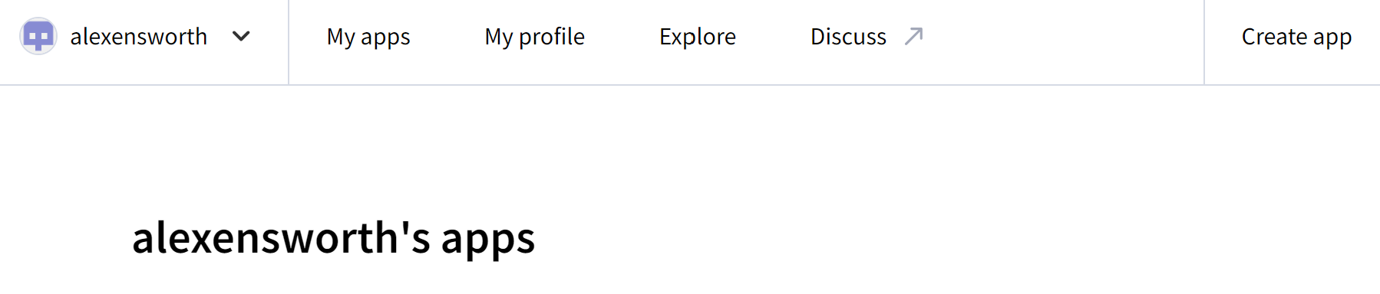
Publish your app
Once you have an account, select “create app” on your streamlit account

Slide 10
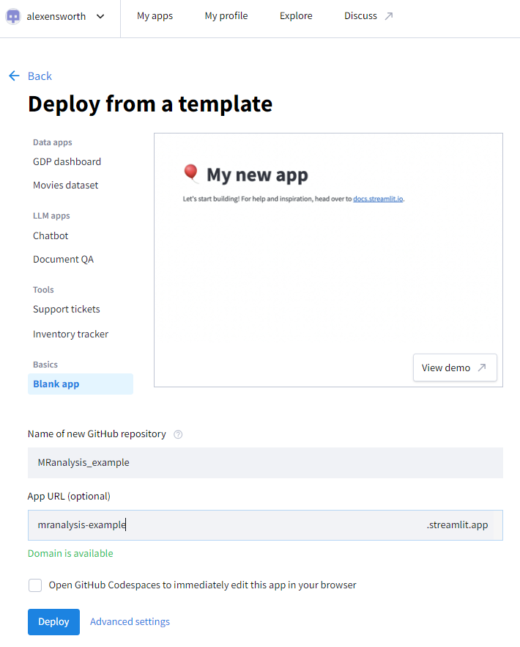
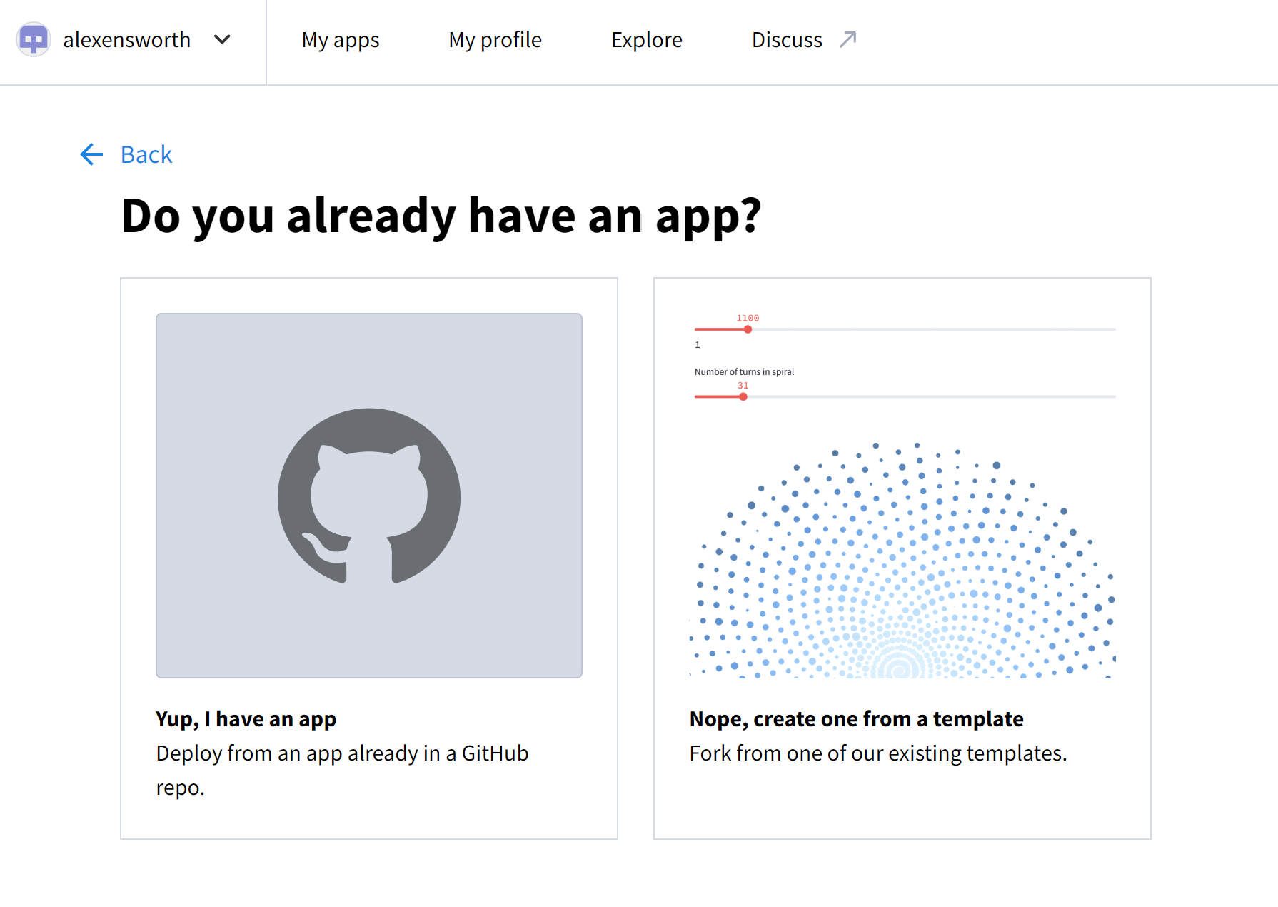

Access streamlit – Community Cloud

Slide 11
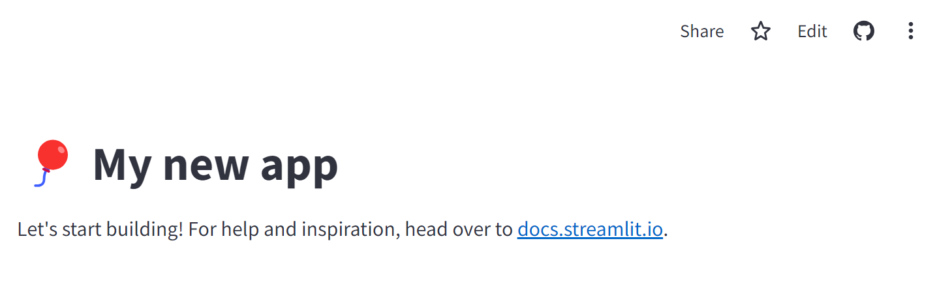
Access streamlit – Community Cloud
If you leave the “Open GitHub Codespaces…” box unchecked, click “edit” on the next page to edit your app

Slide 12
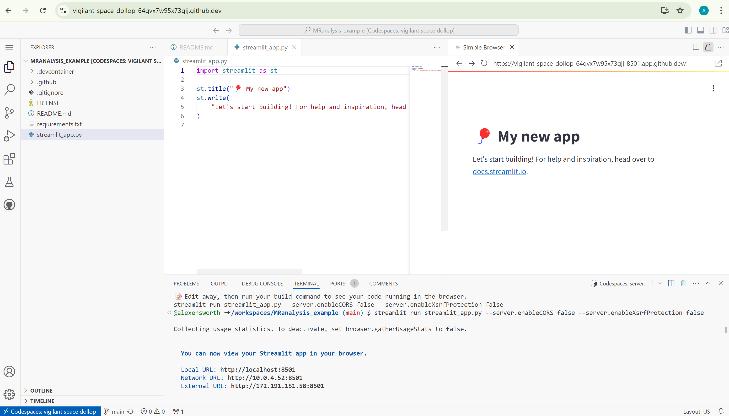
Access streamlit – Community Cloud
After waiting some time, you get a browser page that looks a lot like the visual studio code interface.
Click on “streamlit_app.py” to edit your app!
Edit code here
View your app here

Slide 13
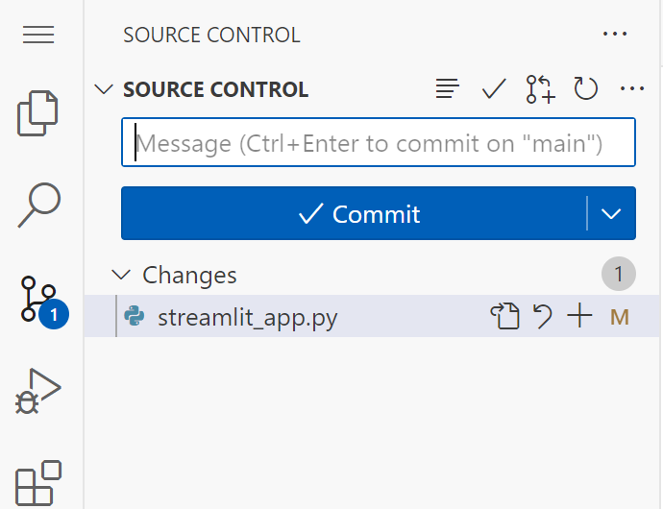
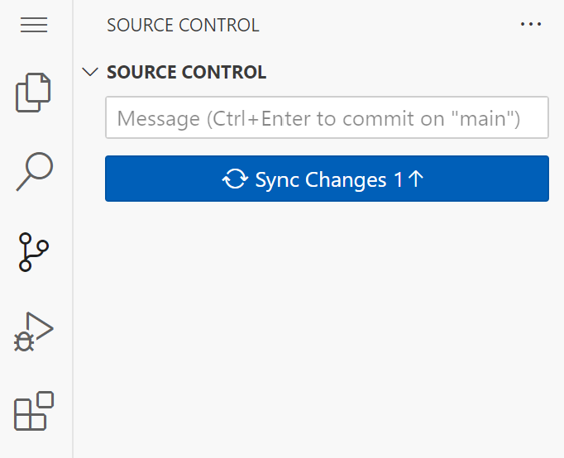
Access streamlit – Community Cloud
Saving your work:
In the toolbar on the left, click on the 3rd icon down, to change from “Explorer” to “Source Control”
Insert a commit message, then hit commit.
Don’t forget to update the “requirements.txt” file if needed
Click “sync changes” to upload them to GitHub

Slide 14
Let’s make an app!

Slide 15
Notes:
Run your code locally with this command in your terminal:
streamlit run my_app.py
Display your code and the streamlit app side by side as you work
Save your code to update the app
Hit “always rerun” in the streamlit app to save yourself a click!

Slide 16
Publish local file tutorial:
Notes:
If you used the community cloud method, you are already done!
This is for publishing local files.

Slide 17
Publish your app
Sign up on Streamlit → https://streamlit.io/

Slide 18
Publish your app
Easiest way is to connect with your GitHub account
Follow the prompts on the screen

Slide 19
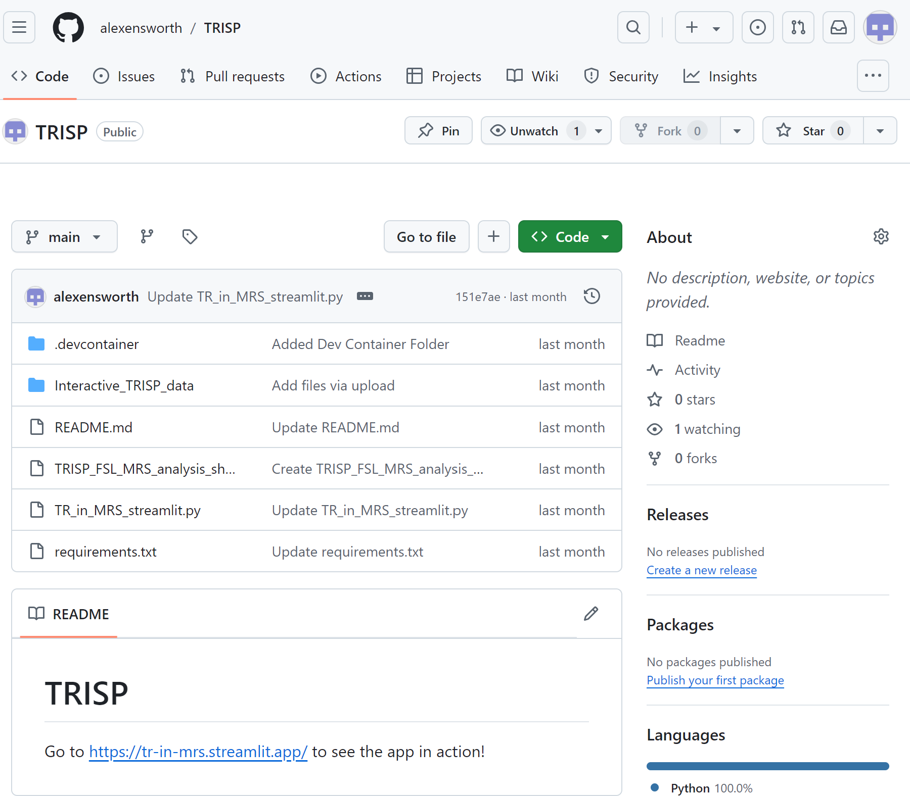
Publish your app
Upload your code to a repository on your GitHub account

Slide 20
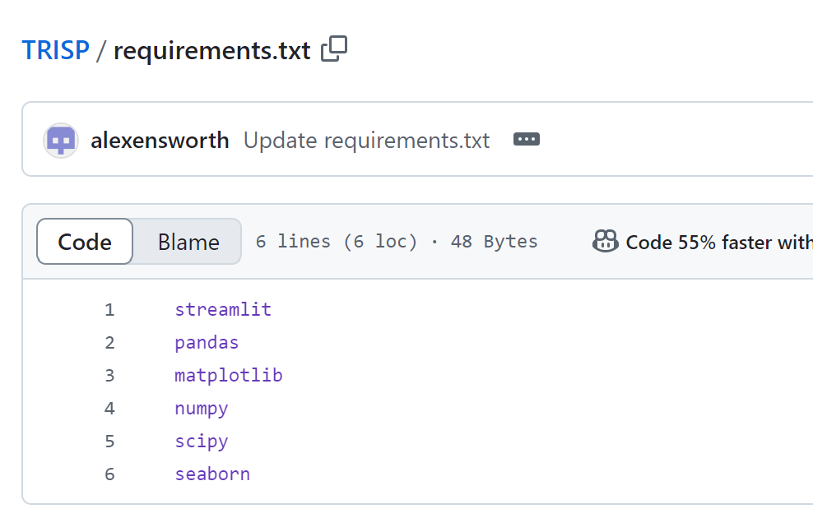
Publish your app
You will need to create a requirements.txt file with list of packages

Slide 21
Publish your app
Once you have an account, select “create app” on your streamlit account

Slide 22
Publish your app
Click deploy from an app already in a GitHub repo

Slide 23
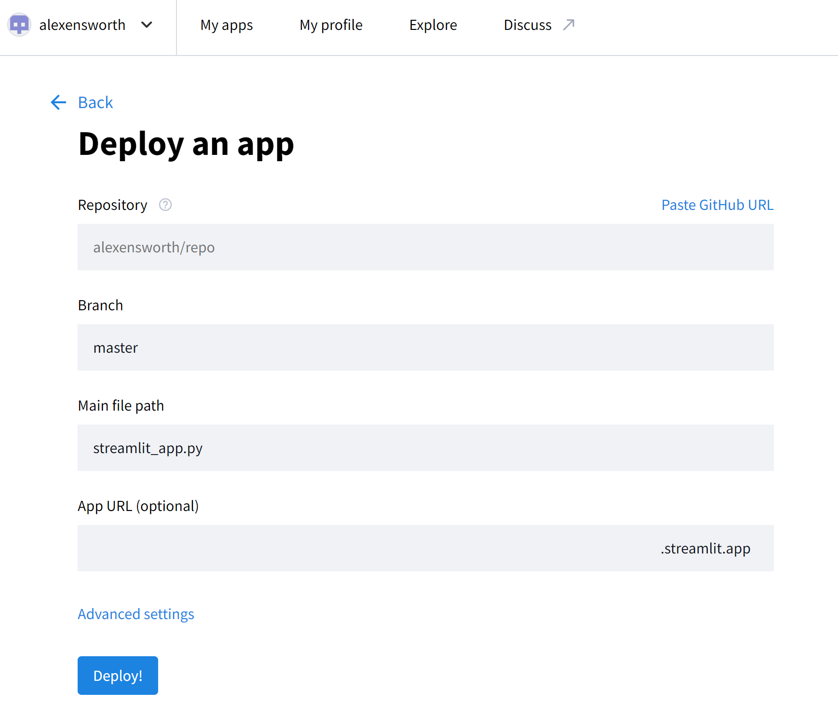
Publish your app
Input the repository path (it should auto complete for you),or paste the GitHub URL
Choose your App URL
Hit Deploy!

