Slide 1
Analysis methods for structural data
May 3, 2023

Slide 2
Types of Analyses
Whole brain
ROI based
Histograms
VBM
TBSS
Atlas/z-scores
Graph Theory

Slide 3
Whole brain (or WM/GM) analysis
Need to segment out the whole brain
BET
ANTs: antsBrainExtraction.sh
Grab the mean (and/or standard deviation) of the whole brain ROI
fslstats
Can also do this analysis for different tissue types such as white matter or grey matter
segment the tissue: FAST or the outputs from ANTs brain extraction

Slide 4
ROI analysis
Many ways to grab ROIs
register to MNI then grab ROIs from FSL atlas and inverse warp them to patient space
I like to use either the JHU-ICBM-labels or JHU-ICBM-tracts-maxprob-thr25
Note: If possible, keep the quantitative images in their original space to avoid smoothing of the data
Use tractography to define tracts
From DTI tractography, tracts can be delineated
But if there’s damage (e.g. lesion), tractography might fail
Hand-draw ROIs
Semi/fully automated lesion segmentation tools
fully automated tools are still not perfect

Slide 5
We have means, now what?
Compare means between different groups
t-test
ANOVA
Correlations
Cohort

Slide 6
Histogram analysis
Can make a histogram of the values within a voxel
fslstats metric_image.nii.gz –k ROI.nii.gz –H nbins min max
Can look at
Peak height
Peak location
Peak Width
Skewness

Slide 7
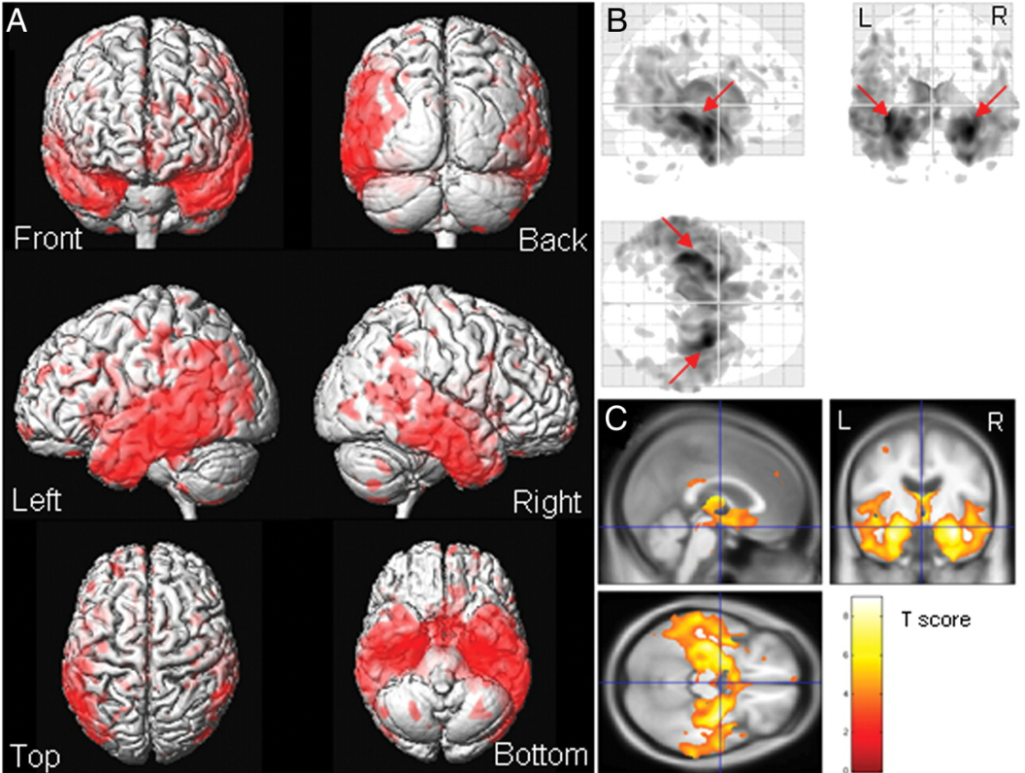
Voxel based morphometry (VBM)
Compares images at a voxel level
first brains are registered to a template
brains are segmented into WM/GM/CSF
then images are smoothed
finally compare volumes at a voxel level
reference: https://doi.org/10.1523/JNEUROSCI.2160-09.2009

Slide 8
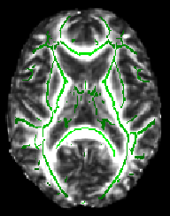
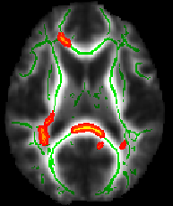
Tract based spatial statistics (TBSS)
First define a tract skeleton (i.e. voxels in the centre of WM tracts are chosen)
uses DTI defined FA to locate tracts
Help found at: https://fsl.fmrib.ox.ac.uk/fsl/fslwiki/TBSS
Compare only the skeleton between subjects

Slide 9
Atlas based (z-scores)
Compares your participant of interest to an atlas made from healthy control (HC) images
use ANTs to create atlas: antsMultivariateTemplateConstruction2.sh
create mean and standard deviation maps from the atlas
compare individual to the atlas using z-scores
Example MWF atlas paper at https://doi.org/10.1038/s41598-020-79540-3
individual value – HC mean value
At each voxel calculate: z-score =
HC standard deviation

Slide 10
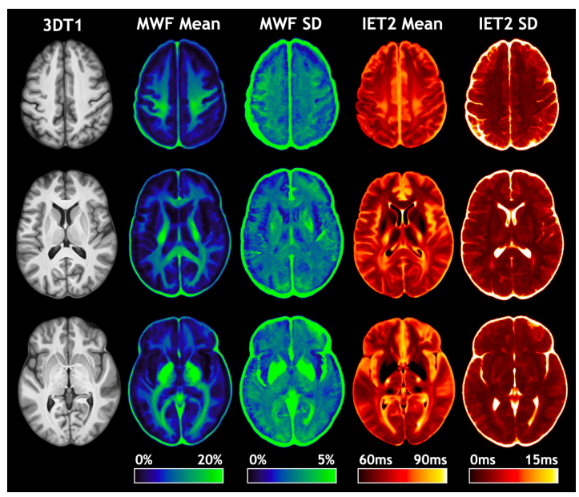
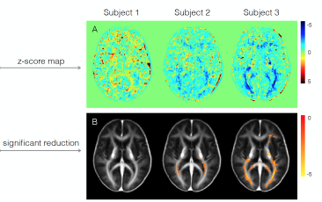
Atlas based (z-score)

Slide 11
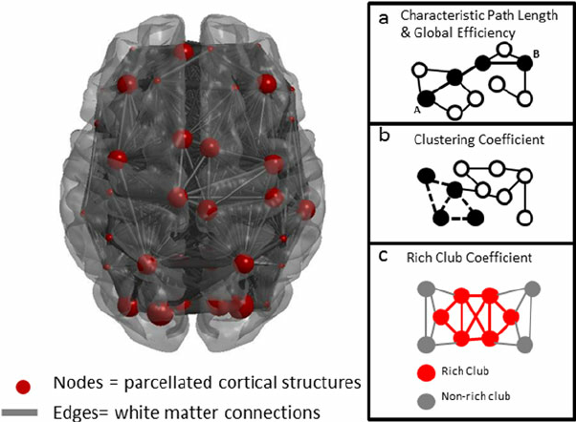
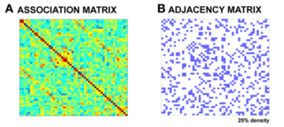
Graph theory
Used to characterise brain connectivity
Many different parameters
path length
local/global efficiency
clustering coefficient
centrality
modularity

Slide 12
Types of Analyses – Pros and Cons
Whole brain
ROI based
Histograms
VBM
TBSS
Atlas/z-scores
Graph Theory
Pros | Cons

Slide 13
Types of Analyses – Pros and Cons
Whole brain
ROI based
Histograms
VBM
TBSS
Atlas/z-scores
Graph Theory
Pros | Cons
Get global information | If effect is small it will be averaged out
Easy to implement | Only comparing groups

Slide 14
Types of Analyses – Pros and Cons
Whole brain
ROI based
VBM
Histograms
TBSS
Atlas/z-scores
Graph Theory
Pros | Cons
Get information specific to an ROI | If effect is small within ROI it will be averaged out
Fairly easy to implement | Only comparing groups
 | Can be overwhelmed by number of tracts
 | Registration to MNI can be tricky if brains have a lot of atrophy or lesions

Slide 15
Types of Analyses – Pros and Cons
Whole brain
ROI based
Histograms
VBM
TBSS
Atlas/z-scores
Graph Theory
Pros | Cons
Each voxel is represented in the histogram | Spatial information is lost
Can look at not only the values of the metric but also the histogram shape | Statistics to compare 2 histogram shapes are more complicated
Can look at individual histograms or histograms averaged over population

Slide 16
Types of Analyses – Pros and Cons
Whole brain
ROI based
Histograms
VBM
TBSS
Atlas/z-scores
Graph Theory
Pros | Cons
Should be sensitive to subtle changes | Influenced by goodness of registration
Visualises regional changes over the whole brain | Influenced by normal differences in brain morphometry
Fairly easy to do | Does not protect against type II errors
 | Accuracy may be affected by atrophy
 | Results differ when using different processing pipelines

Slide 17
Types of Analyses – Pros and Cons
Whole brain
ROI based
Histograms
VBM
TBSS
Atlas/z-scores
Graph Theory
Pros | Cons
By using centre of tract, less influenced by differences between people | Most of the tract is not measured
Can examine the entire white matter | Limited to WM
Fewer spurious results than VBM | Usually used on DTI data
Tools are available with fsl | Can be biased based on the FA value (more sensitive in areas of high FA)
 | May not actually represent the centre of the tract
 | Sensitive to quality of registration

Slide 18
Types of Analyses – Pros and Cons
Whole brain
ROI based
Histograms
VBM
TBSS
Atlas/z-scores
Graph Theory
Pros | Cons
Should be sensitive to subtle changes | Influenced by goodness of registration
Visualises regional changes over the whole brain | Influenced by normal differences in brain morphometry
Measures at an individual level | Need enough control data to make atlas

Slide 19
Types of Analyses – Pros and Cons
Whole brain
ROI based
Histograms
VBM
TBSS
Atlas/z-scores
Graph Theory
Pros | Cons
Represents complexity in picture form | Can have A LOT of measurements
Represents the entire brain | Affected by low signal quality

Slide 20
Other types of analyses
Independent or principle component analysis
Longitudinal
Register to a time point or create individual templates over all timepoints
Multi-centre
Need for data harmonisation
Model fitting
Correlations (with clinical data or other measures)
Can be ROI based or voxel-by-voxel based
Spatial distribution of measurements
e.g. distance from ventricles or changes along a tract

