Slide 1
Preparing your data for fMRI analysis
Irene Vavasour
Nov 1, 2023
UBC MRI Research Monthly Meeting

Slide 2
Disclosure
Most of the information for this presentation was grabbed from the May 2023 fMRI Brain Camp:
Co-organisers: Dr. Justin Andrushko, Andre Zamani and Dr. Daniela Palombo
Teaching assistants: Chantelle Cocquyt, Brandon Forys, Jacqueline Lee, Jen Burrell
Thank-you to all the organisers. It was an excellent course and I learned a lot.
This will be a somewhat condensed version hitting mainly the highlights.
Lastly, I will again note that I’m not an expert at fMRI or fMRI analysis.

Slide 3
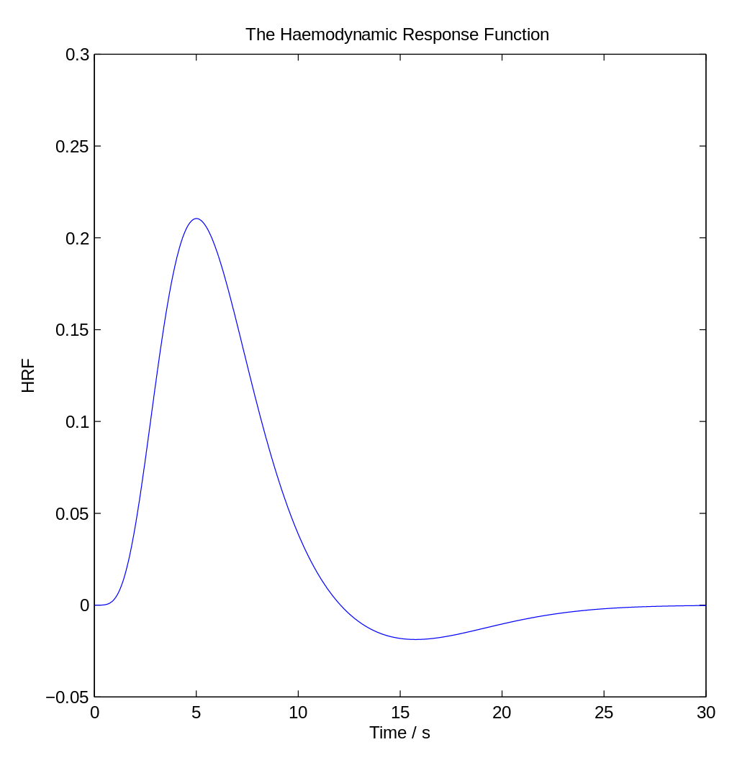
Blood Oxygen Level Dependent (BOLD) signal
reflects changes in deoxyhemoglobin (paramagnetic) driven by localised changes in brain blood flow and blood oxygenation
coupled to underlying neuronal activity
When a region of the brain is activated, the increased neural firing and other signaling processes result in a locally increased energy requirement
Increased blood flow acts to restore local O₂ levels required to overcome the transient deficit; however, more oxygen is delivered than needed
Known as the hemodynamic response

Slide 4
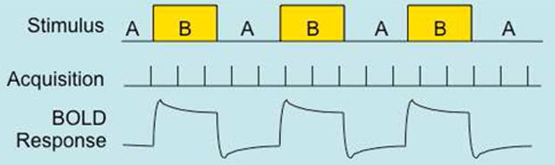
2 Types of fMRI studies
task-based fMRI
Participant is asked repeatedly to do a task followed by a rest period (on-off-on-…)
Analysis compares the BOLD signal while doing the task vs rest
resting-state fMRI
Participant lies in the scanner not thinking of anything in particular while the sequence is being run (min 8 minutes)
Analysis compares the BOLD signal pattern across brain regions

Slide 5
fMRI sequences
Sequence is echo planar imaging (EPI) sensitive to T2* relaxation
rsfMRI
task based fMRI
TR = 1-3s
TE = ~30ms
voxel = 2.5x2.5x2.5mm³
EPI factor = 13-39
Multi-echo
TR = 2s
TE = 12, 24.5, 37ms
voxel = 3x3x3mm³
EPI factor = 19
 | Philips | GE PETMR | GE MR only
Coil | dSTREAM 32 channel | HNU 12 channel | HNU 12 channel
Orientation | Axial Oblique | Axial(PETMR) | Axial/Axial oblique(MR only)
FOV (mm) | 240 | 258 | 258
Slice thickness (mm) | 2.5 | 3 | 3
#Slices | 62 | 62 | 62
Matrix | 96 | 86 | 86
Voxel size FxPxS (mm) | 2.5x2.5x2.5 | 3x3x3 | 3x3x3
TR (ms) | 2000 | 2000 | 2000
TE (ms) | 30 | 25 | 25
Flip angle (deg) | 77 | 77 | 77
Parallel Imaging Factor | 2 | 2 | 2
Multiband factor | 2 | 2 | 2
Acquisition time | 8-15 min | 8-15 min | 8-15 min

Slide 6
Things to think about
When scanning, to know your orientation for sure, place a vitamin E capsule on one side of the head
sometimes orientations can get messed up in the data header files which is a nightmare to try to figure out
Make sure you get your sequence parameters from the scan
some will be important in the analysis
Recommend putting you data in BIDS format
some of the analysis code will expect data to be in BIDS format

Slide 7
Structural Preprocessing

Slide 8
Structural Data Preprocessing Steps
Correct Orientation
Cropping
Bias Field Correction
Brain Extraction
Tissue Segmentation
Subcortical Segmentation
Note: All these steps are done on the 3D T1w images

Slide 9
Correct Orientation
Images are normally reoriented to make sure they are in standard (i.e. MNI template) orientation
This will be an axial slicing of the data
fslreorient2std input.nii.gz output_std.nii.gz

Slide 10
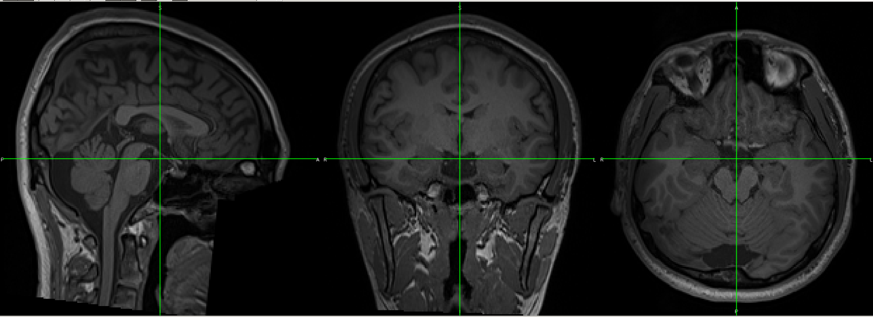
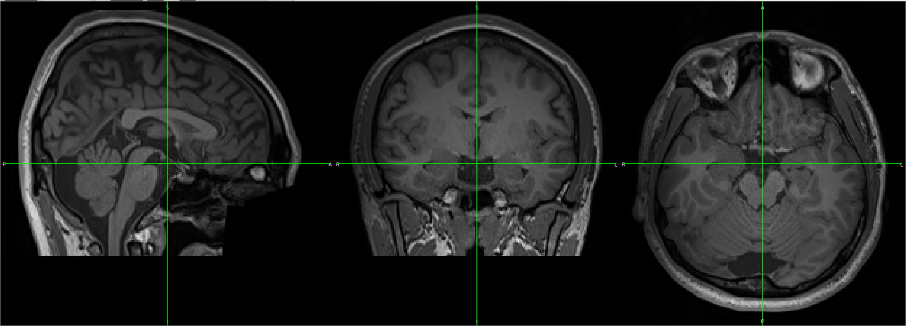
Cropping
Want to remove unwanted parts of the image (e.g. neck) for better brain extraction and segmentation down the line
robustfov -i input_std.nii.gz -r output_std_fov.nii.gz
Before
After

Slide 11
Bias Field Correction
Improves the signal homogeneity across the image
Note: Be wary of using this on quantitative images
Can use a variety of programs including
N4BiasCorrection in ANTs
N4BiasFieldCorrection -d 3 -i filename.nii.gz -o outfilename_N4.nii.gz
FAST in fsl
fast -B -b --nopve -o output input_std_fov.nii.gz

Slide 12
Brain Extraction
Removes the skull and non-brain tissue
bet input_N4.nii.gz output_N4_brain -R -f 0.2 -B
Options:
-R more robust iterative method (but takes longer)
-f fractional intensity threshold; default=0.5; smaller values remove less brain
-B runs bias field correction so no need to do previous step

Slide 13
Tissue Segmentation
Segments the brain into white matter, grey matter and CSF
might want to limit analysis to GM where BOLD signal is thought to predominate
fast -o output input_biascorr_brain.nii.gz
Outputs will be partial volume maps (_pve_#) for each tissue type

Slide 14
Subcortical Segmentation
Segment the subcortical brain structures
Structures are: thalamus, caudate, putamen, pallidum, brain stem, hippocampus, amygdala, accumbens
FAST does not do a good job of this segmentation
run_first_all -d -b -v -i input_biascorr_brain.nii.gz - output
Options
-b indicates input is already brain extracted
-d do not delete intermediate files
-s list of specific structures to segment (one structure or csv file)

Slide 15
Preprocessing pipeline
These preprocessing steps are put into a semi-automated pipeline in
anat_preprocessing_v1_1.sh
found at https://github.com/irenevav/UBC_MRI_Centre_AnalysisHub
or a fully automated pipeline
fsl_anat

Slide 16
Functional Preprocessing

Slide 17
Next steps: Functional Data Preprocessing
Motion Correction
Susceptibility Distortion Correction
Slice Timing Correction
Brain Extraction
High Pass Filtering
Manual ICA Denoising
Spatial Smoothing
Normalisation

Slide 18
Motion Correction
Register all the fMRI volumes within the scan to a reference image
mcflirt -in input_bold.nii.gz -out output_bold_mcf.nii.gz

Slide 19
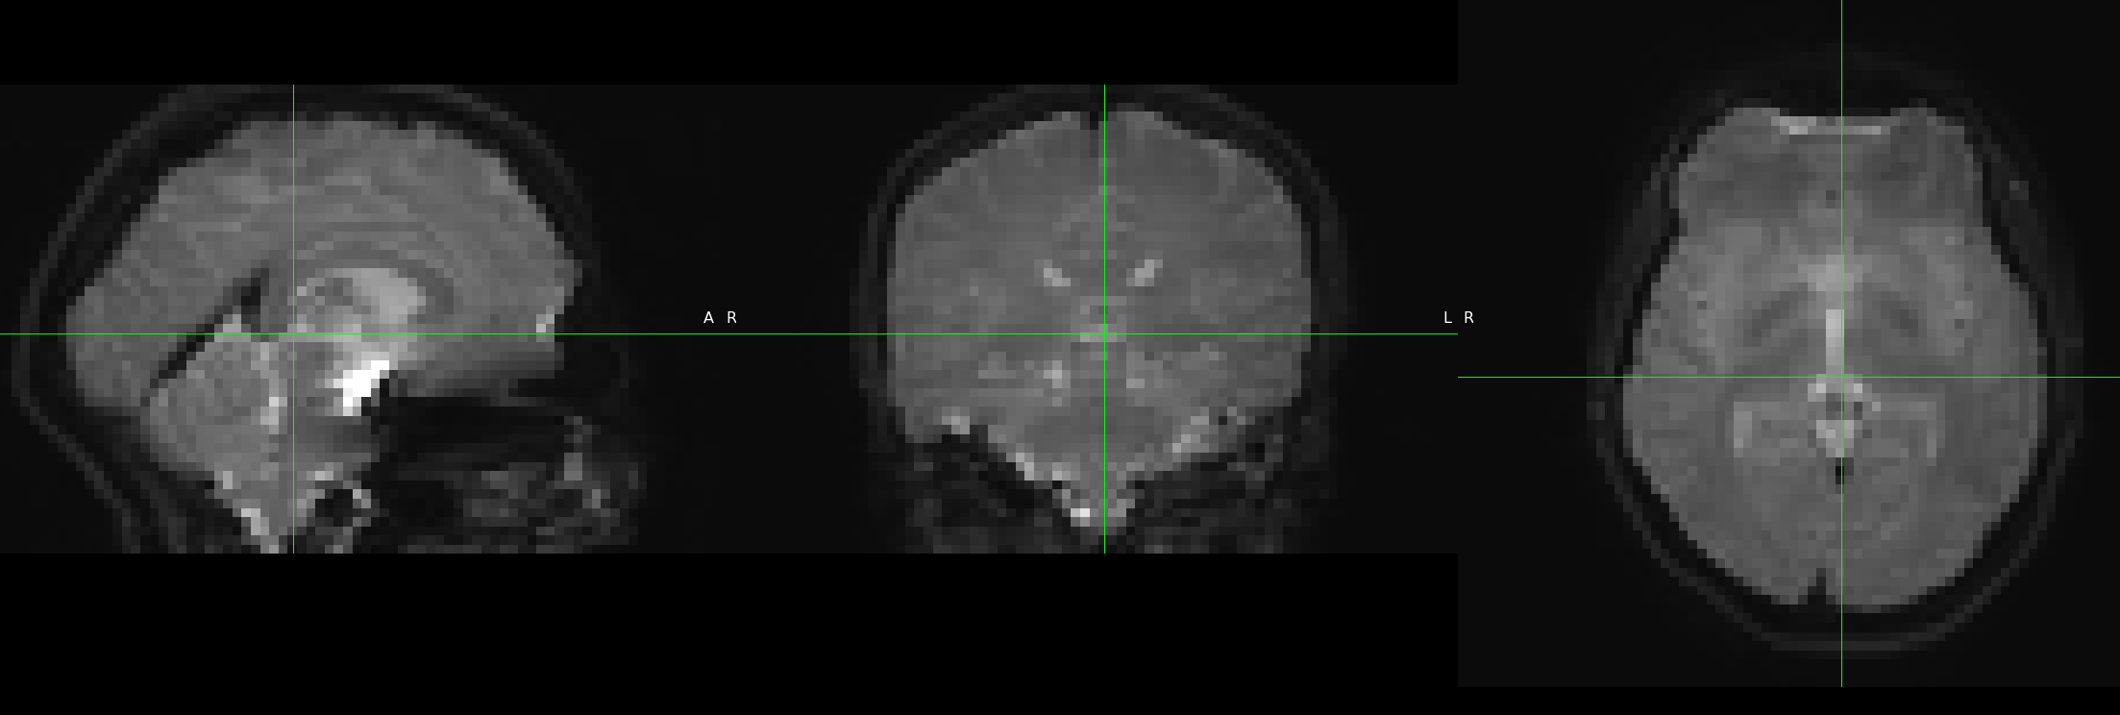
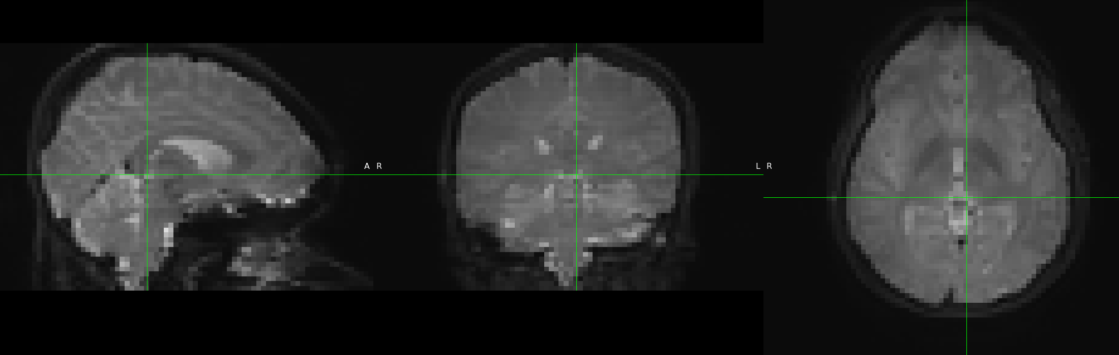
Susceptibility Distortion Correction
Shape of the brain can be distorted when using a fast EPI sequence
Two methods for correction:
fieldmap
collect an extra scan of the Bo field
use FSL FEAT to correct EPI images
SE-EPI_A Anterior >> Posterior
topup
requires an extra dataset collected with the reverse phase-encoding direction
Generally 2 spin-echo EPI sequences are collected, one with each phase-encoding direction
SE-EPI_P Posterior >> Anterior

Slide 20
Topup
0 -1 0 TotalReadoutTime
0 1 0 TotalReadoutTime
create acq_params.txt file:
fslmerge -t output_bold_PA_AP_B0 input_epi_PA input_epi_AP
topup --imain= output_bold_PA_AP_B0 --datain=acq_params.txt --config=b02b0.cnf --out=_rs_topup --fout=_topup_field
applytopup --imain=input_bold --inindex=1 --method=jac --datain=acq_params --topup=…_rs_topup --out=output_bold_corrected
Note: topup requires an even number of slices to run
Echo Spacing * 0.001 * EPI factor
Anterior ← Posterior = 1
Anterior → Posterior = -1

Slide 21
Slice Timing Correction
Interleaved slice acquisition is preferred to diminish cross talk between slices
Spatially adjacent slices are not acquired at the same time so need to correct for this
Use information from nearby timepoints to interpolate the BOLD signal relative to a reference timepoint
can introduce ringing effects and noise spreading
At short TRs, not as necessary
Finicky to do with multiband data

Slide 22
Brain Extraction
Similar to previous BET step but -f factor may need to be modified
Can also use bet to create a whole brain mask to be used later
use the -m option

Slide 23
Temporal Filtering
3 filter types
high-pass
allows high frequencies through but not low frequencies (e.g. cardiac and breathing motions)
low-pass
allows low frequencies through but not high frequencies
not recommended
band-pass
attenuates both high and low frequencies
Shorter TRs can help resolve physiological noise
Shorter TR = higher sampling rate
Increased noise via multiband effects
Increased autocorrelation (physiological cleaning helps)

Slide 24
Denoising
One method is independent component analysis (ICA)
ICA groups data into components that are least correlated with each other
These components will resemble sources of signal, noise or both
Signal
BOLD effect
Noise
Motion
Tissue of no interest
Physiological effects
artefacts
Mixed
Task-correlated motion/signal
Vasculature and signal
Multiband and signal

Slide 25
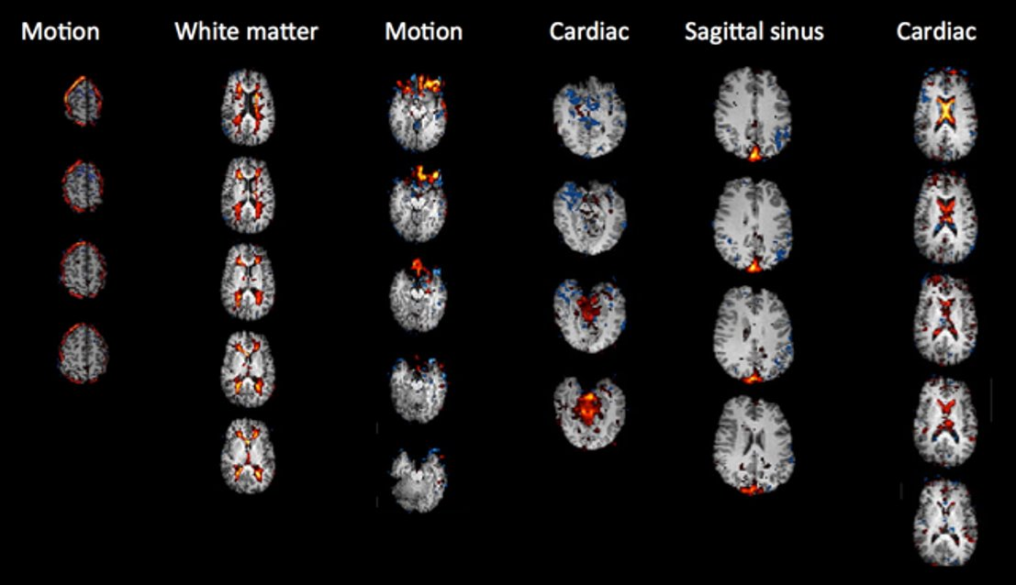
Denoising: Example Noise Components

Slide 26
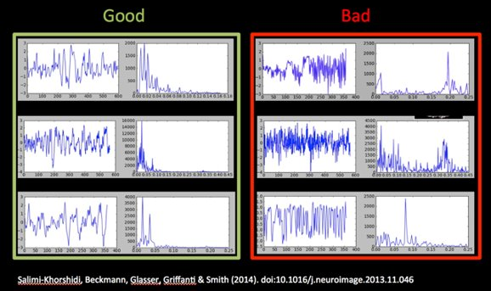
Denoising
Power Spectra
Power Spectra
Timeseries
Timeseries

Slide 27
ICA Denoising
Pros
fairly robust separation of signal and noise
can keep mixed components rather than just throwing away anything with motion contamination
less aggressive denoising
Cons
subjective classification of components
Software for ICA denoising
ICA-AROMA (fully automated)
ICA-FIX

Slide 28
Denoising
After categorising the components as signal, noise or both, we regress out the noise
best to use non-aggressive partial regression to only remove true noise (and keep mixed signal)
fsl_regfitl -i filtered_func_data -o denoise_data -d filtered_func_ data.ica/melodic_mix -f “#,#,#”
component numbers labelled as noise

Slide 29
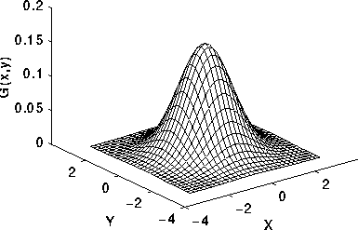
Spatial Smoothing
Reduce high frequency spatial components
Helps with multiple comparison problem
Increases SNR per voxel
Usually use a gaussian filter with width from 4-8mm
Important not to over smooth or might lose signal differences
Decisions of smoothing are dependent upon data quality, preprocessing steps and intended analyses

Slide 30
Spatial Normalisation
Move each participant brain into a “standard space”
MNI most used standard space
Usually done in 3 steps
register functional to structural
register structural to standard
concatenate registration matrices to bring functional to standard
Remember though that normalisation does not equal 1 to 1 voxel matching
In pathological and older brains (large ventricles) this is even more true
There is a great deal of individual variation in brain organisation

Slide 31
Even more processing steps possible
Linear detrending
Despiking
Intensity normalization
Nuisance regression
And more…

Slide 32
Order of processing debate
The order in which some of these steps are done is still under debate
The order I present here (in bold) is based on what the fMRI brain camp suggested
Motion correction before or after distortion correction
Slice timing correction vs. modelling a temporal derivative
Filtering before or after data denoising via independent component analysis
Highpass filtering vs bandpass filtering
Smooth data before or after denoising
Registration: move functional data to structural space or structural data to functional space

Slide 33
Preprocessing using FEAT
FSL has a package that does the preprocessing steps in a gui
called FEAT
Feat &
There are a lot of things to set-up which were described in the fMRI brain camp. If you want to go this route I would suggesting attending the next camp
Feat also allows you to do subject level statistics

Slide 34
fMRIprep: another preprocessing pipeline
more automated but less customisable than fsl
provides a reuseable framework for analysis
install as docker or singularity container
fmriprep input_BIDS_data/ output_dir/ participant –w working_dir/

Slide 35
Next Meeting
When: Nov 29th
Time: 3:30-4:30pm
Topic: Magnetic Resonance Spectroscopy Analysis with LCModel

