Slide 1
White Matter Hyperintensities
UBC MRI Research Analysis Meeting
Apr 2, 2025

Slide 2
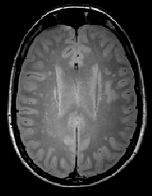
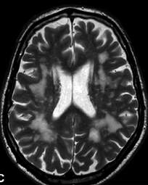
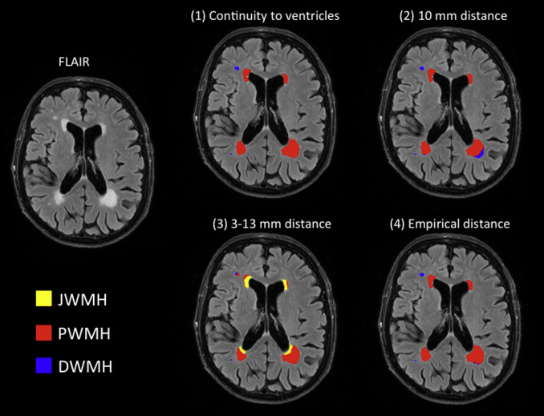
What are WMH?
Areas of increased signal on PD, T2W and FLAIR
Proton Density
T2-weighted
FLAIR

Slide 3
What causes WMH?
cardiovascular diseases
hypertension
diabetes
migraine
infections
inflammatory conditions
multiple sclerosis
genetic disorders
leukodystrophy

Slide 4
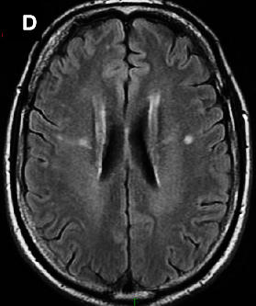
Should we worry about WMH?
Depends on your question
Can be small compared to rest of tissue so won’t really affect anything
Can have different histology (e.g. demyelination) than surrounding tissue and therefore affect MRI signal
May appear dark on T1W and thereby excluded from white matter segmentation
FLAIR can overcall WMHs

Slide 5
Segmentation of WMH
Segmentation

Slide 6
Segmentation of WMH
Gold standard
Manual segmentation
Semi-automated segmentation
Identify WMH with basis points and then automatically grow the hyperintense area
Machine Learning
Algorithms trained on segmented images
We’ve used the algorithm MIMoSA (Method for Inter-Modal Segmentation Analysis)
reference: Valcarcel AM et al. J Neuroimaging. 2018;28(4):389-398. doi: 10.1111/jon.12506.
Others: Synth-seg with freesurfer, TRUENET with FSL toolbox, LesionTOADS

Slide 7
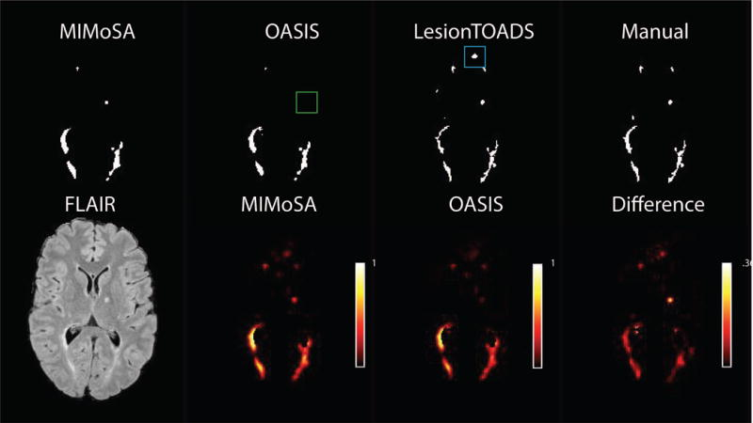
MIMoSA
MIMoSA
requires:
PD
T2W
FLAIR
T1W
(although might still work if missing a modality)
Limitations: Worse at detecting small lesions, trained at 3T on Siemens data

