Slide 1
Magnetic Resonance Spectroscopy Analysis with LCModel
Irene Vavasour
Nov 29, 2023
UBC MRI Research Monthly Meeting
And Big Thank-you to Erin for many of the slides!

Slide 2
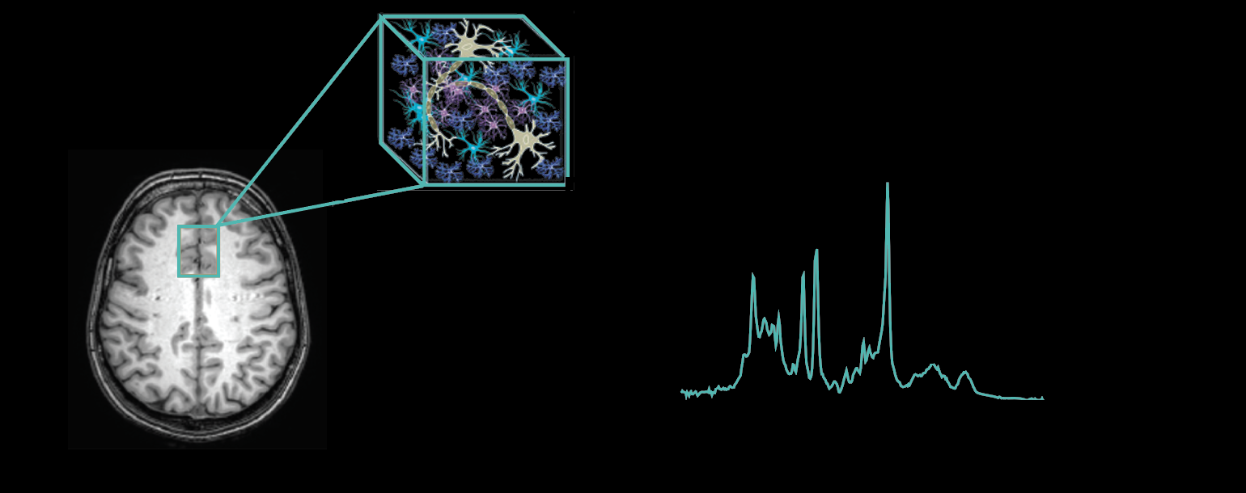
Magnetic Resonance Spectroscopy

Slide 3
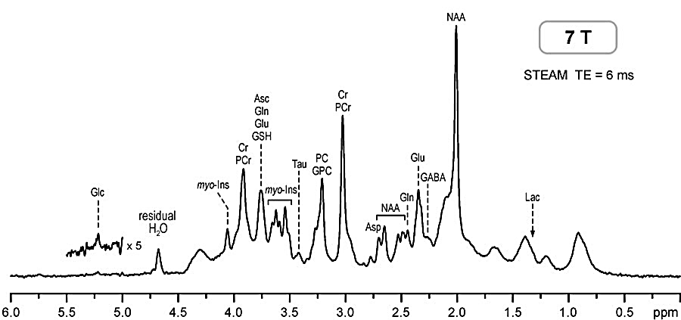
What can we detect with MRS?
NAA
3T MRS can detect chemicals involved in…
Neuronal “integrity”:
N-acetylaspartate (NAA)*
Cell energetics:
Creatine & phosphocreatine (tCr)
Lactate
Membrane turnover:
Choline compounds (Cho)
Lipids
Glial cell density:
Myo-inositol (mI)
NAAG
Glu
Gln
GSH
tCr
Cho
GABA
tCr
mI
Glu
Lipids
mI
Gln
NAA
Lactate
[Water]
6.0
5.0
4.0
3.0
2.0
1.0
ppm
de Graaf. In Vivo NMR Spectroscopy: Principles and Techniques, 2019
*Nordengen et al. Brain Struct Funct 2015

Slide 4
What can we detect with MRS?
NAA
3T MRS can detect chemicals involved in…
Neurotransmission:
N-acetylaspartylglutamate (NAAG)
γ-aminobutyric acid (GABA)
Glutamate (Glu)
Glutamine (Gln)
Anti-oxidant reserve:
Gluthione (GSH)
NAAG
Glu
Gln
GSH
tCr
Cho
GABA
tCr
mI
Glu
Lipids
mI
Gln
NAA
Lactate
[Water]
6.0
5.0
4.0
3.0
2.0
1.0
ppm
de Graaf. In Vivo NMR Spectroscopy: Principles and Techniques, 2019
*Nordengen et al. Brain Struct Funct 2015

Slide 5
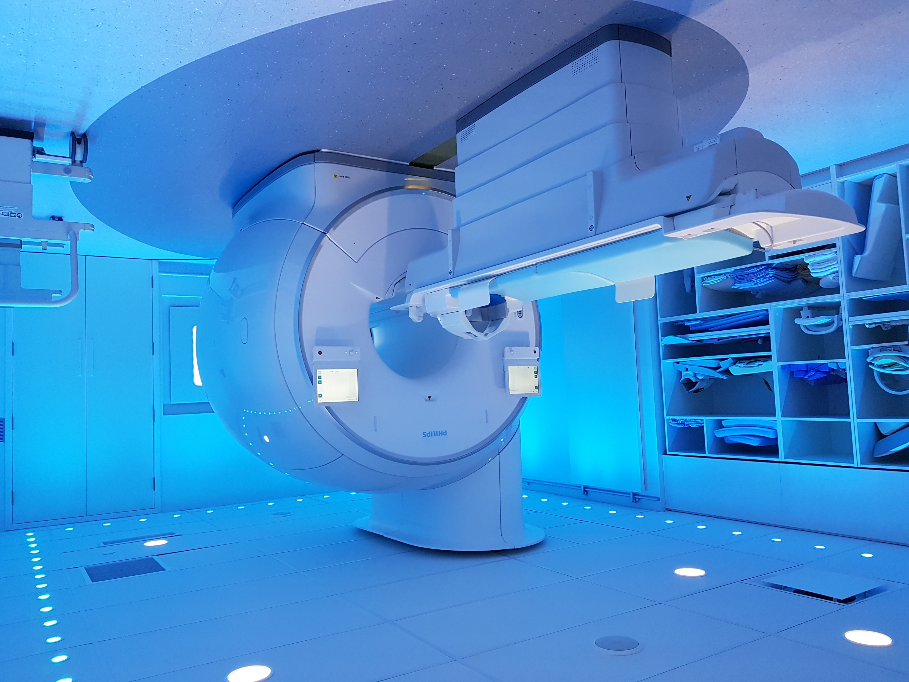
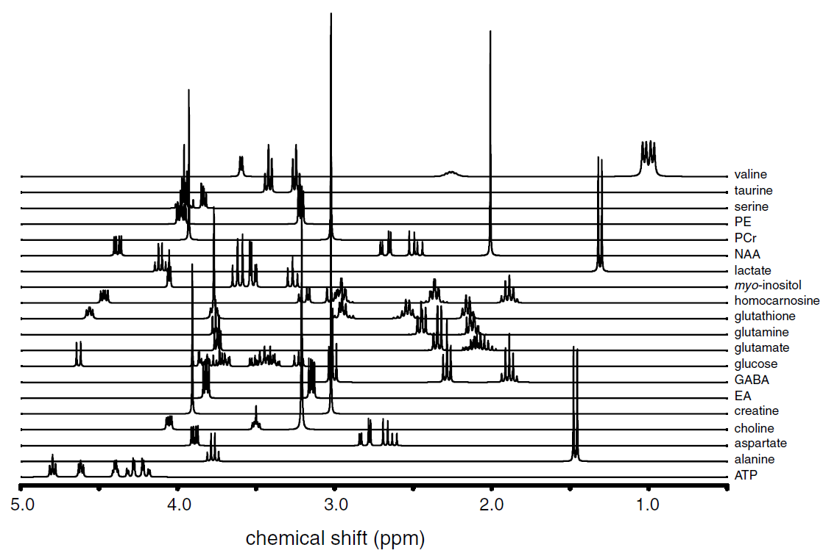
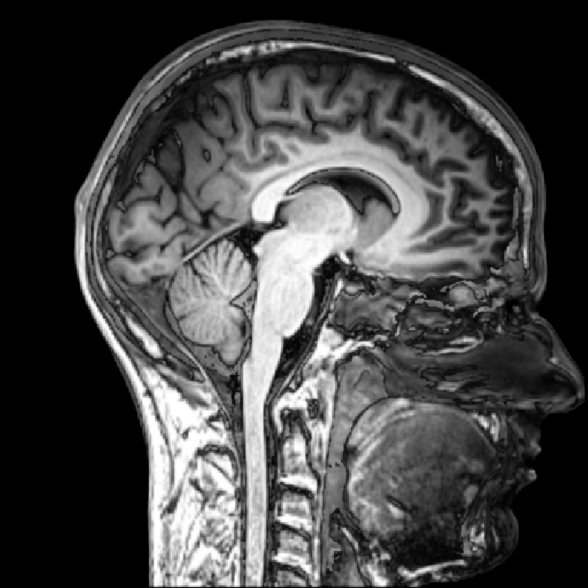


Acquisition of MRS
Data Processing
FFT
Export data
Freq Align
Average
Water Suppression
Localization
Fitting
MRS voxel
Quantification
$$\frac{NAA}{Water}$$
$$\left[NAA\right]=8.5 mM$$

Slide 6
Water Suppression
[H2O] ~5000x > [NAA]
x100

Slide 7
Water Suppression
Necessary to remove overlap of water tail and metabolites
Modern scanners cannot handle the dynamic range
Cannot sensitively measure metabolites at the same time as water
Several water suppression options:
Inversion
Excitation
VAriable Pulse powers and Optimized Relaxation delays (VAPOR)

Slide 8
Voxel Localisation
Several localization options:
Point RESolved Spectroscopy (PRESS)
Stimulated Echo Acquisition Mode (STEAM)
Localization by Adiabatic Selective Refocusing (LASER)
Image Selected In vivo Spectroscopy (ISIS)

Slide 9
Semi-laser MRS localisation acquisition
4 adiabatic full passage pulses – longer TEs
Adiabatic pulses - sharp chemical shift displacement
Adiabatic Full Passage
90°
Selective
echo
NAA
Cr
…TR
RF
TE
Gx
Gy
Gz

Slide 10
MRS data pre-processing
Goal: improve spectral quality prior to fitting
Fitting algorithms are very sensitive to spectral quality
Export each individual shot
Phase and frequency alignment
Averaging
Measures of spectral quality:
SNR=
Linewidth: Full width at half maximum (FWHM)
FWHM
÷ SD[ ]
6.0
5.0
4.0
3.0
2.0
1.0
ppm

Slide 11
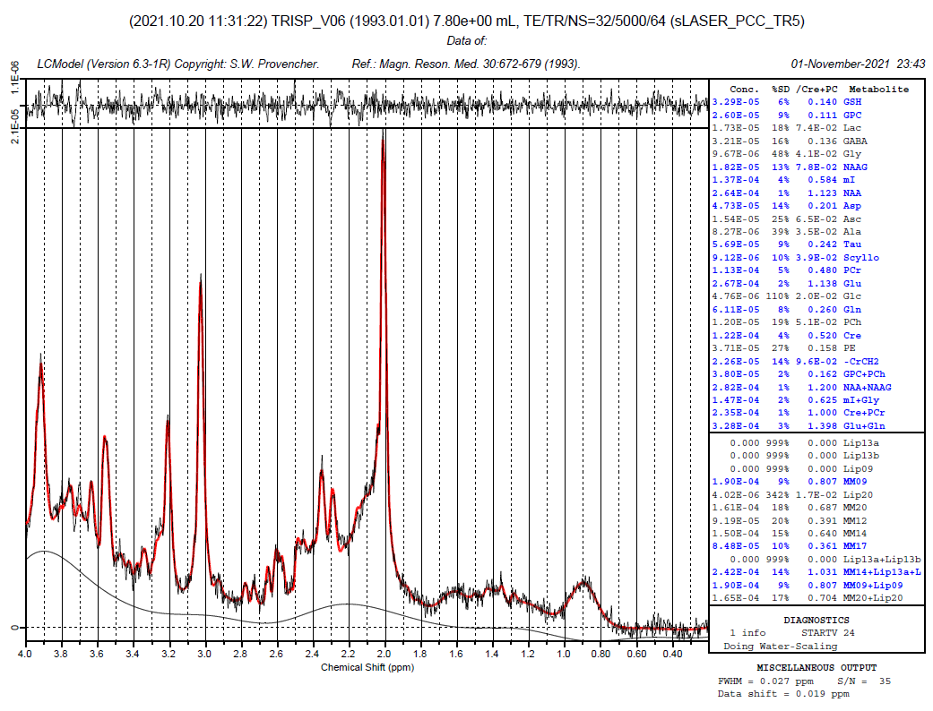
MRS spectral fitting (LCModel)

Slide 12
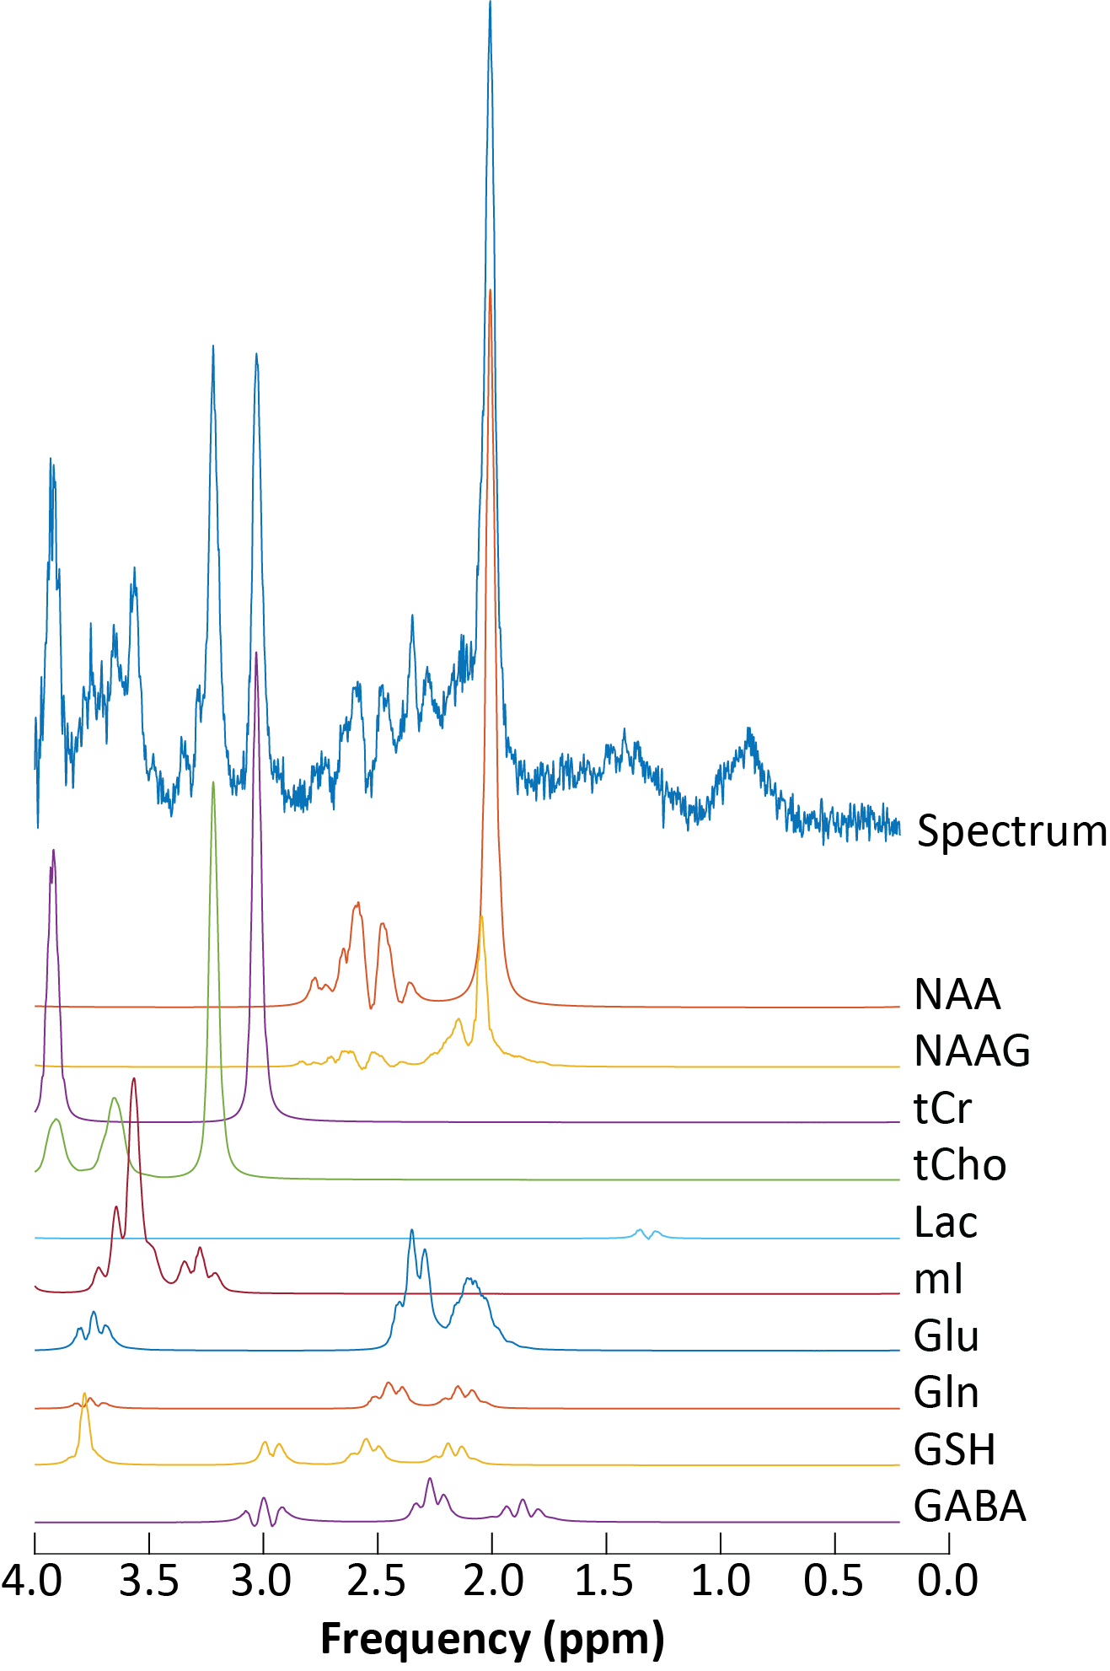
LCModel
Created by Stephen Provencher
uses a linear combination of basis sets to fit the spectrum
the area under each individual metabolite spectrum is related to the concentration
Download information and manuals can be found here:
http://s-provencher.com/lcmodel.shtml

Slide 13
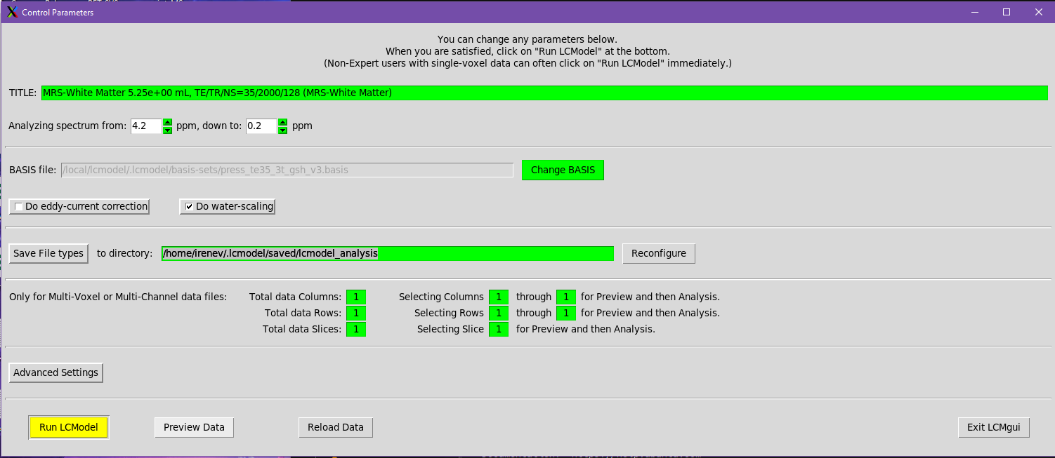
To run LCModel
.lcmodel/lcmgui &
Pick the metabolite file (_met.SDAT or _act.SDAT)
Make sure your basis set matches your localisation technique and TE
Location to save data
Look here to edit Control Parameters

Slide 14
Using LCModel
Parameters to modify
atth2o=1
attmet=1
subbas=F
key=210387309
wconc=1
key=210387309
choose reference file (_wat.SDAT or _ref.SDAT)

Slide 15
LCModel output

Slide 16
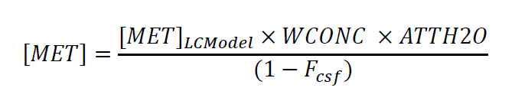
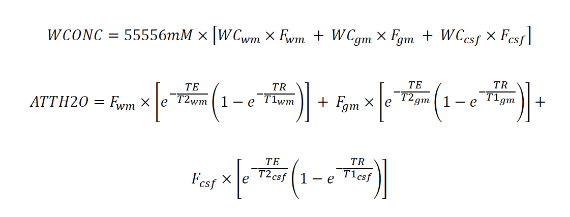
Absolute Quantification
The values that come out of LCModel do not take into account water relaxation times and differences in tissue concentrations

Slide 17
Tissue segmentation
The concentration of metabolites is different in WM, GM and CSF so need to correct
Steps
Segment the brain into WM, GM, CSF (and lesion)
I usually use FAST from FSL on the 3DT1
Localise the MRS voxel onto the 3DT1
We’ve been using some Philips matlab code to do this but recently also implemented it using a python package called suspect
Extract the fraction of WM, GM, CSF (and lesion) within the MRS voxel

Slide 18
Calculating WCONC
MRS voxel fractions of tissue
Expected tissue water contents taken from literature¹
WC_{wm} = 76.4%
WC_{gm} = 82.0%
WC_{Ccsf} = 99.0%
WC_{MS_lesion} = 82.7%
¹MacMillan et al. MSJ 2015

Slide 19
Calculating ATTH2O
Literature values for water relaxation times¹
 | White Matter | Grey Matter | CSF | MS Lesion
T₁ (s) | 1.00 | 1.42 | 3.00 | 1.23
T₂ (ms) | 70 | 75 | 500 | 93
¹MacMillan et al. MSJ 2015

Slide 20
Metabolite relaxation effects
Metabolites also have different relaxation times but usually the values are not know
To minimise effect:
use long TR
≥4s
use short TE
~35ms

Slide 21
Error measurement
LCModel outputs a Cramer-Rao Lower Bounds as a %SD
Often a cut off of 20%-30% is used say data is OK
But this value will be dependent on the mean so could bias the results for higher concentrations
better to use absolute error (AE) = CRLB% * [metabolite]
reject anything with an AE higher than 30% of the median concentration value from all participants^{1,2}
¹MacMillan et al. Mult Scler J Exp Transl Clin, 2019. ²Kreis Magn Reson Med, 2016.

Slide 22
Other MRS analysis packages
LCModel has been the go to analysis package for MRS for many years but Provencher has retired so no new updates will be made
Many other analysis packages
Tarquin
Gannet
Osprey
JMRUI
FSL-MRS (new but combines the FSL tools with MRS)
…

Slide 23
Multi-nuclear MRS
Upgrades to the Philips scanner in Dec 2023 will allow multi-nuclear capabilities
²³Na and ³¹P available
¹³C, ¹²⁹Xe, ¹⁹F if someone buys the coil

Slide 24
Next Meeting
When: Feb 7th
Time: 3-4pm (or maybe 3:15-4:15)
Topic: Artefacts

