Slide 1
Recruitr
Sports never had a talent problem.
It had a visibility problem.
DEMO DAY · May 12, 2026

Slide 2
Every athlete has a camera
in their pocket. None of them
have a direct line to the coaches
who need to see them.
The athletes who get opportunities aren't the best.
They're the most connected.
That's a system-wide problem, and it
compounds at every level.

Slide 3

THE PROBLEM
Talent discovery is broken
at every level.
We get 250 recruiting emails a day.
We watch maybe 1–2 players in full.
— Tobias Esche, Assistant Coach, Columbia University Men’s Soccer
Coaches are drowning. Athletes are invisible.
Film goes to YouTube and dies.

Slide 4
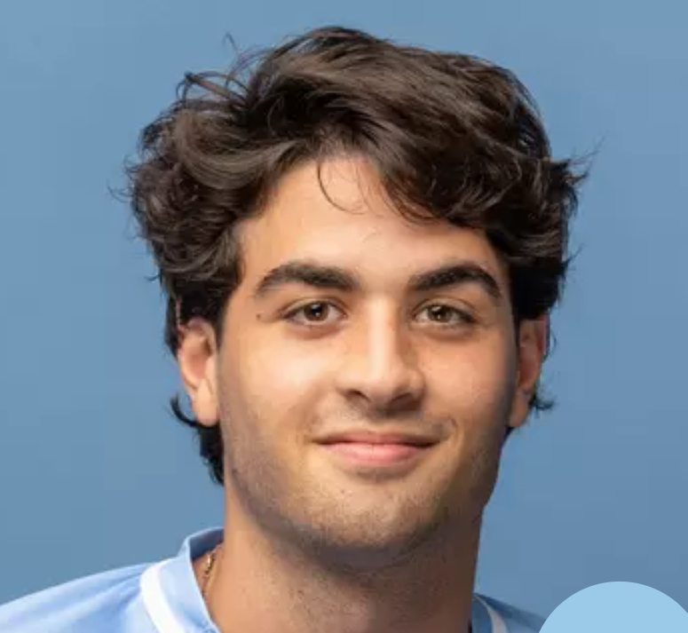


THE TEAM
Why us, for this.
[Photo]
Joao Pedro Lima
Cam Wilson
Benjamin Sidley
Co-founder, Product
Co-founder, Engineering
Co-founder, Growth
Division 1 Athlete
CS @ Columbia
AI @ Accenture
IT Engineer @ Columbia Tech Ventures
CS @ Columbia
Golfer
Division 1 Athlete
CS @ Columbia
Data Analytics @ Stone Street

Slide 5
WHY NOW
There isn’t a better time to build this.
01
Athletes already film everything
Video-first is the default. Every athlete has a highlight reel on their phone.
02
Social Media + NIL + transfer portal blew the market open
Recruiting is not just high school → college → pro. It’s every level, every direction.
03
Camps and networks can’t scale
Coaches need digital discovery tools. The old system tops out.

Slide 6
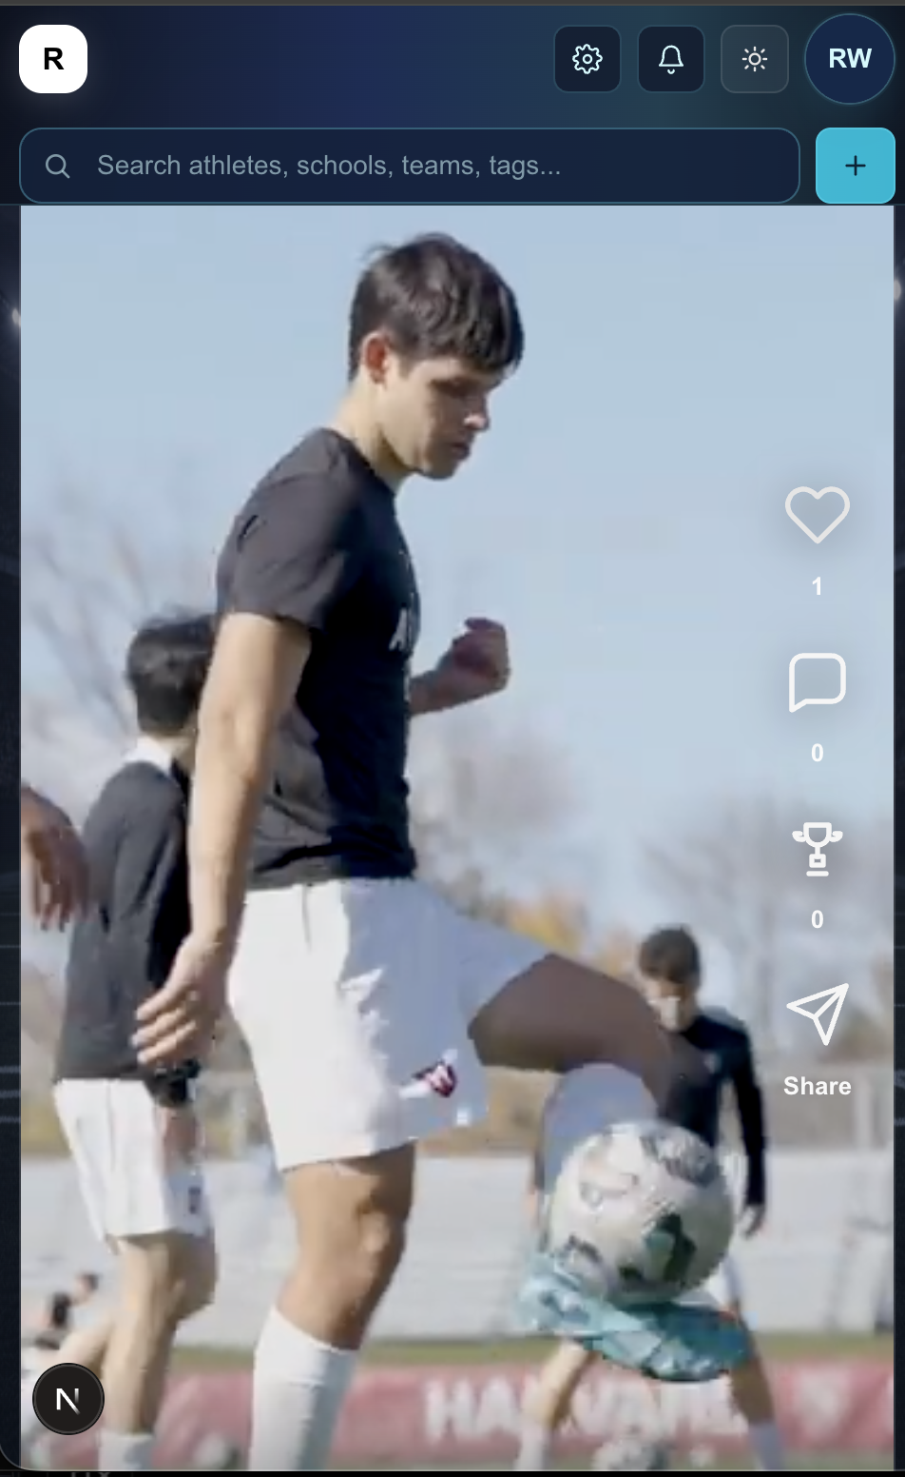
THE SOLUTION
Athletes build video profiles.
Coaches discover them.
A ranked feed surfaces athletes by sport,
position, and fit. Verified coaches search,
shortlist, and message directly.
One platform replaces highlight tapes,
cold emails, spreadsheets, and guesswork.

Slide 7
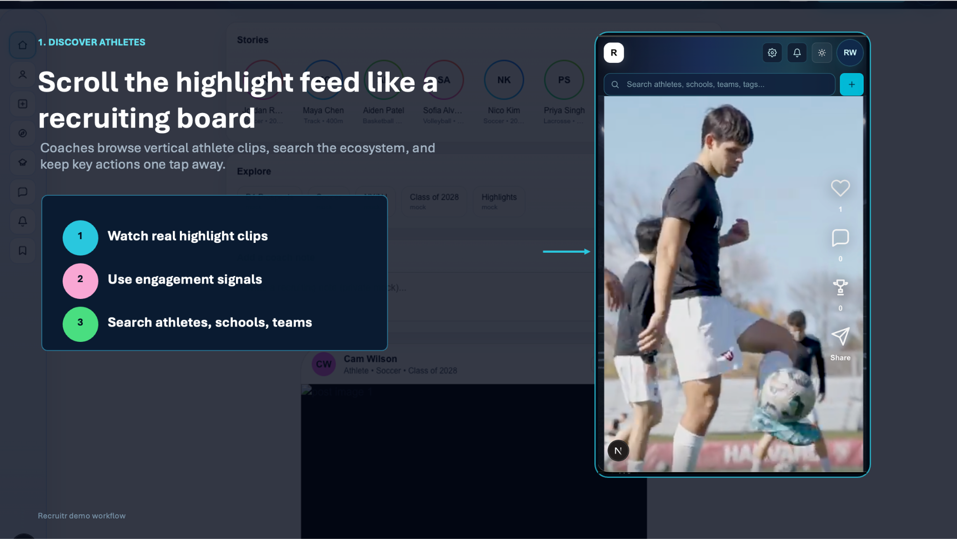

Slide 8
MARKET
$1.3B
TOP-DOWN · Global sports recruiting software market (2025)
Growing to $3.4B by 2035 at 10.1% CAGR
$120M
BOTTOM-UP · 50K coaches × $200/mo × 12 = $120M addressable
2,000+ programs across NCAA, NAIA, NJCAA · 8M high school athletes · 600K+ college athletes.

Slide 9
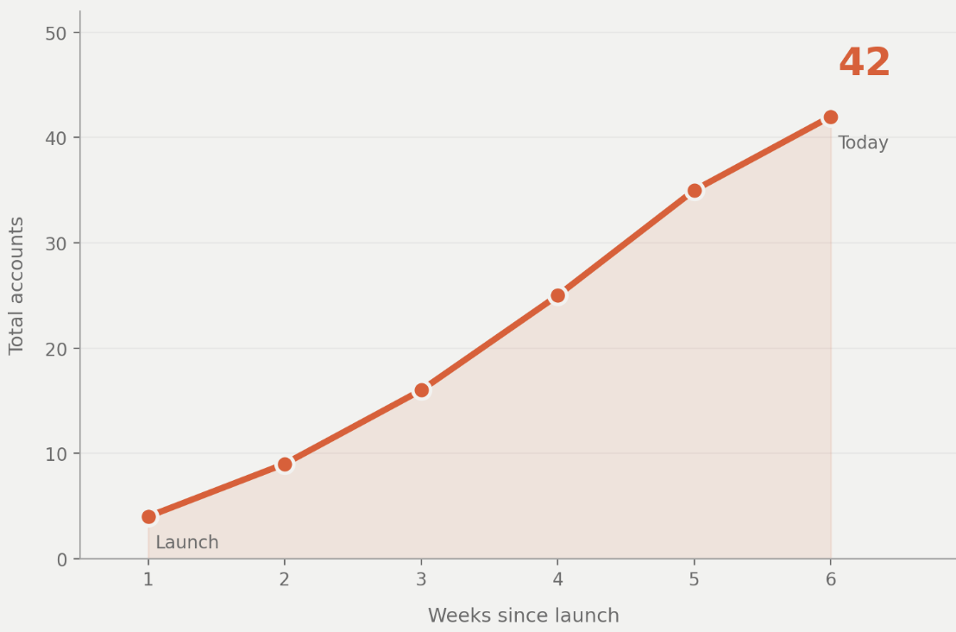
TRACTION
Where we are now
42
Active users
7
User testing sessions
5
Sports represented
9
Coach signups

Slide 10
BUSINESS MODEL
How the money works.
Who pays?
Coaches and programs. Athletes join for free
Pricing
SaaS: search, shortlists, messaging, workflow
Per seat
$200 / month per program, billed annually
Gross margin
80%+ software margins

Slide 11

COMPETITIVE LANDSCAPE
What exists today
and what’s missing.
NCSA / Hudl
Database, not social. No two-sided discovery.
Recruitr’s wedge
Interactive social product
FieldLevel
College-only. No mobile-first experience.
Two-sided marketplace
YouTube / Twitter
No structure. Film dies in the feed.
Verified coach trust model
All levels, all sports
Spreadsheets + email
The real competitor. Doesn’t scale.
Workflow tools that replace spreadsheets

Slide 12

THE ASK
$100k pre-seed
Deploys to: native mobile app, coach acquisition, athlete seeding
Milestones: production recruiting loop, 50 paying coach accounts
Runway: 18 months

Slide 13
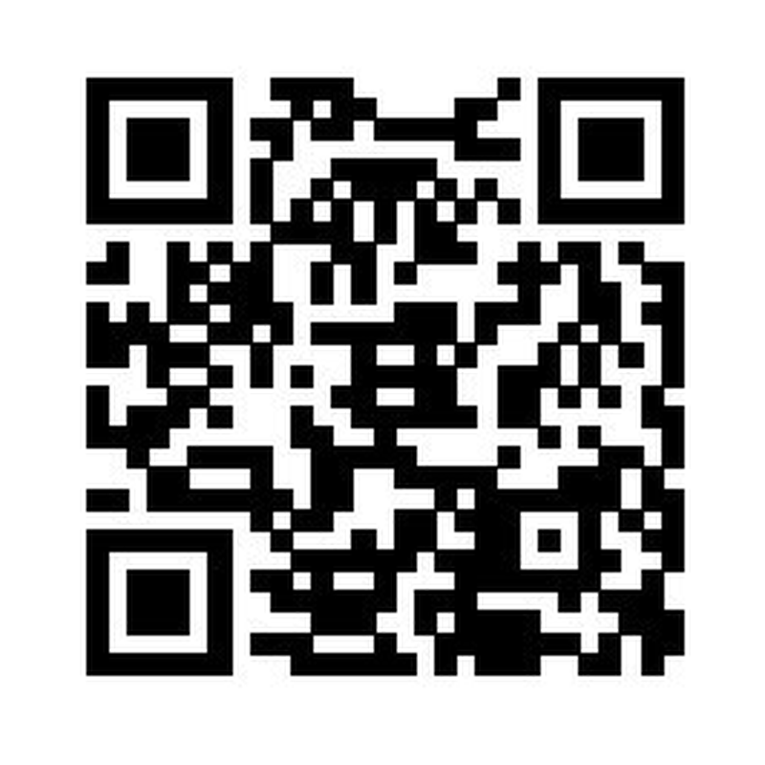
TRY IT
Try Recruitr.
Athletes — build your video profile in minutes
Coaches — discover verified prospects, message directly
Get Recruitr Now
Point your camera here

