Slide 1
Recruitr
Sports never had a talent problem.
It had a visibility problem.
DEMO DAY · May, 2026

Slide 2
Every athlete has a camera
in their pocket. None of them
have a direct line to the coaches
who need to see them.
The athletes who get opportunities aren't the best.
They're the most connected.
That's a system-wide problem, and it
compounds at every level.

Slide 3
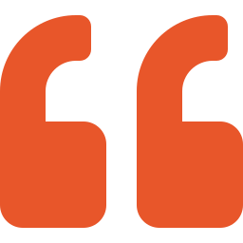
THE PROBLEM
Talent discovery is broken
at every level.
We get 250 recruiting emails a day.
We watch maybe 1–2 players in full.
— Tobias Esche, Assistant Coach, Columbia University Men’s Soccer
Coaches are drowning. Athletes are invisible.
Film goes to YouTube and dies.

Slide 4
WHY NOW
This couldn’t have been built
two years ago.
01
Athletes already film everything
Video-first is the default. Every athlete has a highlight reel on their phone.
02
Social Media + NIL + transfer portal blew the market open
Recruiting is not just high school → college → pro. It’s every level, every direction.
03
Camps and networks can’t scale
Coaches need digital discovery tools. The old system tops out.

Slide 5
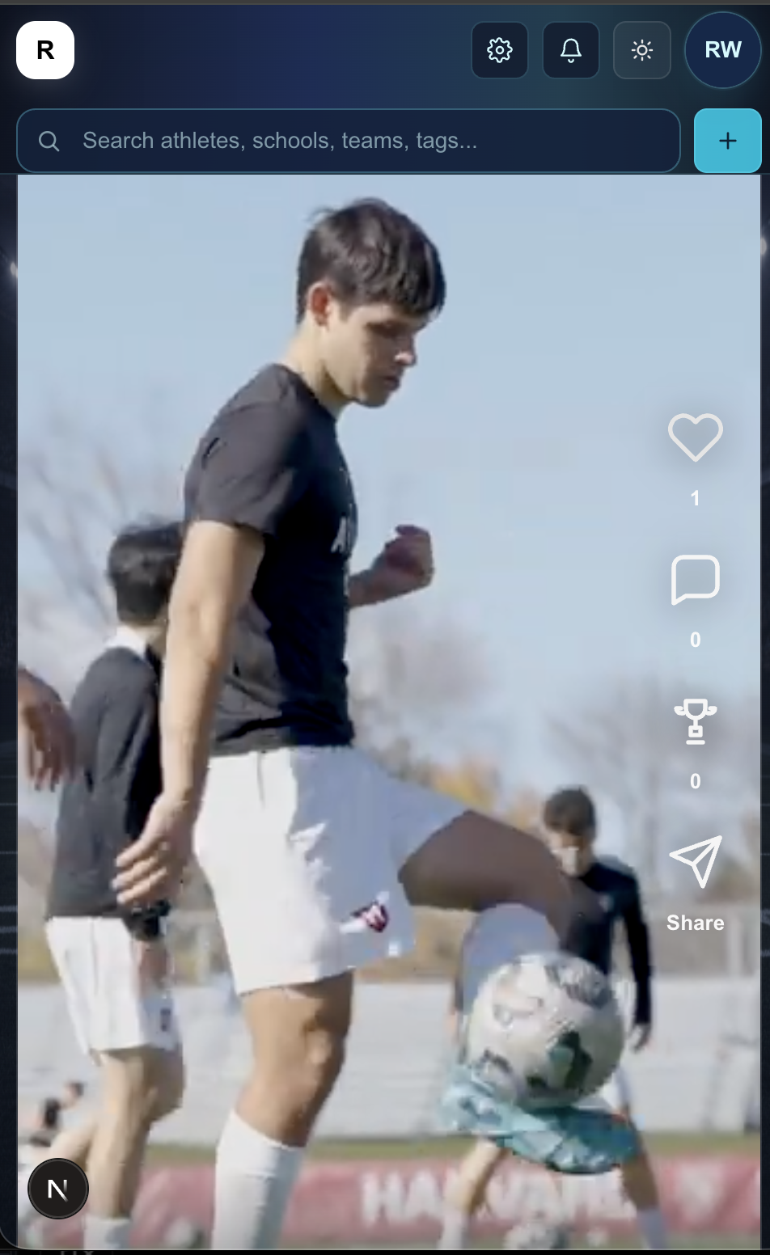
THE SOLUTION
Athletes build video profiles.
Coaches discover them.
A ranked feed surfaces athletes by sport,
position, and fit. Verified coaches search,
shortlist, and message directly.
One platform replaces highlight tapes,
cold emails, spreadsheets, and guesswork.

Slide 6
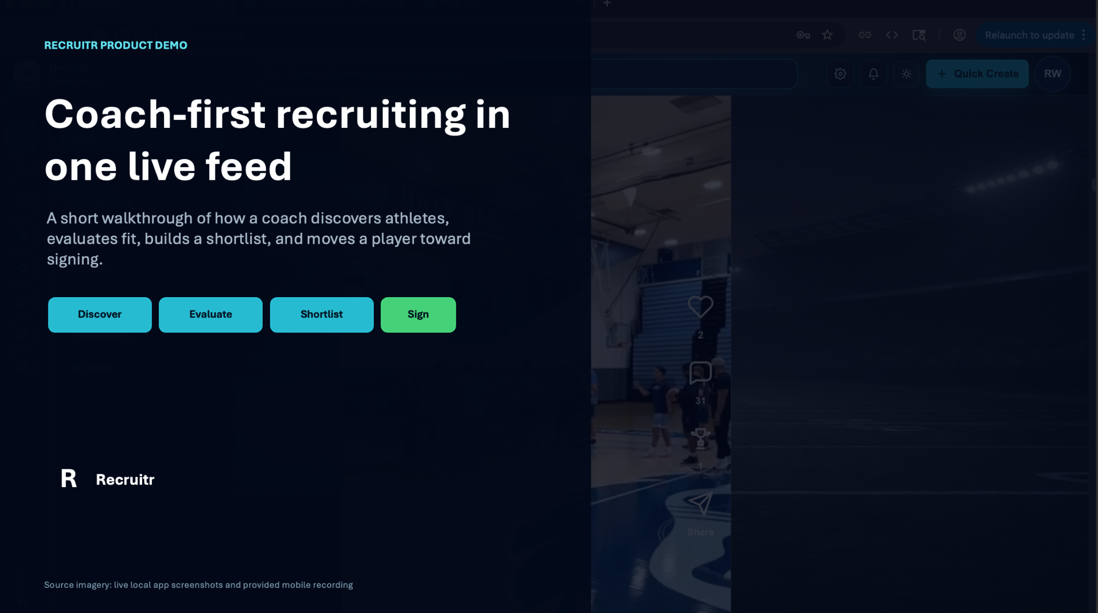
PRODUCT
[Walkthrough of the core action]
A coach finds their next player in minutes, not months.

Slide 7
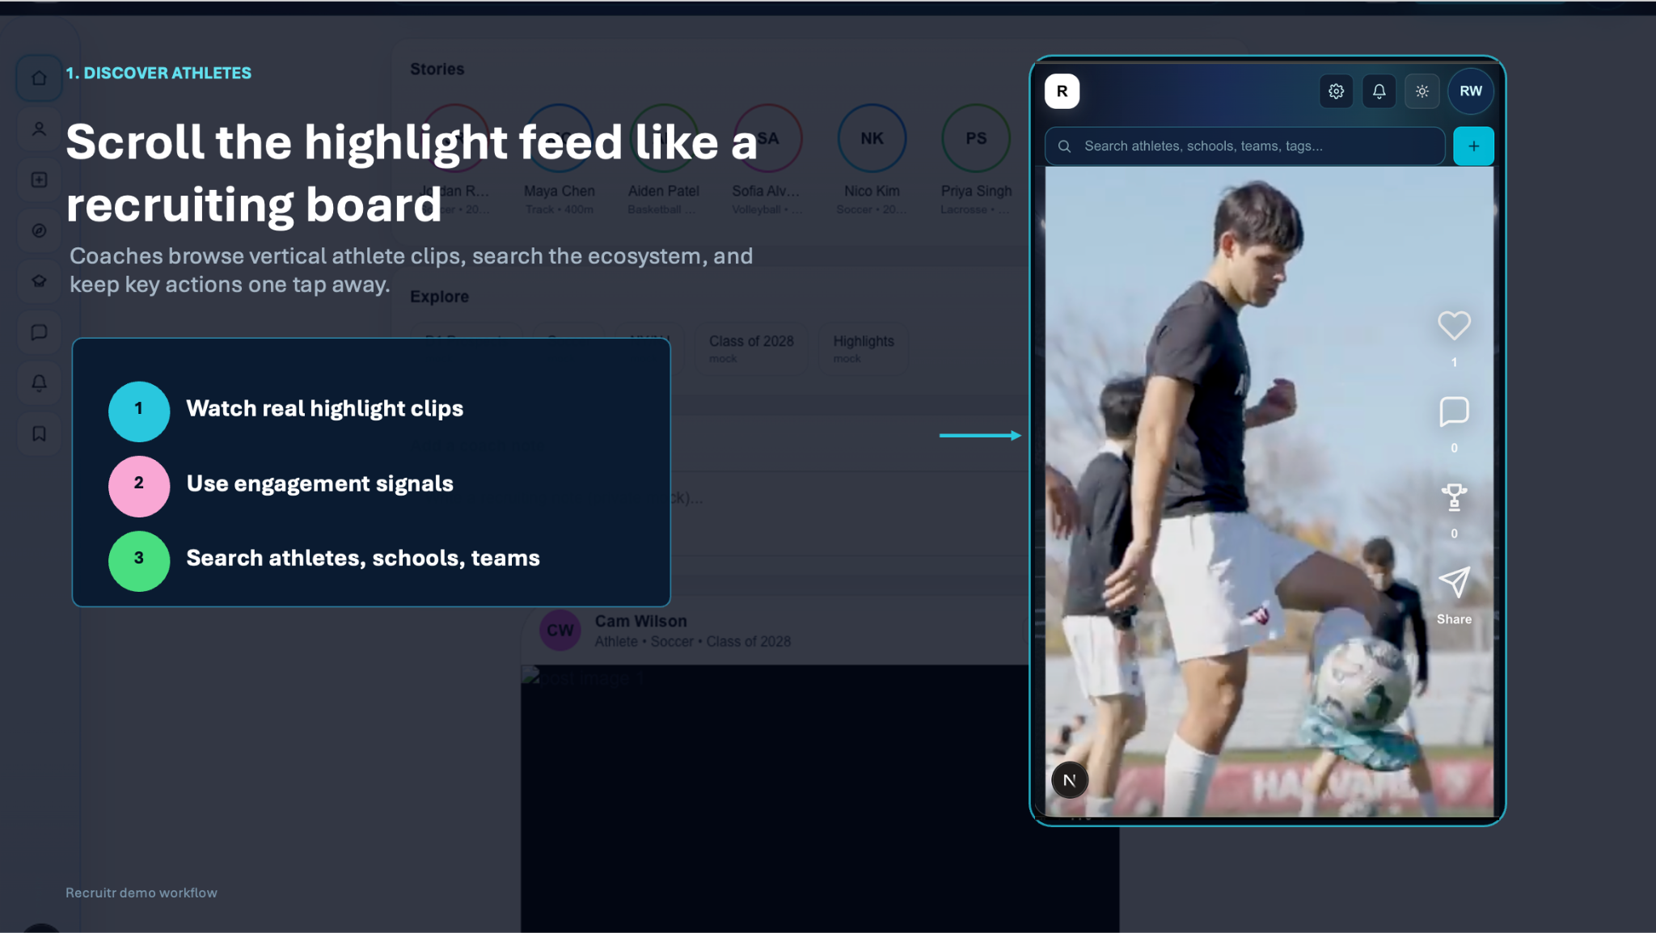

Slide 8
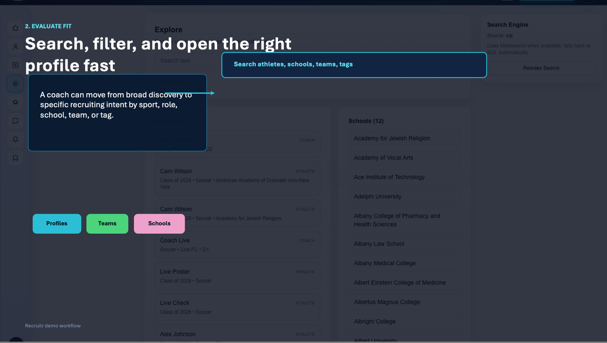

Slide 9
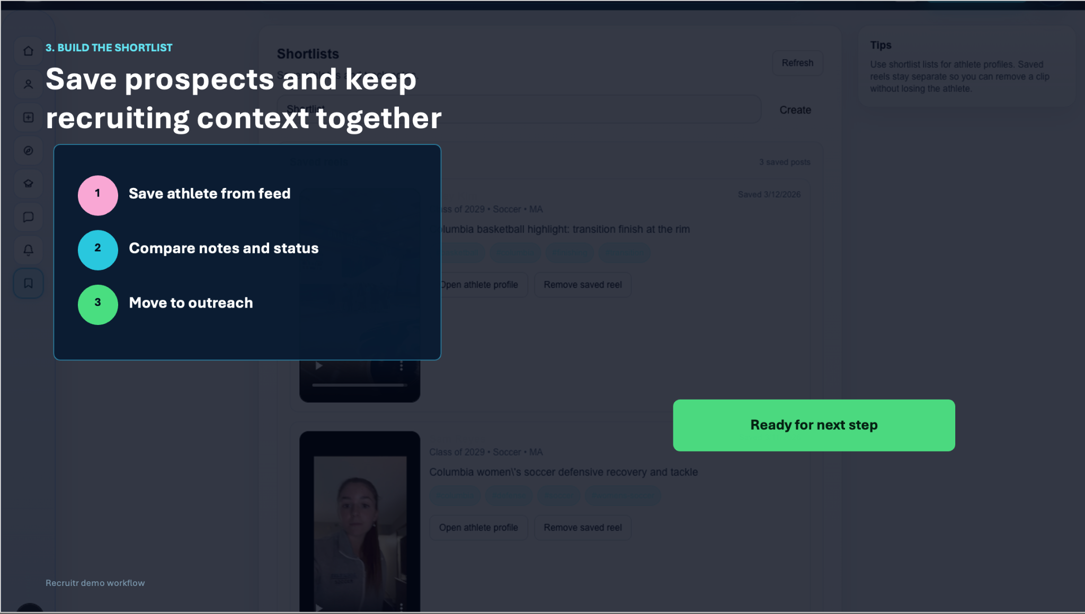

Slide 10
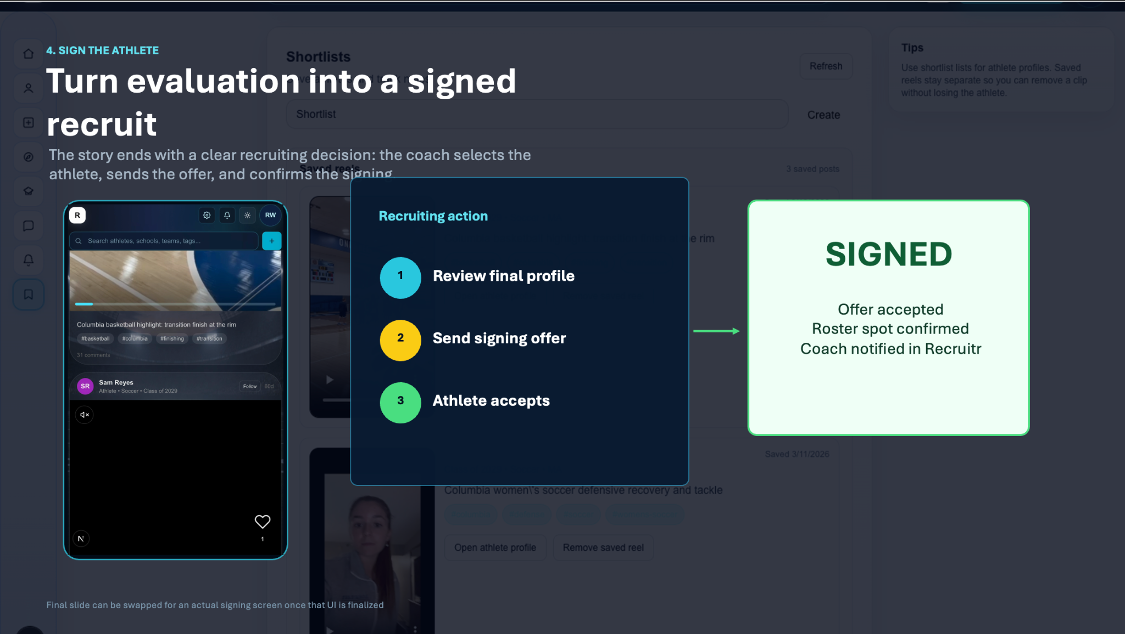

Slide 11
MARKET
$1.3B
TOP-DOWN · Global sports recruiting software market (2025)
Growing to $3.4B by 2035 at 10.1% CAGR
$120M
BOTTOM-UP · 50K coaches × $200/mo × 12 = $120M addressable
2,000+ programs across NCAA, NAIA, NJCAA · 8M high school athletes · 600K+ college athletes.

Slide 12
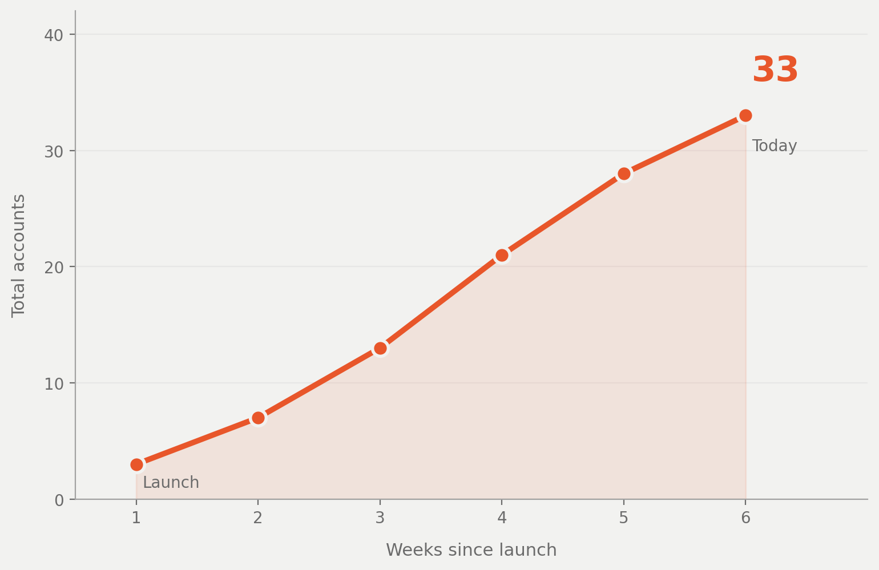
TRACTION
Show the slope, not the point.
33
Active users
6
User testing sessions
2
Sports represented
4
Coach signups

Slide 13
BUSINESS MODEL
How the money works.
Who pays?
Coaches, scouts, and programs. Athletes are free.
Pricing
SaaS: search, shortlists, messaging, workflow
Per seat
$200 / month per coach, billed annually
Gross margin
80%+ software margins

Slide 14

COMPETITIVE LANDSCAPE
What exists today
and what’s missing.
NCSA / Hudl
Database, not social. No two-sided discovery.
Recruitr’s wedge
Interactive social product
FieldLevel
College-only. No mobile-first experience.
Two-sided marketplace
YouTube / Twitter
No structure. Film dies in the feed.
Verified coach trust model
All levels, all sports
Spreadsheets + email
The real competitor. Doesn’t scale.
Workflow tools that replace spreadsheets

Slide 15
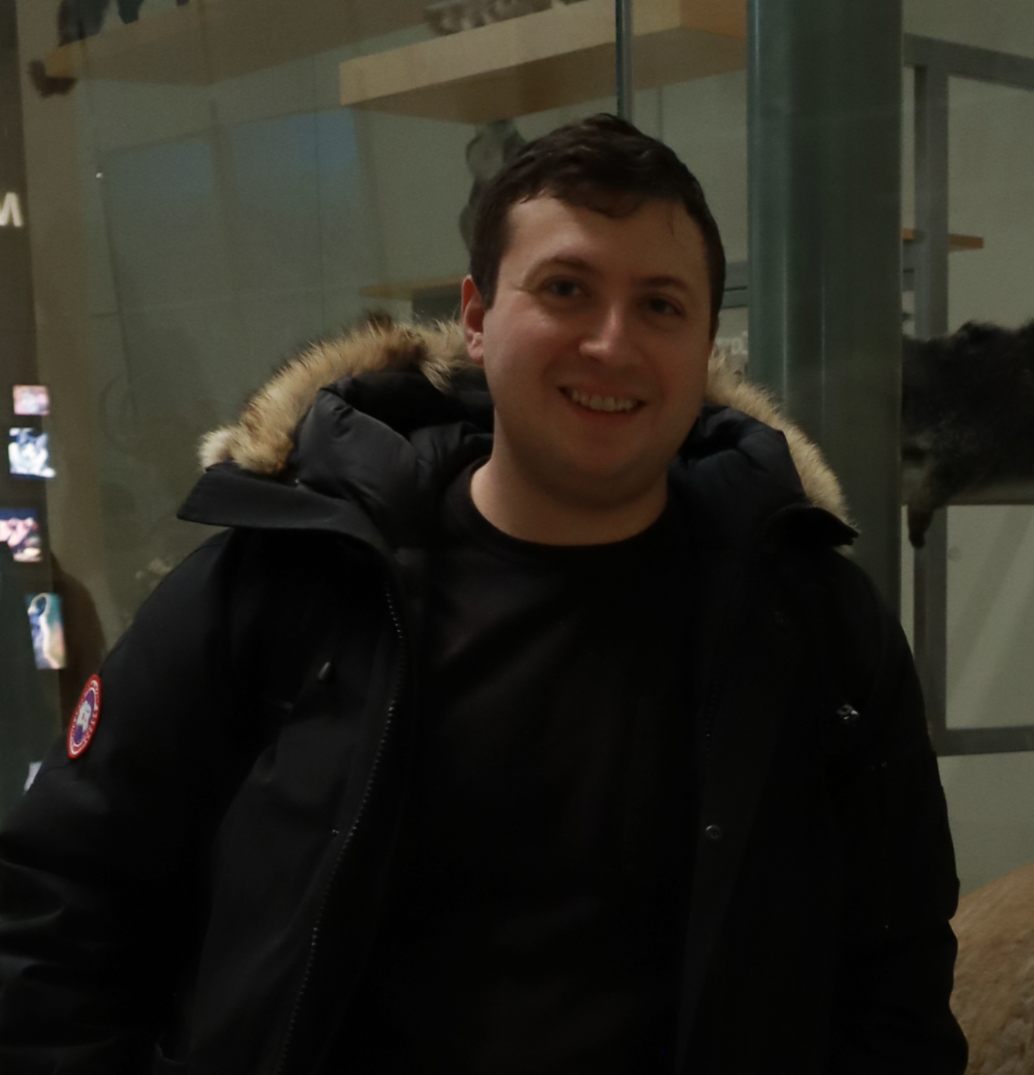
THE TEAM
Why us, for this.
[Photo]
[Photo]
[Photo]
Joao Pedro Lima
Cam Wilson
Benjamin Sidley
Co-founder, Product
Co-founder, Engineering
Co-founder, Growth
Division 1 Athlete
CS @ Columbia
Developer and Architect
Coach outreach
+ go-to-market

Slide 16

THE ASK
$500K pre-seed
Deploys to: native mobile app, coach acquisition, athlete seeding
Milestones: production recruiting loop, 50 paying coach accounts
Runway: 18 months
recruitr.app · team@recruitr.app

Slide 17
APPENDIX A · USER RESEARCH
What 6 sessions with athletes
and coaches told us.
01
Athletes stalled after signup
Both athlete testers finished signup but didn’t know building their profile was the next step. Fix: 3-step guided onboarding (photo → school → first highlight).
02
Coaches got blocked silently on messaging
An unverified coach hit our messaging gate with no explanation. Fix: inline copy explaining verification + a direct link to submit credentials.
03
Landing page didn’t convey what we do
0 of 4 participants could articulate what Recruitr is from the landing page. Fix: split-path landing (athlete vs. coach) with explicit value props and coach-verification explainer.

Slide 18
APPENDIX B · ROADMAP
What we’re building over the
next 8 weeks.
01
Real media upload pipeline
Phone-captured highlights persisting reliably to profile, feed, and DMs. MinIO now, Cloudflare Stream later. The supply side of the marketplace depends on this.
02
Mobile web before native
Athletes live on their phones. Fixing mobile-web layouts, tap targets, and the upload flow buys us the athlete experience without React Native cost.
03
End-to-end recruiting loop with real users
Demo Day target: one real athlete signs up, uploads a highlight, gets discovered by a real verified coach, receives a message, and replies. All real, no demo data.

Slide 19
APPENDIX C · MVP STATUS
What’s shipped vs. what’s next.
Backend
API endpoints live: auth, profiles, search, shortlist. 500+ NE schools seeded from IPEDS.
Frontend
Web app: feed, profiles, shortlists, in-app search via Meilisearch
Faked for now
Manual coach verification (school email check). Email-based DM until in-app inbox ships.
Next 8 weeks
Real video uploads (MinIO → Cloudflare Stream), mobile-web polish, end-to-end recruiting loop with real users.

Slide 20
APPENDIX D · RISKS & QUESTIONS
What could kill this
and how we’ll find out.
Video uploads
Highest-risk dependency. Phone uploads on slow networks must just work, or the supply side breaks.
What we’ll learn
Profile completion %
Coach adoption
Demand side requires trust. Slow to warm up; today driven by 1:1 outreach and warm intros.
Coach session frequency & depth
Profile completion
Drop-off rate from signup to first uploaded highlight is the metric we don’t yet measure. Instrumenting now.
Trust signal: is verification enough?
Athlete re-engagement trigger
Off-platform leakage
Recruiting moves to phone/visit once intro happens. Re-engagement hook for athletes is unproven.
Feed ranking signal quality

