Slide 1
eBPF Tools
Jules Irenge, Student, University of Manchester, LFX Mentee
Elana Copperman, PhD, Mobileye/Intel, LFX Mentor (ELISA)

Slide 2

Agenda
Introduction to BPF
Overview
Applications and Issues
eBPF
Overview
How does it work
What can eBPF do ?
How to use BPF?
bcc, bpftrace
XDP (eXpress Data Path)
Support for safety
Demo tools

Slide 3
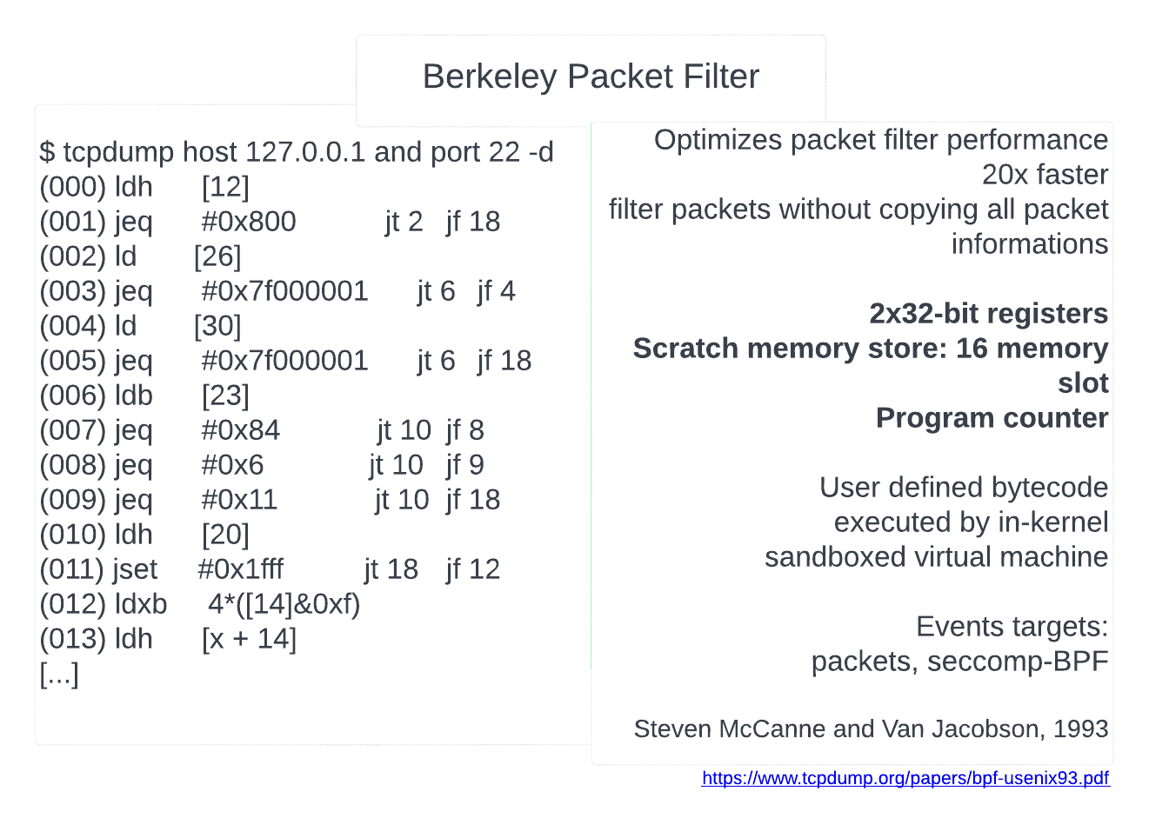
Introduction

Slide 4
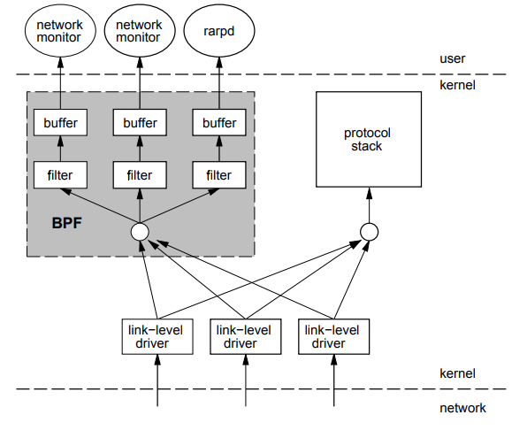
OVERVIEW
Two Components:
Network tap
Packets filter

Slide 5
Extended BPF
struct bpf_insn prog[] = {
BPF_MOV64_REG(BPF_REG_6, BPF_REG_1),
BPF_LD_ABS(BPF_B, ETH_HLEN + offsetof(struct iphdr, protocol) /* R0 = ip->proto */),
BPF_STX_MEM(BPF_W, BPF_REG_10, BPF_REG_0, -4), /* *(u32 *)(fp - 4) = r0 */
BPF_MOV64_REG(BPF_REG_2, BPF_REG_10),
BPF_ALU64_IMM(BPF_ADD, BPF_REG_2, -4), /* r2 = fp - 4 */
BPF_LD_MAP_FD(BPF_REG_1, map_fd),
BPF_RAW_INSN(BPF_JMP | BPF_CALL, 0, 0, 0, BPF_FUNC_map_lookup_elem),
BPF_JMP_IMM(BPF_JEQ, BPF_REG_0, 0, 2),
BPF_MOV64_IMM(BPF_REG_1, 1), /* r1 = 1 */
BPF_RAW_INSN(BPF_STX | BPF_XADD | BPF_DW, BPF_REG_0, BPF_REG_1, 0, 0), /* xadd r0 += r1*/
BPF_MOV64_IMM(BPF_REG_0, 0), /* r0 = 0 */
BPF_EXIT_INSN(),
};
eBPF or Just BPF
10x64-bit registers
maps(hashes)
Actions
Packets, kernel functions, user functions, tracepoint, user markers, PMCs
Alexei Starovoitov, 2014+

Slide 6
eBPF
Run custom code in the kernel
Event-driven
Run when the kernel or an application passes a certain hook point.
Predefined hooks include system calls, function entry/exit, kernel tracepoints, network events, etc.
http://ebpf.io/what-is-ebpf

Slide 7
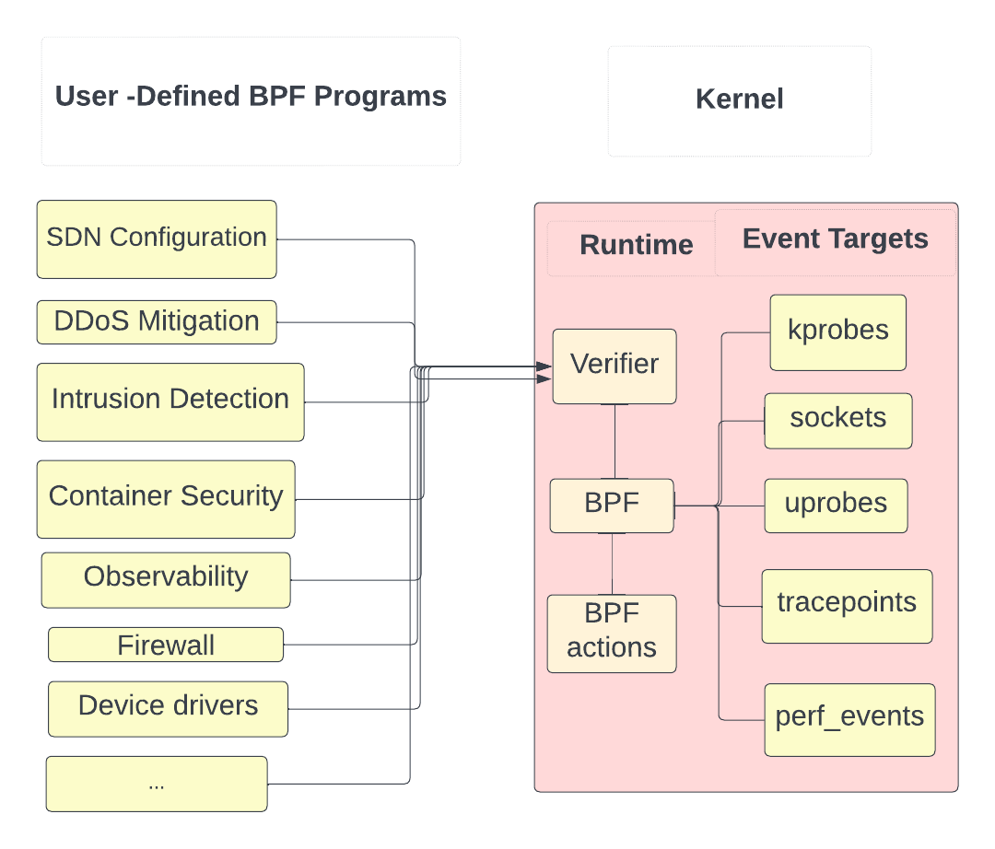
What eBPF can do
Observability
Tracing, debugging
Tool: bcc, bpftrace
Networking
SDN configuration,
DDoS mitigation, Load balancing...
Tool: XDP
Security
Intrusion detection
Tool: XDP
Safety – Network, kernel tracing

Slide 8
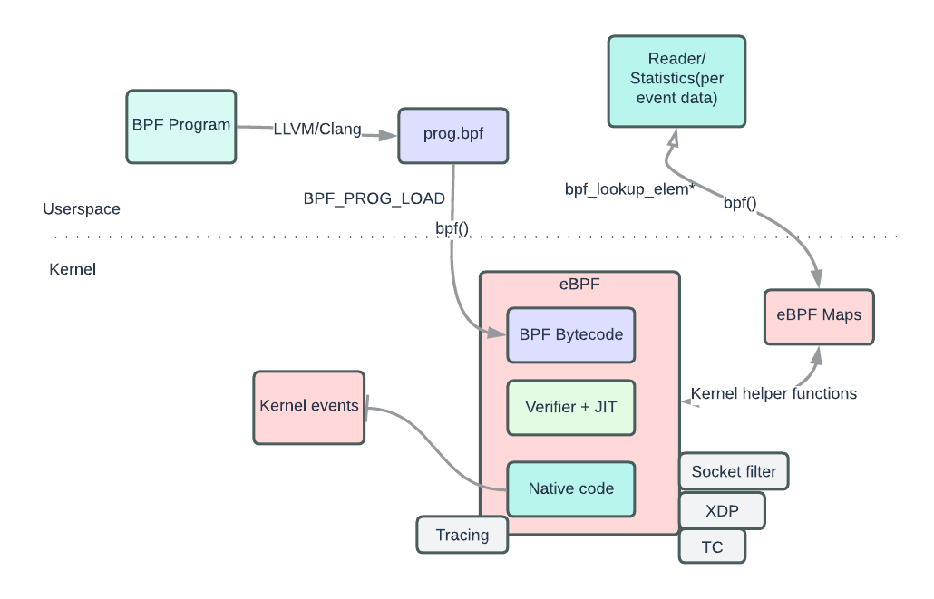
How does eBPF/BPF work ?

Slide 9
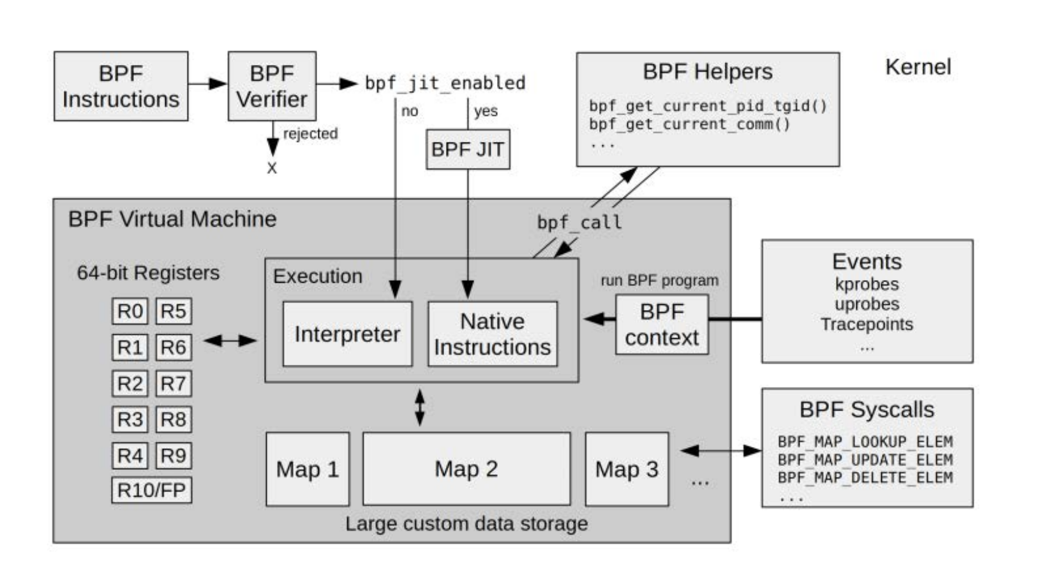
BPF runtime internals

Slide 10
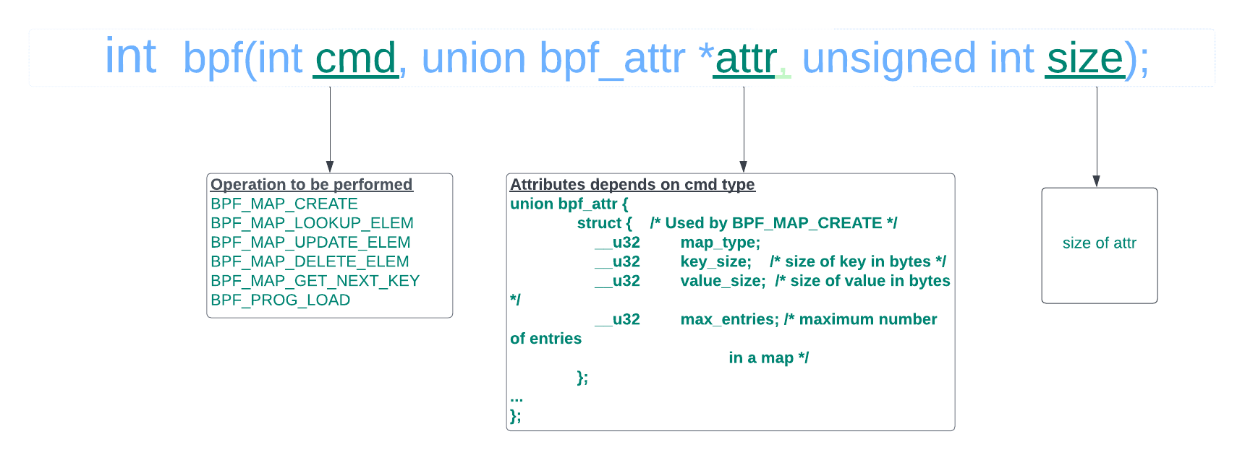
bpf() syscall

Slide 11
BPF maps
key/values pair can store data of any kind for sharing between kernel and userspace
accessed from user space via BPF syscall
Create a map map_fd = bpf(BPF_MAP_CREATE, union bpf_attr *attr, u32 size)
Lookup key in a given map
Create or update key/value pair
Find and delete element in key/value pair in a given map
Delete map
different types: hash, array, bloom filter, radix-tree, etc.

Slide 12
eBPF Verifier
Determine the safety of the ebpf program, reject or accept ebpf bytecode.
Does Directed acyclic Graph checks
disallow unbounded loops and perform other CFG validations checks.
detect instructions in the program that are unreachable
Starts from instruction and check all possible paths
simulates and observe state change of registers and stack

Slide 13
Raw BPF
struct bpf_insn prog[] = {
BPF_MOV64_REG(BPF_REG_6, BPF_REG_1),
BPF_LD_ABS(BPF_B, ETH_HLEN + offsetof(struct iphdr, protocol) /* R0 = ip->proto */),
BPF_STX_MEM(BPF_W, BPF_REG_10, BPF_REG_0, -4), /* *(u32 *)(fp - 4) = r0 */
BPF_MOV64_REG(BPF_REG_2, BPF_REG_10),
BPF_ALU64_IMM(BPF_ADD, BPF_REG_2, -4), /* r2 = fp - 4 */
BPF_LD_MAP_FD(BPF_REG_1, map_fd),
BPF_RAW_INSN(BPF_JMP | BPF_CALL, 0, 0, 0, BPF_FUNC_map_lookup_elem),
BPF_JMP_IMM(BPF_JEQ, BPF_REG_0, 0, 2),
BPF_MOV64_IMM(BPF_REG_1, 1), /* r1 = 1 */
BPF_ATOMIC_OP(BPF_DW, BPF_ADD, BPF_REG_0, BPF_REG_1, 0),
BPF_MOV64_IMM(BPF_REG_0, 0), /* r0 = 0 */
BPF_EXIT_INSN(),
};

Slide 14
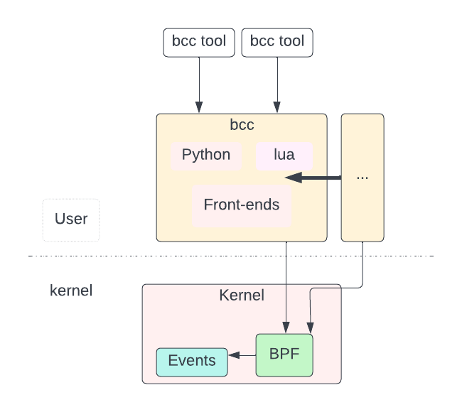

bcc
BPF Compiler Collection
Compiler framework and libraries for building BPF software
https://github.com/iovisor/bcc
Includes tracing , perf tools...
Provides BPF front-ends:
Python
Lua
C++
C helper libraries
golang(gobpf)

Slide 15
bcc/BPF(C & Python)
bpf_text = """
#include <uapi/linux/ptrace.h>
#include <linux/blkdev.h>
struct proc_key_t {
char name[TASK_COMM_LEN];
u64 slot;
};
BPF_HISTOGRAM(dist, struct proc_key_t);
TRACEPOINT_PROBE(block, block_rq_issue)
{
struct proc_key_t key = {.slot = bpf_log2l(args->bytes / 1024)};
bpf_probe_read_kernel(&key.name, sizeof(key.name), args->comm);
dist.atomic_increment(key);
return 0;
}””
# load BPF program
b = BPF(text=bpf_text)
print("Tracing block I/O... Hit Ctrl-C to end.")
# trace until Ctrl-C
dist = b.get_table("dist")
try:
sleep(99999999)
except KeyboardInterrupt:
dist.print_log2_hist("Kbytes", "ProcessName", section_print_fn=bytes.decode)

Slide 16
BPFtrace
Allow to to write ‘one liners’ or more simple BPF instruction
https://github.com/iovisor/bpftrace

Slide 17
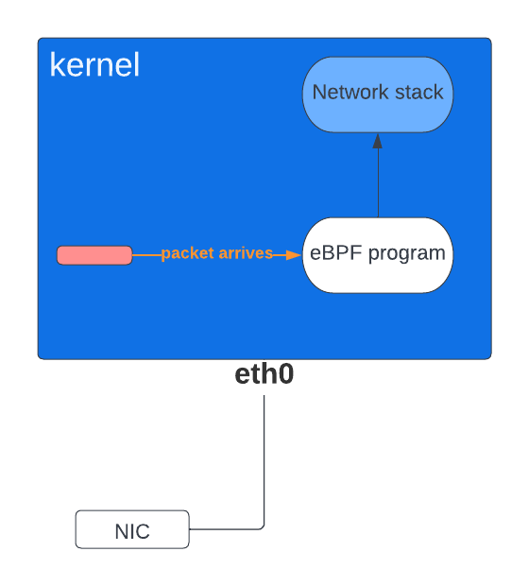
eXpress Data Path(XDP)
Allow to run eBPF on the network interface card instead of running on the CPU
Use kernel bypass technique
Avoid expensive context switches kSpace and uSpace
XDP program return action /verdict
XDP_DROP, XDP_ABORTED
XDP_PASS, XDP_TX
XDP_REDIRECT
Example:
attach_xdp()
https://github.com/xdp-project/xdp-paper/blob/master/xdp-the-express-data-path.pdf

Slide 18
Demo

Slide 21
Thanks
Mentor : Dr. Elana Copperman
LFX mentorship programs
Maintainers on mailing list

