Slide 1
Cloudflare Workers : Just Write Code Webinar
Meeting the growing demands of the modern digital consumer

Slide 2

Today’s Speaker
İren Saltalı
Co-founder & CTO
image4io

Slide 3


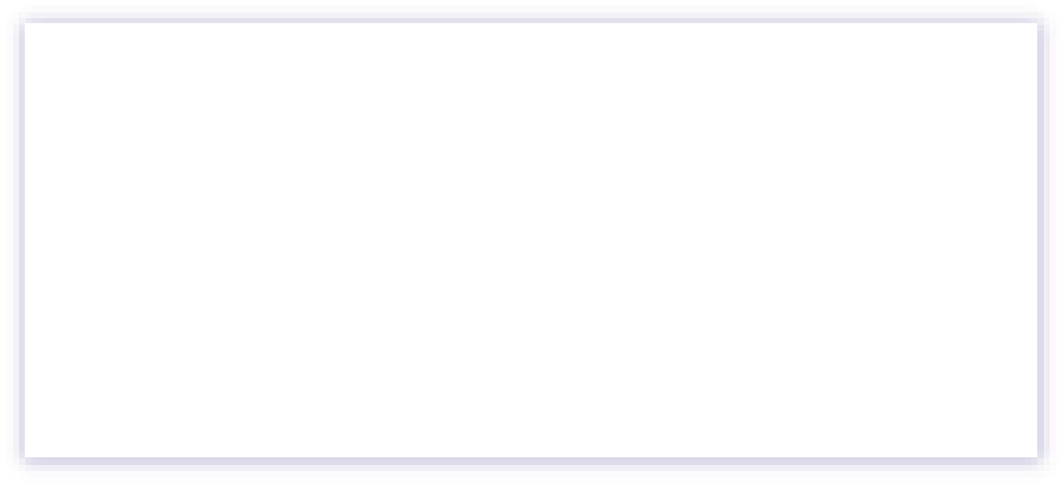
Disclaimer
I’m not related to Cloudflare any way possible. I’m just a customer of them.

Slide 4
What is workers?
https://workers.cloudflare.com
Serverless
JS, Rust, C and C++
Edge
Affordable

Slide 5
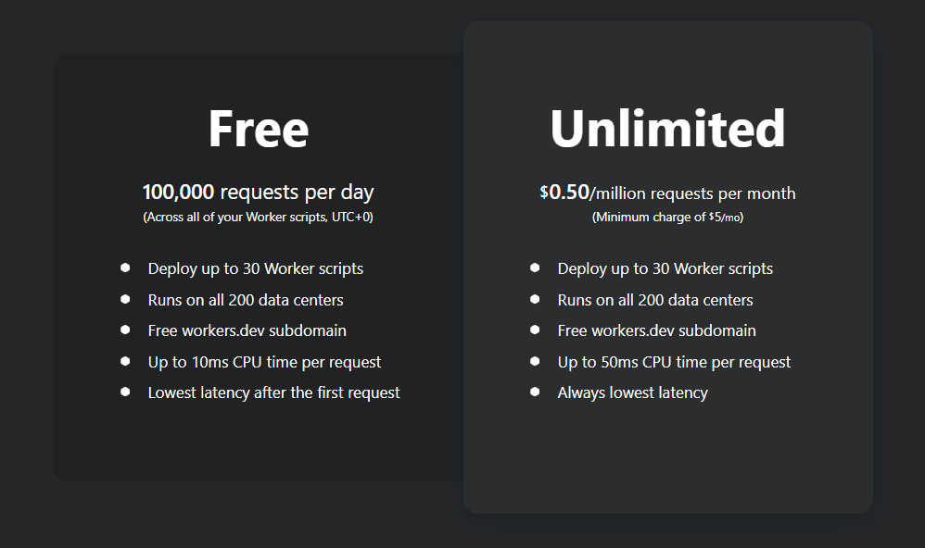
Pricing

Slide 6
Pricing Comparison
 | Workers | Lamda Edge
Per 1M Request | 0.5$ | 0.6$
Duration | - | $0.00005001 for every GB-second

Slide 7
Limits
 | Workers (Free) | Workers (Unlimted) | Lamda Edge
Memory | 128MB | 128MB | 128MB/Lambda
CPU | 10ms | 50ms | 30s/5s
Daily Request Limit | 100K | - | -
Script Size | 1MB | 1MB | 1MB/40KB
https://developers.cloudflare.com/workers/about/limits/ https://docs.aws.amazon.com/AmazonCloudFront/latest/DeveloperGuide/cloudfront-limits.html#limits-lambda-at-edge

Slide 8
Key-Value Storage
Workers KV is a global, low-latency, key-value data store. It supports exceptionally high read volumes with low-latency, making it possible to build highly dynamic APIs and websites which respond as quickly as a cached static file would.

Slide 9

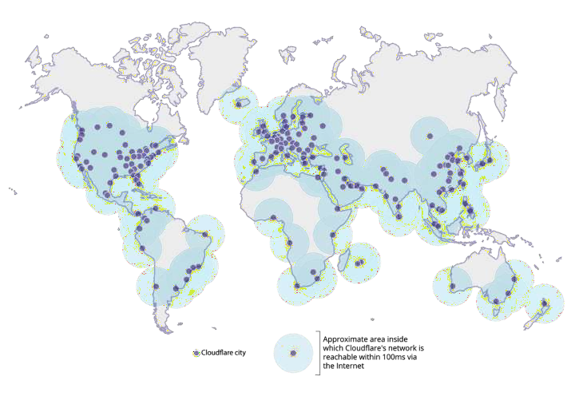
25M+
Cloudflare’s network operates at massive scale
Internet properties
200
Cities and 95+ countries
50B
Cyber threats blocked each day in Q4’19
99%
Of the Internet-connected population in the developed world is located within 100 milliseconds of our network
Note: Data as of June 28, 2019.

Slide 10

Q&A

