Slide 1

Faculty of Economic Sciences, UW
Applications of
eXplainable AI in
Predictive Modelling
X
A
I
X
I
A
Irena Zimovska
2025

Slide 2

😎
Class 15
Presentations
Course roadmap:
Recap
🤔
Class 14
101 into AutoML in Python
🤔
Class 12-13
Image Recognition in PyTorch
Class 8-11
🤔
Regression in Python
Class 7
Clean Code & Collaboration Practices
✅
Class 1-6
Introduction into XAI & Classification in R
Irena Zimovska | WNE UW [XAI 2025]
Class 7: Data Science Workflow Best Practices
Class 8-11: Regression in Python
Class 12-13: Image Recognition
Class 14: AutoML in Python

Slide 3
X
Agile Way of Working
How work is done in software development and beyond
X
Code Version Control & Environment
Management
Class 7
{ Clean Code and Collaboration Practices }
How to avoid pitfalls and risk of technical problems
X
Clean Code Standards: PEP 8
How to write code to be respected by your collegues
X
Automatic Testing
Test your product as long as you develop it
X
Deployment & CI/CD
Automation in code deployment
Irena Zimovska | WNE UW [XAI 2025]

Slide 4
01
{ Agile Way of Working }
Irena Zimovska | WNE UW | XAI 2025

Slide 5
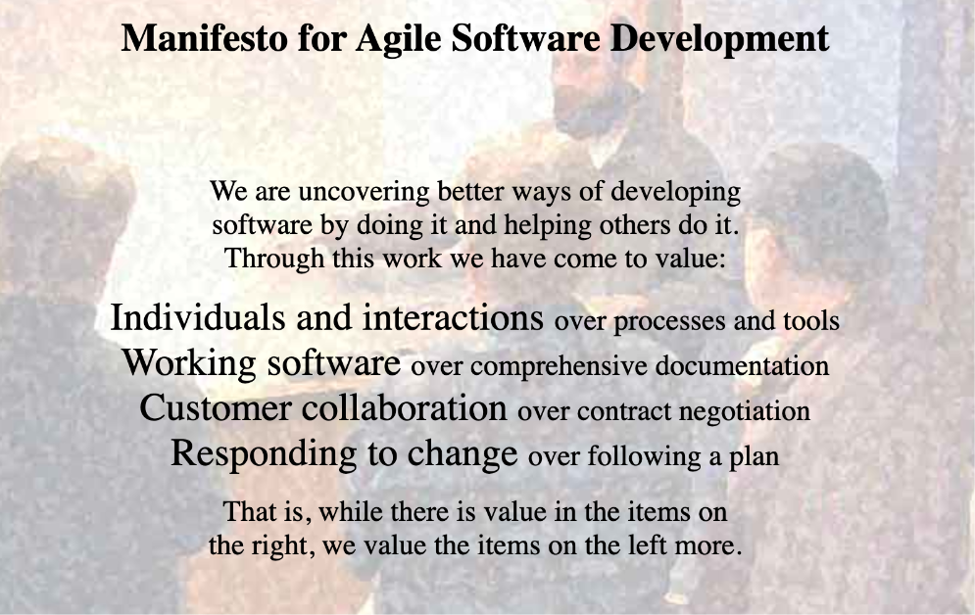
Agile Way of Working
Source: https://agilemanifesto.org/
Irena Zimovska | WNE UW | XAI 2025

Slide 6
Agile Principles
Customer satisfaction by early and continuous delivery of valuable software.
Welcome changing requirements, even in late development.
Deliver working software frequently (weeks rather than months).
Close, daily cooperation between business people and developers.
Projects are built around motivated individuals, who should be trusted.
Face-to-face conversation is the best form of communication (co-location).
Working software is the primary measure of progress.
Sustainable development, able to maintain a constant pace.
Continuous attention to technical excellence and good design.
Simplicity— the art of maximizing the amount of work not done —is essential.
Best architectures, requirements, and designs emerge from self-organizing teams.
Regularly, the team reflects on how to become more effective, and adjusts accordingly.
[View source for Agile software development - Wikipedia]
Irena Zimovska | WNE UW | XAI 2025

Slide 7
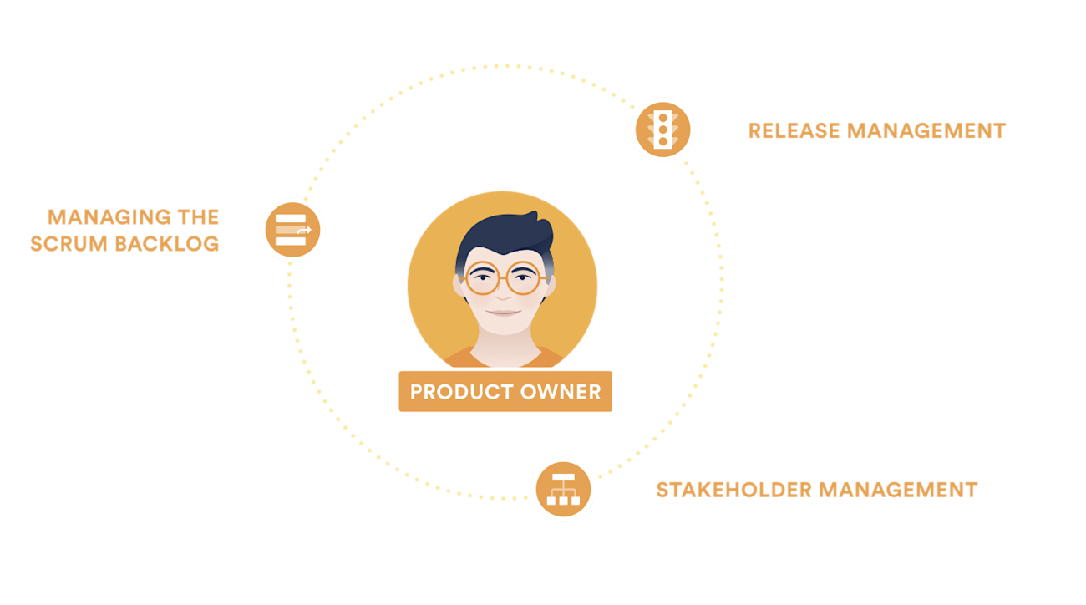
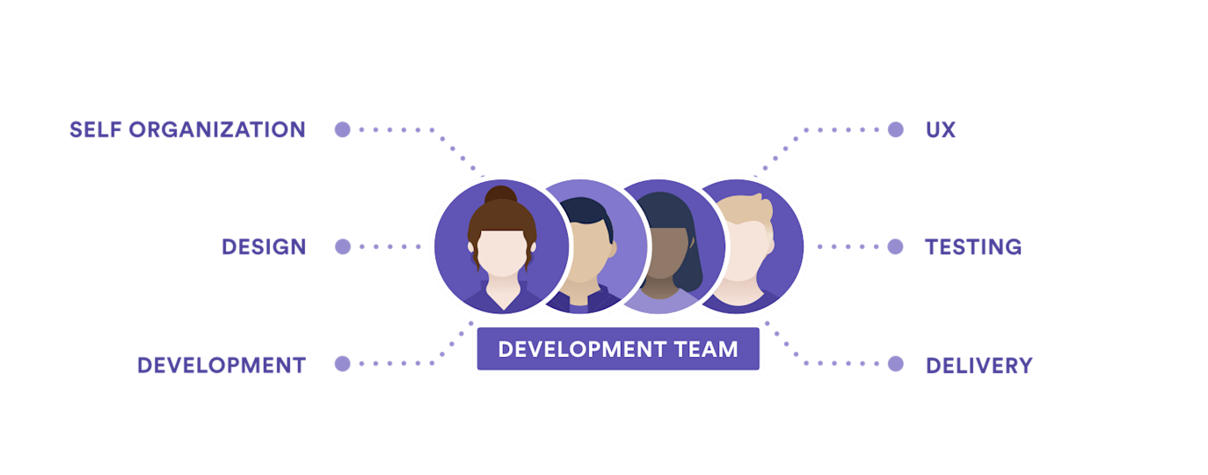
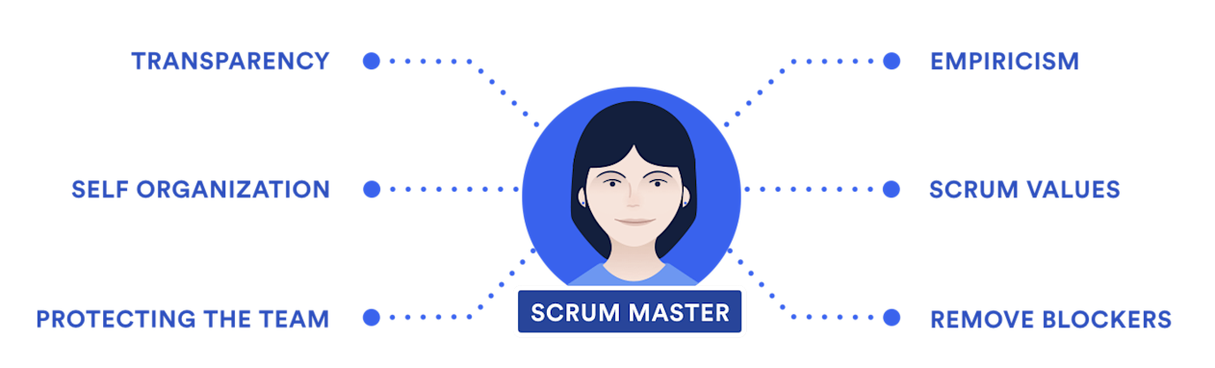
Agile Roles
Product Owner
Developers
Scrum Master
Source: https://www.atlassian.com/agile/scrum/roles
Irena Zimovska | WNE UW | XAI 2025

Slide 8
What is Scrum?
{ Scrum }
Framework that helps teams structure their work into short development cycles called sprints. Scrum teams commit to shipping work at the end of each sprint and adopt practices and a team structure that helps them achieve this cadence. Scrum takes the agile principles one step further, creating structure that helps teams live the agile principles in their day-to-day work. Scrum is a well-documented agile framework that many teams can adopt without much disruption.
Irena Zimovska | WNE UW | XAI 2025

Slide 9
Scrum Ceremonies
Sprint Planning
Daily Stand-ups
Sprint Review
Sprint Retrospective
X
X
X
X
1-2 hour meeting at
The beginning of sprint
Requires team members
to identify tasks
and prepare backlog
At most 15-30 mins
everyday
Inform:
What did I work
on yesterday?
What am I working on
today?
What issues are
blocking me?
1.5 h per two week
sprint
Demonstrate work
finished within the
iteration, and
get immediate
feedback
1.5 h per two week
sprint
Find out what's not
working and use the
time to find
creative solutions
and develop an
action plan
X
X
X
X
Irena Zimovska | WNE UW | XAI 2025

Slide 10
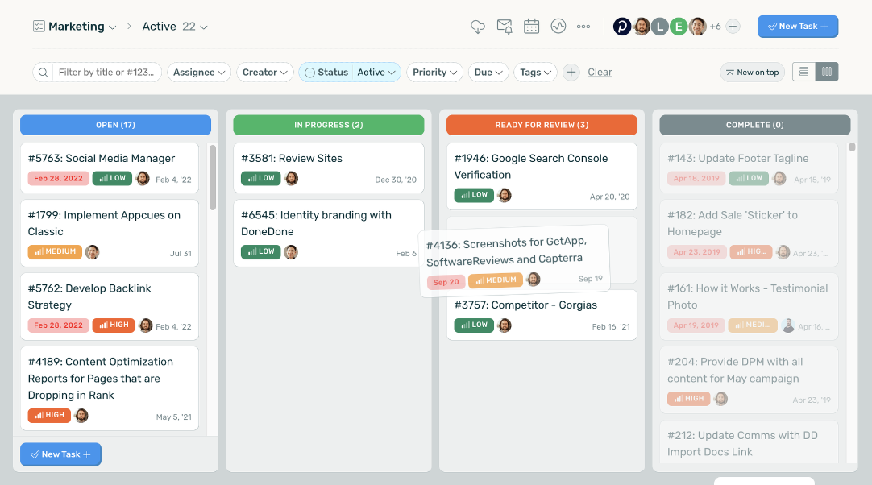
Kanban: your daily to-do assistant
🛠️ Tips:
Adequately reflect the scope of your work in tasks
Regularly update the board
Use labels for task prioritization
Do not overload “in progress”: set the limit
Write effective task tickets
Irena Zimovska | WNE UW | XAI 2025

Slide 11
02
{ Version Control & Environment Management}
Irena Zimovska | WNE UW | XAI 2025

Slide 12
Technical Debt
The future cost incurred when code is written or implemented in a way that is expedient but suboptimal. This often happens when developers prioritize speed or immediate results over long-term maintainability and quality.
Time available for new feature development
🛠️ Tips to combat:
Follow clean code standards (naming, architecture, etc.)
Encourage code review culture
Pair programming
Write documentation (e.g. README, docstrings -the more visualizations, the better)
Automatic tests
Continuous delivery
Time struggling with complexity and debt
Irena Zimovska | WNE UW | XAI 2025

Slide 13
Freezing environments
X
X
Reproducibility Across Environments
Mitigating Dependency Conflicts
Ensures that anyone who clones the project can replicate the exact setup
Python packages often depend on other libraries, and updates in one dependency might break compatibility.
X
X
Consistency in CI/CD Pipelines
Regression Prevention in Production
In CI/CD workflows, frozen environments ensure tests are executed in a controlled setup. Prevent pipeline failures caused by changes in dependency versions.
Unfrozen environments risk introducing regressions if a library is updated automatically (e.g., pip install without version constraints).
Irena Zimovska | WNE UW | XAI 2025

Slide 14
Freezing environments
Useful commands to snapshot env
TXT
yaml
pip freeze > requirements.txt
conda env export --no-builds > environment.yml
Alternatively, use tools like poetry conda-lock for more robust dependency resolution.
Recreate environment
conda create -n myenv python=3.9
conda activate myenv
pip install -r requirements.txt
conda env create -f environment.yml
conda activate <environment_name>
Irena Zimovska | WNE UW | XAI 2025

Slide 15
Version control with Git
X
X
Reproducibility of Experiments
Ensures Code Integrity
Git helps track code, data processing scripts, and model versions, ensuring that experiments can be reproduced consistently.
Git provides a distributed system where every developer has a full copy of the repository, reducing the risk of data loss.
X
X
Facilitates Collaboration
Supports Experimentation
Multiple developers can work on the same project simultaneously without conflicts, thanks to branches and merging.
Developers can create branches to test new features or fixes without affecting the main codebase, enabling safer development.
Irena Zimovska | WNE UW | XAI 2025

Slide 16
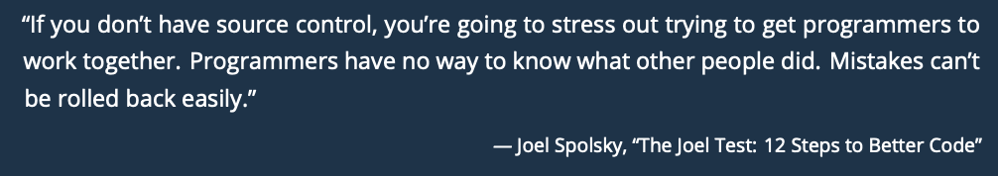
Collaboration is a challenge
School
Job
👤
👤
👤
👤
👤
👤
👤
{ VS }
👤
👤
👤
Irena Zimovska | WNE UW | XAI 2025

Slide 17
Can you explain Git it in just a minute?
Client
{ Could explain one more time what is really the difference between git add and git commit? }
👤
Data Scientist
👤
{ Yeah, of course!}
😵‍💫
Irena Zimovska | WNE UW | XAI 2025

Slide 18
03
{ Clean Code Standards}
Irena Zimovska | WNE UW | XAI 2025

Slide 19
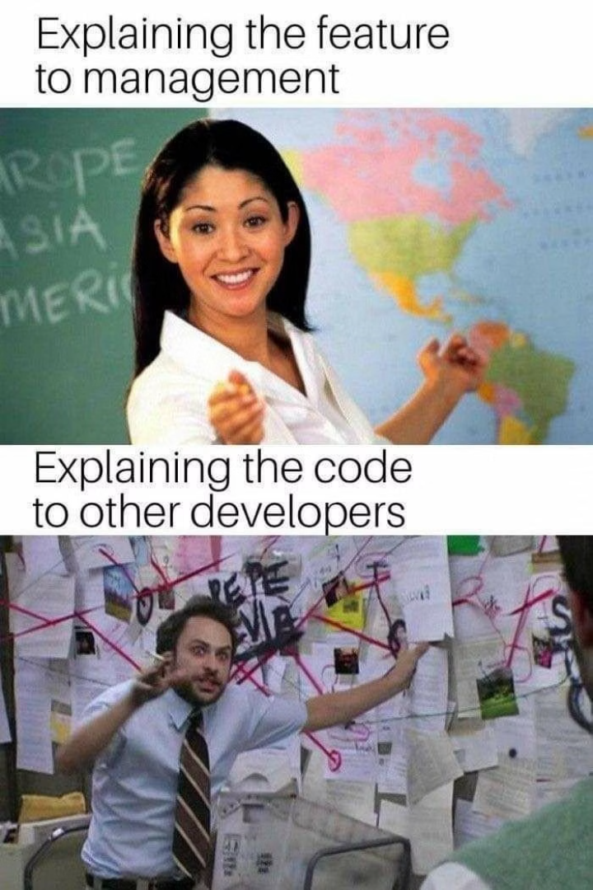
Clean Code practices make you better
Makes Your Work Understandable for Others
Reduces Code Maintanance Cost
Extends Code Longevity
Encourages Reusability
Enhances Onboarding
Fosters Professionalism
Irena Zimovska | WNE UW | XAI 2025

Slide 20

PEP8
PEP stands for Python Enhancement Proposal. A PEP is a design document providing information to the Python community, or describing a new feature for Python or its processes or environment. The PEP should provide a concise technical specification of the feature and a rationale for the feature.
We intend PEPs to be the primary mechanisms for proposing major new features, for collecting community input on an issue, and for documenting the design decisions that have gone into Python. The PEP author is responsible for building consensus within the community and documenting dissenting opinions.
Source: https://peps.python.org/
Irena Zimovska | WNE UW | XAI 2025

Slide 21
Leverage code formatters
Code formatters
autopep8: format Python code to conform to the PEP 8 style guide.
black: uncompromising Python code formatter.
ruff: fast Rust-powered linter and code formatter, for Python. The formatter is 100% compatible with Black.
yapf: yet another Python code formatter from Google.
Irena Zimovska | WNE UW | XAI 2025

Slide 22
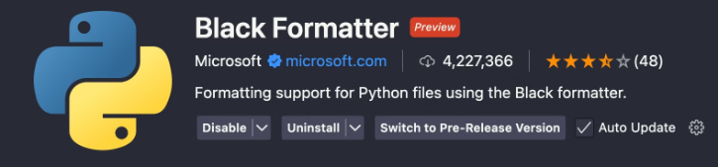
How to install Black in VS Code
Install Black in your python environment
pip install black
2. Install VSCode extension from Microsoft
Edit your user Settings (Command Pallete > Open User Settings (JSON))
"[python]": {
"editor.formatOnSave": true,
"editor.defaultFormatter": "ms-python.black-formatter"
},
Irena Zimovska | WNE UW | XAI 2025

Slide 23
04
{ Automated Testing }
Irena Zimovska | WNE UW | XAI 2025

Slide 24
Automated Testing
Definition: Automatic testing refers to the process of using specialized software tools to execute tests on your codebase automatically. Instead of manually checking if the code behaves as expected, tests are run automatically, providing quick feedback.
Benefits:
Faster feedback on code quality and functionality.
Reduced human error in testing.
Scalability: Tests can be run repeatedly with little to no manual intervention.
Improved code quality: Helps in detecting issues early in the development process.
Continuous Integration (CI): Automatically runs tests during the build process, improving overall project stability.
Irena Zimovska | WNE UW | XAI 2025

Slide 25
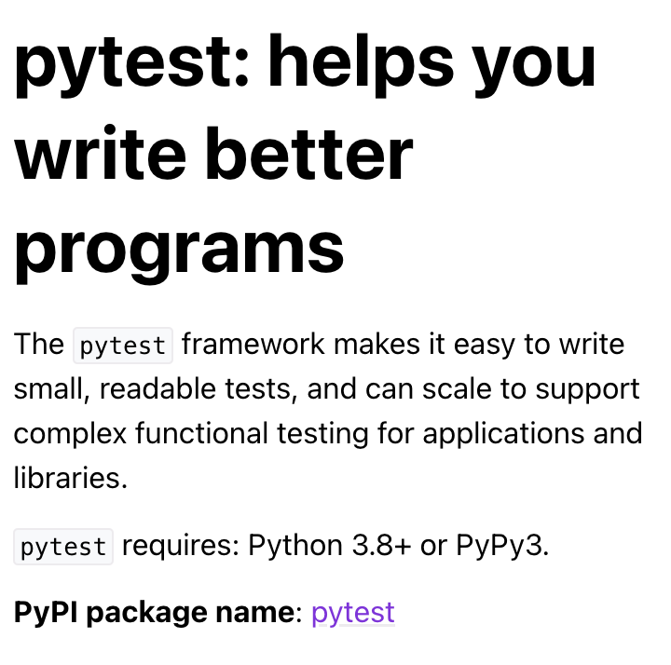
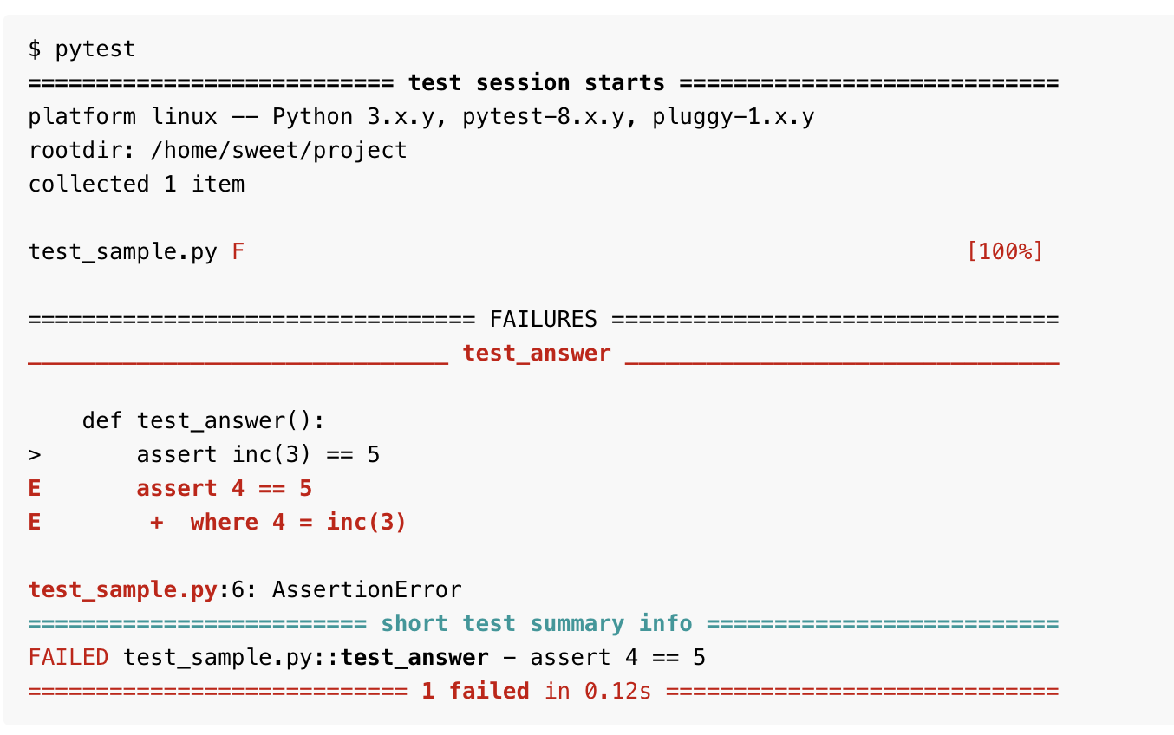
Automated Testing
Source: https://docs.pytest.org/en/stable/index.html
Irena Zimovska | WNE UW | XAI 2025

Slide 26
05
{ Deployment & CI/CD }
Irena Zimovska | WNE UW | XAI 2025

Slide 27
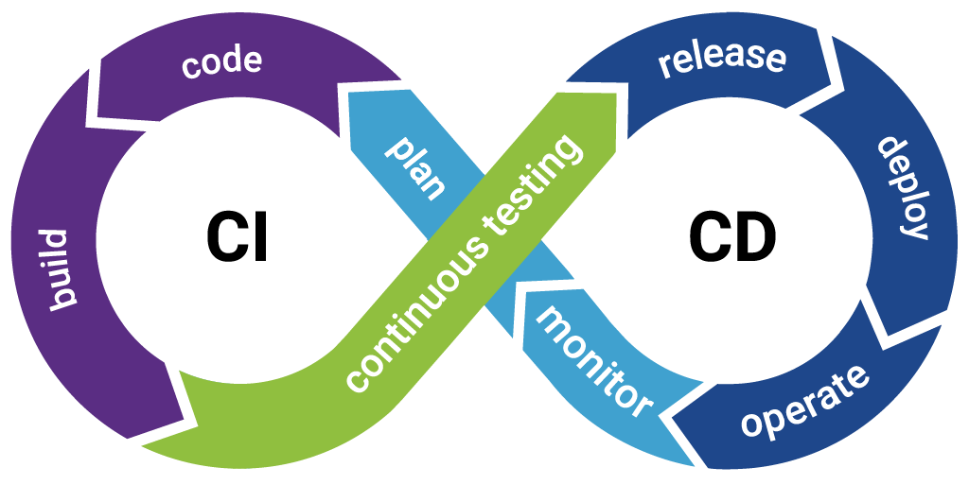
Continuous Integration
Continuous Integration (CI)
CI is the practice of frequently integrating code changes from multiple developers into a shared repository (e.g., GitHub, GitLab). Each code change triggers an automated build and testing process to catch errors early.
🔹 Key Aspects of CI: ✅ Developers push small code updates regularly. ✅ Automated tests check for errors in new code. ✅ Early bug detection reduces integration issues.
Irena Zimovska | WNE UW | XAI 2025

Slide 28
Continuous Delivery
CD extends CI by automating the release process so that new code can be quickly and safely deployed to production.
📌 Two Variants:
Continuous Delivery: Requires manual approval before deployment.
Continuous Deployment: Deploys automatically without human intervention.
🔹 Key Benefits of CD: ✅ Faster software releases. ✅ Reduces manual work in deployments. ✅ Ensures consistent deployment processes.
Irena Zimovska | WNE UW | XAI 2025

Slide 29
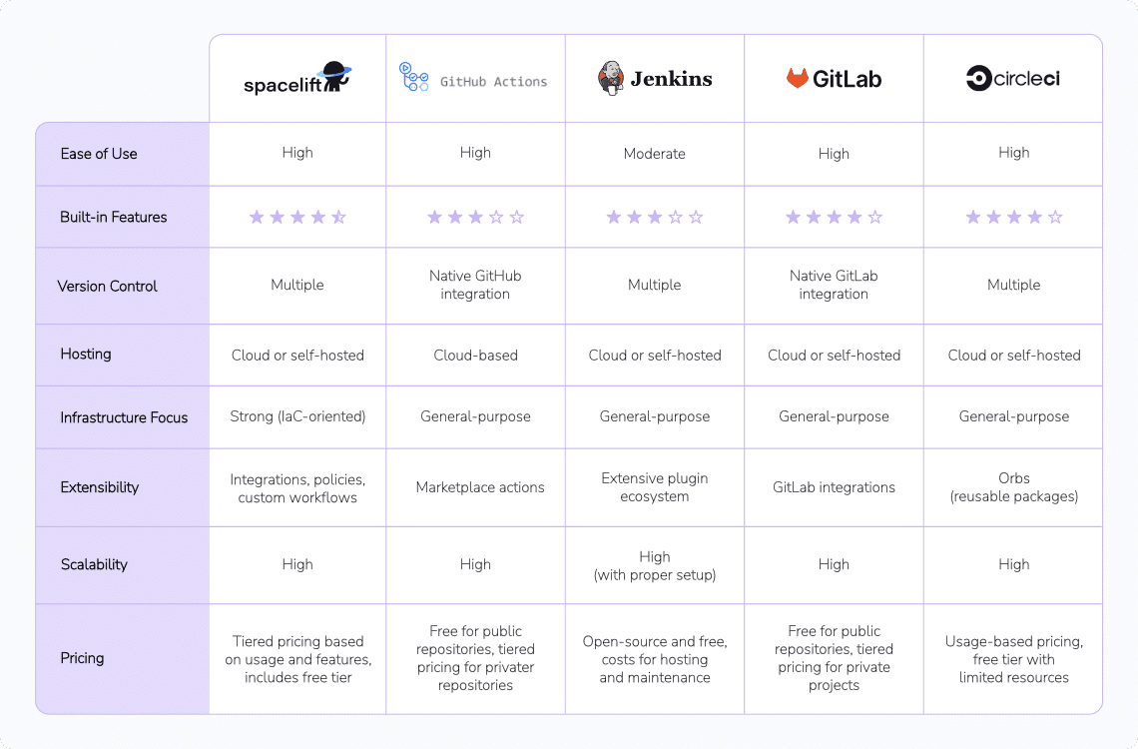



CI/CD Tools
GitHub Actions
Check out more tools: https://spacelift.io/blog/ci-cd-tools
Irena Zimovska | WNE UW | XAI 2025

Slide 30
06
{ DEMO }
Irena Zimovska | WNE UW | XAI 2025

Slide 31
The Case
{ Meet Julia, a Data Analyst from the Modelling team. She is an experienced specialist, taking care of data verification processes. Every month she has to update the data verification reports and preprocess data for the further processes. Every time she manually performs checks and imputes data in Jupyter notebooks. Please help to design solution to automate her work.
}
Julia, Data Analyst
👩‍💻
Irena Zimovska | WNE UW | XAI 2025

Slide 32
😎
Class 15
Presentations
Course roadmap:
Recap
🤔
Class 14
101 into AutoML in Python
🤔
Class 12-13
Image Recognition in PyTorch
Class 8-11
🤔
Regression in Python
✅
Class 7
Clean Code & Collaboration Practices
✅
Class 1-6
Introduction into XAI & Classification in R
Irena Zimovska | WNE UW [XAI 2025]

