Slide 1
Bank Analytics Dashboard
By: Mohammed Maanish
PGDA - 37

Slide 2
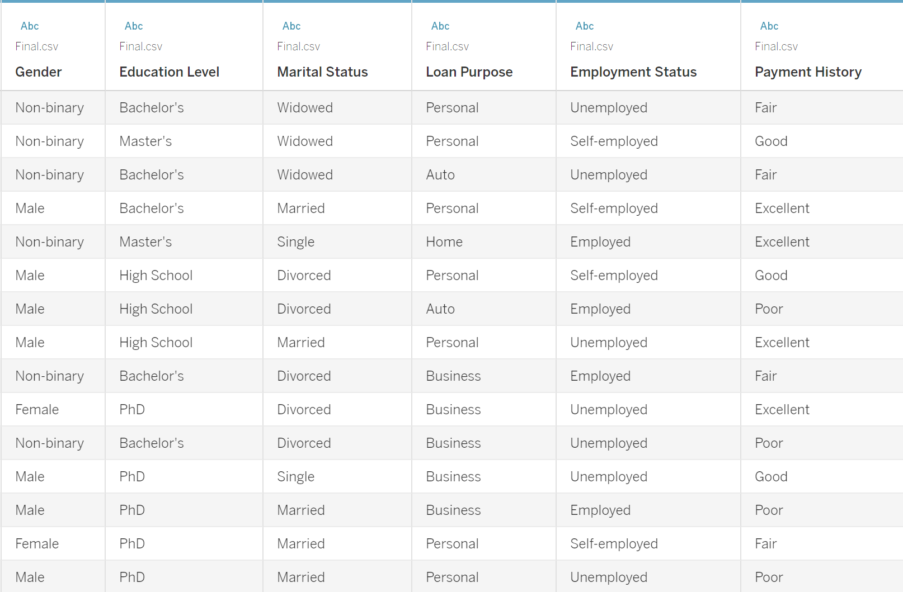
Problem Statement
In the banking sector, assessing the risk profile of loan applicants is critical to minimizing default rates and maintaining financial stability. However, with diverse variables such as employment status, gender, education level, debt-to-income ratio, and loan purpose, and many others, it becomes challenging to identify patterns of borrower behaviour and associated risks.
These dashboards aims to explore among other things the relationships between these key variables and the risk of loan default, leveraging a dataset that includes borrower demographics, loan characteristics, and financial indicators some of which are shown in the image. By analysing employment status, income, loan amounts, risk ratings, and other attributes, we seek to uncover insights that can inform better lending practices and more accurate risk assessments.

Slide 3
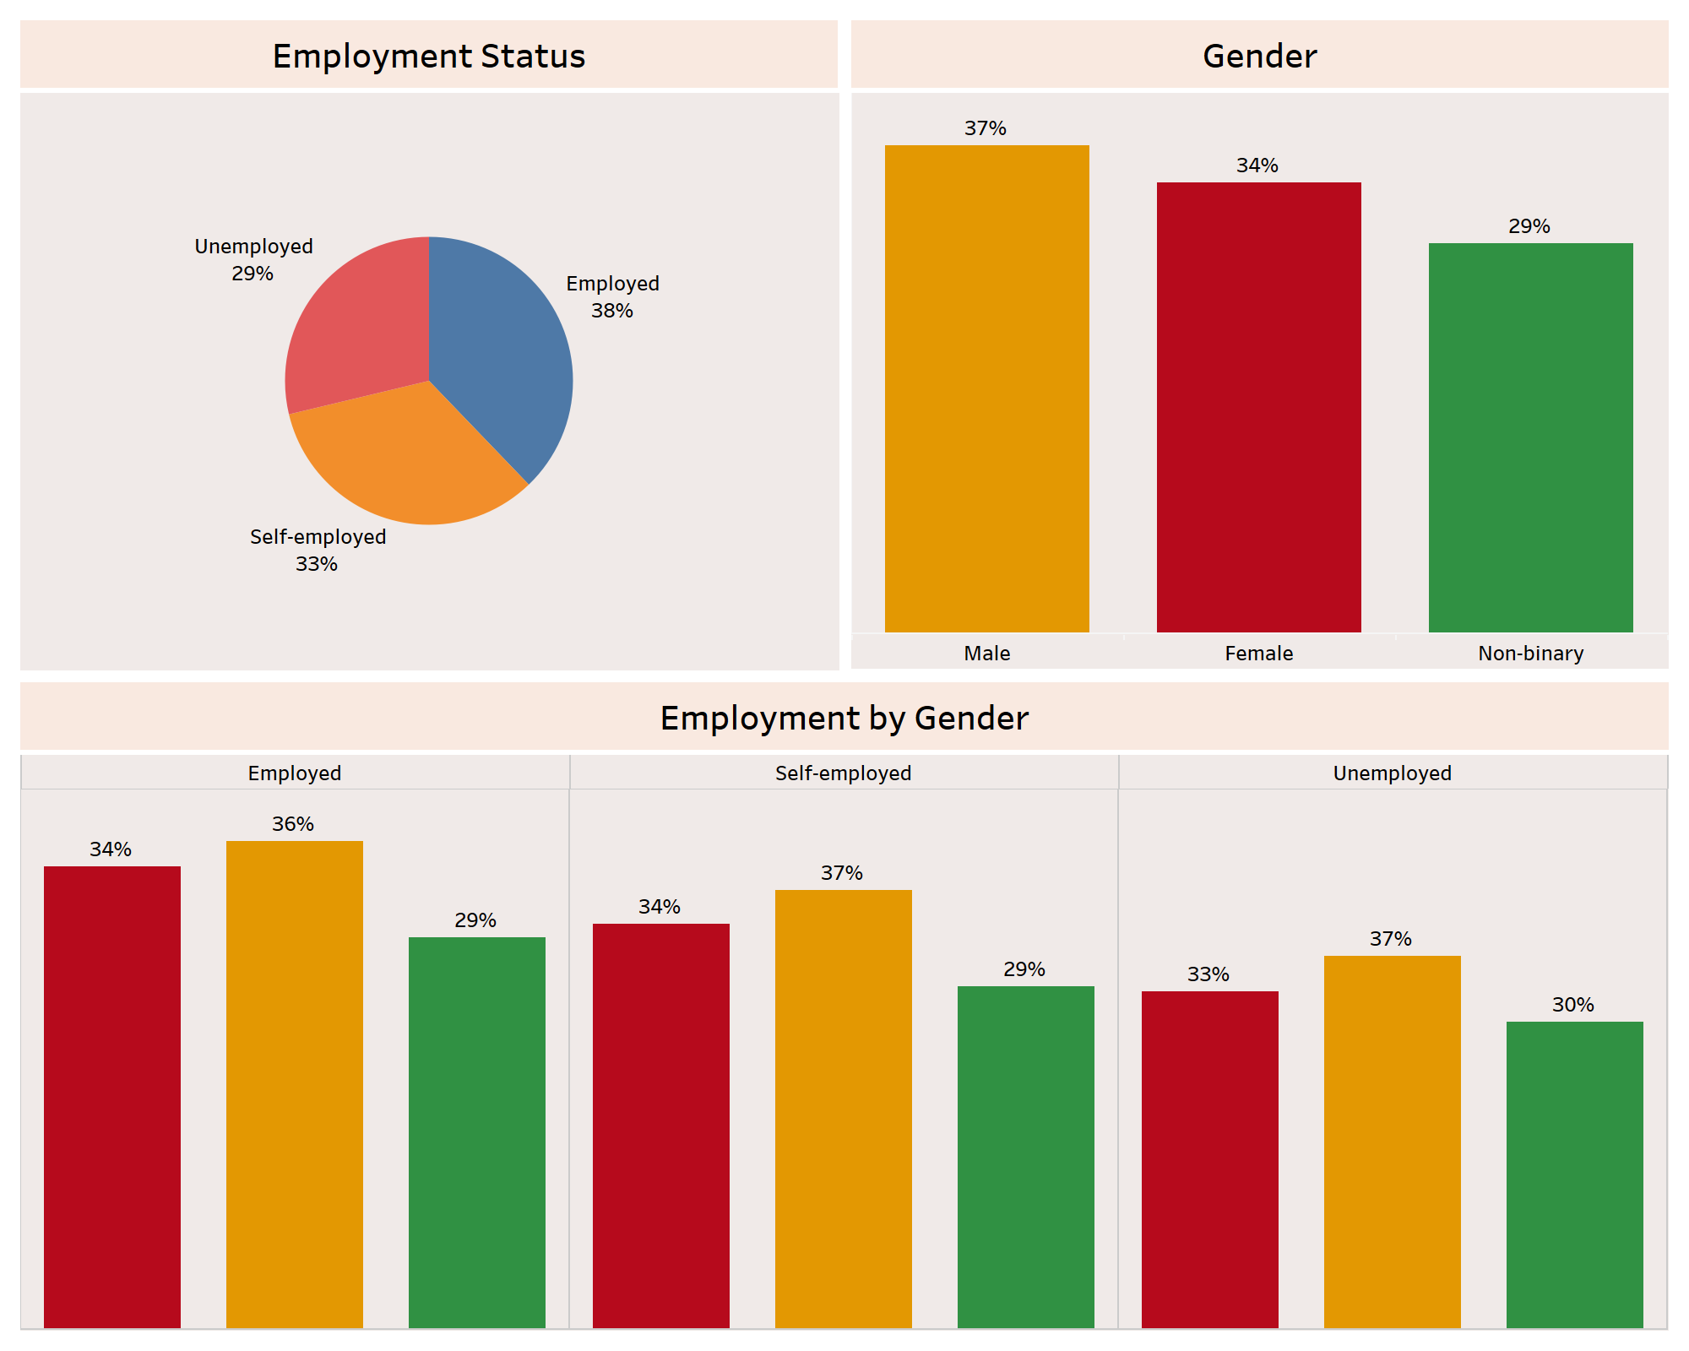

Slide 4
Employment Status & Gender Distribution Insights
Employment Status Distribution:
The largest portion of individuals are employed (38%), followed closely by those who are self-employed (33%). A significant proportion, 29%, are unemployed.
This distribution suggests a balanced mix of employment types, which can impact risk evaluation for the bank.
Gender Distribution:
The majority gender in the dataset is male (37%), followed closely by female (34%). A smaller portion of individuals identify as non-binary (29%).
This distribution highlights a relatively diverse gender representation, with males forming the largest group.
Employment by Gender:
Among the employed, males represent 36%, females 34%, and non-binary individuals 29%.
For the self-employed category, males also have the highest representation at 37%, followed by females at 34%, and non-binary individuals at 29%.
Unemployment is also fairly evenly distributed, with males and females at 37% and 34% respectively and non-binary individuals at 30%.
This suggests that employment and self-employment are more prevalent among males, but unemployment affects non-binary individuals and females similarly.

Slide 5
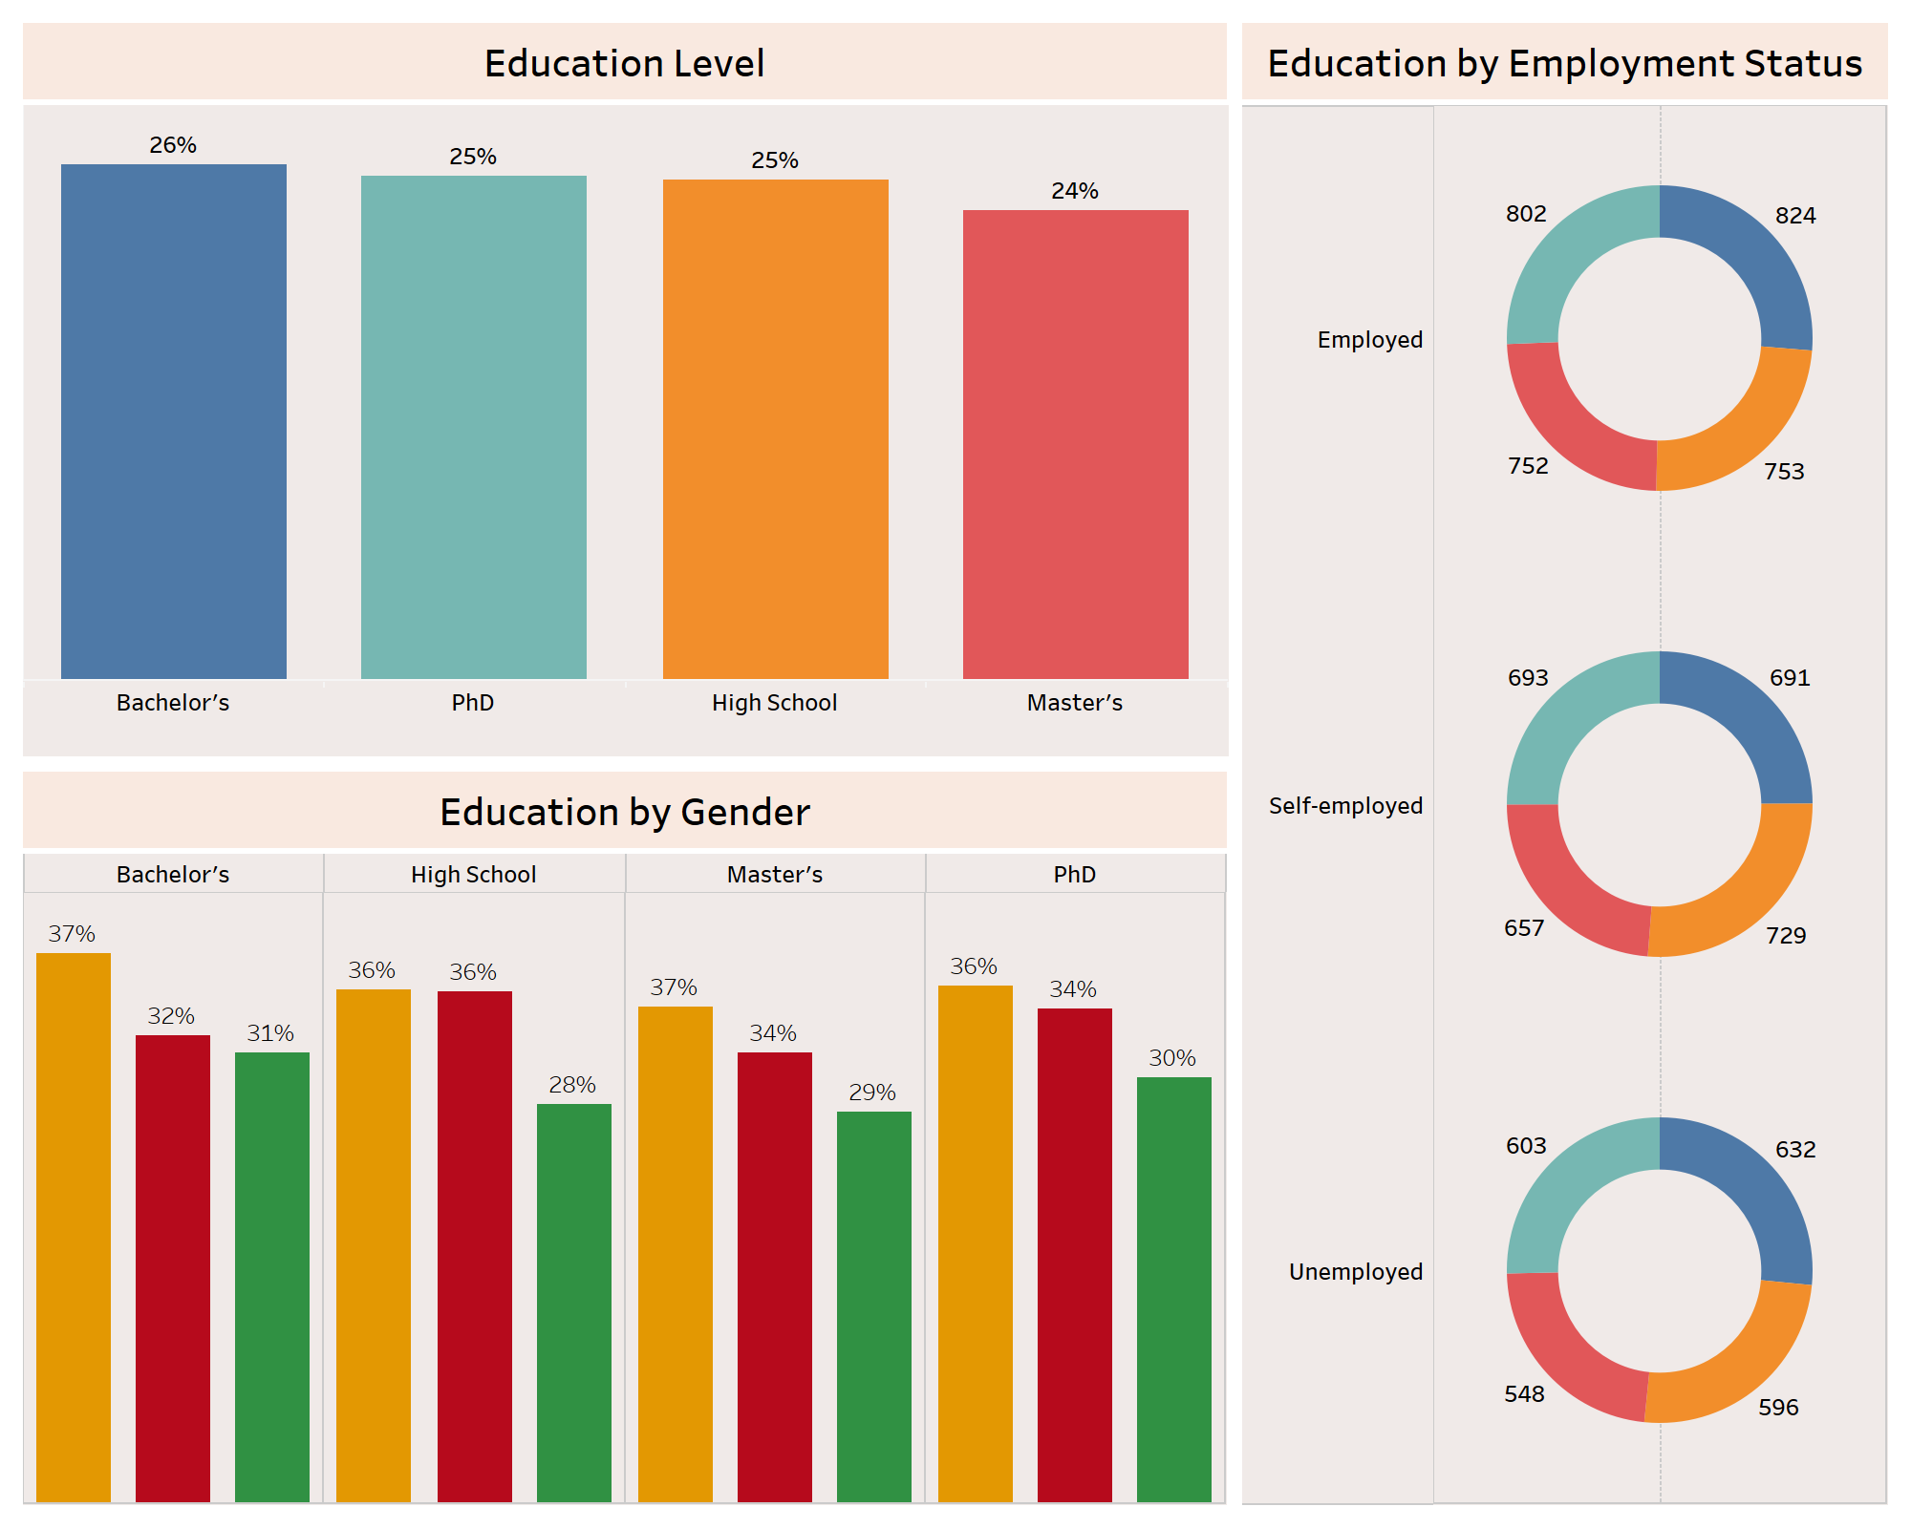

Slide 6
Employment & Education Distribution Insights by Gender
Education Level Distribution:
The dataset is relatively balanced across educational levels, with Bachelor's degree holders having a slight edge at 26%, followed by PhD and High School graduates at 25% each, and Master’s degree holders at 24%.
This balanced distribution indicates that individuals with varying education levels are represented.
Education by Employment Status:
Among the employed, the numbers are quite balanced across education levels, with Bachelor's degree holders leading slightly.
For the self-employed, there is a fairly balanced distribution as well.
For the unemployed, the pattern remains consistent, though the total counts are smaller.
The data suggests that education level does not significantly affect employment status, as all groups are fairly represented across employment categories.
Education by Gender:
Males have a higher representation across most education levels, particularly in Bachelor’s (37%) and Master’s (37%) degrees.
Females are also strongly represented in PhD (34%) and High School (36%) categories.
Non-binary individuals have the lowest representation in all education levels.
This indicates some gender variation across different education levels, with males generally having higher representation at advanced educational levels.

Slide 7
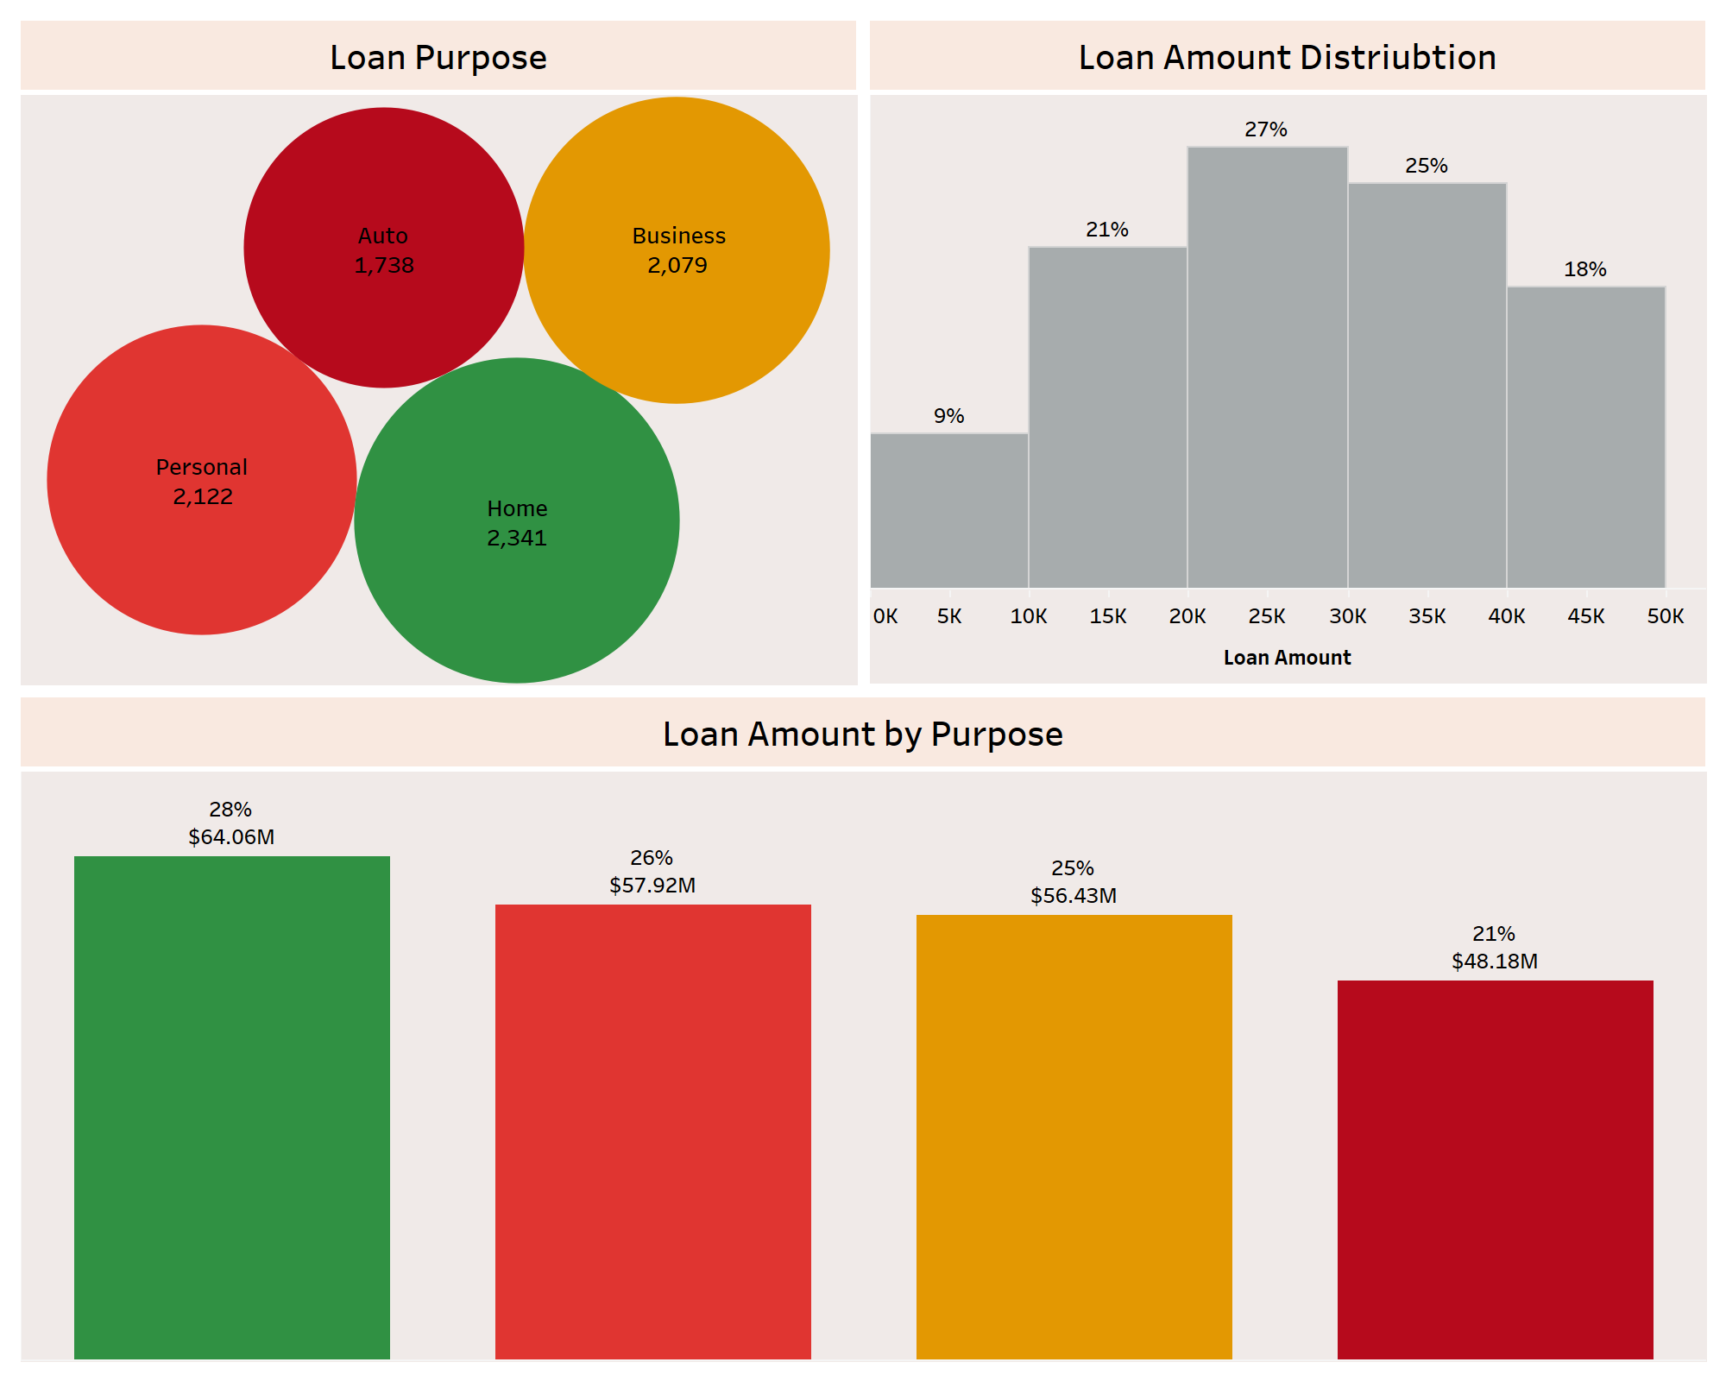

Slide 8
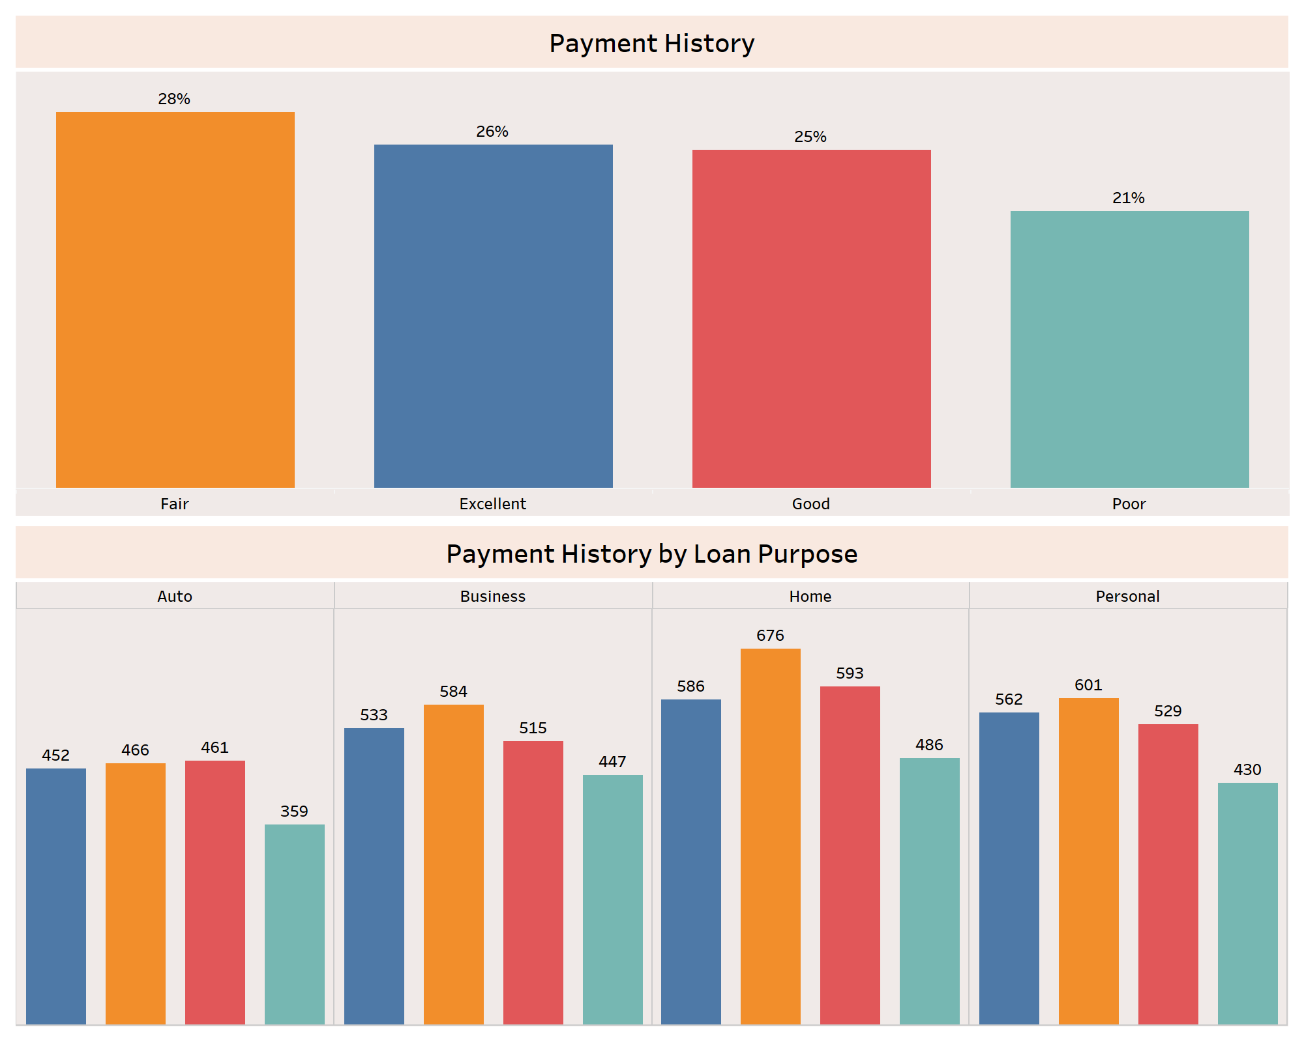

Slide 9
Loan Purpose & Payment History Insights
Loan Purpose Distribution:
The most common loan purpose is for Home loans, followed by Personal loans. Business loans also make up a significant portion. Auto loans are the least common, with 1,738 instances.
Loan Amount Distribution:
The most frequent loan amount range is $20K to $30K, accounting for 27% of loans. About 25% of loans fall within the $30K to $40K range. Smaller loan amounts, between $5K and $10K, account for only 9% of the loans.
Loan by Purpose:
Home loans represent the highest share in terms of total amount, contributing 28% of the overall loan volume, amounting to $64.06M. Personal loans make up 26% of the total loan amount, contributing $57.92M. Business loans contribute 25% with a total loan amount of $56.43M. Auto loans represent the smallest portion of the loan amount at 21%, totalling $48.18M.
Payment History:
A majority of the individuals have a payment history rating of “Fair” closely followed by “Excellent” and “Good”. The “Poor” rating is the least common
Payment History by Loan Purpose:
All the loan purposes have the highest instances of the “Fair” rating and the lowest instances of the “Poor” rating. Something noteworthy is that the loans for the purpose of automobiles have similar instances of “Fair”, “Excellent”, and “Good”, where the “Good” rating takes a slight lead

Slide 10
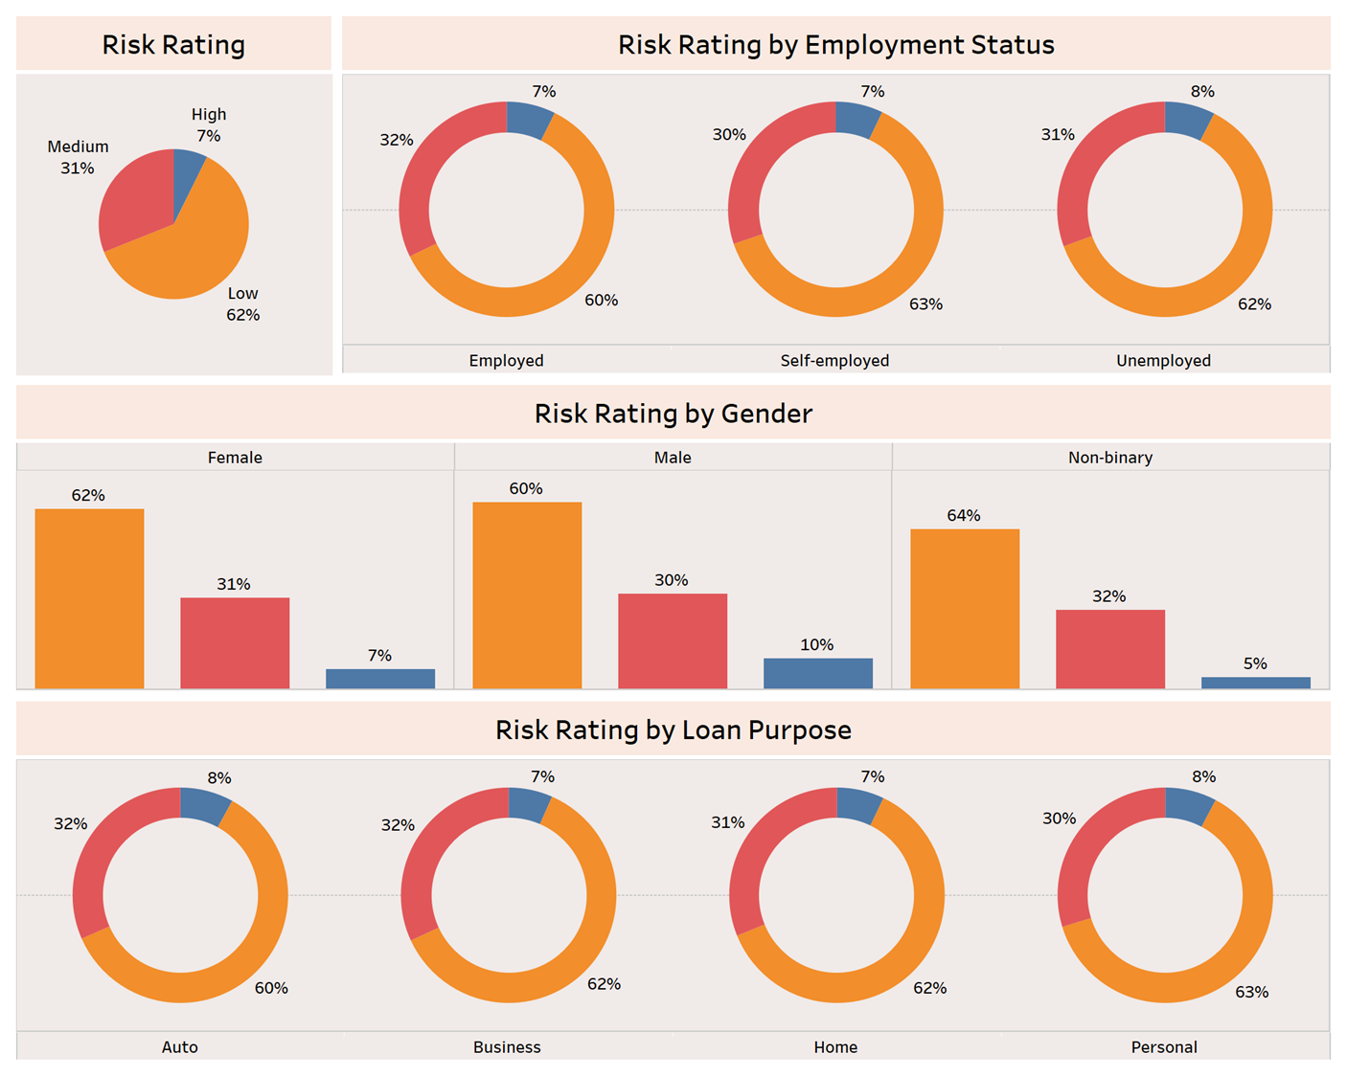

Slide 11
Risk Rating by Gender, Employment Status, & Loan Purpose
Overall Risk Rating Distribution:
The majority of individuals fall under the low-risk category (62%), while 31% are rated as medium risk, and only 7% are considered high risk.
This distribution suggests that most individuals in the dataset have a relatively low risk of default, which might influence loan approval strategies for the bank
Risk Rating by Gender:
Non-binary individuals have higher proportions in low-risk (64%) and medium-risk (32%) categories compared to males and females.
Males have a higher prevalence of high-risk ratings (10%) than females (7%) and non-binary individuals (5%), indicating males carry slightly higher financial risk.
Risk Rating by Employment Status:
The employed and self-employed have similar risk profiles, with low-risk individuals comprising 60% and 63% respectively, and medium-risk individuals around 30 - 32%. High-risk individuals are few across all groups, with the unemployed having the highest share at 8%. Overall, employment status has a minor impact on financial risk
Risk Rating by Loan Purpose:
Risk ratings are consistent across loan purposes, with low-risk individuals making up 60 - 63% and medium-risk individuals 30 - 32%. High-risk individuals are a small minority, with Auto loans at 8%, followed by Personal (8%) and Business loans (7%). This suggests loan type has minimal impact on financial risk.

Slide 12
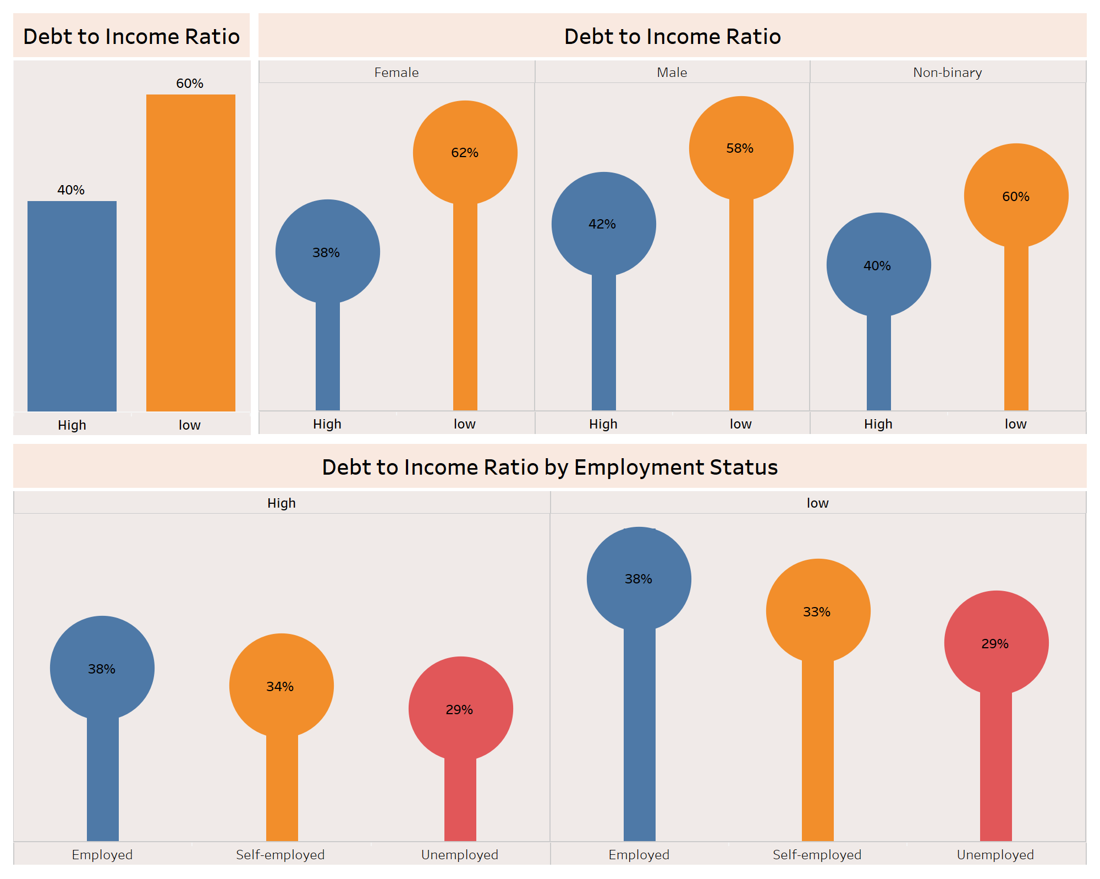

Slide 13
Debt-to-Income Analysis by Gender & Employment Status
Overall Debt-to-Income Ratio:
A larger portion of individuals have a low debt-to-income (DTI) ratio (60%), while 40% have a high DTI ratio.
This indicates that the majority of individuals in the dataset maintain relatively manageable debt levels compared to their income, suggesting potentially lower financial strain and risk for the bank.
Debt-to-Income Ratio by Gender:
Females show a higher proportion of individuals with a low DTI ratio (62%), while 38% have a high DTI ratio.
Males also have a majority in the low DTI ratio (58%), but the percentage of males with a high DTI ratio (42%) is slightly larger than that of females.
Non-binary individuals exhibit the same pattern as females, with 60% having a low DTI ratio and 40% a high DTI ratio.
This suggests that males are more likely to have a higher debt burden relative to income compared to females and non-binary individuals, who generally have lower debt ratios.
Debt-to-Income Ratio by Employment Status:
Employed individuals show the highest High DTI ratio, with 38% closely followed by Self-employed individuals (34%) and the Unemployed individuals have the lowest High DTI ratio.
As for the highest Low DTI ratio, the pattern persists.

Slide 14
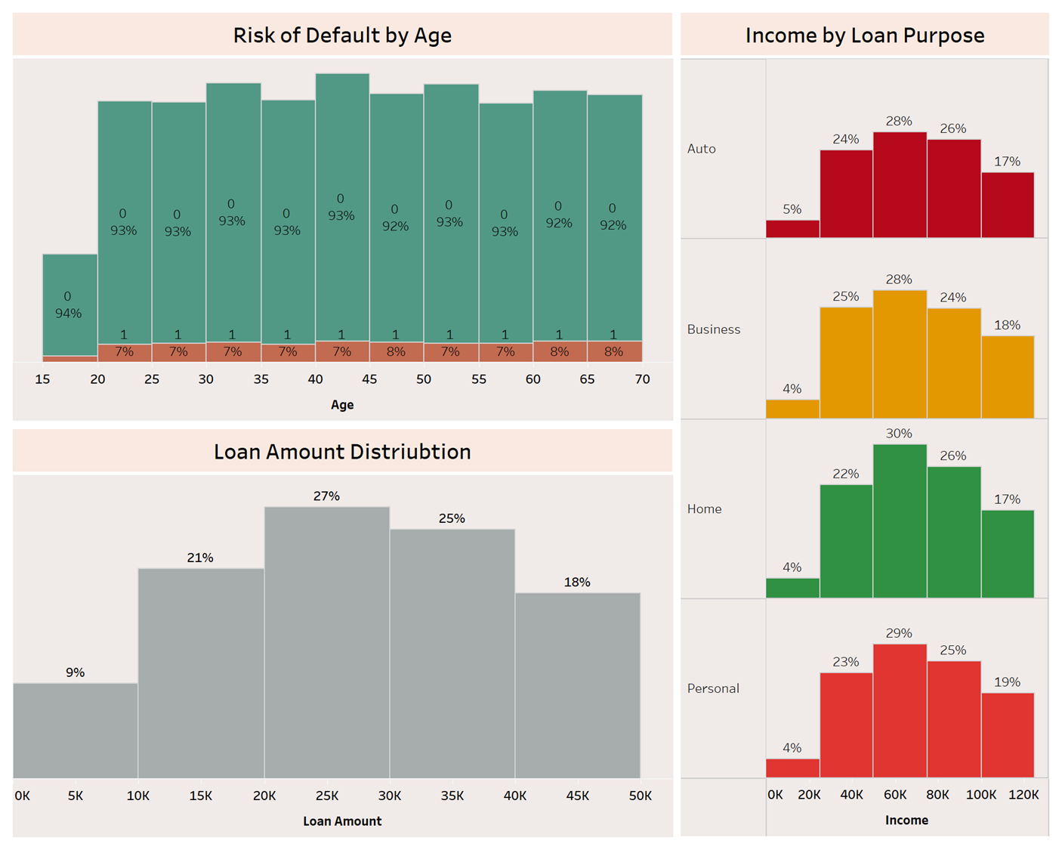

Slide 15
Loan Amount Distribution and Risk Analysis by Age
Risk of Default by Age:
Across most age groups, the risk of default remains relatively stable, with 93% to 94% of individuals across age brackets showing no default risk.
The percentage of individuals with a risk of default remains low at 7% to 8%, with slight variations across the ages.
Loan Amount Distribution:
The most common loan amounts are clustered in the $20K - $30K range, representing 27% of all loans.
Smaller loan amounts up to $5K are less common, making up 9% of the total, while the largest loan amounts of $40K - $50K are also less frequent, accounting for 18%.
This suggests that mid-range loans ($20K - $30K) are the most popular among borrowers
Income by Loan Purpose:
Individuals who fall under the $45K to $80K income range have a majority in all the types of loans and Home loans being the highest. Individuals up to the $20K income range have the lowest representation in all the types of loans.

Slide 16
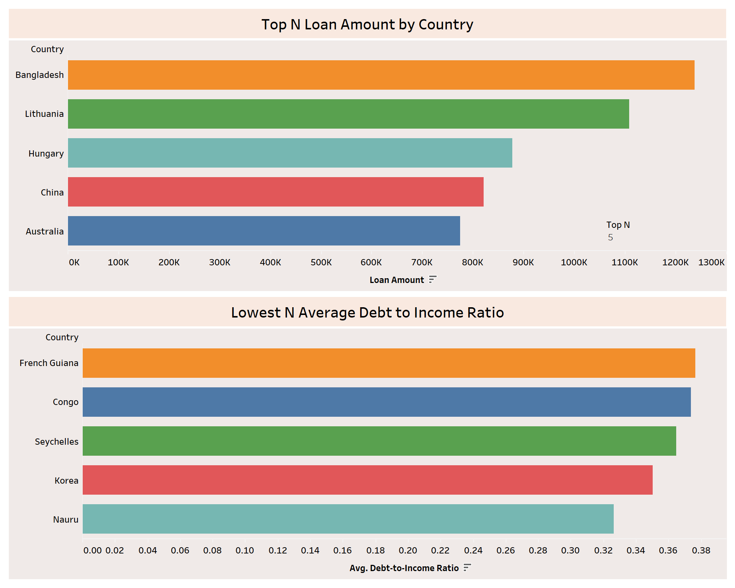

Slide 17
Country wise Analysis
Top N Loan Amount By Country:
The image shows the top 5 countries with the highest loan amounts with Bangladesh ranking 1st and Australia ranking 5th .
This suggests that Bangladesh has a higher loan volume compared to other countries which may be die to a higher demand for credit.
Lowest N Average Debt-to-Income By Country:
French Guiana ranks as the country with the lowest debt-to-income ratio and Nauru ranks as the 5th country with the lowest average DTI.
A lower debt-to-income ratio typically indicates a healthier financial status, suggest that individuals in these countries are borrowing responsibly relative to their income.

Slide 18
Thank You

