Slide 1
Real Estate Value Forecasting
Presented By Mohammed Maanish
PGDA - 37

Slide 2
Introduction – Problem Statement
Buying a home is a major financial decision, and understanding its potential cost is crucial. The real estate market is highly dynamic, with property prices fluctuating due to various factors. Accurately predicting real estate prices is crucial for homebuyers. Traditional methods of property valuation often rely on expert opinions, which may lack consistency. Key factors like location, size, etc, play a big role in determining house prices.

Slide 3
Introduction - Objective
The primary objective of this project is to use various machine learning models capable of forecasting real estate property values based on historical data and relevant features. The models will aim to provide accurate price predictions that can help make informed decisions in real-time.

Slide 4
Dataset Overview
The dataset has been obtained from Kaggle.
It contains features like, Area Type, Location, Size, Total Square Feet, Price, etc.
The dataset contains a total of 13320 rows and 9 columns before data preprocessing.
The dataset also contains missing values, duplicates and other inconsistencies that have been rectified before model building

Slide 5
Data Preprocessing - Duplicates
The dataset contains 529 duplicate rows.
All duplicate records have been dropped

Slide 6
Data Preprocessing – Missing Values
The dataset contains 6023 missing values. The values from each column with missing columns are as follows
Location: 1
Size: 16
Society: 5328
Bath: 73
Balcony: 605

Slide 7
Data Preprocessing – Missing Values
Location:
Dropped the record since only 1 null value
Society:
Fill the missing values with 'independent’. This step may increase bias, but removing 42% of the data is out of the question.
Balcony:
Assume the missing values in 'balcony' indicates that there's no balcony.
Total Square Feet:
Feature Engineering carried out
Size:
Feature Engineering carried out

Slide 8
Data Preprocessing – Feature Extraction
The size feature contains many inconsistencies.
This feature is broken down into two new features, namely, house_size and house_type.
The house_type feature represents either BHK, RK or Bedroom
The house_size feature represents the number of rooms

Slide 9
Data Preprocessing - Outliers
The features, price, bath, total_sqft contain outliers.
The outliers are treated using IQR and given some leeway in order to reduce excessive data loss.

Slide 10
Data Preprocessing – Encoding
The availability feature is manually encoded.
‘Ready to Move’ is set to 1 and the rest is set to 0.
Target encoding is applied on society and location.
these columns does not contain any inherent order and have 2,686 & 1305 distinct society and locations respectively.
Ordinal Encoding is applied on area_type.
'Super built-up Area': 4, 'Built-up Area’: 3, 'Plot Area': 2, 'Carpet Area': 1

Slide 11
Model Building
The following models have been used to make predictions
Linear Regression, Ridge Regression, Decision Tree Regressor, Random Forest Regressor, Gradient Boosting Regressor, Ada Boost Regressor, XGB Regressor, and, Extra Trees Regressor.
The model with the best performance is chosen to make the final predictions

Slide 12
Model Results
ID | MODEL | MAE | MSE | RMSE | R2
0 | XGBoost | 0.16 | 0.05 | 0.23 | 0.86
1 | Random Forest | 0.16 | 0.06 | 0.24 | 0.86
2 | Extra Trees | 0.17 | 0.06 | 0.25 | 0.85
3 | Gradient Boosting | 0.19 | 0.07 | 0.26 | 0.84
4 | Decision Tree | 0.21 | 0.10 | 0.32 | 0.75
5 | Ridge Regression | 0.25 | 0.11 | 0.33 | 0.73
6 | Linear Regression | 0.25 | 0.11 | 0.33 | 0.73
7 | AdaBoost | 0.27 | 0.12 | 0.35 | 0.70

Slide 13
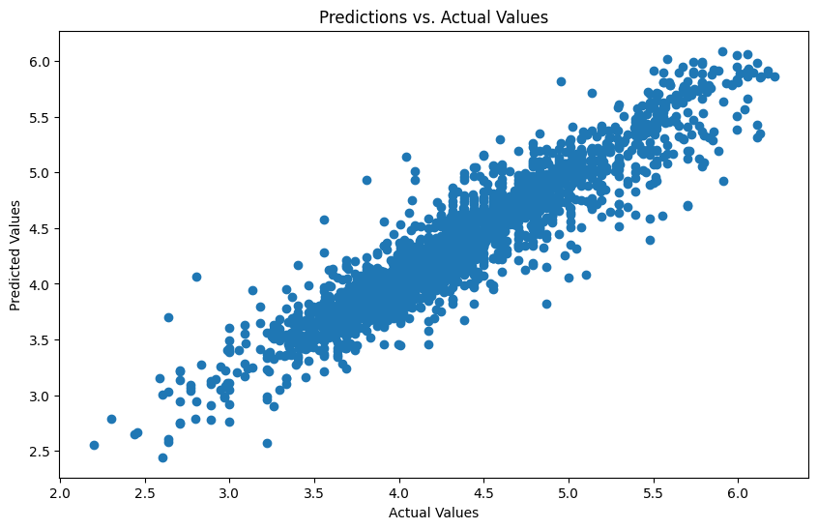
XGBoost – Predictions vs Actual

Slide 14
Future Improvements
Dimensionality Reduction techniques like PCA to further improve the models performance.
Deploying the model using web application tools like Flask.
Handling missing data more effectively.
Further Hyperparameter tuning

Slide 15
Conclusion
The XGBoost algorithm performed the best, achieving an R2 score of 0.86. This suggests that the model captures a significant portion of the variance in house prices but still leaves room for improvement.
Through careful data preprocessing, feature engineering, and the handling of outliers and missing values, the model demonstrated strong predictive power. The use of multiple models and cross-validation ensured the model's robustness. Further improvements could be achieved by incorporating additional features and exploring advanced algorithms for better accuracy.

Slide 16
Thank You.

