Slide 3
44 columns/variables to take into consideration – we can drop 6
3 of the columns regarding partner – missing values and no consistency, would not provide a reliable prediction
Column regarding number of children who are 16-18 – zero for all clients in this cohort
Columns regarding physical disability and mental health vulnerabilities – these are 1 (assuming this means that they are vulnerable) for all clients so not useful for prediction
Leaves us with 38 columns

Slide 4
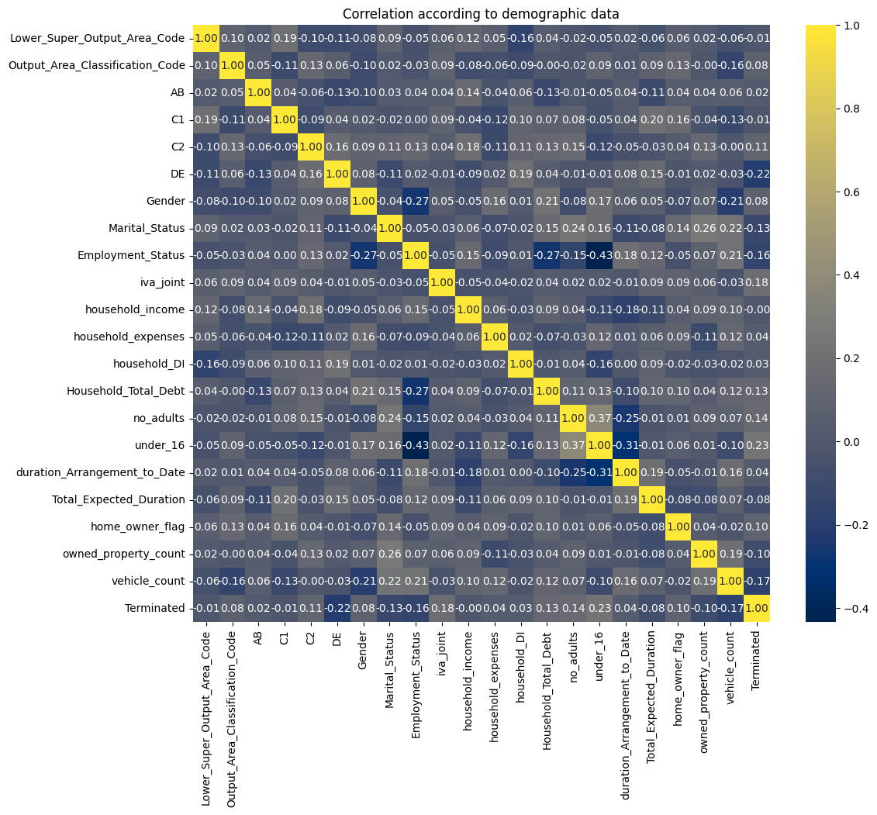
We can start seeing some relevant values
DE negatively correlates (-0.22)

Slide 5
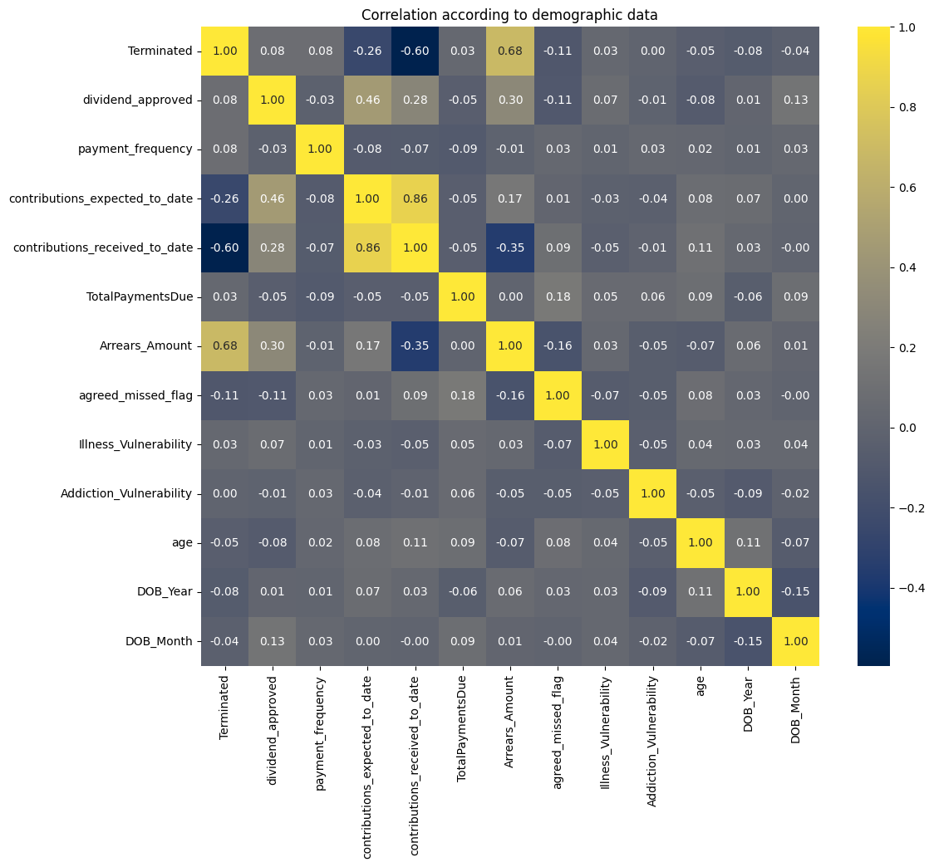
Contributions expected to date – neg correlate (-0.26)
Contributions received to date – neg correlates (-0.60)
Arrears amount – positively correlates (0.68)

Slide 6
Demographic data
6 columns
Area code – seems to correspond to the postcode
Classification code – ‘high level social grades’ is the explanation we are given; however, what does this mean? Is this a ranking with 1 being the best and the higher the number, the worse the social grade? Maybe it indicates the number of people in this area code who are in the highest social grade? This should then correlate with the % of AB in the area code, which it does not (Class code 79 has AB 13.7% but Class code 124 has AB 16%)
AB, C1, C2, DE – percentages of various social grades; but % of what? Is this the percentage of the population within the area code? If so, shouldn’t this add up to 100% for the specific area?

Slide 7
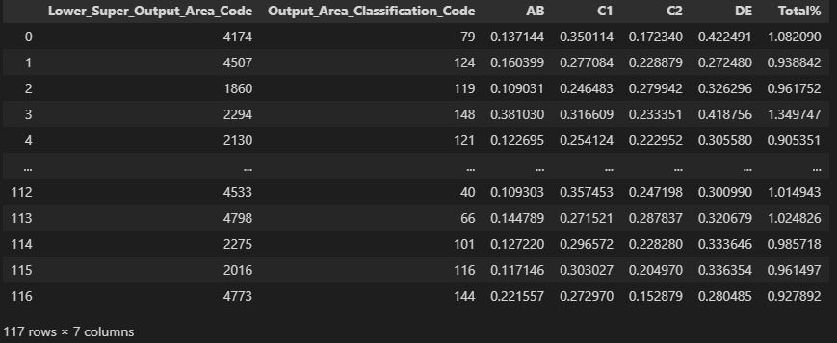
The percentages do not add up to 100 – they are slightly above or slightly below
This tells me the percentages may be calculated on something else rather than the area code – maybe the numbers are obtained from a wider area code and the percentages are then pulled down to the smaller area codes which then do not fully correspond

Slide 8
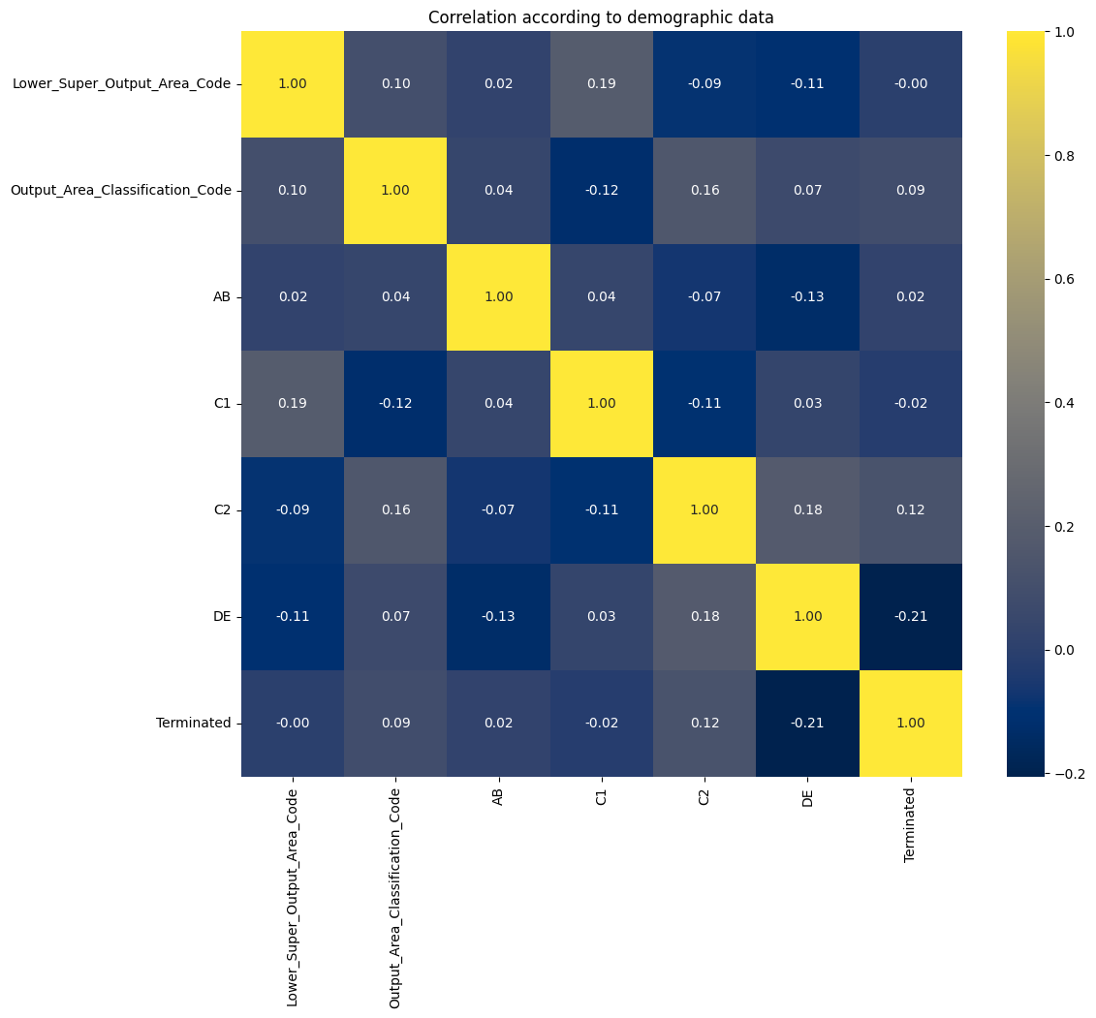
Correlation matrix in demographic data – small correlation between DE and termination (-0.21)

Slide 9
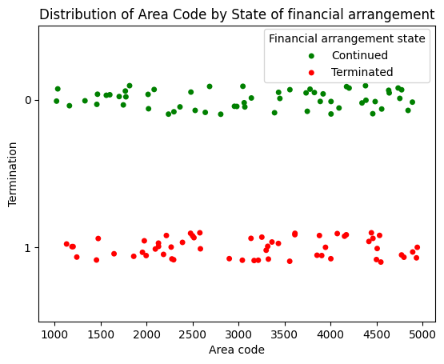
We can see there is not much correlation between area code and whether the arrangement has been terminated or not
I am not convinced this data is useful for our prediction – at least not without further information on what the various parameters mean and where they were obtained from

Slide 10
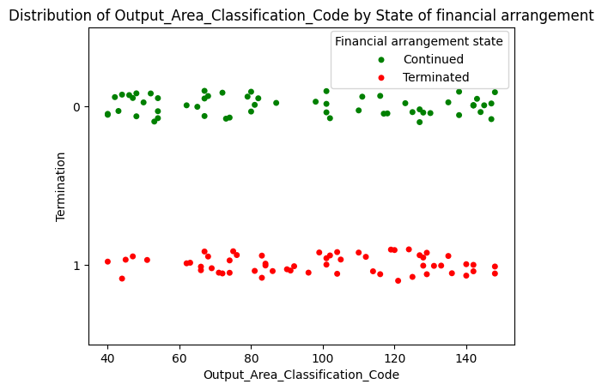
Again, no correlation

Slide 11
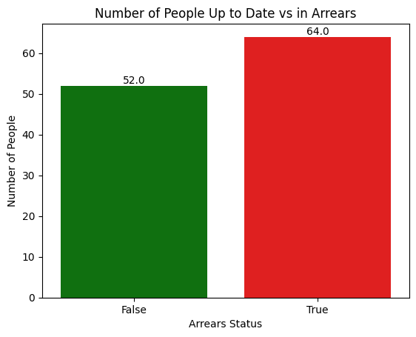
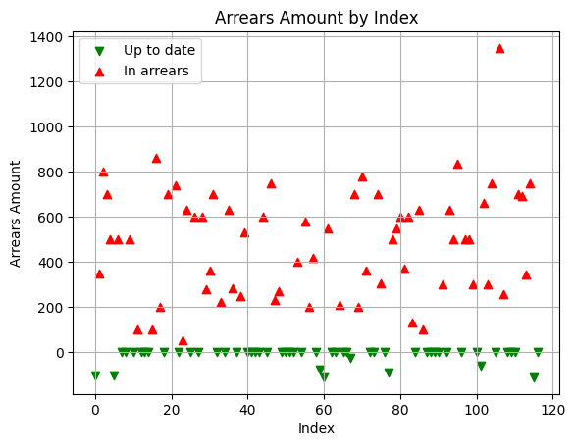

Slide 12
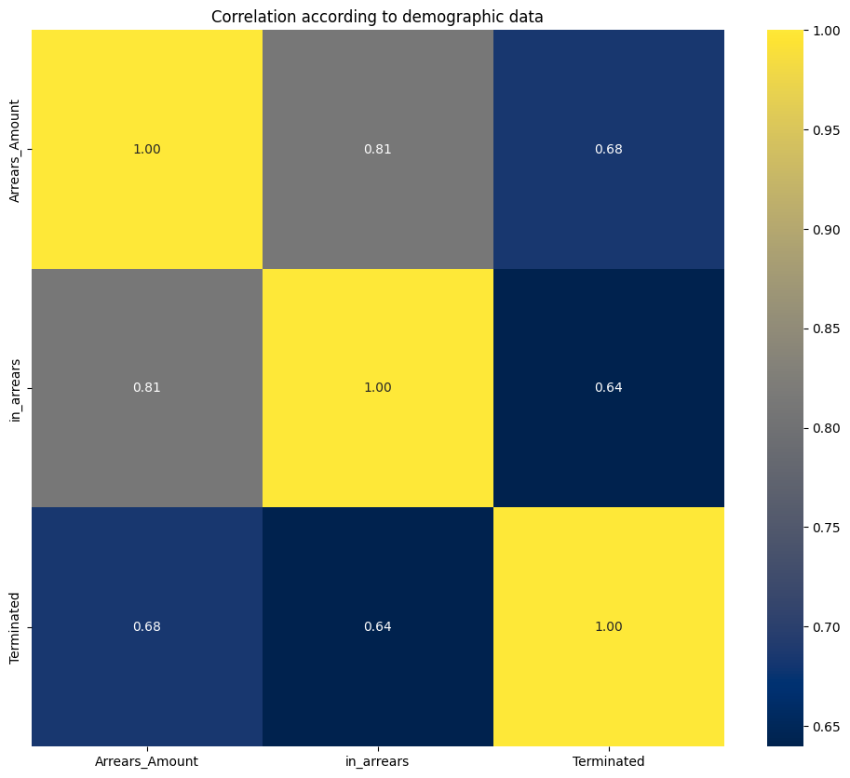

Slide 13
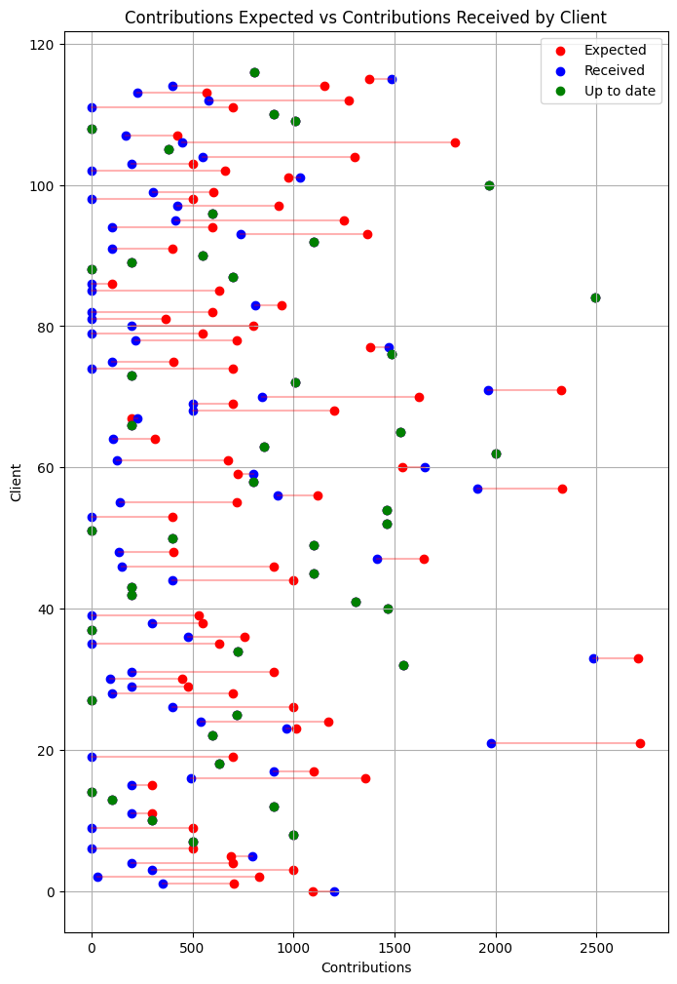

Slide 14
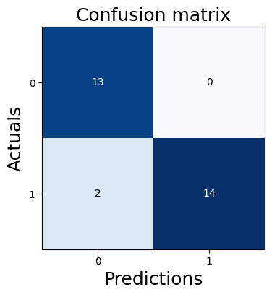
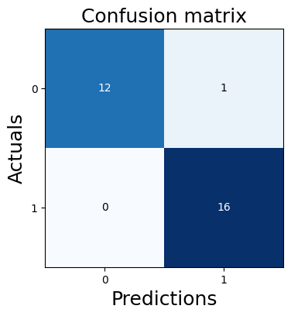
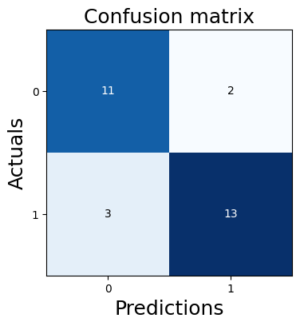
Naïve Bayes
TP
FP
FN
TN
96.55%
Logistic regression
kNN
92.76%
82.76%

Slide 15
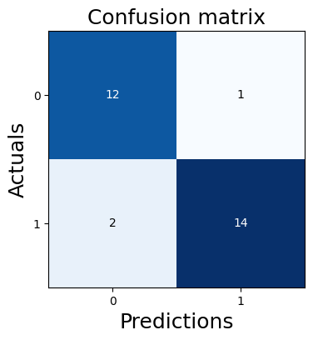
Decision tree classifier
Gini
93.10%
Entropy
93.10%
Max depth 3
89.66%

Slide 16
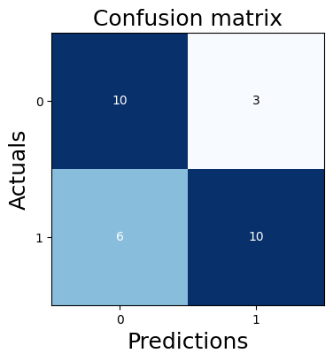
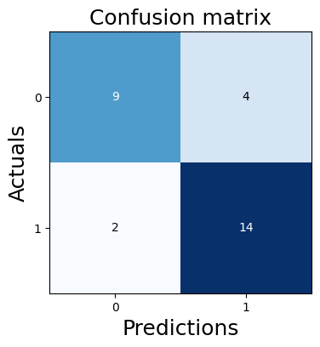
SVM
Linear
89.66%
Sigmoid
68.97%
RBF
79.31%

Slide 17
Random forest
93.10%

