Slide 1
Good-Light Bad-USB
Lab Training Embedded Systems SS2018
12 July, 2018
By: Rachit Gupta
Bidisha Bera
Iresh Dudeja

Slide 2
Contents
Task purpose
Hardware Requirements
Design
Implementation
Demonstration

Slide 3

Purpose
Low Light intensity in room.
Light Sensor detects the light intensity.
Prompt user to increase the light intensity.

Slide 4
Hardware Requirements
Arduino Board
Breadboard
LCD screen
LDR(Light-Dependent Resistor)
220 ohm resistor
Jumper wires

Slide 5
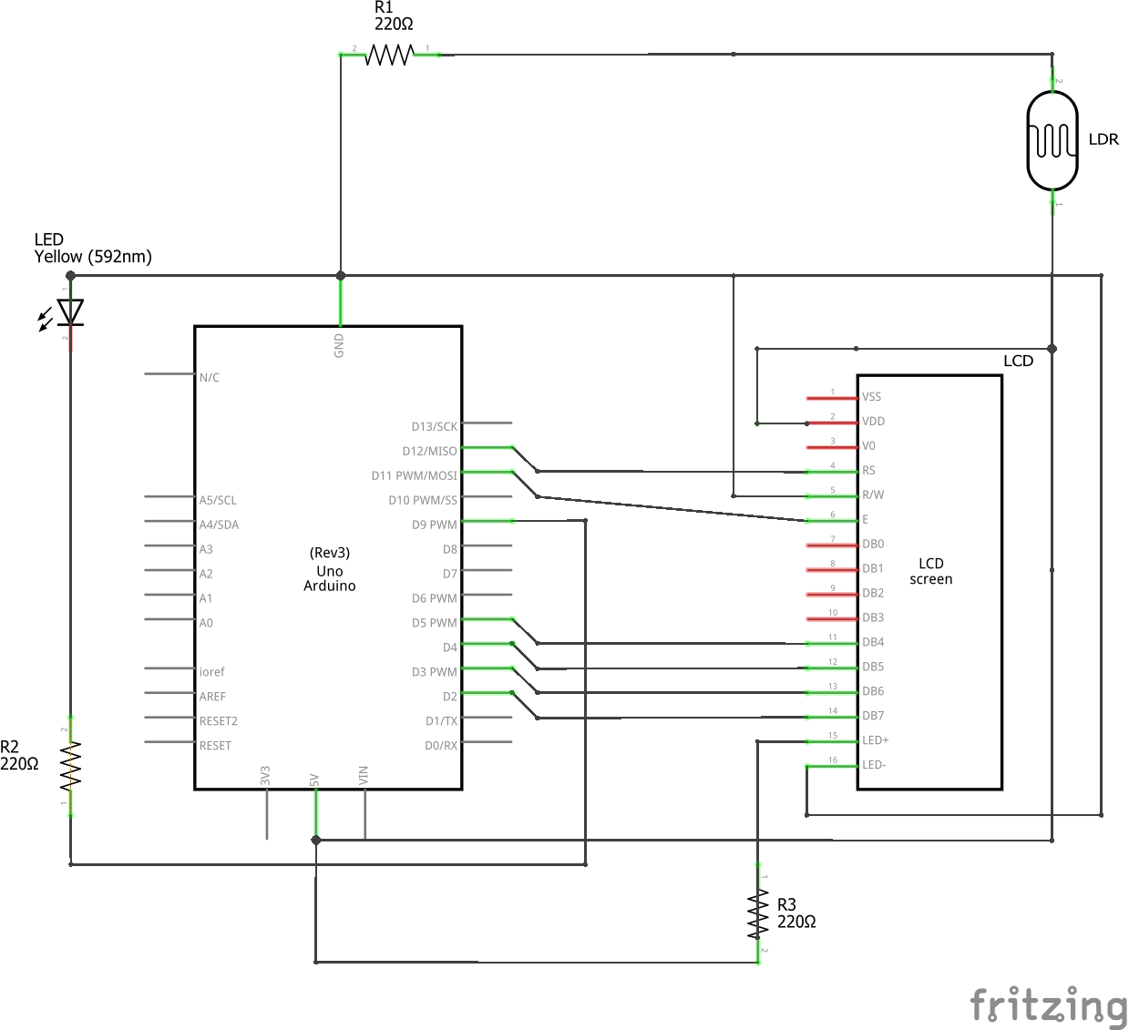
Design

Slide 6
Implementation
LDR(Light-Dependent Resistor) should continuously sense the intensity of the surrounding Light.
If the surrounding light intensity is High:
Do Nothing.
If the surrounding light intensity is Low:
After 1 minute display a pop-up on monitor with message "Light Intensity is Low. Please increase the Light Intensity."
Wait for 5 minutes so that user can increase the light intensity.
If person doesn't increase the light intensity:
Perform the action i.e. Lock the PC screen.
If user increase the light intensity:
Do Nothing.

Slide 7
Demonstration

Slide 8
Thank you!!!
https://github.com/ireshdudeja/GoodLight_BadUSB

