Slide 1
Good-Light Bad-USB
Lab Training Embedded Systems SS2018
12 July, 2018
By: Rachit Gupta
Bidisha Bera
Iresh Dudeja

Slide 2
Contents
Task purpose
Hardware Requirements
Design
Implementation
Demonstration

Slide 3

Purpose
Low Light intensity in room.
Light Sensor detects the light intensity.
Prompt user to increase the light intensity.

Slide 4
Hardware Requirements
Arduino Board
Breadboard
LCD screen
LDR(Light-Dependent Resistor)
220 ohm resistor
Jumper wires

Slide 5
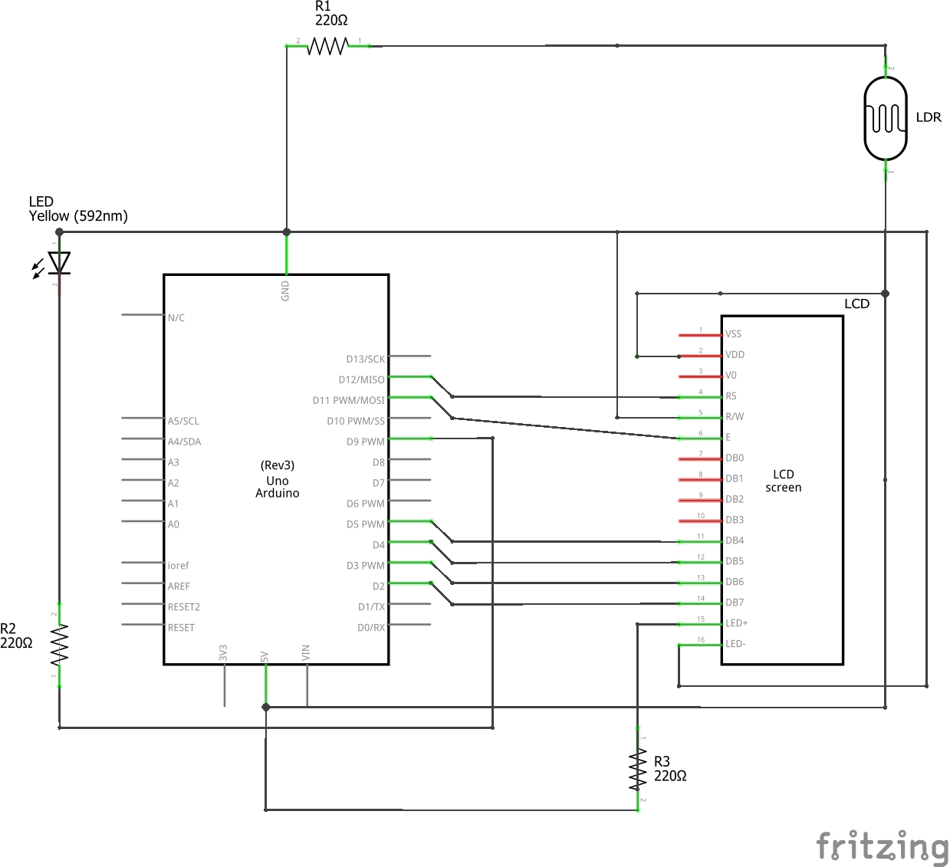
Design

Slide 6
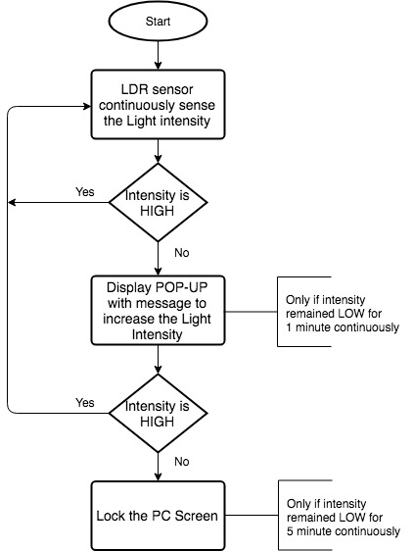
Implementation

Slide 7
Demonstration

Slide 8
Thank you!!!
https://github.com/ireshdudeja/GoodLight_BadUSB

