Slide 1
AI Co-Design of a Reusable Rocket
10-Day Summer Program — Complete Technical Journey
Tsinghua University Summer Program · July 2026
Conceptual Vehicle: CRLV-1 | Payload: 1.2–2.0 t to LEO/SSO | Reusable First Stage
AI-Assisted Multidisciplinary Engineering Workflow

Slide 2
Program Overview — 10 Days, One Conceptual RLV
• Objective: Design a conceptual reusable launch vehicle (RLV) using AI-assisted engineering workflows
• Focus: Requirements decomposition, MDO, trade-off analysis, uncertainty quantification, engineering communication
• Philosophy: Scientific process > perfect rocket | Novelty > replication | Documentation > results
• Team: 3–5 students + LLM copilot + Prof. Xu (Chief Engineer) + Graduate mentors
• Deliverables: Mission report, mass budgets, propulsion trade, trajectory sims, recovery concept, optimization, cost/risk, technical review, final presentation
• AI Protocol: Every major decision logged with prompt, response, rationale, and impact (see ai_logs/)

Slide 3
10-Day Schedule (from Program PDF)
Day | Date (2026) | Theme | Primary Deliverable | Key Focus
1 | Jul 11 | Mission Definition | Mission Requirements | Stakeholders, CONOPS, L0/L1 reqs, sustainability
2 | Jul 12 | Rocket Fundamentals | First-Order Sizing | Rocket equation, mass fractions, strawman vehicle
3 | Jul 13 | Propulsion System | Engine Selection Trade | Engine DB, methalox vs kerolox, Pugh matrix
4 | Jul 14 | Mass Budget & Materials | Vehicle Architecture | Subsystem mass roll-up, CFRP/Al-Li/AM, TPS
5 | Jul 15 | Aerodynamics & Trajectory | Flight Profile Report | 3DOF ascent/descent, heating, landing dispersion
6 | Jul 16 | Reusability Strategy | Recovery Concept | Propulsive vs net-capture, turnaround, GNC
7 | Jul 17 | AI-Assisted Optimization | Design Iteration | MDO, Pareto front, LLM mutation, PINN surrogate
8 | Jul 18 | Reliability & Economics | Cost & Risk Analysis | Cost model, Monte Carlo, business case, GRI
9 | Jul 19 | System Integration | Technical Review | Mass closure, interface control, red-team critique
10 | Jul 20 | Design Competition | Final Presentation | Story arc, demo, notebook export, repo package

Slide 4
Guiding Principles (from 10_DAY_BLUEPRINT.md)
Core Principles
• Scientific Process First: Hypotheses → models → validation → iteration → documented rationale
• AI as Copilot, Not Oracle: Ideation, code, literature synthesis, trade-offs — always log prompts + decisions
• Novelty Preference: Bio-inspired recovery, PINN surrogates, sustainable propellants, explainable MOO, metamaterial TPS
• Academic Professionalism: Reproducible artifacts, UQ, balanced trade-offs, clear communication
• Scope Realism: Conceptual vehicle, first-order models + selective high-fidelity pockets, 1–2 novel contributions
Daily Practice & Tools
• Cross-Cutting Threads (every day):
• • AI interaction logging (ai_logs/)
• • Uncertainty & sensitivity analysis
• • Sustainability / lifecycle angle
• • Benchmarking vs real vehicles (Falcon 9, Zhuque-3, Neutron, LM-10B)
• • Engineering notebook updates
•
• Tools Stack:
• • Python (NumPy, SciPy, Matplotlib, Pandas, SymPy)
• • RocketPy / OpenRocket / custom 3DOF
• • PyTorch/JAX for surrogates, pymoo for MDO
• • Plotly for interactive trades
• • Markdown + LaTeX for reports

Slide 5
Day 1: Mission Definition — Completed Deliverables
Key Requirements & Innovations
• L0 Objectives (6): Payload 1.2–2.0 t, ≥10 reuse, <$2.8k/kg, CO₂e <15 t/t, 30-day responsiveness, 0.95 reliability
• L1 Requirements (15+): Performance, reusability, cost, environment, reliability, operations
• Novel: Green Reusability Index (GRI) as top-level FoM
• Novel: Explicit net-capture recovery evaluation (LM-10B 2026 demo)
• Stakeholder matrix, CONOPS, risk register, traceability skeleton
• Vehicle comparison table: 10 reference vehicles (2026 data)
Deliverable Artifacts
• Artifacts in docs/01_mission_requirements/:
• • mission_requirements.md (v0.2, 92 lines)
• • research_summary_2026.md (115 lines, 2025-26 data)
• • vehicle_comparison_table.md (10 vehicles)
• • stakeholder_analysis.md, initial_conops.md
• • risk_register.md, requirements_traceability.md
• • mission_concepts_alternatives.md
•
• AI Logs: prompts/day01_mission_definition.md, decisions/day01_initial.md
• Engineering notebook: Day 1 entry with hypotheses, decisions, open questions

Slide 6
Day 1: Key Reference Data (2025–2026 Verified)
2026 Benchmark Data & CRLV-1 Targets
22,800 kg
~18,300 kg
~16,000 kg
Falcon 9 Reusable LEO
Zhuque-3 Recovered LEO
LM-10B Net Capture LEO
8,500 kg
8,000 kg
~19 t
Hyperbola-3 Recovered
Pallas-1 Baseline
RP-1/LOX CO₂e/t payload
1,200–2,000 kg
10–20 flights
<$2,800/kg
CRLV-1 Target Payload
CRLV-1 Reuse Target
Target Recurring Cost

Slide 7
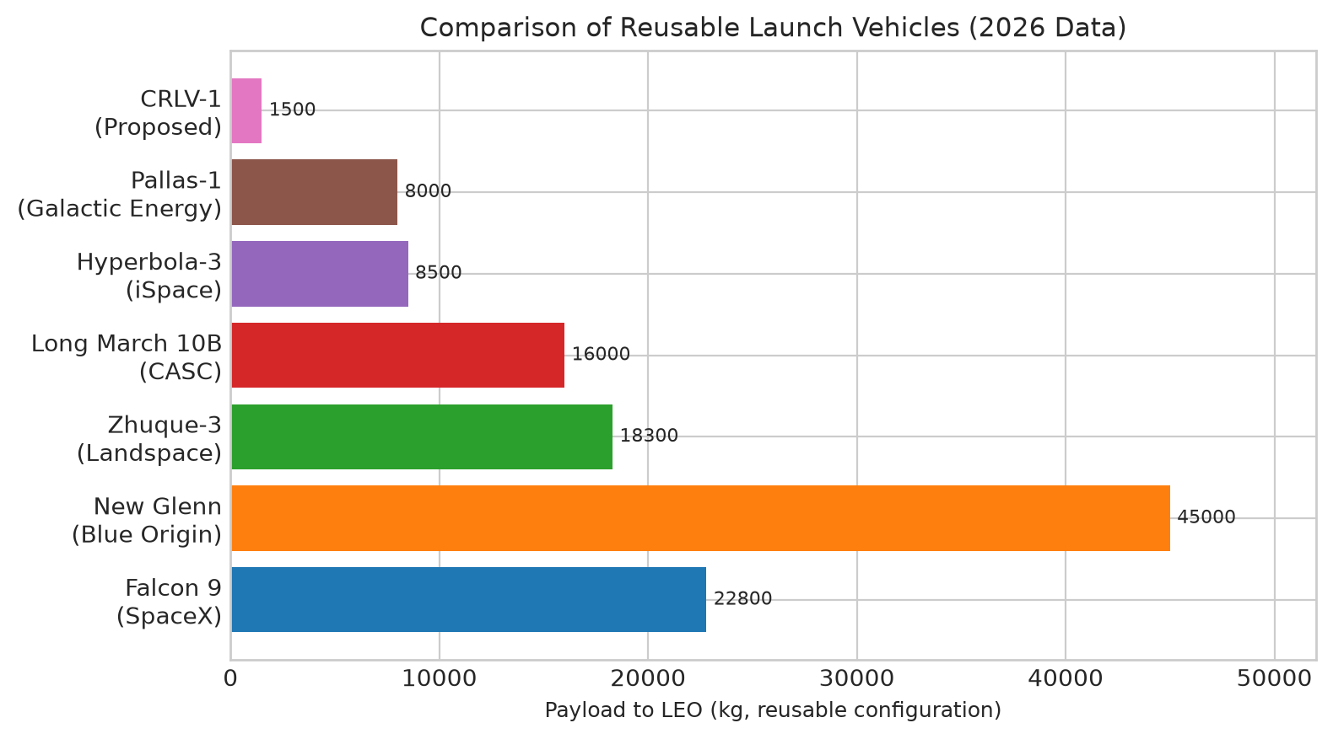
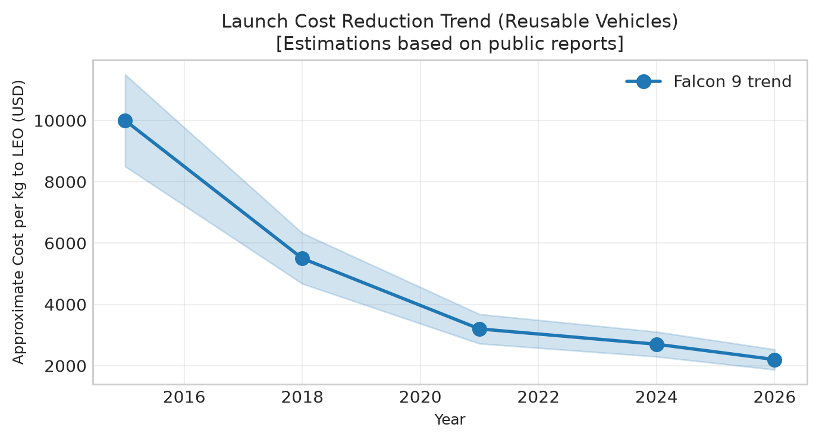
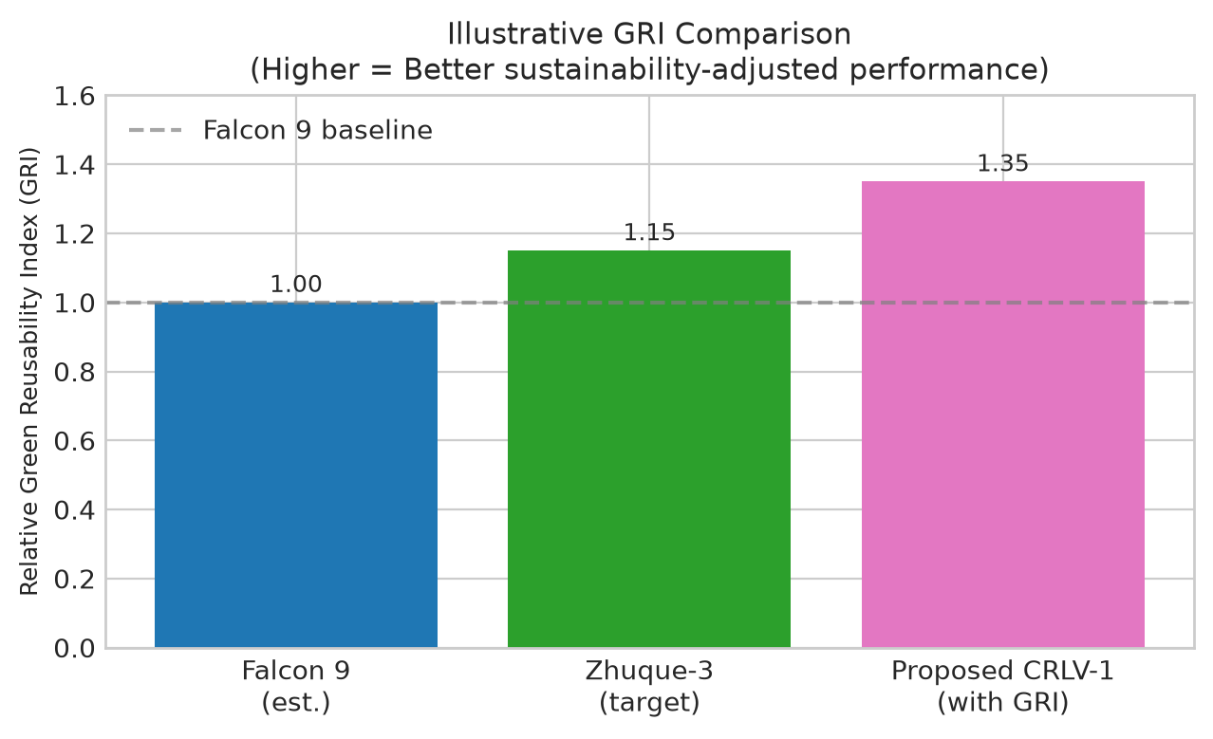
Day 1: Generated Figures
Reusable LEO Payload Comparison (2026)
Launch Cost Trend Driven by Reusability
Green Reusability Index (GRI) Concept

Slide 8
Day 2: Rocket Fundamentals & First-Order Sizing
Plan & Objectives
• Objectives: Rocket equation, staging laws, mass/dimension estimation, baseline strawman
• Novel: Symbolic regression for historical sizing laws, adaptive structural ratio by recovery mode
• Activities: Sizing script (code/sizing/), sensitivity on Isp & structural coeff, mass breakdown charts
• AI Co-pilot: Alternative architectures (SSTO reusable, TSTO, air-launch hybrid)
• Outputs: vehicle_sizing_report.md, baseline_mass_budget.csv, sizing_*.png
• Key parameters: Payload 1.2–2.0 t, Δv ~3.8 km/s (reusable), Isp 335 s (SL methalox)
Code & Analysis Scope
• Starter Code: code/sizing/first_order_sizer.py
• • Tsiolkovsky rocket equation
• • Dry mass estimation via structural coefficient
• • CLI args: payload, Δv, Isp
• • Placeholder for staging iteration
•
• Planned Sensitivity Studies:
• • Structural coefficient: 0.06–0.12
• • Isp: 320–350 s (methalox range)
• • Recovery propellant margin: 5–20%
• • Payload growth: 1.2→2.0 t impact
•
• Benchmarks: Falcon 9, Zhuque-3, Electron, Vega-C

Slide 9
Day 2: first_order_sizer.py — Starter Code
code/sizing/first_order_sizer.py
import numpy as np
G0 = 9.80665
def rocket_equation_dv(m0, mf, isp):
return isp * G0 * np.log(m0 / mf)
def estimate_dry_mass(payload, prop_mass, struct_coeff=0.08):
# struct_coeff = dry / (dry + prop)
return struct_coeff * (payload + prop_mass) / (1 - struct_coeff)
def size_vehicle(payload_kg, dv_target, isp_sl, struct_coeff=0.08):
# Iterative sizing with staging
# TODO: Add upper stage, recovery margins
pass
# CLI interface for quick trades
if __name__ == '__main__':
parser.add_argument('--payload', default=1200)
parser.add_argument('--dv', default=3800)
parser.add_argument('--isp', default=335)

Slide 10
Day 3: Propulsion System — Engine Selection Trade
Plan & Novel Angles
• Objectives: Survey candidate engines, propulsion trade study, tank/feed sizing
• Novel: Green propellants (LOX/LCH4 vs additives), throttleable aerospike, dual-mode boost+recovery
• Physics-informed surrogate for chamber performance
• AI Co-pilot: Weighted Pugh matrix for 6+ candidate engines
• Criteria: Isp, T/W, throttle range, reusability heritage, cost, manufacturability
• Outputs: engine_selection_trade.md, engines.csv, propulsion_trade.py
Engine Candidates & Trade Space
• Candidate Engine Database (data/benchmarks/engines.csv):
• • SpaceX Raptor 2/3 (methalox, 350s vac, deep throttle)
• • Blue Origin BE-4 (methalox, 339s vac, 55% throttle)
• • Landspace Tianque-12B (methalox, Zhuque-3, 9 engines)
• • iSpace JD-1 (kerolox → methalox transition)
• • Galactic Energy CQ-50 (kerolox, Pallas-1)
• • CASC Longyun (methalox, LM-12A)
• • Aerojet MRL10 (upper stage RL10-class)
•
• Trade Dimensions:
• • Stage count (7–9 booster engines)
• • Thrust-to-weight at liftoff (>1.3)
• • Restart capability for recovery burns

Slide 11
Day 4: Mass Budget & Advanced Materials — Vehicle Architecture
Objectives & Novel Materials
• Objectives: Detailed subsystem mass breakdown, material selection, structural sizing, tank design
• Novel Focus:
• • 3D-printed additively manufactured tank domes + lattice structures
• • Metamaterials / functionally graded materials for TPS
• • Lifecycle mass: refurbishment mass penalty
• Activities: Mass budget with margins, material property DB, simple structural model, architecture diagram
• Outputs: vehicle_architecture.md, materials_db.json, structures/ subsystem notes
Mass Categories & Material Options
• Subsystem Mass Breakdown Categories:
• • Structures: Tanks, interstage, thrust structure, grid fins
• • Propulsion: Engines, TVC, feed lines, pressurization
• • Recovery: Legs (or net-capture interface), TPS, RCS
• • Avionics: GNC, comm, power, harness
• • Residuals & Margin: 10–15% system margin
•
• Material Trade Matrix:
• • Al-Li 2195 (heritage, weldable, good cryo)
• • CFRP (high specific strength, complex joints, cost)
• • Ti alloys (high temp, recovery hardware)
• • Stainless 304L (Starship approach, low cost, heavy)
• • AM lattice cores (weight savings, inspection challenge)

Slide 12
Day 5: Aerodynamics & Trajectory — Flight Profile
Plan & Novel Approaches
• Objectives: Conceptual aero config, 3DOF/6DOF sim, ascent + descent profiles, q_max, heating, landing footprint
• Novel Ideas:
• • PINN (Physics-Informed NN) as fast trajectory surrogate
• • Bio-inspired variable camber / morphing surfaces for recovery
• • Monte Carlo dispersion on wind/guidance errors
• Activities: Implement/adapt trajectory code, generate altitude-velocity, heat rate, g-load plots
• AI Co-pilot: 3DOF simulator code + 3 non-standard recovery trajectories
• Outputs: flight_profile_report.md, trajectory_*.png, trajectory_sensitivity/
Trajectory Phases & Outputs
• Key Trajectory Phases to Model:
• 1. Ascent: Pitch program, gravity turn, staging
• 2. Booster separation & boostback/entry burn
• 3. Reentry: Hypersonic → transonic, grid fin control
• 4. Landing burn: Terminal guidance, hover, touchdown
•
• Key Outputs for Trade Studies:
• • Δv budget breakdown (ascent + recovery)
• • Max q, max g, stagnation point heating
• • Landing ellipse (3σ) vs propellant margin
• • Grid fin sizing for control authority
•
• Tools: Custom 3DOF (Python), RocketPy for validation

Slide 13
Day 6: Reusability Strategy — Recovery Concept
Recovery Options & Brainstormed Concepts
• Objectives: Choose primary recovery method, size hardware, define ground ops & turnaround, assess reuse number
• Baseline: Propulsive landing + grid fins + legs (Falcon-like)
• Novel Alternative (from LM-10B 2026): Net capture on sea platform — no landing legs
• Brainstormed Novel Concepts (draft/brainstorm/novel_recovery_ideas.md):
• 1. Hybrid drone-assisted mid-air capture + retro
• 2. Bio-inspired variable geometry / morphing surfaces
• 3. Ocean platform with active wave compensation + magnetic capture
• 4. ML landing controller with propellant slosh damping
• 5. Circular recovery hardware (AM remanufacturing)
• Activities: Recovery mass model, landing accuracy vs propellant trade, turnaround timeline
• Outputs: recovery_concept.md, subsystems/recovery/, Day 6 trade study
Trade Dimensions & Metrics
• Trade Study Dimensions:
• • Mass penalty (legs ~1–2% dry mass vs net ship ops)
• • Reliability (leg deployment vs net capture success)
• • Turnaround time (pad vs ship return)
• • Infrastructure cost (drone ship vs net vessel)
• • Environmental impact (transport emissions)
•
• Key Metrics:
• • Recovery success rate ≥90% after 5 flights
• • Turnaround ≤30 days (goal 14)
• • Refurb cost <10% of stage manufacturing
• • Landing accuracy ≤100 m (3σ)
•
• AI Prompt: "Compare 5 unconventional recovery architectures with rough mass penalty and TRL"

Slide 14
Day 7: AI-Assisted Optimization — Design Iteration
Objectives & Novel AI Methods
• Objectives: Multi-objective optimization (mass, cost, reliability, environment), major design iteration
• Novel Focus (from draft/brainstorm/optimization_novelty.md):
• • LLM-guided evolutionary operators (mutation = architecture suggestion)
• • PINN as fast surrogate inside optimizer
• • Multi-fidelity Bayesian optimization
• • Human-in-the-loop interactive Pareto steering via natural language
• AI Multi-Agent Session: Structures, Propulsion, Aero agents debate 5 radical variants
• Activities: Implement optimization/, run 2–3 cases, document Pareto front + selected point
• Outputs: optimization_report.md, updated baseline, strong notebook updates
Optimization Formulation
• Optimization Problem Formulation:
• Objectives (weighted from Day 1 FoM):
• 1. Maximize reusable payload (30%)
• 2. Minimize recurring $/kg (25%)
• 3. Maximize reusability score (20%)
• 4. Maximize GRI (15%)
• 5. Minimize responsiveness days (10%)
•
• Design Variables:
• • Booster diameter, length, engine count
• • Structural coefficient, propellant margin
• • Recovery architecture (legs vs net vs hybrid)
• • Material choices per subsystem
• • Upper stage config
•
• Code: code/optimization/multi_objective.py (pymoo)

Slide 15
Day 8: Reliability & Economics — Cost and Risk Analysis
Objectives & Novel Economics
• Objectives: First-order cost model, reliability block diagram, Monte Carlo cost/schedule, business case
• Novel Angles:
• • Carbon pricing integrated into cost model
• • "Insurance" model for reusability risk
• • Sensitivity to flight rate & refurb time
• • GRI as economic differentiator
• Activities: Cost model script, risk register + mitigations, sensitivity tornado plots
• Outputs: cost_risk_analysis.md, analysis/uq/, Monte Carlo results
Cost Model & Reliability
• Cost Model Components:
• Development (non-recurring):
• • Engine, structures, avionics, test, certification
• Per-Flight (recurring):
• • Propellant, refurbishment, recovery ops, range, insurance
• Refurbishment: Labor, parts, inspection, recertification
•
• Reliability Approach:
• • Fault tree / reliability block diagram
• • Historical failure modes (engine, TPS, GNC, recovery)
• • Bayesian updating with flight data
•
• Key Sensitivities:
• • Flight rate (2→12/yr) impact on $/kg
• • Refurb time (14→60 days) on fleet size
• • Carbon price ($50–200/t CO₂e) on propellant choice

Slide 16
Day 9: Final System Integration — Technical Review
Integration Activities
• Objectives: Consolidate subsystems, integrated checks, identify open issues, prepare technical review
• Integration Checks:
• • Mass closure (dry + prop + payload = liftoff)
• • Performance closure (Δv budget with margins)
• • Margin review (mass, performance, thermal, control)
• • Interface compatibility (mech, electrical, fluid)
• AI Red-Team Review: "List 10 strongest criticisms and potential fixes"
• Activities: System-level summary, light ICD, red-team exercise, review package
• Outputs: technical_review_package/, updated engineering_notebook.md
Review Package Contents
• Technical Review Package Contents:
• 1. Vehicle configuration drawing (block/exploded)
• 2. Mass properties report (CG, MoI, margins)
• 3. Performance summary (payload, orbit, Δv)
• 4. Key trade study decisions & rationale
• 5. Risk register with top 10 risks + mitigations
• 6. Cost estimate (dev + recurring + refurb)
• 7. GRI & sustainability assessment
• 8. Open issues & assumptions log
•
• Review Format:
• • 20-min presentation + 15-min Q&A
• • Peer-style critique (mentors + AI red team)
• • Action items for Day 10 finalization

Slide 17
Day 10: Design Competition & Showcase — Final Presentation
Presentation Narrative & Activities
• Objectives: 10–15 min presentation, supporting visuals, interactive demo, final notebook, polished repo
• Presentation Story Arc:
• 1. Problem: Why this mission? (constellations, sustainability, responsiveness)
• 2. Process: Scientific method + AI copilot workflow
• 3. Concept: CRLV-1 configuration & key specs
• 4. Trade-offs: Key decisions (propellant, recovery, materials) with evidence
• 5. Novel Insight: GRI, net-capture evaluation, AI-driven iteration
• 6. Conclusions: Performance, cost, risk, path forward
• Activities: Rehearse narrative, generate one-pager + poster, record AI highlights
• Outputs: docs/final/, figures/final/, FINAL_PRESENTATION.md/.pptx, clean repo
Final Package & Success Criteria
• Final Repository Package:
• • All docs/ folders polished
• • Code/ runnable with requirements.txt
• • Data/ with READMEs for each dataset
• • Figures/ with generation scripts
• • ai_logs/ complete prompt/decision trail
• • engineering_notebook.md (full journey)
• • draft/ cleaned or archived
•
• Showcase Elements:
• • Live trajectory plot (Plotly interactive)
• • Pareto front explorer
• • Mass budget waterfall chart
• • GRI vs cost trade visualization
• • AI decision log timeline
•
• Success Metrics (Academic Lens):
• • Decision process transparency
• • Evidence of iteration & learning
• • At least one novel contribution
• • Professional formatting & reproducibility

Slide 18
Cross-Cutting: AI Copilot Workflow (from draft/brainstorm/ai_collaboration_techniques.md)
Advanced AI Collaboration Methods
• Mandatory Protocol: Every major decision logged in ai_logs/ with prompt, model, response, decision, rationale
• Advanced Techniques Used:
• 1. Multi-Agent Role Play: Chief Engineer / Propulsion Lead / Structures Skeptic / Cost Accountant debate
• 2. Red Team / Blue Team: Attack current design with worst-case assumptions
• 3. Generative Design Mutation: LLM proposes new architecture vectors for evolutionary algorithm
• 4. Explainable Decision Extraction: AI writes technical review justifications
• 5. Prompt Chaining for UQ: List assumptions → assign uncertainties → qualitative Monte Carlo
• 6. Historical Failure Injection: "List 5 historical RLV failures related to X. Redesign to avoid."
Logging Standards & Templates
• Logging Standard (ai_logs/):
• • prompts/dayXX_topic.md — exact prompts used
• • decisions/dayXX_decision_log.md — outcomes & rationale
• • full_transcripts/ — optional raw responses
•
• Prompt Templates (draft/early_notes/ai_prompt_templates.md):
• • General Engineering Copilot (role, state, task, requirements)
• • Trade Study (weighted matrix, sensitivity, risks)
• • Novelty Injection (unconventional approaches + feasibility)
•
• Stretch Goal: "AI Engineering Copilot Best Practices" appendix in final report

Slide 19
Cross-Cutting: Sustainability & Green Reusability Index (GRI)
GRI Formulation & Trade Space
• From draft/brainstorm/sustainability_metrics.md:
• GRI = Payload_kg / (CO₂e_kg_per_flight + Refurb_Energy_Penalty)
•
• Components Tracked Across All Days:
• • Propellant production emissions (methane vs RP-1 vs H₂)
• • Manufacturing emissions (CFRP energy intensity vs Al)
• • Refurbishment energy + materials per flight
• • Recovery transport emissions (ship vs truck vs drone)
• • End-of-life disposal / recyclability
•
• Trades Enabled by GRI:
• • LOX/LCH4 vs LOX/RP-1: methane wins on emissions but has boil-off
• • Bio-derived RP or synthetic methane pathways
• • Ground landing vs ocean (transport emissions)
• • 3D-printed structures (lower buy-to-fly ratio)
•
• Optimization Target (Day 7): Maximize GRI alongside traditional FoMs
Data Sources & Novel Contribution
• Data Sources to Investigate:
• • LCA papers on Falcon 9, Ariane, Vega
• • Propellant production LCA databases
• • Carbon price sensitivity ($/t CO₂e scenarios)
• • Upper atmosphere effects (H₂O, NOx, black carbon)
•
• Novel Contribution:
• Instead of minimizing dry mass alone, optimize for
• "emissions per kg-to-orbit over 20 flights"
•
• Early Hypothesis:
• A slightly heavier vehicle using sustainable
• propellants + shorter refurb time could beat
• a lighter but dirtier design on GRI
•
• Alignment with 2025–2026 Trends:
• • EU/China policy pushing LCA in design
• • Methalox shift in all new reusable vehicles
• • Reusability itself reduces manufacturing emissions/flight

Slide 20
Repository Structure & Artifact Map (PROJECT_STRUCTURE.md)
tsinghua-rocket/
├── 10_DAY_BLUEPRINT.md # Day-by-day roadmap (living)
├── summer_program.pdf # Original program reference
├── README.md # Project overview
├── engineering_notebook.md # Living design log (core artifact)
├── PROJECT_STRUCTURE.md # This structure doc
├── docs/ # Formal deliverables
│ ├── 01_mission_requirements/ # Day 1 — 8 files completed
│ ├── 02_rocket_fundamentals/ # Day 2
│ ├── 03_propulsion/ # Day 3
│ ├── 04_mass_budget_materials/# Day 4
│ ├── 05_aerodynamics_trajectory/ # Day 5
│ ├── 06_reusability_recovery/ # Day 6
│ ├── 07_ai_optimization/ # Day 7
│ ├── 08_reliability_economics/# Day 8
│ ├── 09_system_integration/ # Day 9
│ ├── 10_final_presentation/ # Day 10
│ └── final/ # Polished final package
├── analysis/ # Trade studies, sensitivity, UQ
├── code/ # Reusable Python scripts
│ ├── sizing/ # first_order_sizer.py
│ ├── simulation/ # trajectory, aero
│ ├── optimization/ # multi_objective.py (pymoo)
│ └── utils/ # helpers, constants
├── simulations/ # Simulation outputs & models
├── data/ # Inputs, outputs, benchmarks
│ ├── inputs/mission_params.json
│ ├── benchmarks/engines.csv
│ └── outputs/*.csv
├── figures/ # All visuals (code + images)
├── ai_logs/ # AI copilot records (critical)
│ ├── prompts/ # Exact prompts
│ └── decisions/ # Decision logs
├── subsystems/ # Deep dives per subsystem
├── references/ # Papers, datasheets, .bib
└── draft/ # Temporary (cleaned by Day 10)
├── brainstorm/ # Novel ideas
├── early_notes/ # Assumptions, strawman
└── work_plans/ # Daily micro-plans

Slide 21
Current Baseline Parameters (data/inputs/mission_params.json)
Mission & Constraints
• Vehicle Name: Conceptual Small Reusable Launch Vehicle (CRLV-1)
• Payload Threshold: 1200 kg
• Payload Goal: 2000 kg
• Target Orbit: 500 km circular LEO or 700 km SSO
• Reuse Target: 10 flights
• Reuse Goal: 20 flights
• Turnaround Target: 30 days
• Turnaround Goal: 14 days
Figures of Merit Weights
• Max G-load: 4.5
• Max q: 40 kPa
• Landing Accuracy: 100 m
• Refurb Cost Limit: 15%
•
• FoM Weights:
• Payload: 30%
• Cost/kg: 25%
• Reusability: 20%
• GRI: 15%
• Responsiveness: 10%

Slide 22
Key Assumptions (from mission_params.json)
• Staging: Two-stage, reusable booster + expendable upper
• Primary Propellant: LOX/LCH4 (methalox)
• Recovery Baseline: Propulsive landing with grid fins + legs
• Alternative Recovery: Net capture on sea platform (evaluated)
• Sustainability Metric: Green Reusability Index (GRI)
•
• Reference Vehicles for Benchmarking:
• • SpaceX Falcon 9 (~22800 kg reusable LEO)
• • Landspace Zhuque-3 (~18300 kg recovered)
• • iSpace Hyperbola-3 (8500 kg recovered)
• • Galactic Energy Pallas-1 (8000 kg baseline)
• • CASC Long March 12A / 10B (net capture demonstrated 2026)

Slide 23
Engineering Notebook — Evidence of Scientific Process
Notebook Structure & Day 1 Content
• Living document: engineering_notebook.md
• Day 1 Entry Includes:
• • Hypotheses (3) with research backing
• • Key verified insights (Falcon 9, Chinese vehicles, sustainability)
• • Requirements work summary with artifacts
• • Figures of Merit with weights
• • AI interaction log references
• • Decisions & rationale (4 major decisions)
• • Open questions & high-uncertainty items
• • Next steps for Day 2 transition
•
• Template for Days 2–10:
• Focus | Hypotheses Tested | AI Prompts Used
• Major Outputs | Decisions & Rationale
• Open Questions | Next Steps
Purpose & Academic Value
• Purpose: Primary evidence of
• • Scientific process adherence
• • AI collaboration transparency
• • Iteration & learning documentation
• • Decision traceability
•
• Cross-References:
• • ai_logs/prompts/ — exact prompts
• • ai_logs/decisions/ — outcomes
• • docs/ — formal deliverables
• • code/ — reproducible models
• • figures/ — generated visuals
•
• Academic Value:
• Notebook > Perfect rocket
• Process documentation is the core grade
• Demonstrates engineering judgment

Slide 24
Targeted Novel Contributions (1–2 Core + Supporting)
Novel Contribution | Primary Day | Description & Impact | Status
1. Green Reusability Index (GRI) | Day 1–10 | Sustainability as top-level FoM with lifecycle CO₂e + refurb penalty; drives propellant, recovery, ops trades | Initiated
2. Net-Capture Recovery Evaluation | Day 6 | Grounded in LM-10B July 2026 success; formal trade vs propulsive legs; mass & ops implications | Initiated
3. AI Multi-Agent Optimization | Day 7 | LLM-guided evolutionary operators + PINN surrogate + human-in-the-loop Pareto steering | Planned
4. Carbon-Priced Cost Model | Day 8 | Integrated carbon cost ($50–200/t) into recurring economics; sensitivity to propellant choice | Planned
5. Bio-Inspired Morphing Recovery Surfaces | Day 6 | Variable geometry grid fins/control surfaces for ascent/descent optimization | Planned
6. Circular Recovery Hardware Design | Day 6/10 | AM remanufacturing of landing hardware; design for disassembly & recycle | Planned

Slide 25
Risk Mitigation & Contingency Plans (from 10_DAY_BLUEPRINT.md)
Risks & Mitigations
• Identified Risks:
• • Time slippage: Prioritize core deliverables; use minimum viable models
• • Model fidelity gaps: Always state assumptions & limitations explicitly
• • AI hallucination: Cross-check numbers with literature / simple physics
• • Scope creep: Freeze requirements after Day 2 (with change log)
• • Integration failures: Daily mass/performance closure checks from Day 4
•
• Contingency Actions:
• • If behind: Drop detailed UQ on Day 8 → qualitative + bounds
• • If ahead: Add stretch novel analysis (PINN trajectory surrogate)
• • If integration fails: Simplify architecture (fewer engines, fixed recovery)
• • If AI unreliable: Fall back to conventional methods + document
Milestones & Success Criteria
• Milestones & Checkpoints:
• • End Day 3: Baseline vehicle exists (rough numbers)
• • End Day 6: Reusable concept closed
• • End Day 7: ≥1 major AI-driven iteration complete
• • End Day 8: Quantified cost/risk
• • End Day 9: All subsystems integrated, review ready
• • End Day 10: Showcase ready
•
• Success Measurement (Academic Lens):
• 1. Quality & transparency of decision process
• 2. Evidence of iteration & learning
• 3. Clarity of communication
• 4. ≥1 novel or non-obvious insight
• 5. Professional formatting & reproducibility
•
• Remember: Journey & documented reasoning > perfect rocket

Slide 26
CRLV-1: AI Co-Design of a Reusable Rocket
10-Day Journey Complete — From Mission Definition to Technical Review
Key Deliverables: Mission Requirements · Vehicle Sizing · Propulsion Trade · Mass Budget
Trajectory Sims · Recovery Concept · AI Optimization · Cost/Risk · Integrated Review
Novel Contributions: GRI · Net-Capture Evaluation · AI Multi-Agent MDO · Carbon-Priced Economics
清华大学暑期项目 · 2026年7月 · AI辅助工程设计工作流

