Slide 1


GenAI Project Solution Presentation
A. Irfaan Fareed| AI Health Advisor

Slide 2


Problem Statement
To develop a tool that generates personalized health and wellness tips based on user profiles inputs such as age, gender, activity level, and health goals (e.g., weight loss, muscle gain).
Personalized health advice empowers individuals to make informed lifestyle choices, improving overall well-being and helping achieve specific health goals. However, it is not easy to obtain personalized and professional fitness advice in today’s world. So, the proposed system serves well, thus tackling this issue.
Objectives
1
2
3
4
To survey the user of their attributes(age, height, weight, gender, etc).
To create a RAG model that retrieves similar workout and diet context.
To provide personalized workout and diet plans based on user attributes,
To store the vector word bag in a cloud database.

Slide 3

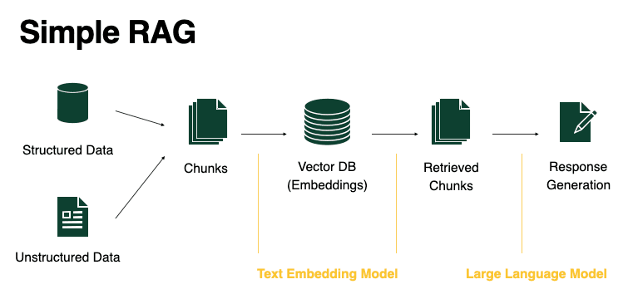
Approach and Methodology
This system employs the RAG - Retrieval Augmented Generation Model which enables the LLM to be supported by a database.
The dataset is split into chunks and converted/embedded into vectors which represent the relevance of the words that are stored in a chroma database in the cloud.
The user’s input query is converted to a similar vector and compared with the chroma database and the most relevant matches are converted back into words and displayed as a response.
Flask
Groq
GoogleApiClient
Langchain
Software Toolkit
Meta’s Llama3
LLM Model Used

Slide 4

Key Features
The proposed system removes the need to re-train the model whenever there is any change or update in the dataset.
The chroma database efficiently maps and stores words with their respective embedded vectors.
The vector dataset is stored in the cloud (Google Drive) for efficient access from remote devices.
The system produces precise results due to the double querying method -
First, the database is queried to fetch relevant data or context related to the query.
Then, the retrieved context itself is provided as input (which acts as examples for similar inputs) in the query to the LLM model (Llama3) which then provides a more personalized or precise routine.
The system suggests workout plan, diet plan and additional tips that are perfectly tailored to the user’s age, gender, Body Mass Index (BMI) and activity level.

Slide 5

Challenges and Learnings
Challenges | How I Overcame it?
It wasn’t easy to find a dataset for the system. Given that it was a RAG model, the conditions were too precise. | Instead of relying on a single dataset, I found multiple csv datasets and compiled them into a single markdown file by converting the rows into rules which were strings.
Finding a free LLM API was quite time consuming since most LLMs that offered the most features were subscription based. | Found the Groq API which is a tool that helps developers build and manage AI applications. It is used to query and filter data stored in the Chroma database and provided an interface to Meta’s Llama3 LLM model.
Rephrasing the prompt to produce the desired output was tiresome. | Trial and error method allowed me to discover the various types and formats of responses that the model produced and was able to filter out those undesired responses.
Uploading and downloading the file database directory in Google drive was out of order. | Performed recursive or tree-based upload and download.

Slide 6

Live Demo

Slide 7

Future Improvements
The database that is stored in the cloud can be encrypted, which requires the decryption process to happen before comparing the embedded relevance which is a direct comparison between the user query and the dataset.
A more effective cloud storage solution can be used that doesn’t need to download the directory onto the local/remote device.
The links to the food products in the suggested plan and workout equipment can be listed as an inventory in the result page using APIs like Google Shopping API.
The most viable real-world applications are -
As a prescription after cost-efficient overall fitness/health check-up.
Personalized gym trainer with diet plans that is complementary with gym memberships.
A cost-effective solution for routine prescription instead of consulting a fitness counsellor.

Slide 8

Conclusion
Thus, the proposed system addresses the challenge of personalized health management by implementing an AI-driven solution using RAG model that suggests tailored workout and diet plans based on individual user profiles. By leveraging efficient data retrieval methods and dynamic updates from a cloud-based Chroma database, the system ensures accuracy and adaptability. This innovation not only simplifies health tracking but also empowers users by promoting healthier lifestyles and better fitness outcomes.
Thank You
I welcome all questions and feedback you may have.

