Slide 1
Sales Call Performance Dashboard
Internship Task 4: Dashboard Design
Tool: Microsoft Power BI
Dataset: Product Sales

Slide 2
Project Objective
Objective: To design an interactive Power BI dashboard that analyzes sales call performance. The dashboard enables business stakeholders to monitor agent performance, product sales, call pickup status, average call duration, and conversion rate through interactive visuals and slicers.
Prepared by: Irfaan Basha | Tool: Microsoft Power BI

Slide 3
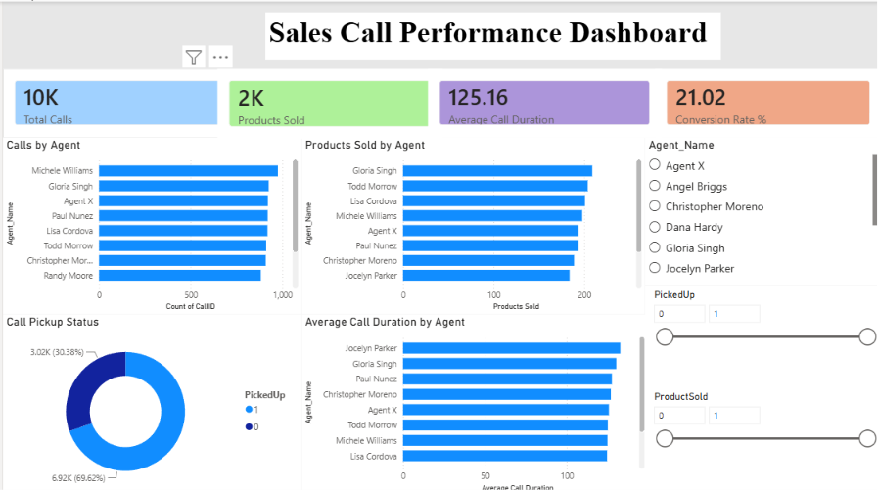
Dashboard Overview
Key KPIs
• Total Calls: 10K
• Products Sold: 2K
• Average Call Duration: 125.16 sec
• Conversion Rate: 21.02%
Prepared by: Irfaan Basha | Tool: Microsoft Power BI

Slide 4
Key Insights
• Total calls handled: 10,000
• Products sold: 2,102
• Overall conversion rate: 21.02%
• 69.62% of calls were picked up successfully.
• Top-performing agents achieved higher product sales.
• Average call duration: 125.16 seconds.
• Interactive slicers allow dynamic filtering by agent and sales status.
Prepared by: Irfaan Basha | Tool: Microsoft Power BI

Slide 5
Conclusion
✓ Designed an interactive and user-friendly Power BI dashboard.
✓ Used KPI cards, bar charts, a donut chart, and slicers.
✓ Analyzed sales calls, agent performance, and conversion rate.
✓ The dashboard supports data-driven business decisions.
✓ Successfully completed Internship Task 4.
Prepared by: Irfaan Basha | Tool: Microsoft Power BI

