Slide 1
ROUND 1 REVIEW
MaskGate | Smart Data Masking for PII Protection
Team Name
Team Leader
SENTINEX
Aswini Lakshya
Track
Date
BFSI / Problem 11
17 October 2026
Notes:
Source: official problem statement, https://be.innosmart.in/media/talentap/Smart%20Data%20Masking%20System%20for%20PII%20Protection_1.pdf
Official seven-slide template linked under this problem on the InnoSmart portal, reviewed 17 October 2026.
This is a proposed design. Implementation, testing and performance measurements are planned. Initial audience and adoption path are hypotheses, not measured market estimates. Build timing and permitted tools remain subject to organizer rules.

Slide 2
Use Case
Problem Statement
Sensitive customer fields can reach internal users who do not need the full values.
Support staff, analysts and administrators need different levels of access.
The task is to protect query results across databases while preserving the original records.
Market Opportunity
Target users: financial institutions with support and analytics teams.
Growth path: pilot sensitive tables, then extend the same policies to more databases.
Alternatives: native database masking, manual tagging and separate masked copies.
Market size is not yet quantified; validate demand and deployment effort in a pilot.
Notes:
Source: official problem statement, https://be.innosmart.in/media/talentap/Smart%20Data%20Masking%20System%20for%20PII%20Protection_1.pdf
Official seven-slide template linked under this problem on the InnoSmart portal, reviewed 17 October 2026.
This is a proposed design. Implementation, testing and performance measurements are planned. Initial audience and adoption path are hypotheses, not measured market estimates. Build timing and permitted tools remain subject to organizer rules.

Slide 3
Proposed Solution
Solution Overview
Scan column names and row samples with rules to identify sensitive fields.
Tag fields as PII_HIGH or FINANCIAL_CONFIDENTIAL and apply role policies.
Admin gets full values, Support partial masking, Analyst redaction or keyed hashes.
The demo uses SQLite and DuckDB. Mask returned values; keep source records unchanged.
Proposed role views
Admin
Full values
Support
Partial masking
Analyst
Redaction or hashes
Notes:
Source: official problem statement, https://be.innosmart.in/media/talentap/Smart%20Data%20Masking%20System%20for%20PII%20Protection_1.pdf
Official seven-slide template linked under this problem on the InnoSmart portal, reviewed 17 October 2026.
This is a proposed design. Implementation, testing and performance measurements are planned. Initial audience and adoption path are hypotheses, not measured market estimates. Build timing and permitted tools remain subject to organizer rules.

Slide 4
Design Steps & Architecture
Technical Implementation
Architecture Diagram
1. Use SQLite and DuckDB read-only query adapters.
2. Scan schema and samples; review uncertain tags.
3. Apply server-side roles to approved query results.
4. Test all roles, rejected requests, original-data equality and query latency.
Server-assigned role + approved query
Read-only database adapter
Field tags + masking policy
Only permitted values reach user
Current demo: Python + Flask, SQLite + DuckDB; fixed query and demo identities.
Final-event plan: Day 1, scanner and policies; Day 2, cross-backend and failure tests.
Production authentication and PostgreSQL support remain future work.
Notes:
Source: official problem statement, https://be.innosmart.in/media/talentap/Smart%20Data%20Masking%20System%20for%20PII%20Protection_1.pdf
Official seven-slide template linked under this problem on the InnoSmart portal, reviewed 17 October 2026.
This is a proposed design. Implementation, testing and performance measurements are planned. Initial audience and adoption path are hypotheses, not measured market estimates. Build timing and permitted tools remain subject to organizer rules.

Slide 5
Challenges & Mitigation
Challenge 1: Missed sensitive fields
Problem: names alone can misclassify customer fields.
Mitigation: combine schema and sample patterns. Block uncertain fields pending review.
Challenge 2: Access bypass
Problem: a forged role or unsupported query could expose data.
Mitigation: verify roles on the server, restrict queries and deny unsupported requests.
Challenge 3: Different database behavior
Problem: field types and query results can differ between backends.
Mitigation: use adapters and run the same role-policy tests on both databases.
Notes:
Source: official problem statement, https://be.innosmart.in/media/talentap/Smart%20Data%20Masking%20System%20for%20PII%20Protection_1.pdf
Official seven-slide template linked under this problem on the InnoSmart portal, reviewed 17 October 2026.
This is a proposed design. Implementation, testing and performance measurements are planned. Initial audience and adoption path are hypotheses, not measured market estimates. Build timing and permitted tools remain subject to organizer rules.

Slide 6
Unique Selling Proposition (USP)
Key Differentiator 1
Key Differentiator 2
Key Differentiator 3
Discover and protect
Connect field detection directly to explicit masking policies.
One policy, two backends
Demonstrate consistent role behavior on SQLite and DuckDB.
Originals stay intact
Mask returned values without creating a second customer-data copy.
Competitive Advantage Summary
Test the scanner against a column-name-only baseline to measure detection errors.
Use a small, inspectable policy layer with access tests instead of relying on screen-only hiding.
Notes:
Source: official problem statement, https://be.innosmart.in/media/talentap/Smart%20Data%20Masking%20System%20for%20PII%20Protection_1.pdf
Official seven-slide template linked under this problem on the InnoSmart portal, reviewed 17 October 2026.
This is a proposed design. Implementation, testing and performance measurements are planned. Initial audience and adoption path are hypotheses, not measured market estimates. Build timing and permitted tools remain subject to organizer rules.

Slide 7
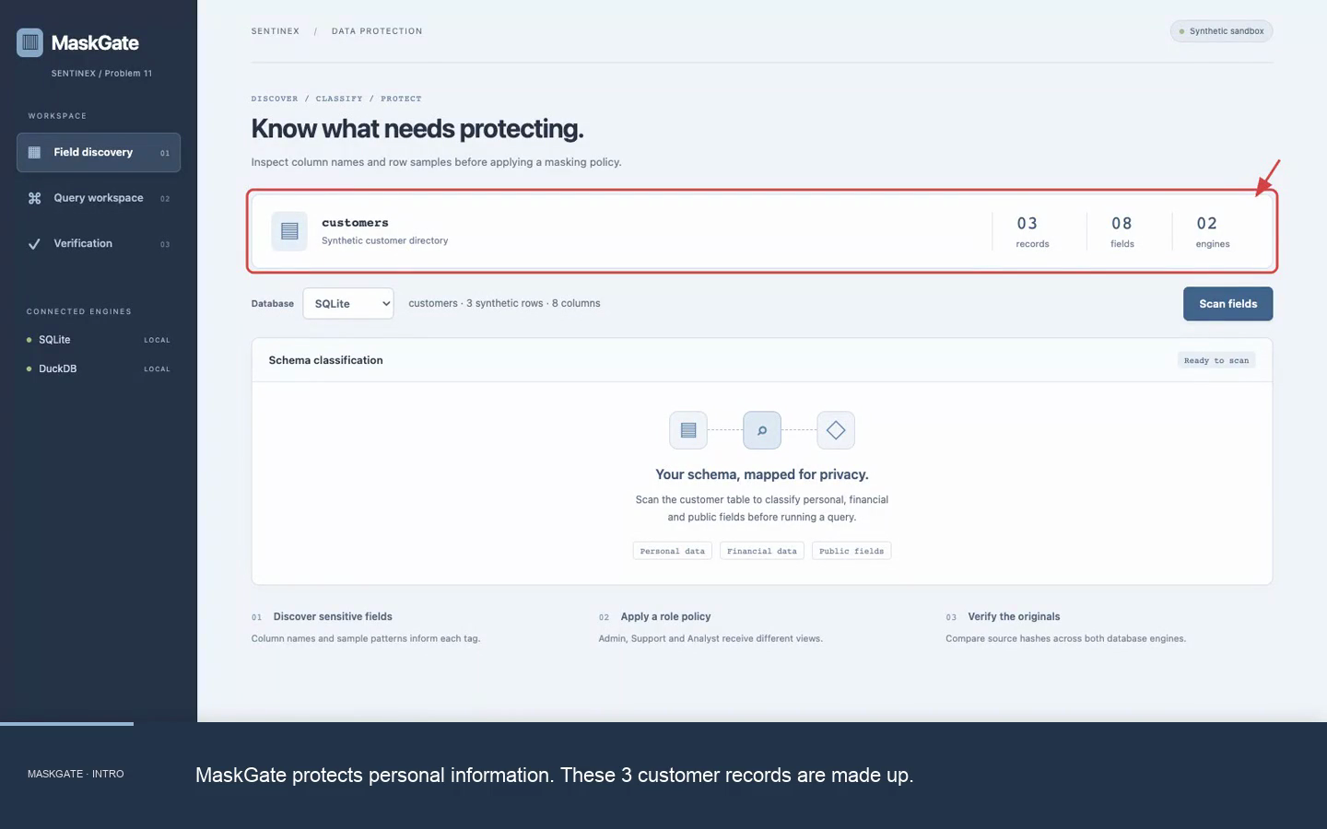
Demo & POC Video
MaskGate | Watch the 52-second captioned demo
https://drive.google.com/file/d/18HuoMSGaUn9quMf1XL7NKIqIIgtfB1Wn/view?usp=drivesdk
Notes:
Silent recording of the working local prototype, 17 October 2026. Burned-in captions, red highlights and arrows explain the tests. Browser link: https://drive.google.com/file/d/18HuoMSGaUn9quMf1XL7NKIqIIgtfB1Wn/view?usp=drivesdk. Synthetic customer records; SQLite and DuckDB; password-free demo identities. Small fixture only.
Measured demo results: {
"latency": [
{
"backend": "SQLite",
"baseline_ms": 0.011,
"masked_ms": 0.015
},
{
"backend": "DuckDB",
"baseline_ms": 0.271,
"masked_ms": 0.269
}
],
"limits": "Tiny synthetic fixture. Scanner includes a known false positive. Demo identities have no passwords. Fixed SELECT only. PostgreSQL and production authentication remain future work.",
"policy": {
"passed": 144,
"total": 144
},
"scanner": {
"examples": 14,
"fn": 0,
"fp": 1,
"precision": 0.889,
"recall": 1,
"tp": 8
},
"source_checks": [
{
"backend": "SQLite",
"sha256": "d5113b4b1b913729f70b7e7e8018ebfcb6b9a6133606c4464f9fc04798c0ce3a",
"unchanged": true
},
{
"backend": "DuckDB",
"sha256": "d5113b4b1b913729f70b7e7e8018ebfcb6b9a6133606c4464f9fc04798c0ce3a",
"unchanged": true
}
]
}

