Slide 1
ROUND 1 REVIEW
MedSafe | The Medication Safety Second Pair of Eyes
Team Name
Team Leader
SENTINEX
Aswini Lakshya
Track
Date
Healthcare / Problem 9 (H4)
17 October 2026
Notes:
Source: official problem statement, https://be.innosmart.in/media/talentap/H4.%20The%20Medication%20Safety%20Second%20Pair%20of%20Eyes_2.pdf
Official seven-slide template linked under this problem on the InnoSmart portal, reviewed 17 October 2026.
This is a proposed design. Implementation, testing and performance measurements are planned. Initial audience and adoption path are hypotheses, not measured market estimates. Build timing and permitted tools remain subject to organizer rules.

Slide 2
Use Case
Problem Statement
Patients may take medicines from several prescribers, with mixed names and incomplete lists.
Clinicians need to spot interactions, duplicate therapy and patient-specific risks.
Missed serious issues can harm patients. Too many minor alerts can hide urgent ones.
Market Opportunity
Target users: clinicians and pharmacists reviewing older patients on multiple medicines.
Growth path: pilot one review workflow, then assess hospital integration.
Alternatives: manual reference lookups and existing medication-checking tools.
Market size is not yet quantified; validate demand and adoption through pilot feedback.
Notes:
Source: official problem statement, https://be.innosmart.in/media/talentap/H4.%20The%20Medication%20Safety%20Second%20Pair%20of%20Eyes_2.pdf
Official seven-slide template linked under this problem on the InnoSmart portal, reviewed 17 October 2026.
This is a proposed design. Implementation, testing and performance measurements are planned. Initial audience and adoption path are hypotheses, not measured market estimates. Build timing and permitted tools remain subject to organizer rules.

Slide 3
Proposed Solution
Solution Overview
Match brand names and misspellings to the supplied drug reference before checking.
Check interactions, duplicate therapy, renal-dose concerns and contraindications.
Show severity, involved medicines, a reference-backed action and match confidence.
Flag uncertain names. Every alert includes limitations; a clinician decides.
Proposed review flow
Medication list
Patient context
Name matching
Reference checks
Prioritized alerts
Clinician review
Notes:
Source: official problem statement, https://be.innosmart.in/media/talentap/H4.%20The%20Medication%20Safety%20Second%20Pair%20of%20Eyes_2.pdf
Official seven-slide template linked under this problem on the InnoSmart portal, reviewed 17 October 2026.
This is a proposed design. Implementation, testing and performance measurements are planned. Initial audience and adoption path are hypotheses, not measured market estimates. Build timing and permitted tools remain subject to organizer rules.

Slide 4
Design Steps & Architecture
Technical Implementation
Architecture Diagram
1. Load organizer-supplied drug, interaction and synthetic patient tables.
2. Resolve exact names, then cautious fuzzy matches. Leave ambiguity unresolved.
3. Apply reference rules; rank and deduplicate alerts.
4. Measure matching accuracy, serious-issue recall and excess alerts.
Patient list and context
Name resolver + confidence
Rules + supplied references
Alert list for clinician review
Current demo: Python + Flask, difflib matching, fictional medicines and rules.
Final-event plan: Day 1, supplied data and rules; Day 2, evaluation and review UI.
Report recall on all 300 seeded near-misses prominently; official assets are pending.
Notes:
Source: official problem statement, https://be.innosmart.in/media/talentap/H4.%20The%20Medication%20Safety%20Second%20Pair%20of%20Eyes_2.pdf
Official seven-slide template linked under this problem on the InnoSmart portal, reviewed 17 October 2026.
This is a proposed design. Implementation, testing and performance measurements are planned. Initial audience and adoption path are hypotheses, not measured market estimates. Build timing and permitted tools remain subject to organizer rules.

Slide 5
Challenges & Mitigation
Challenge 1: Wrong medicine match
Problem: similar names can refer to different medicines.
Mitigation: use exact matches first and require confirmation for ambiguity.
Challenge 2: Alert fatigue
Problem: too many low-severity warnings can distract the clinician.
Mitigation: rank by severity, merge duplicates and measure excess alerts.
Challenge 3: Incomplete clinical context
Problem: missing medicines or patient details limit the checks.
Mitigation: show missing context and limitations. Never declare the list safe.
Notes:
Source: official problem statement, https://be.innosmart.in/media/talentap/H4.%20The%20Medication%20Safety%20Second%20Pair%20of%20Eyes_2.pdf
Official seven-slide template linked under this problem on the InnoSmart portal, reviewed 17 October 2026.
This is a proposed design. Implementation, testing and performance measurements are planned. Initial audience and adoption path are hypotheses, not measured market estimates. Build timing and permitted tools remain subject to organizer rules.

Slide 6
Unique Selling Proposition (USP)
Key Differentiator 1
Key Differentiator 2
Key Differentiator 3
Resolve names first
Show match confidence before applying safety rules.
Prioritize useful alerts
Balance serious-issue detection against unnecessary warnings.
Explain each concern
Show supporting rules, limitations and a clinician action.
Competitive Advantage Summary
Compared with a simple exact-name lookup, test whether cautious matching finds more valid cases.
Make uncertainty visible and keep every recommendation tied to the supplied references.
Notes:
Source: official problem statement, https://be.innosmart.in/media/talentap/H4.%20The%20Medication%20Safety%20Second%20Pair%20of%20Eyes_2.pdf
Official seven-slide template linked under this problem on the InnoSmart portal, reviewed 17 October 2026.
This is a proposed design. Implementation, testing and performance measurements are planned. Initial audience and adoption path are hypotheses, not measured market estimates. Build timing and permitted tools remain subject to organizer rules.

Slide 7
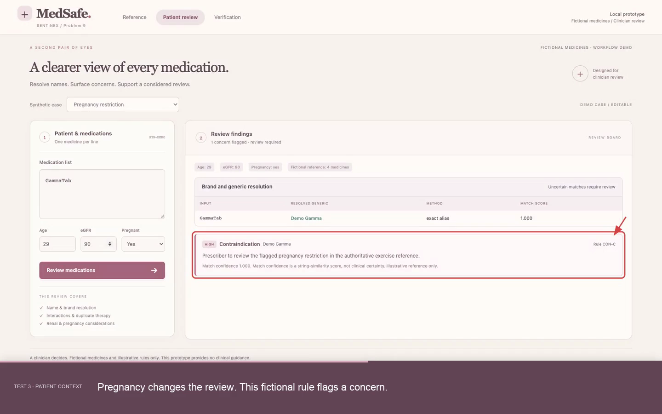
Demo & POC Video
MedSafe | Watch the 54-second captioned demo
https://drive.google.com/file/d/18q2uwPBda-AzrffcW6c4JY9j5vB-349o/view?usp=drivesdk
Notes:
Silent recording of the working local prototype, 17 October 2026. Burned-in captions, red highlights and arrows explain the tests. Browser link: https://drive.google.com/file/d/18q2uwPBda-AzrffcW6c4JY9j5vB-349o/view?usp=drivesdk. Fictional medicines and illustrative rules only. No clinical validation. Official 300-case evaluation not run.
Measured demo results: {
"cases": [
{
"case": "review",
"expected": [
"DUP-A",
"INT-01",
"REN-A"
],
"observed": [
"DUP-A",
"INT-01",
"REN-A"
],
"pass": true
},
{
"case": "pregnancy",
"expected": [
"CON-C"
],
"observed": [
"CON-C"
],
"pass": true
},
{
"case": "no_issue",
"expected": [],
"observed": [],
"pass": true
},
{
"case": "incomplete",
"expected": [],
"observed": [],
"pass": true
}
],
"extra_alerts": 0,
"limitations": "Tiny handcrafted demo fixtures only. Official 300-case near-miss recall is not measured. Organizer reference and evaluate.py have not been supplied.",
"matching": {
"passed": 8,
"total": 8
},
"official_near_miss_recall": null,
"serious": {
"found": 3,
"total": 3
}
}

