Slide 1
how to create ‘devoted’ customers
a practical guide by andy hanselman

Slide 2
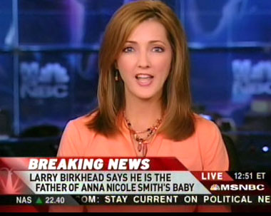
UK consultant says “forget ‘delighted’ customers, start thinking ‘devoted’ customers”

Slide 3
‘devoted’ customers?

Slide 4
not ‘satisfied’ customers

Slide 5
not even ‘delighted’ customers

Slide 6
why?

Slide 7
86
% of defectors express satisfaction with the previous supplier
frederick reicheld – ‘the loyalty effect’

Slide 8
so

Slide 9
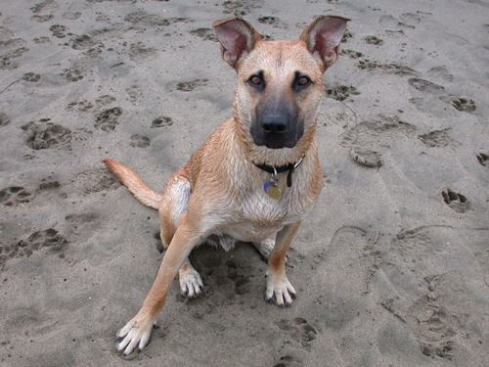
forget ‘satisfaction’
think ‘devotion’

Slide 10
some customers have

Slide 11
high expectations

Slide 12
some customers have

Slide 13
low expectations

Slide 14
all customers either have

Slide 15
a ‘great’
experience

Slide 16
or

Slide 17
a ‘poor’
experience

Slide 18
look at it like this

Slide 19
high expectations
a ‘poor’
experience
a ‘great’
experience
low expectations

Slide 20
high expectations
a ‘poor’
experience
a ‘great’
experience
‘delighted’
low expectations

Slide 21
‘delighted’ customers

Slide 22
are surprised by the level of service you provide

Slide 23
are surprised by the level of service you provide
( positively surprised please!)

Slide 24
so

Slide 25

‘delighting’ customers
is ‘a good start’

Slide 26
but

Slide 27
with time

Slide 28
expectations will rise

Slide 29
(which is a good thing)

Slide 30
the challenge is to consistently deliver

Slide 31
a ‘great’
experience

Slide 32
high expectations
‘devoted’
a ‘poor’
experience
a ‘great’
experience
low expectations

Slide 33
why?

Slide 34
‘devoted’ customers

Slide 35
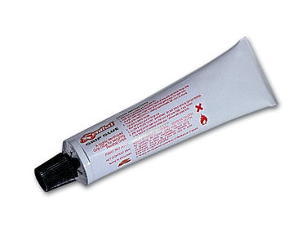
stick with you

Slide 36
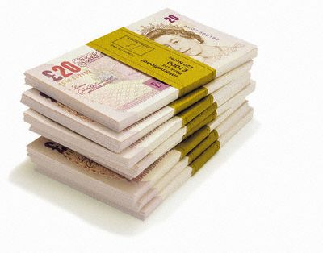
spend more

Slide 37

shout about you to others

Slide 38
the goal therefore is to create

Slide 39
‘devoted’ customers

Slide 40
how?

Slide 41
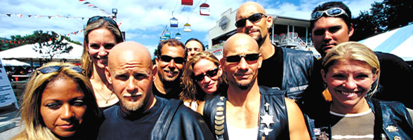
“ the more you engage with
customers the clearer things become and the easier it is to determine what you should be doing”
John Russell, President, Harley-Davidson Europe

Slide 42
so

Slide 43
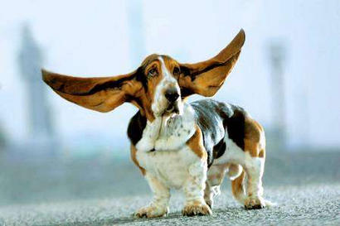
give your customers a
damn good listening to
give your customers ‘a damn good listening to’

Slide 44
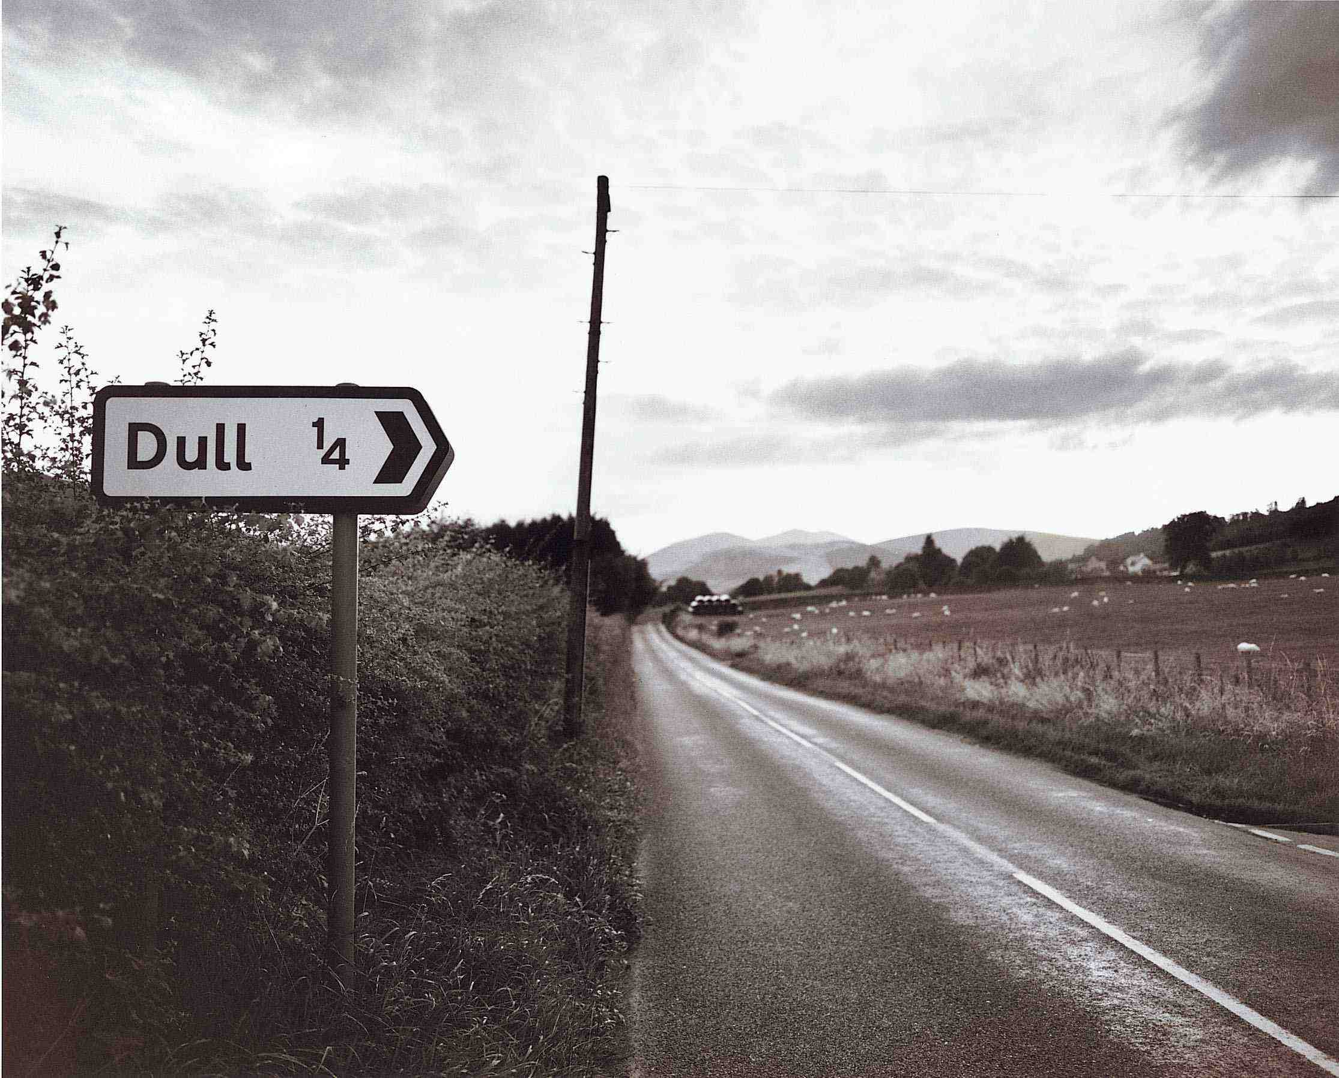
44% of consumers say the majority of their customer experiences are bland

Slide 45
so

Slide 46
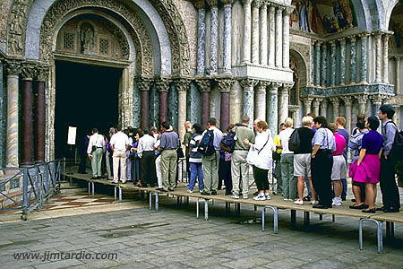
stand in your own queues

Slide 47
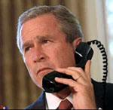
identify
your
barriers to giving
a great
experience

Slide 48
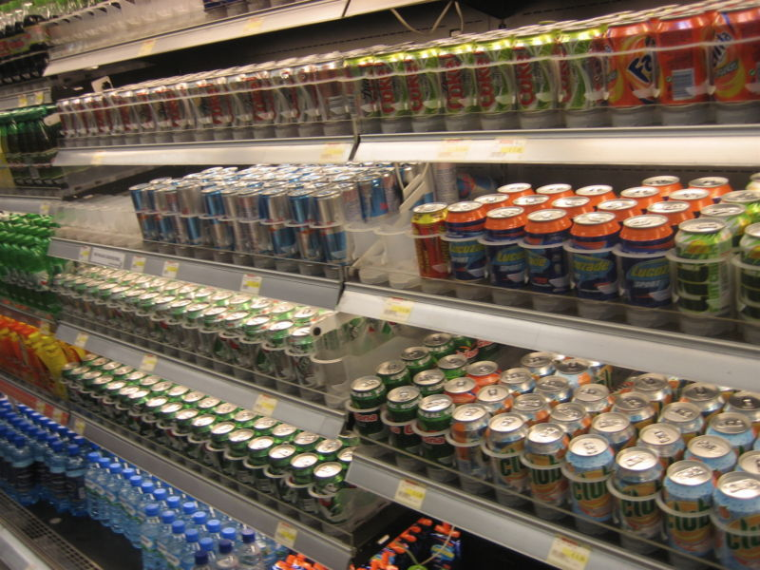


“in every single industry
there is now overcapacity
of production and
lack of capacity
in terms of people”
sir martin sorrell, chief executive WPP

Slide 49
so

Slide 50

think 3D

Slide 51
be
dramatically and demonstrably different

Slide 52
it’s an ongoing process

Slide 53

be an
‘enemy of
the status quo’

Slide 54
aim
for

Slide 55
this

Slide 56
high expectations
a ‘poor’
experience
a ‘great’
experience
low expectations

Slide 57
high expectations
a ‘poor’
experience
a ‘great’
experience
low expectations

Slide 58
so

Slide 59
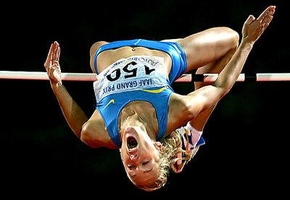
raise the bar

Slide 60

“stand out” and deliver consistently

Slide 61
it’s not easy

Slide 62
occasionally customers will have

Slide 63
a ‘poor’
experience

Slide 64
high expectations
‘disappointed’
a ‘poor’
experience
a ‘great’
experience
low expectations

Slide 65
so

Slide 66
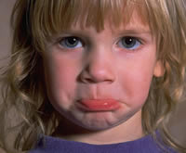
spot ‘disappointment’

Slide 67
ask

Slide 68
were you completely happy with our service?

Slide 69
act
and

Slide 70
get
back

Slide 71
this
to

Slide 72
high expectations
‘devoted’
a ‘poor’
experience
a ‘great’
experience
low expectations

Slide 73
this
not

Slide 74
high expectations
a ‘poor’
experience
a ‘great’
experience
‘disaffected’
low expectations

Slide 75
“executives say that the way their organisations interact with customers will be the greatest challenge in their operations between now and 2010”
Economist Intelligence Unit – Business 2010

Slide 76
so

Slide 77
go for ‘delighted’

Slide 78
aim for ‘devoted’

Slide 79
spot ‘disappointed’

Slide 80
avoid ‘disaffected’

Slide 81
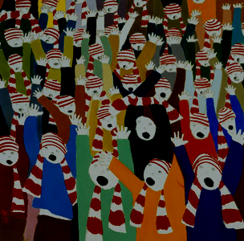
creating
‘devoted’
customers

Slide 82
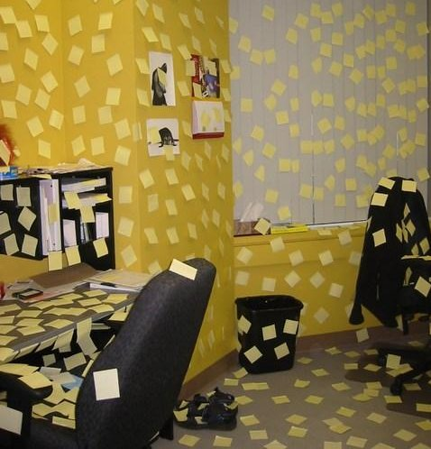
means
taking
action,
not notes

Slide 83
so

Slide 84

don’t just stand there….. do something!
dick dastardly

Slide 85
andy hanselman is one of the uk’s leading experts in business competitiveness. he writes, consults and speaks on issues that help organisations maximise their competitive advantage, their customer relationships and their competence.
you can find out more at www.andyhanselman.com
you can email him at andy@competeorgetbeat.com
andy hanselman consulting
sheffield technology park
60 shirland lane
sheffield
s9 3sp
uk
telephone: +44 114 243 4666

