Slide 1
MODERN WEB – an Introduction
By Irfan Maulana | Front End Developer

Slide 2
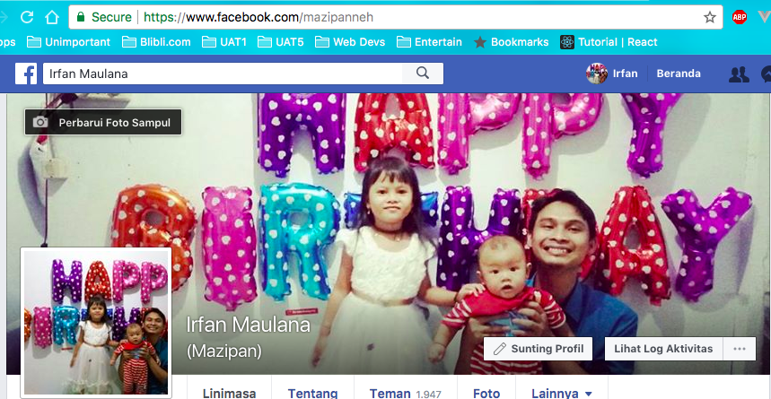
😎 About Me

Slide 3
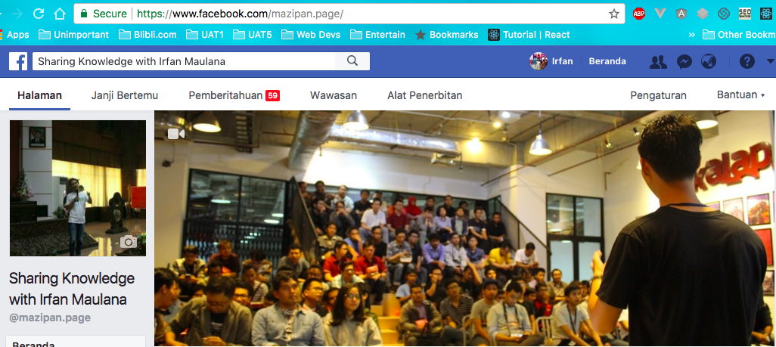
🤣 Fans ?

Slide 4
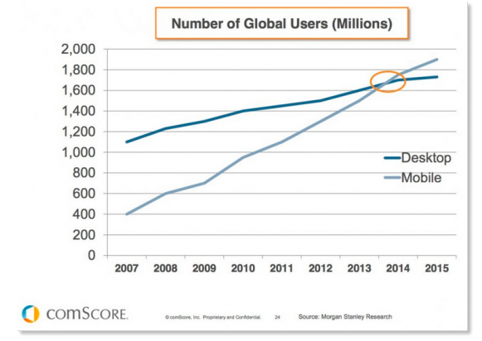
🤔 Users Nowadays

Slide 5
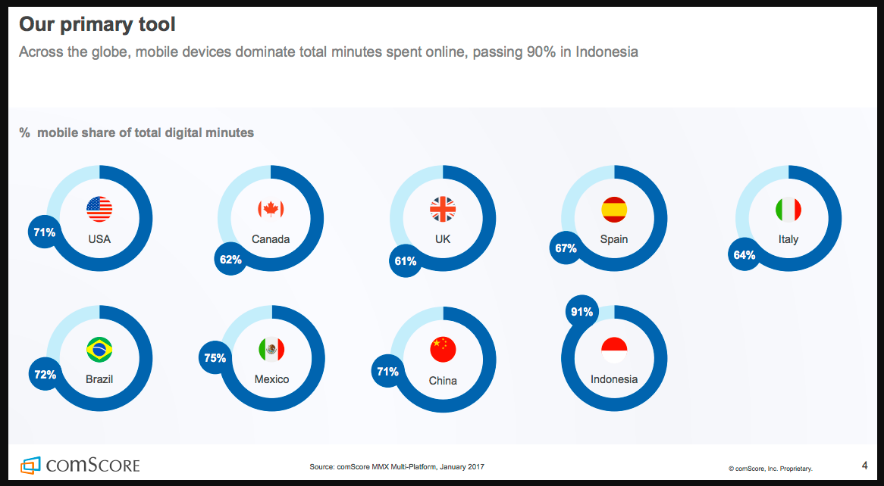
🤔 Users Nowadays

Slide 6

📱 Mobile First is Must

Slide 7
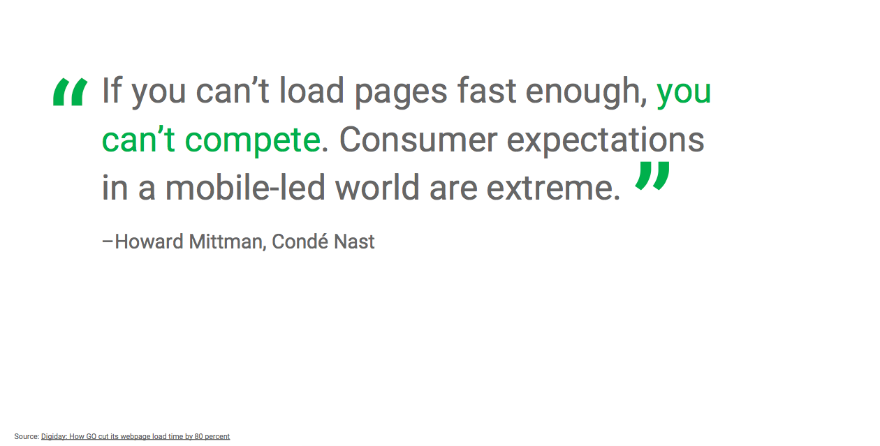
📱😈 Mobile World are Extreme

Slide 8

🏃⚡️ You Need to be Flash ?

Slide 9
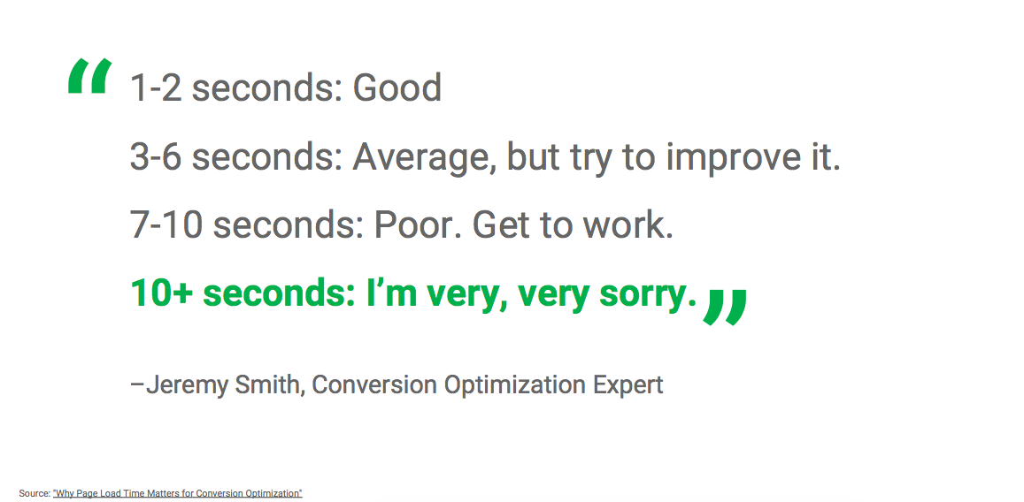
🏃⚡️ You Need to be Flash ?

Slide 10

👽 Welcome to Modern Web Tech

Slide 11


Slide 12
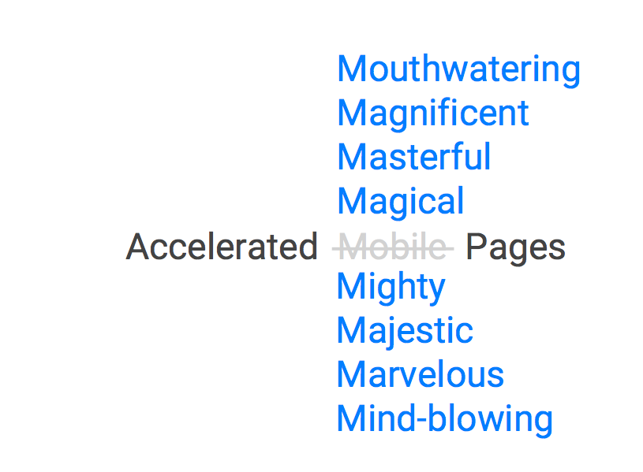
🤔 What’s AMP ?

Slide 13
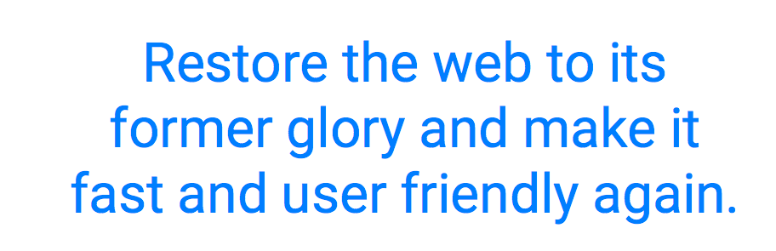
🤷‍♂️ Why AMP ?

Slide 14
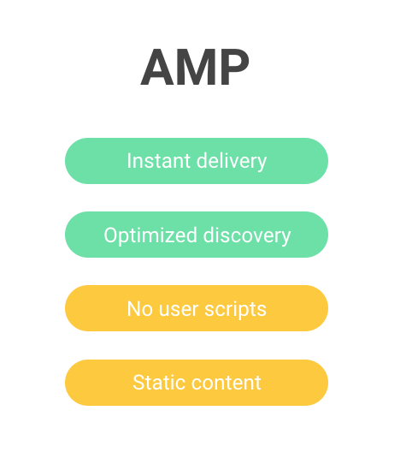
🚀 What You Can Get from AMP ?

Slide 15
👨‍🍳 How to AMP ?
ampproject.org

Slide 16


Slide 17
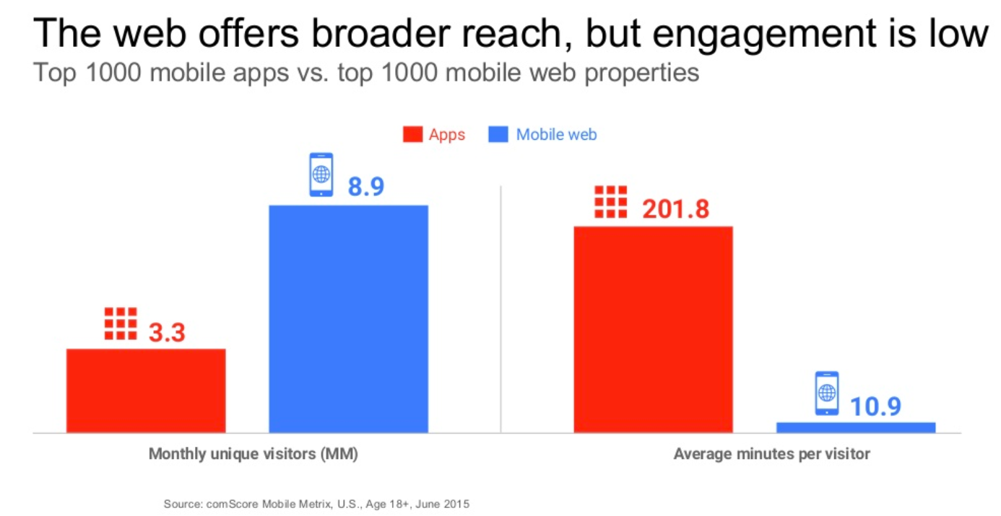
🤷‍♂️ Why PWA ?

Slide 18




🤔 What’s PWA ?
Fast – Integrated – Reliable – Engaging
https://developers.google.com/web/fundamentals/

Slide 19
👨‍🍳 How to PWA ?
bit.ly/pwa-howto

Slide 20
👍 PWA Sample
⚡️ bit.ly/pwa-wwwid

Slide 21
👍 Do you like my talks ?
🎤 bit.ly/mazipan-talks

