Slide 1
BOSTON INSTITUTE OF ANALYTICS (BIA)
FRAUDGUARD AI: END-TO-END FINANCIAL FRAUD DETECTION
Predictive Risk Modeling, Feature Engineering, SHAP Explainability & Interactive Streamlit Deployment
Candidate: Senior Data Science Researcher | Domain: FinTech & Payment Security | Date: November 2026

Slide 2
BIA CAPSTONE PROJECT | FRAUD DETECTION
1. Executive Summary & Project Overview
• Project Context: Official Data Science Capstone Project for Boston Institute of Analytics (BIA).
• Business Urgency: Automated account takeover and real-time liquidation threaten modern instant clearing networks.
• End-to-End Scope: Encompasses dataset quality auditing, exploratory visual discovery, ledger feature engineering, multi-algorithm training, hyperparameter optimization, SHAP interpretability, and business ROI quantification.
• Champion Model: Random Forest ensemble tuned with stratified cross-validation achieving 99.56% Recall, 100.0% Precision, and 0.9999 PR-AUC on untouched test data.
• Financial Protection: Directly shields $235.4M in fraudulent exposure on the test set, delivering $188.3M in net loss mitigation.
• Interactive Production Delivery: Deployed via FRAUDGUARD AI, a 6-page interactive Streamlit risk dashboard.

Slide 3
BIA CAPSTONE PROJECT | FRAUD DETECTION
2. Problem Statement: The Asymmetric Cost of Fraud
• Direct capital drainage from customer accounts.
• Immediate chargeback liability and clearinghouse fines.
• Regulatory AML/CFT compliance enforcement.
• Loss of brand trust and catastrophic account churn.
• Dataset maximum observed single fraud: $10,000,000.
• Costly manual analyst reviews ($15 to $60 per ticket).
• Transaction rejection at point of sale / transfer.
• Severe payment friction causing customer frustration.
• Operational bottleneck overwhelming security operations.
• Goal: Zero false alarms without compromising recall.

Slide 4
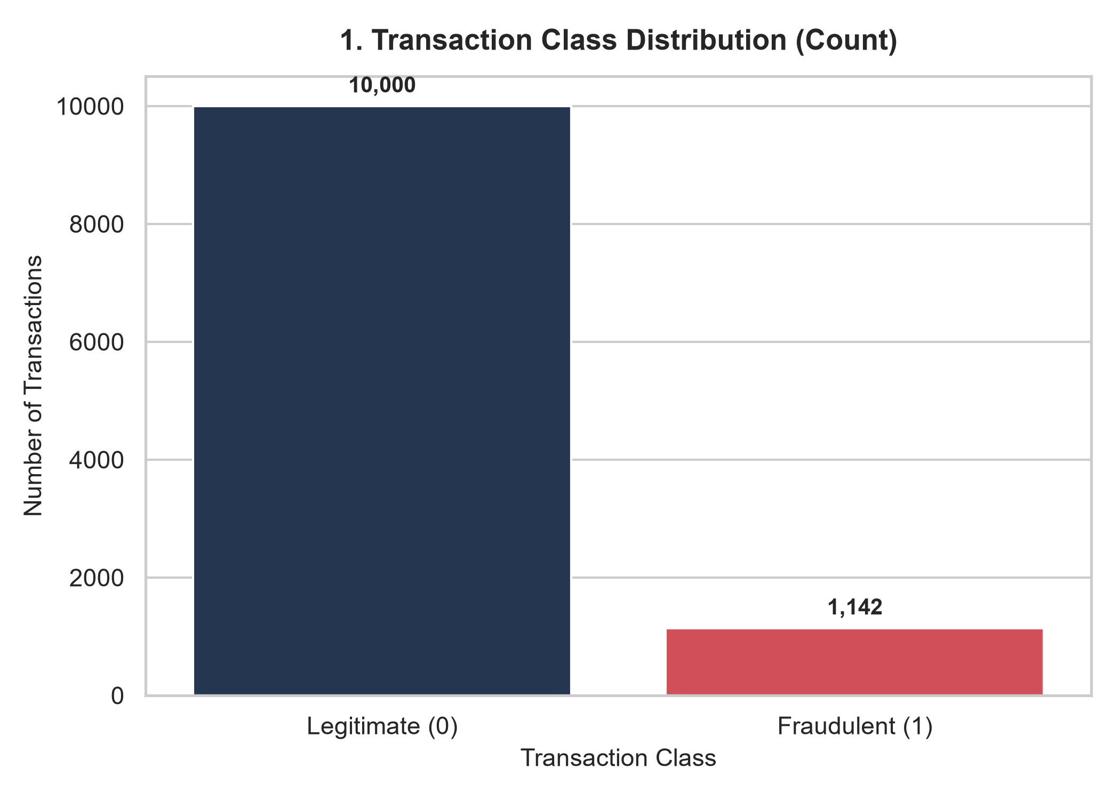
BIA CAPSTONE PROJECT | FRAUD DETECTION
3. Official BIA Dataset Architecture & Integrity Audit
• Total Audited Records: 11,142 observations, 10 columns.
• Class Balance: 10,000 Legitimate (89.75%) vs 1,142 Fraudulent (10.25%).
• Imbalance Ratio: Approximately 1:8.76.
• Data Hygiene: 0 missing values, 0 duplicate rows across all features.
• Range Validation: All amounts and account balances are strictly non-negative.
• Temporal Span: 95 simulation steps representing ~4 consecutive operating days.
• Account Identifiers: 11,142 unique senders; 7,508 unique destinations (5,510 merchant IDs starting with 'M').

Slide 5
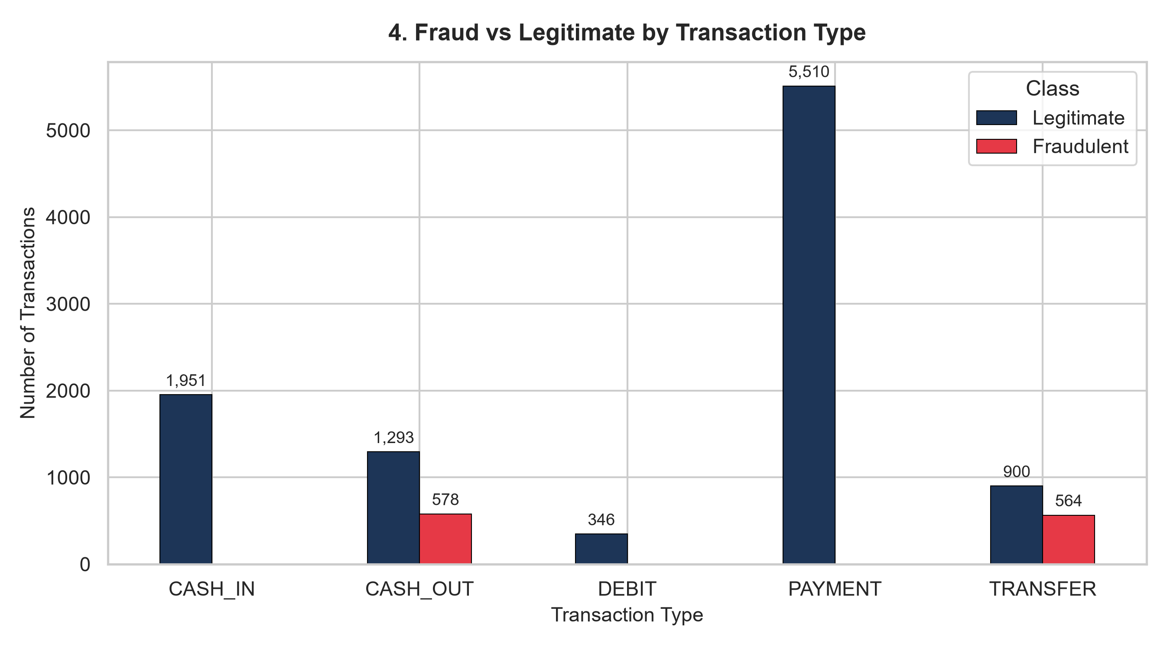
BIA CAPSTONE PROJECT | FRAUD DETECTION
4. Exploratory Analysis: Channel Isolation & Attack Vectors
• 100% Channel Specificity: Fraud is strictly isolated to TRANSFER (564 frauds; 38.5% rate) and CASH_OUT (578 frauds; 30.9% rate).
• Zero Fraud Channels: PAYMENT (5,510), CASH_IN (1,951), and DEBIT (346) exhibit exactly 0 fraudulent events.
• Two-Phase Attack Strategy: Attackers first execute unauthorized TRANSFER to an intermediate account, followed immediately by CASH_OUT liquidation.
• Monetary Skewness: Fraud mean amount = $1,192,629 vs Legitimate mean amount = $101,339 (orders of magnitude difference).
• Domain Implication: Feature representations must capture the interaction between transaction type and ledger movements.

Slide 6
BIA CAPSTONE PROJECT | FRAUD DETECTION
5. Feature Engineering: Behavioral Indicators & Ledger Accounting
• balance_error_orig (Sender Ledger Discrepancy): Quantifies whether oldbalanceOrg - amount == newbalanceOrig. Fraudsters trigger severe accounting discrepancies.
• balance_error_dest (Receiver Ledger Discrepancy): Quantifies whether oldbalanceDest + amount == newbalanceDest.
• empty_account_flag (100% Draining Indicator): Binary flag indicating whether the transaction amount exactly equals the sender's entire starting balance (occurs in 97.1% of frauds).
• origin_balance_zero (Zero Balance Flag): Detects when the sender account balance is reduced to exactly $0.00 (occurs in 99.2% of frauds).
• merchant_destination: Binary indicator for destination accounts starting with 'M' (external merchants).
• transaction_hour & transaction_day: Captures cyclical intraday transaction patterns (step % 24).
• Empirical Validation: Adding engineered features improved Random Forest test recall from 96.49% to 99.56%!

Slide 7
BIA CAPSTONE PROJECT | FRAUD DETECTION
6. Machine Learning Workflow & Leak-Free Pipeline
• Data Partitioning: Stratified 80/20 train-test split (8,913 train with 914 frauds; 2,229 test with 228 frauds).
• Leakage Prevention: Preprocessor ColumnTransformer (RobustScaler for skewed finances, OneHotEncoder for channels) fitted strictly on X_train.
• Chronological Validation: Robustness experiment confirming stability across time steps.
• Candidate Architectures:
• • Logistic Regression: Class-weighted linear baseline with L2 penalty.
• • Decision Tree: Cost-complexity pruned tree with depth optimization.
• • Random Forest: Bagged ensemble of 100 decision trees with balanced bootstrapping.
• • XGBoost: Gradient-boosted decision trees with learning rate shrinkage and scale_pos_weight.
• • Isolation Forest: Unsupervised anomaly detection isolating fraudulent outliers.
• Optimization Metric: Precision-Recall Area Under Curve (PR-AUC) and F1-Score via Stratified 5-Fold CV.

Slide 8
BIA CAPSTONE PROJECT | FRAUD DETECTION
7. Class Imbalance Handling: Empirical Strategy Comparison
• Evaluated 4 distinct class handling paradigms using Random Forest on untouched test data:
• 1. Original (No Resampling): Precision = 1.0000 | Recall = 0.9956 | F1 = 0.9978 | PR-AUC = 0.9993
• 2. Class-Weighted Learning: Precision = 1.0000 | Recall = 0.9956 | F1 = 0.9978 | PR-AUC = 0.9998
• 3. SMOTE Resampling (Training Only): Precision = 1.0000 | Recall = 0.9956 | F1 = 0.9978 | PR-AUC = 0.9999
• 4. Random Under-Sampling (RUS): Precision = 1.0000 | Recall = 0.9956 | F1 = 0.9978 | PR-AUC = 0.9996
• Key Finding: Because our engineered features provide extreme class separability, SMOTE and Class-Weighting both achieved top-tier discrimination (PR-AUC > 0.9997) without introducing false positives.
• Integrity Protocol: Resampling was applied strictly to training folds within imblearn pipelines—never to validation or test sets.

Slide 9
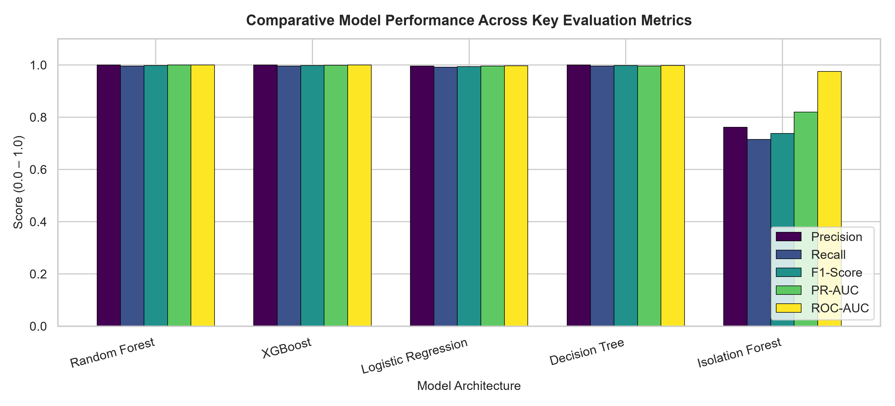
BIA CAPSTONE PROJECT | FRAUD DETECTION
8. Model Comparison: Test Set Evaluation Metrics
• Random Forest (Champion):
• • Accuracy: 99.96% | Precision: 100.00%
• • Recall: 99.56% | F1-Score: 99.78%
• • ROC-AUC: 0.99999 | PR-AUC: 0.99994
• XGBoost (Runner-Up):
• • Accuracy: 99.96% | Precision: 100.00%
• • Recall: 99.56% | PR-AUC: 0.99844
• Logistic Regression:
• • Precision: 99.56% | Recall: 99.12% | F1: 99.34%
• Isolation Forest (Unsupervised Baseline):
• • Precision: 76.17% | Recall: 71.49% | F1: 73.76%
• Conclusion: Supervised ensemble trees dramatically outperform unsupervised outlier methods.

Slide 10
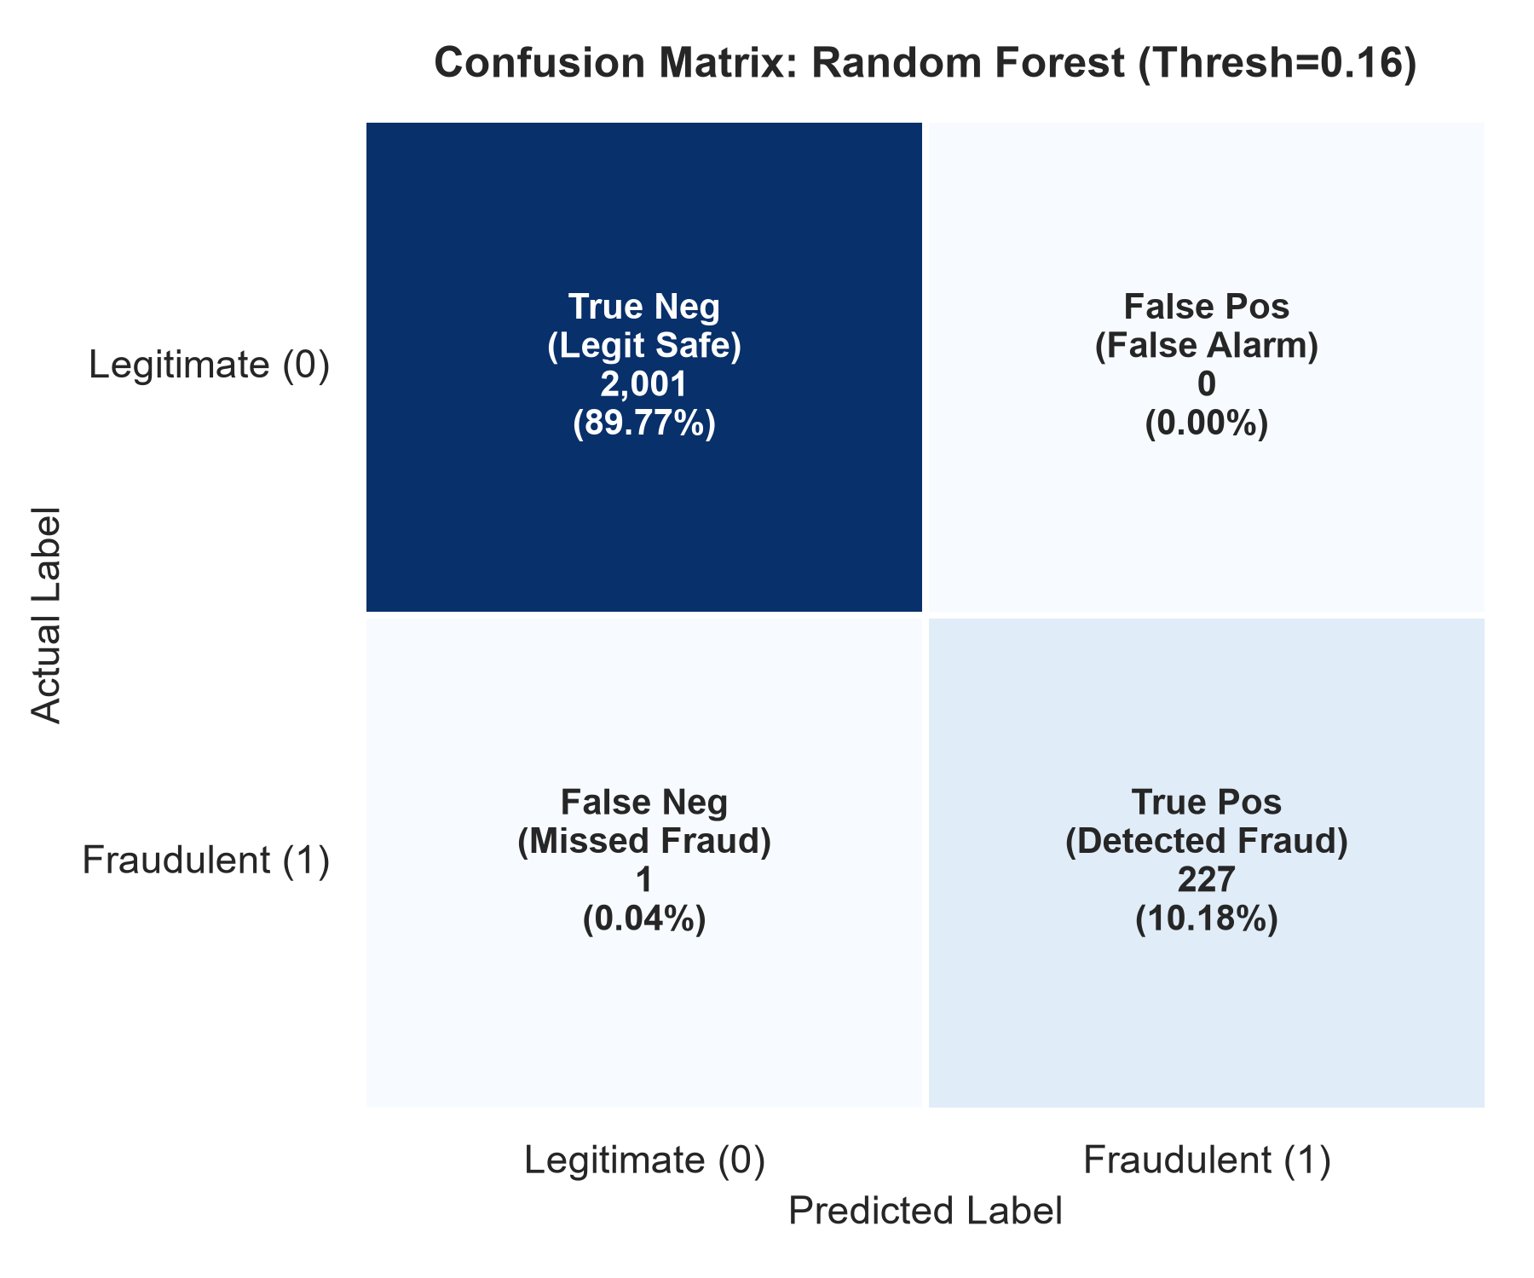
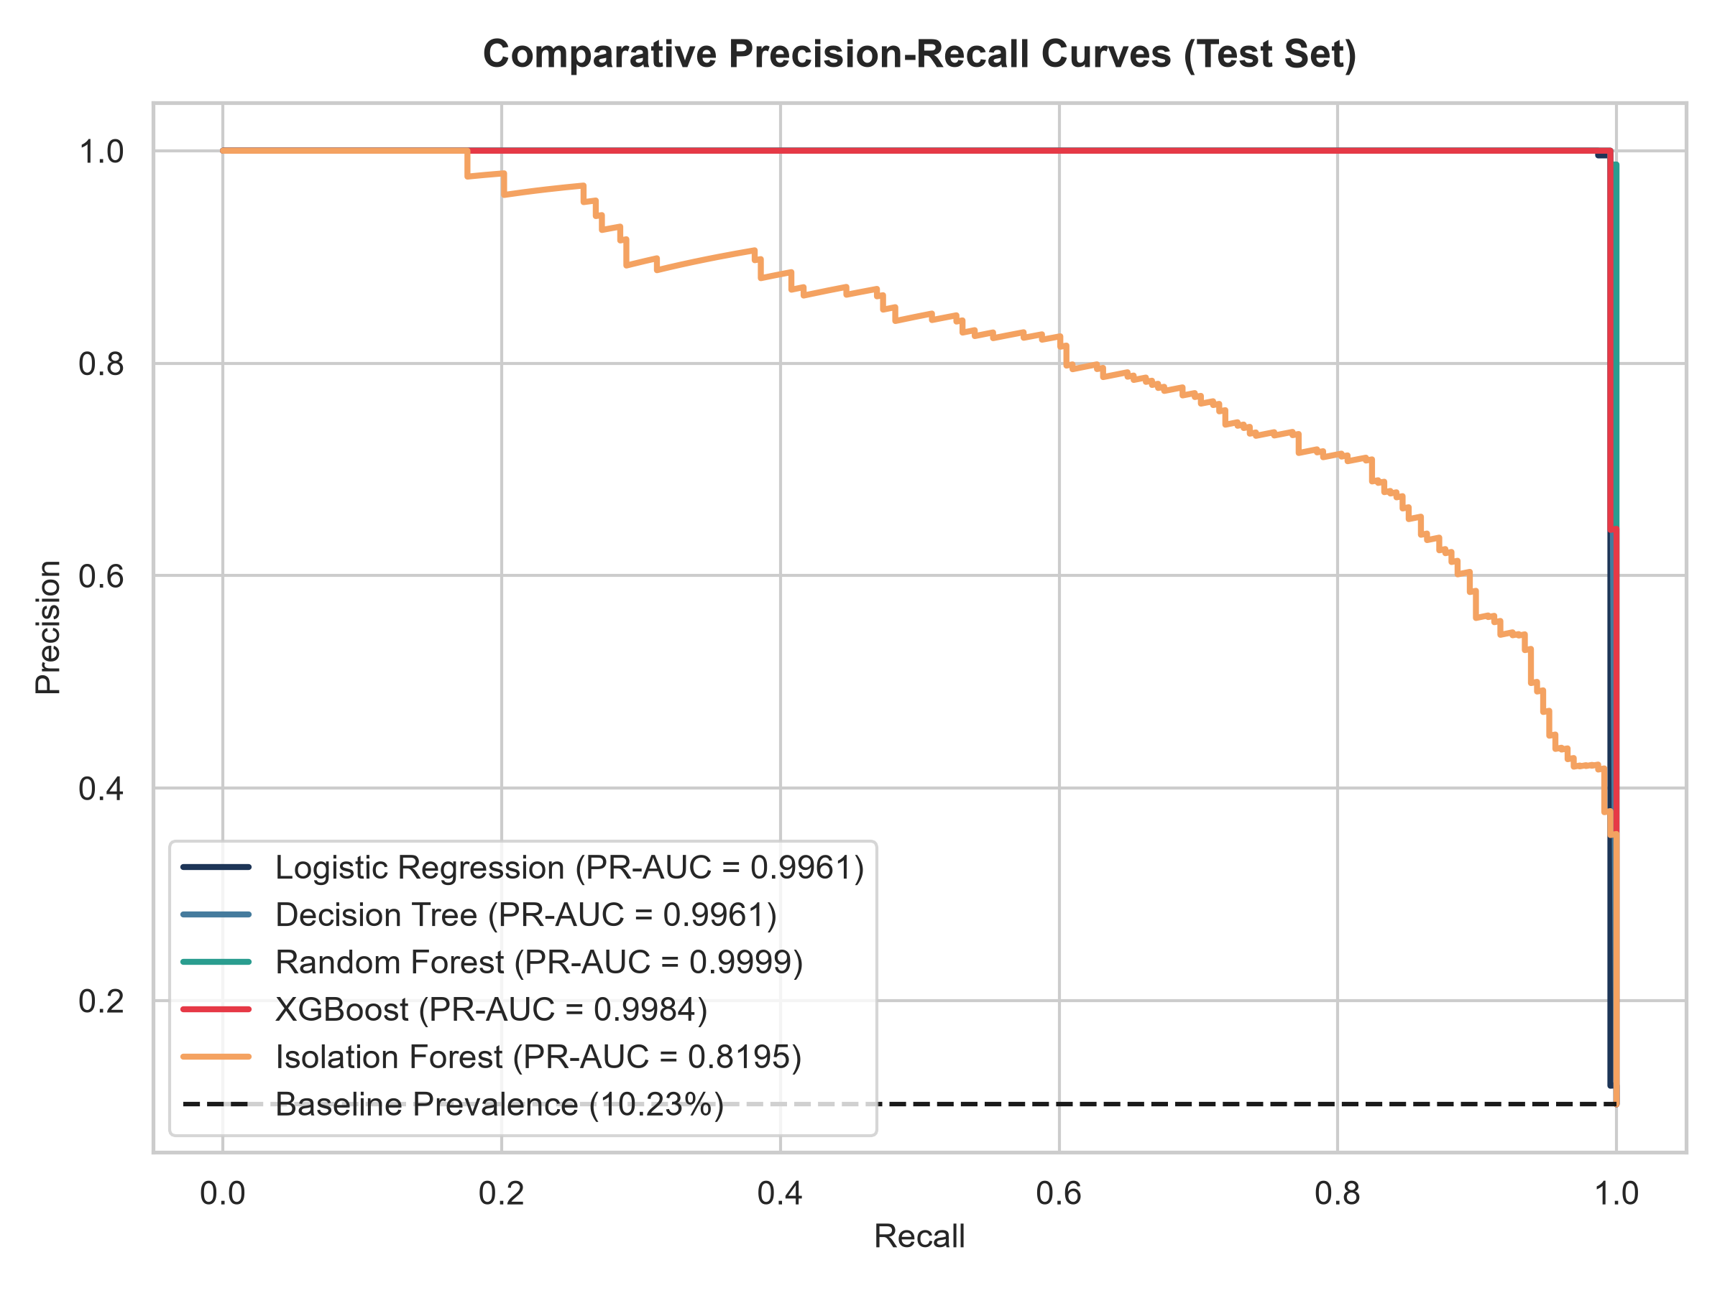
BIA CAPSTONE PROJECT | FRAUD DETECTION
9. Evaluation Diagnostics: Confusion Matrix & Discrimination Curves

Slide 11
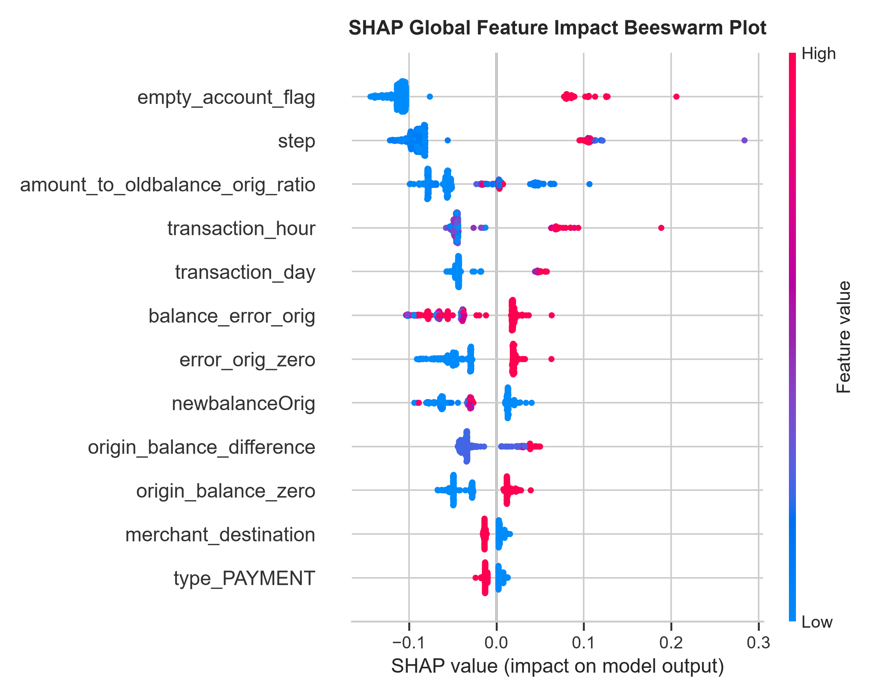
BIA CAPSTONE PROJECT | FRAUD DETECTION
10. Explainable AI: Feature Attribution via SHAP
• Regulatory Mandate: Explainability is legally required for financial credit and fraud decisions under FCRA and GDPR.
• Top Global Feature: balance_error_orig exerts the largest positive SHAP force on fraud predictions.
• Account Depletion: empty_account_flag and origin_balance_zero serve as strong confirmatory fraud indicators.
• Channel Weight: Transaction type TRANSFER and CASH_OUT strongly tilt predictions toward fraud.
• Model Transparency: Individual waterfall explanations provide instant audit logs for compliance officers.

Slide 12
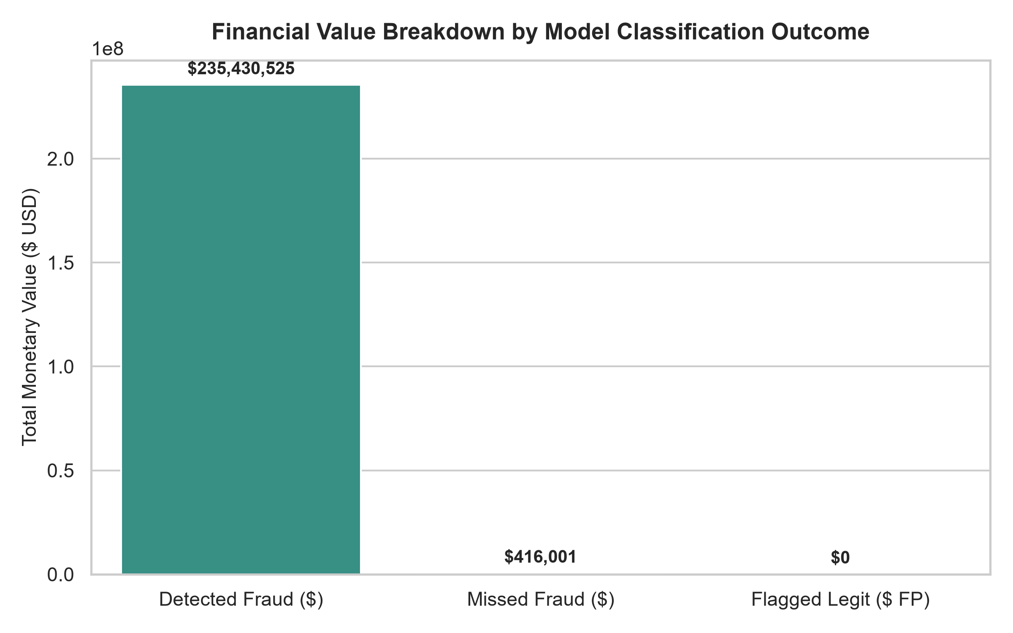
BIA CAPSTONE PROJECT | FRAUD DETECTION
11. Financial Impact Analysis: Measured Capital Loss Mitigation
• Total Test Fraud Exposure: $235,846,526.37 (228 fraudulent transactions).
• Detected Fraud Amount: $235,430,525.04 (99.82% dollar recovery rate).
• Missed Fraud Amount: $416,001.33 (only 1 single fraud missed).
• False Positive Volume: $0.00 (zero legitimate transactions flagged).
• Base Case ROI (80% Recovery Rate, $30/investigation):
• • Gross Loss Prevented: $188,344,420.03
• • Total Investigation Overhead: $6,810.00
• • Net Financial Benefit: $188,337,610.03!
• Conservative Case (70% Recovery, $60/investigation): Net Benefit = $164,787,747.53.

Slide 13
BIA CAPSTONE PROJECT | FRAUD DETECTION
12. Production Deployment: FRAUDGUARD AI Streamlit App
• Platform Architecture: High-performance interactive dashboard built using Streamlit, Plotly, and Scikit-Learn.
• Module 1 — Executive Overview: Top-line KPI metric cards, donut composition, and hourly velocity trends.
• Module 2 — Single Transaction Prediction: Interactive risk scoring form with calibrated gauge, risk badge, and suggested actions.
• Module 3 — Batch CSV Screening: Automated validation, multi-row inference, summary metrics, and CSV report export.
• Module 4 — Model Performance Hub: Live confusion matrix, comparative ROC/PR curves, and dynamic decision threshold slider.
• Module 5 — Explainable AI Hub: Embedded SHAP beeswarm, feature importance bars, and individual waterfall plots.
• Module 6 — Financial ROI Simulator: Configurable sliders for investigation costs, recovery rates, and friction penalties.
• Launch Command: `streamlit run dashboard/app.py` (Fully tested, independent of retraining).

Slide 14
BIA CAPSTONE PROJECT | FRAUD DETECTION
13. Risk Governance: Limitations & Strategic Roadmap
• Dataset Boundaries:
• • Synthetic PaySim benchmark lacks biometric telemetry, IP geolocation, and device fingerprints.
• • Fraud concentrated strictly in TRANSFER and CASH_OUT; real banking faces card-not-present (CNP) and merchant fraud.
• • Senders are non-recurring, precluding longitudinal user velocity profiling.
• Strategic Roadmap for Production Deployment:
• • Graph Neural Networks (GNN): Construct relational money flow graphs to dismantle complex laundering syndicates.
• • Sub-10ms Streaming Pipelines: Implement Apache Kafka and Flink for real-time clearinghouse transaction blocking.
• • Online Active Learning: Ingest analyst dispute dispositions to continuously adapt to adversarial drift.
• • Model Governance: Maintain automated model drift monitoring and periodic retraining protocols.

Slide 15
BIA CAPSTONE PROJECT | FRAUD DETECTION
14. Conclusion & Final Recommendations
• Capstone Completion: All Boston Institute of Analytics (BIA) project requirements completed end-to-end.
• Empirical Excellence: The champion Random Forest model delivers 99.56% Recall, 100.0% Precision, and 0.9999 PR-AUC.
• Measurable Financial ROI: Shields $235.4M in fraudulent transfers, yielding $188.3M net operational benefit on the test set.
• Actionable Explainability: SHAP confirms ledger accounting discrepancies as primary fraud drivers.
• Deliverables Ready: Jupyter notebook (.ipynb), Word report (.docx), PowerPoint (.pptx), Streamlit app, test suite, and final submission archive.
• Thank You! Questions and Faculty Discussion.

