Slide 1

Project Title -
Seasonal Agriculture Performance Analysis
[Student Name : Irfan
College Name-Guru Nanak Dev Engineering College Bidar ]
AICTE STU ID : (STU67fe8405bb9571744733189)

Slide 2

PROBLEM STATEMENT
Analyze how agricultural performance varies across Kharif, Rabi, and Zaid seasons.
Compare environmental conditions: rainfall, temperature, sunlight, and soil moisture.
Evaluate water, fertilizer, pesticide use and irrigation practices.
Measure seasonal differences in yield, water efficiency, revenue, cost, and profit.
Assess pest/disease risk and its relationship with environmental factors.

Slide 3
Project Description
The project analyzes a 4,000-record seasonal agriculture dataset covering environmental conditions, farming practices, productivity, and economics. Data is cleaned using group-wise imputation, numerical relationships are validated, and new measures such as Profit_Per_Hectare, Input_Cost_Per_Hectare, Total_Fertilizer_kg_ha, and Fertilizer_Per_Yield are engineered. Comparative EDA and statistical testing are then used to identify seasonal patterns and risks.

Slide 4

WHO ARE THE END USERS?
Farmers — for seasonal crop and resource planning.
Agricultural planners — for irrigation, fertilizer, and crop decisions.
Agricultural stakeholders — for evaluating productivity, profitability, and seasonal risk.
Decision-makers — for evidence-based resource optimization and risk mitigation.

Slide 5

Technology Used
Python
Pandas — data loading, cleaning, transformation, and feature engineering
NumPy — numerical operations
Matplotlib & Seaborn — exploratory analysis and visualization
SciPy — Kruskal-Wallis hypothesis testing

Slide 6
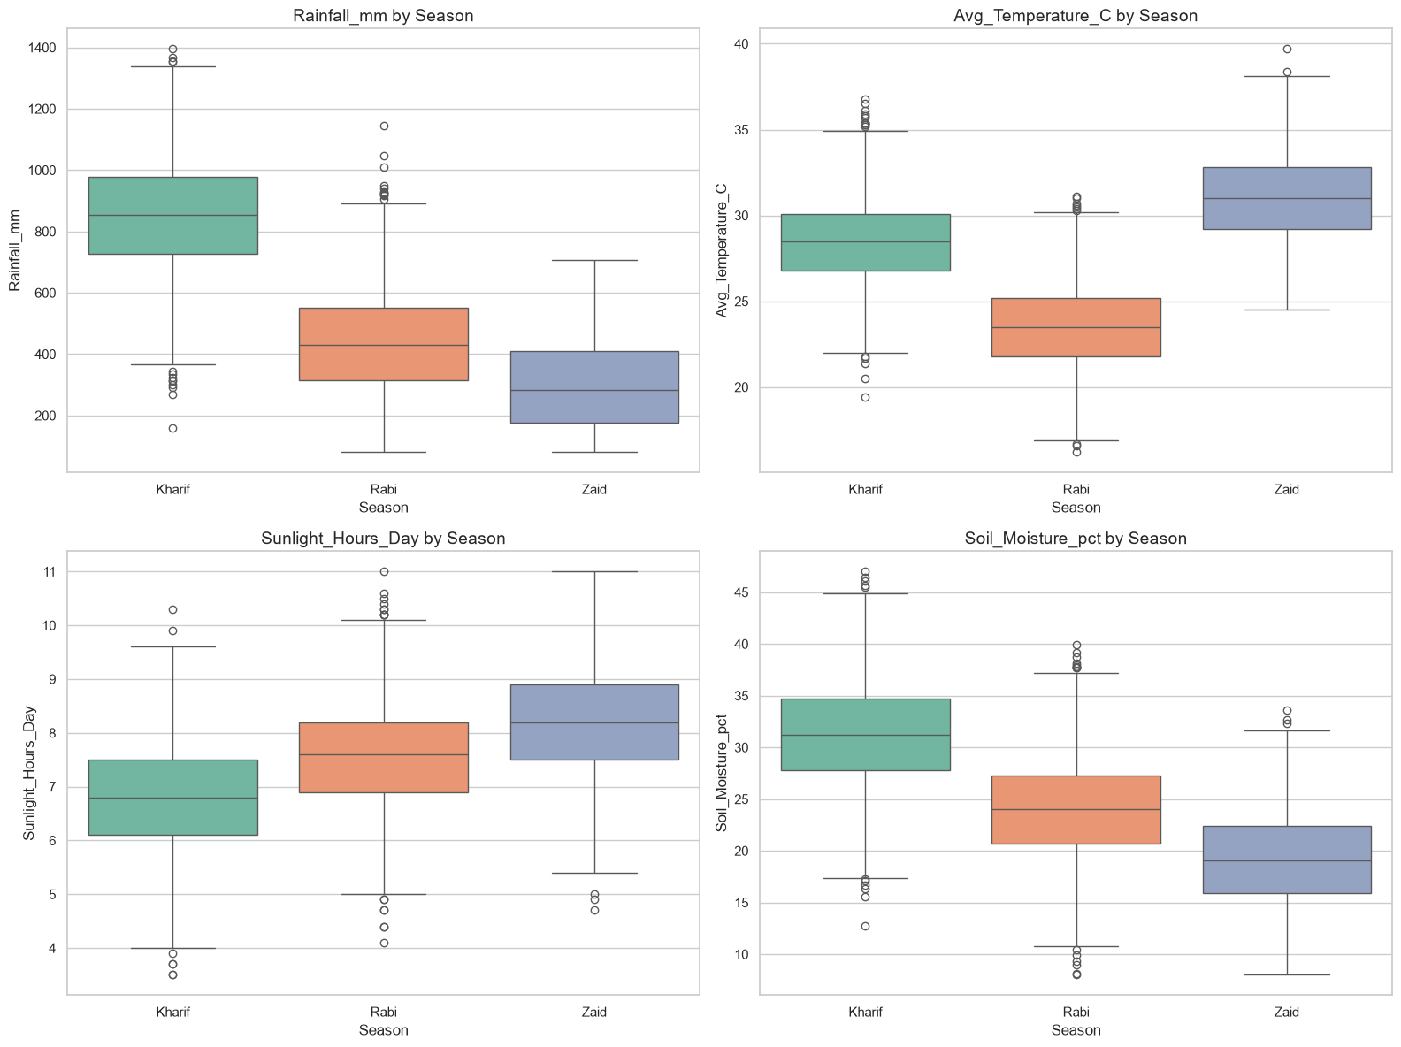
RESULTS
Seasonal Profile Breakdown
Finding
Environmental conditions vary by season. Kharif generally shows higher rainfall and soil moisture.
Analysis
The notebook compares rainfall, temperature, sunlight hours, and soil moisture across Kharif, Rabi, and Zaid.

Slide 7
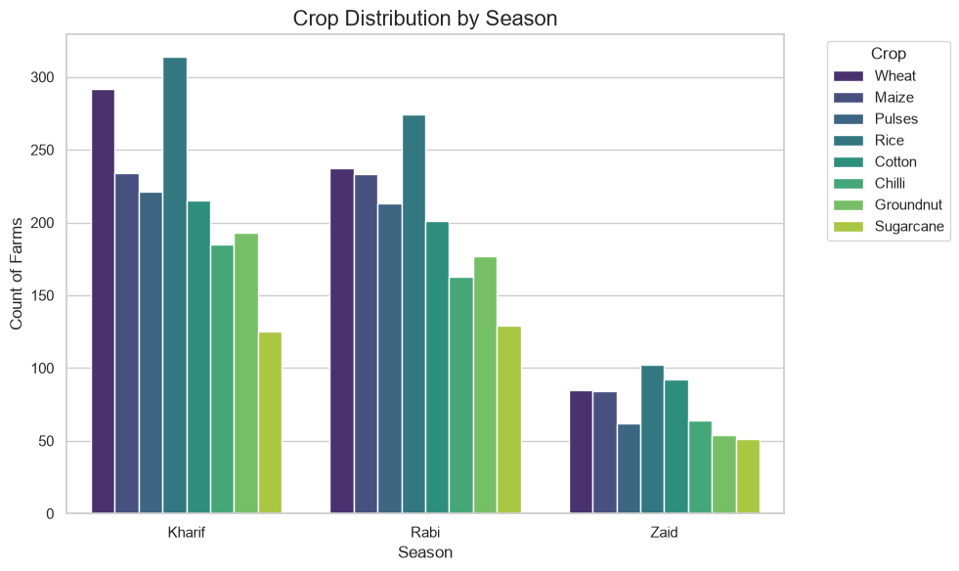
RESULTS
Crop & Season Distribution
Finding
Crop composition differs across seasons, showing seasonal crop specialization.
Analysis
The distribution chart counts farms by season and crop to reveal which crops are represented in each growing period.

Slide 8
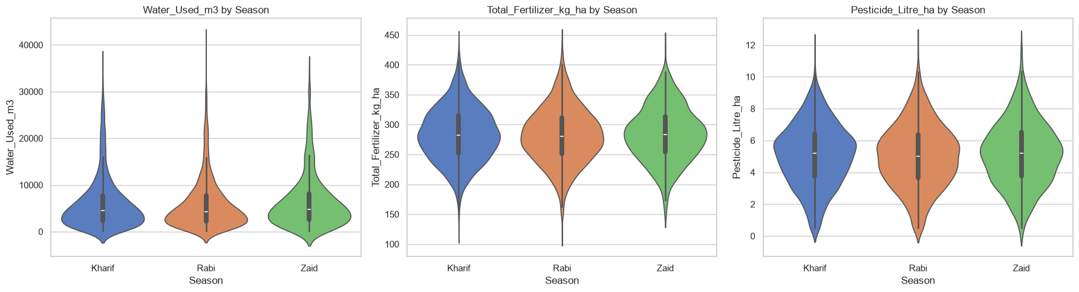
RESULTS
Resource Utilization
Finding
Water, fertilizer, and pesticide intensity vary across seasons.
Analysis
The analysis compares Water_Used_m3, Total_Fertilizer_kg_ha, and Pesticide_Litre_ha by season and highlights irrigation practices.

Slide 9
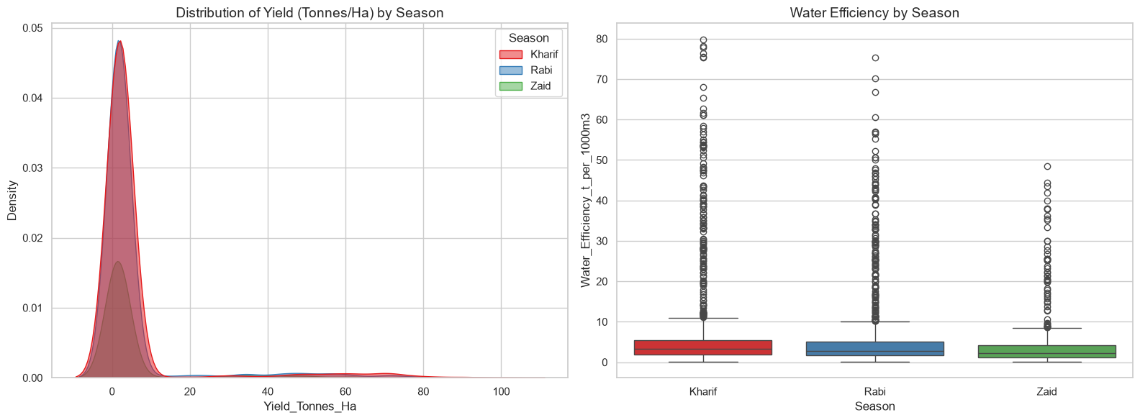
RESULTS
Productivity & Yield
Finding
Yield and water-efficiency distributions differ across seasons.
Analysis
The notebook visualizes Yield_Tonnes_Ha distributions and Water_Efficiency_t_per_1000m3 by season.

Slide 10
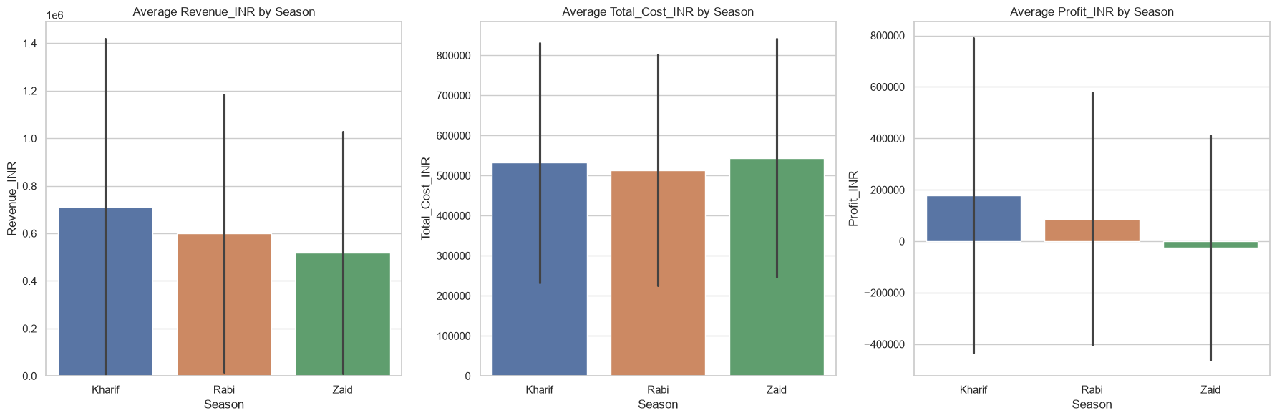
RESULTS
Economic Variations
Finding
Revenue, cost, and profit show clear seasonal variation.
Analysis
Kruskal-Wallis testing found statistically significant seasonal differences in profit: H=101.93, p=7.36e-23.

Slide 11
Future scope
• Build early-warning systems using humidity and temperature forecasts.
• Expand predictive models for yield, profit, and pest/disease risk.
• Optimize irrigation and fertilizer recommendations at farm level.
• Extend analysis to additional seasons, crops, and locations.
• Develop dashboards for continuous agricultural monitoring.
• Use statistical and ML models to support seasonal crop planning.

Slide 12
GitHub Link
GitHub repository link: https://github.com/irfan-shekh/Seasonal-Agriculture-Performance-Analysis

Slide 13

VOIS Course completion certificate -
Course name- Data Visualization
Course: Data Visualization
VOIS Course Completion Certificate

Slide 14
Thank you
.

