Slide 1

Crop Recommendation System
Supervisor :
Mr. Ali Samad
Presented by:
Muhammad Hamad F20BDATS1M02052
Muhammad Irfan F20BDATS1M02073
Department of Data Science
The Islamia University of Bahawalpur Pakistan

Slide 2
Table content
Introduction
motivation
Diagram
Methodology
Algorithms
Results

Slide 3
Introduction
Agriculture is the basic source of food supply for all countries, whether underdeveloped, developing, or developed.
Unpredictable weather conditions make it difficult to ensure food sustainability
A Crop Recommendation System can address this challenge by helping farmers make informed decisions
The system takes N-P-K (Nitrogen, Phosphorous, and Potassium) and pH values, along with temperature and humidity, as inputs
The accuracy of these models is compared, and the best-performing model is chosen
The selected model is stored using the pickle module
The machine learning model is deployed using Tkinter labrery
Farmers can input parameters like Nitrogen, Phosphorous, Potassium, pH value, Rainfall through a user-friendly interface

Slide 4
Motivation
Understanding the critical role of soil metrics in assessing soil health.
address challenges faced by farmers in optimizing crop selection.
Importance of measuring nitrogen, phosphorous, potassium levels, pH value, temperature, humidity, and rainfall.
Process often prioritized based on budget constraints due to its costly and time-consuming nature.
Creates a Recommended model utilizing historical soil data to assist farmers in crop selection.
Trains the model to establish relationships between soil conditions and crop choices.
Optimizes crop selection, empowering farmers to achieve optimal growth and maximum yields based on their specific soil conditions.

Slide 5
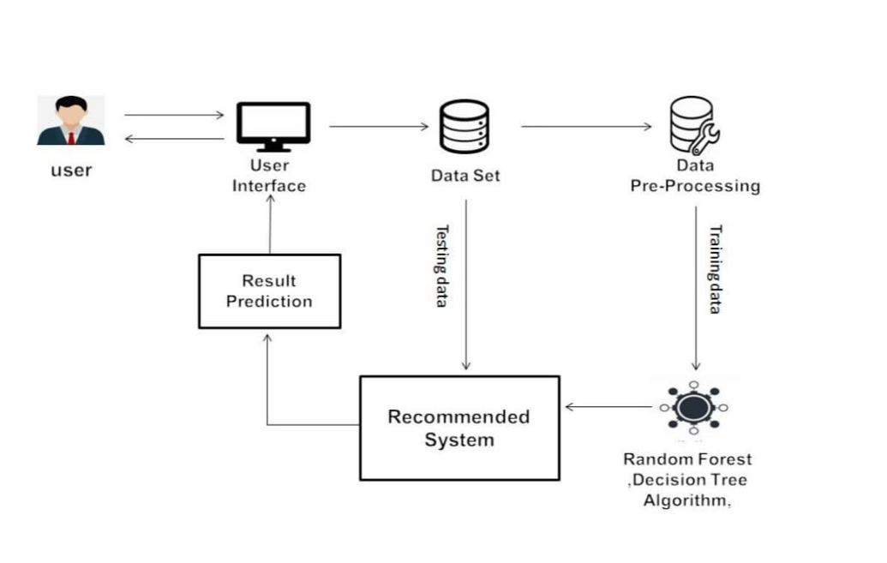

Slide 6
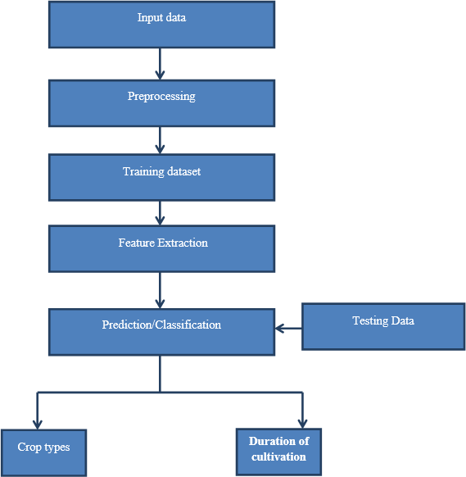
Methodology Workflow

Slide 7
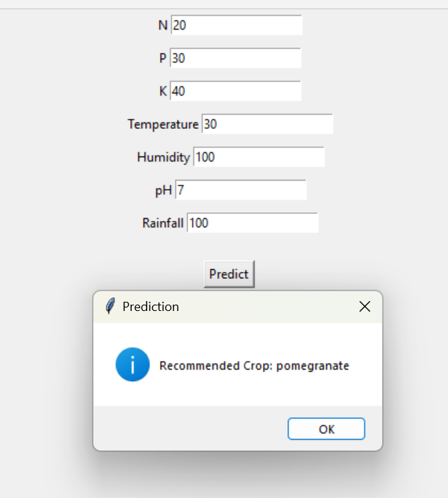
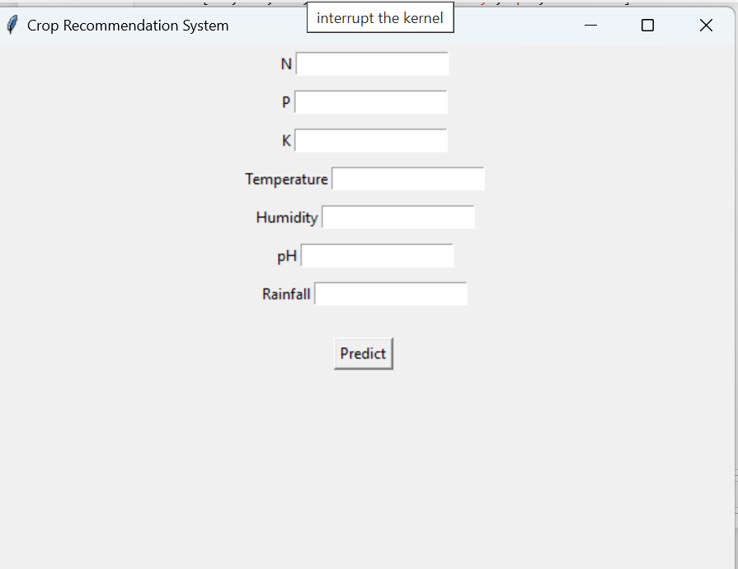
User Interface
Recommendation

Slide 8
Role of the Model
Trained on crop dataset: Learns from data to generate reliable recommendation responses.
RF,SVM,DT,KNN: All of these model provide good accuracy model during
model building.
Fine-tuned on our dataset: Optimized for maximum accuracy and relevance
Selected suitable kinter library for UI: User can predict their recommendation for suitable result.

Slide 9
Algorithms Used
FAISS: For creating and storing vector embeddings and performing fast searches.
Transformer Models (from Hugging Face): For generating vector embeddings and for the language model (`llama-2-7b-chat.ggmlv3.q8_0.bin`).
Retrieval-Based Question Answering (RetrievalQA): Combines document retrieval with a language model to answer questions based on retrieved context.
difflib: For evaluating the similarity between the true answers and the generated answers to measure accuracy.

Slide 10
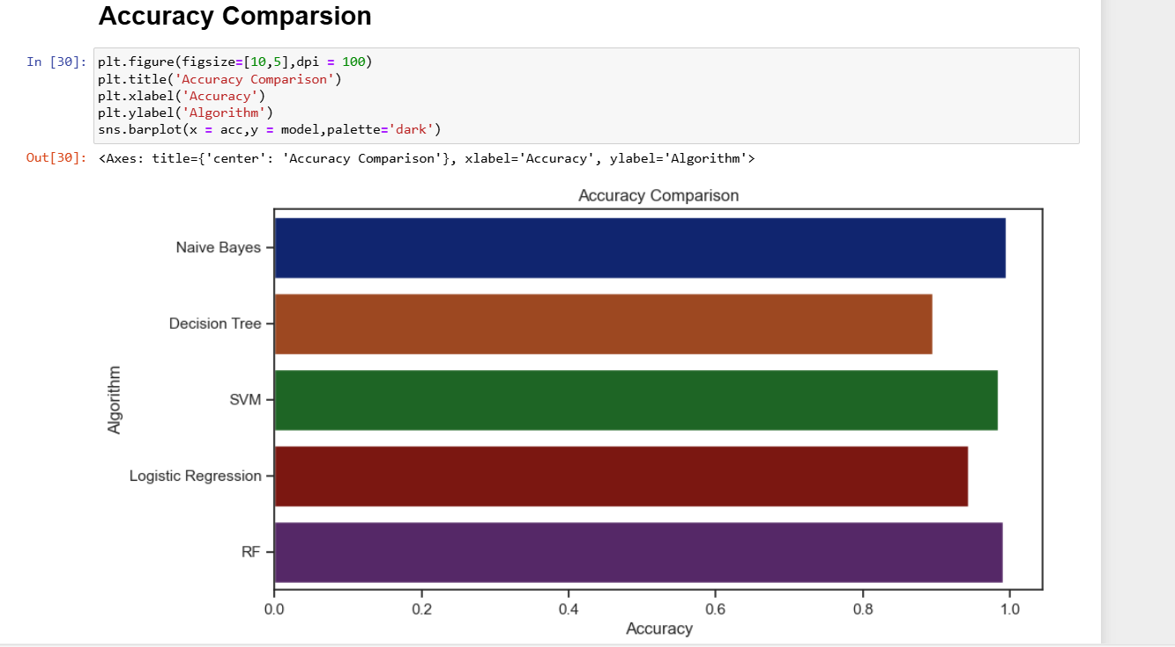
Results of accuracy of the model:
DT:89.54%
SVM:98
RF|:99%
LR:94%

