Slide 1
STOCK MANAGEMENT SYSTEM

Slide 2
AIM OF THE PROJECT
An inventory stock management system is a project that manages the stock system of any organization.
It processes and stores stock inflow and outflow.
This task if carried out manually will be tedious and includes chances of mistakes.
Thus this system reduces manual work to a great extent and allows a smooth flow of stock managing and data storing activities by removing chances of errors in the details.

Slide 3
OBJECTIVE OF THIS PROJECT
This project system was highly recommended due to the rapid increase of computer related tools in the industry.
With this proposed system features and functions of E-stock management that will be able to accommodate more reliably consistently and faster in providing a better service to the users.

Slide 4
SOFTWARE REQUIREMENTS
Front end : JAVA Swing.
Back end : mysql, java
SOFTWARE USED:
For Development: NetBeans.
For Server: Xampp
For Database: phpMyAdmin

Slide 5
PROPOSED SYSTEM
Proposed system is an Inventory Stock Management System. Through our software an admin can access 4 modules Vendor, Product , Purchase, Sales.
User friendly interface
Fast access to database
Less error
More Storage Capacity
Look and Feel Environment
Quick transaction

Slide 6
MODULE LIST
Main
Vendor
Product
Purchase
Sales
Logout

Slide 7
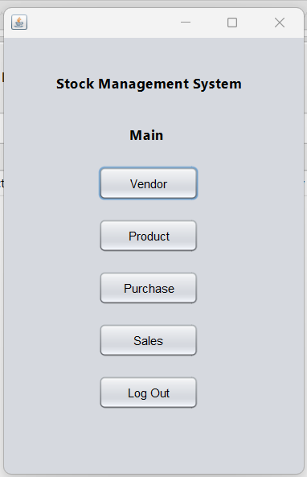
SCREENSHOTS

Slide 8
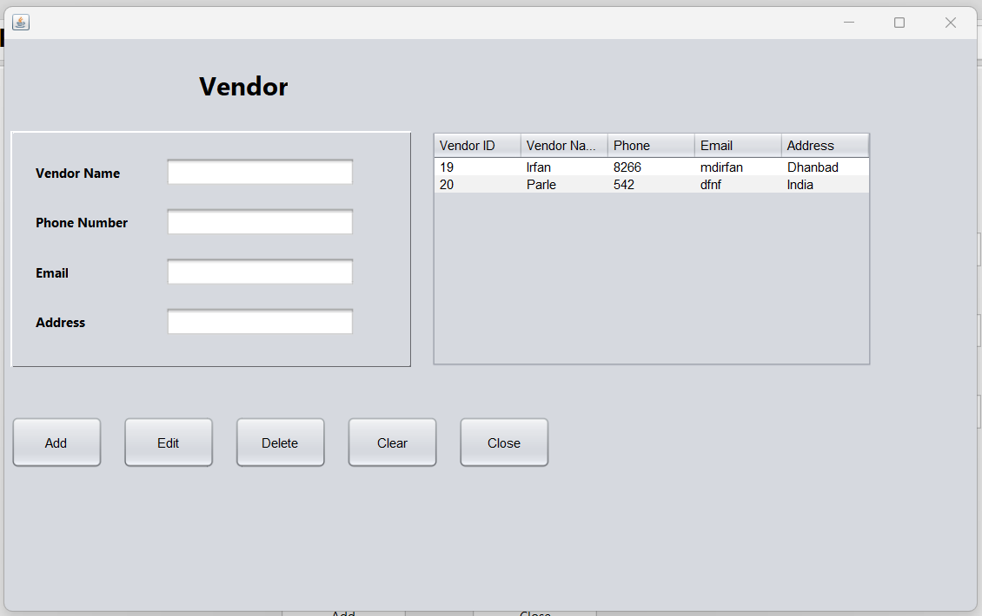

Slide 9
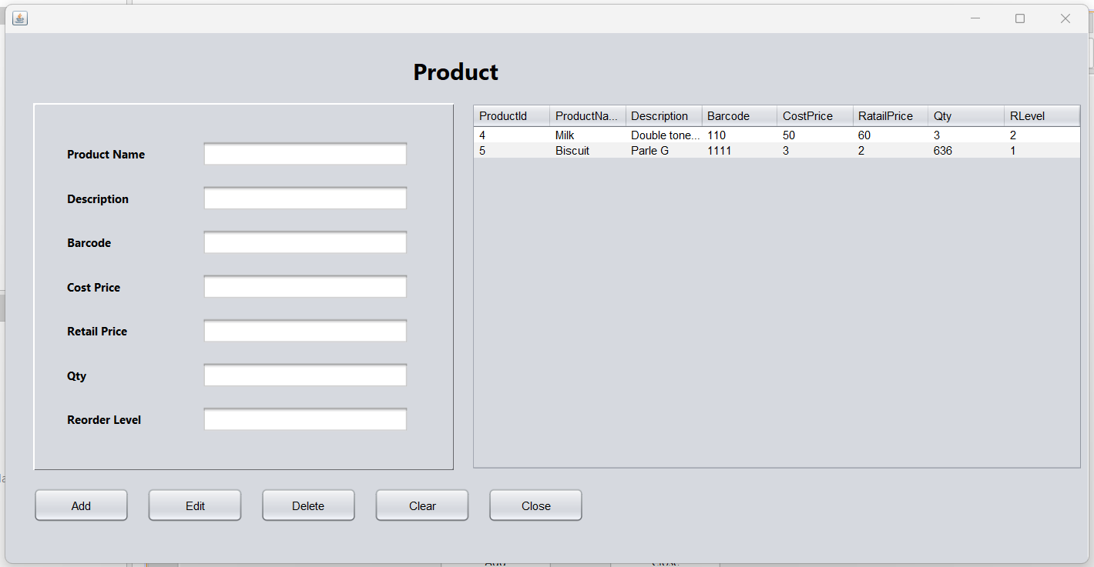

Slide 10
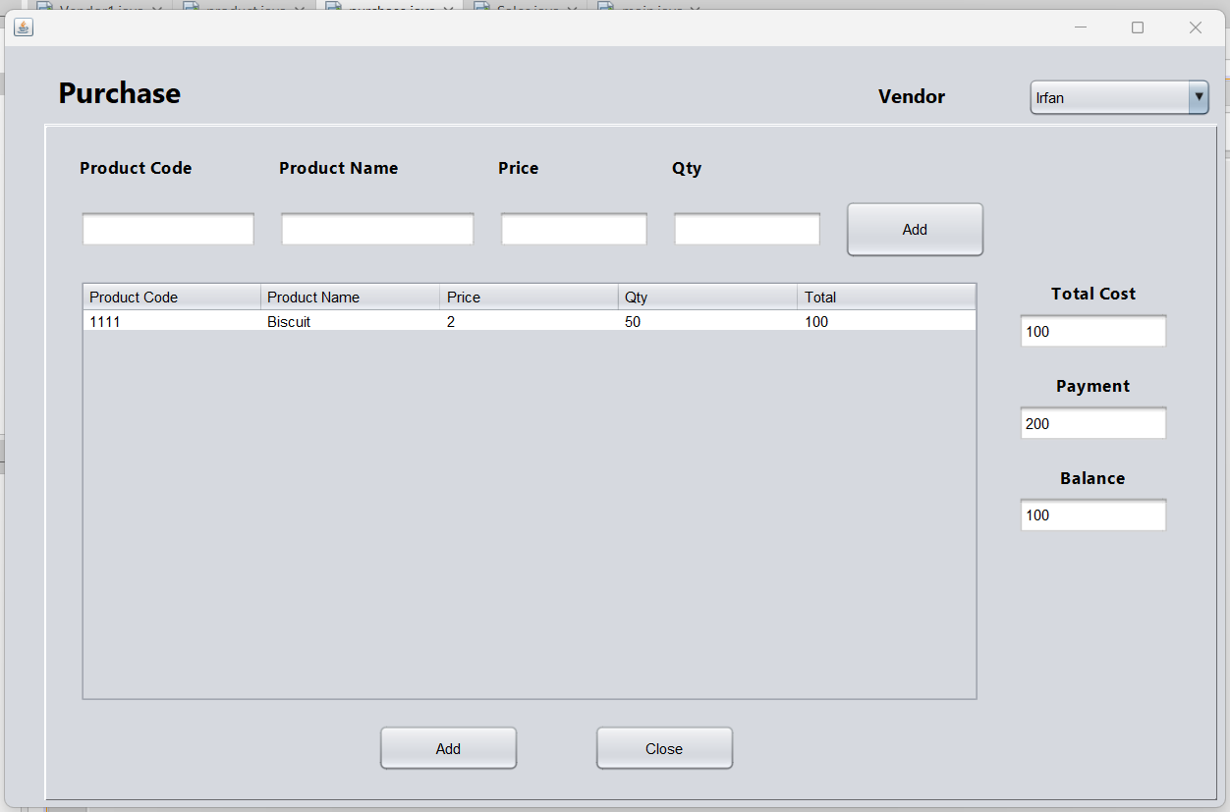

Slide 11
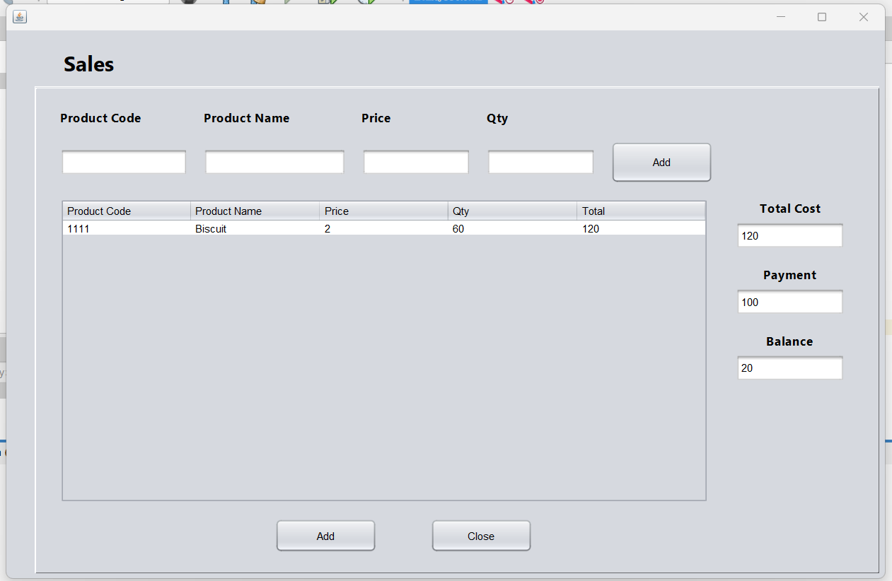

Slide 12
To conclude , Stock management system is a simple application basically suitable for small organization. It has basic modules which is used for the small organization. We have successfully developed an application where we can insert , view and delete the Vendor list and Product list.
We can also manage the purchase and sales of product using sales and purchase module which helps us to see a simple report and manage the sales and purchase.
CONCLUSION

