Slide 1


NETFLIX Movies/Shows Search
Team Members:
Irfan Ahmed
Srikanth Yelem
Divyanshi Kothari

Slide 2
Irfan contribution to the project:
Creating BOW (using Rake)
Linear Kernel for recommendation
Creating Deep Learning Model using LSTM

Slide 3
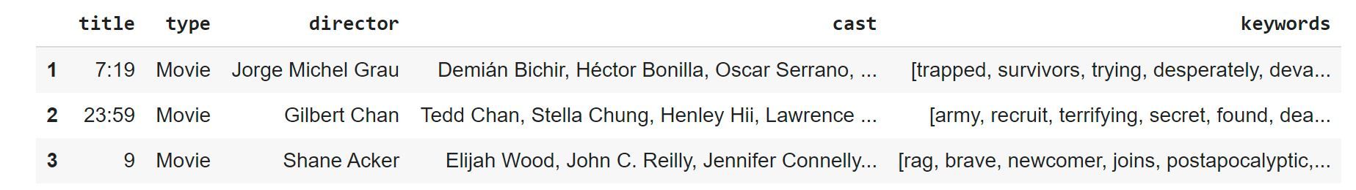
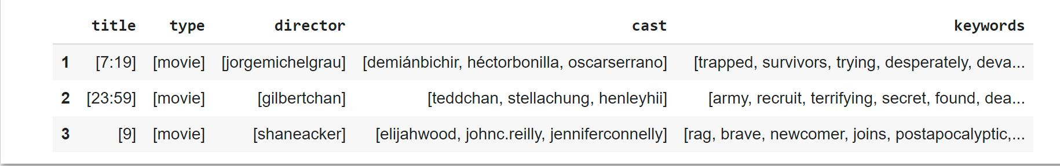
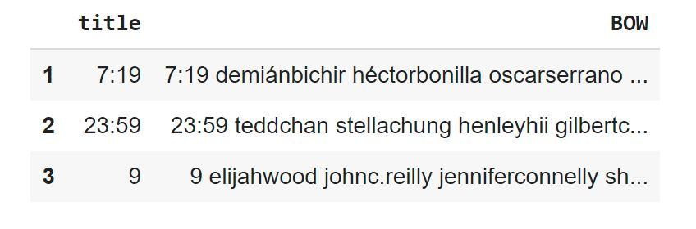
Rake: Rake Automatic Keyword Extraction
RAKE is keyword extraction algorithm. The algorithm uses stopwords and key phrases in a text/sentence to determine word frequency and its occurrence relating to other words in the document.
The Netflix dataset was used which was obtained from Kaggle:
For the purpose of this project only the title, type, director, cast, description columns were used.
For each of the description the keywords were extracted using rake and saved into a new column.
Then the other columns were mapped so they cold be combined with the keyword.

Slide 4
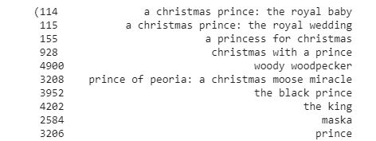
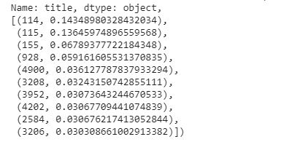
SVM Linear Kernel used for movie recommendation
Linear Kernel is used for linearly separable data using a line. This is often good to use when there are greater quantity of features in a dataset, such as text datasets.
The dataset created with RAKE was used to see if this method would improve the movie recommendations or not.

Slide 5
Keras model with LSTM layer
It a s feedforward artificial network.
Consists of three-layer nodes.
Input, hidden, output layer.
Consists of artificial neurons .
The units have weighted input signals and an activation function is used to produce an output.
The API style that I decided to use was Sequential Model:
- It is simple to use and great for 70% of the use cases.
For the complier optimizer ‘adam’ used used, and loss function ‘sparse_categorical_crossentropy’

Slide 6
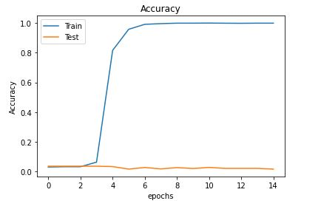
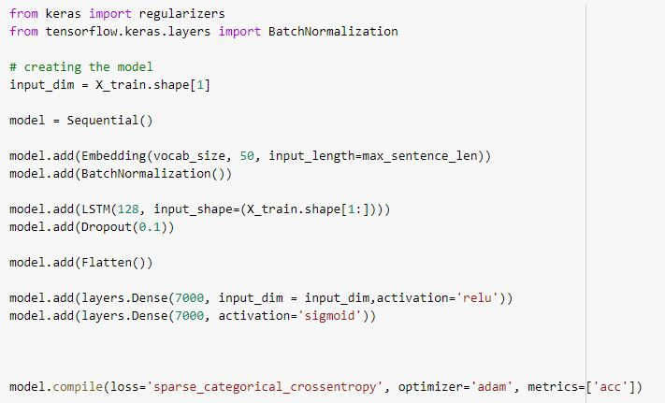
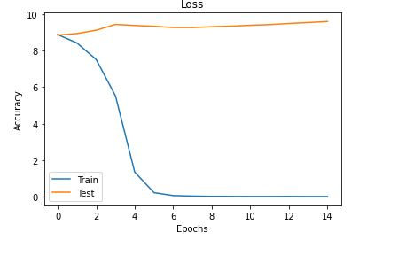
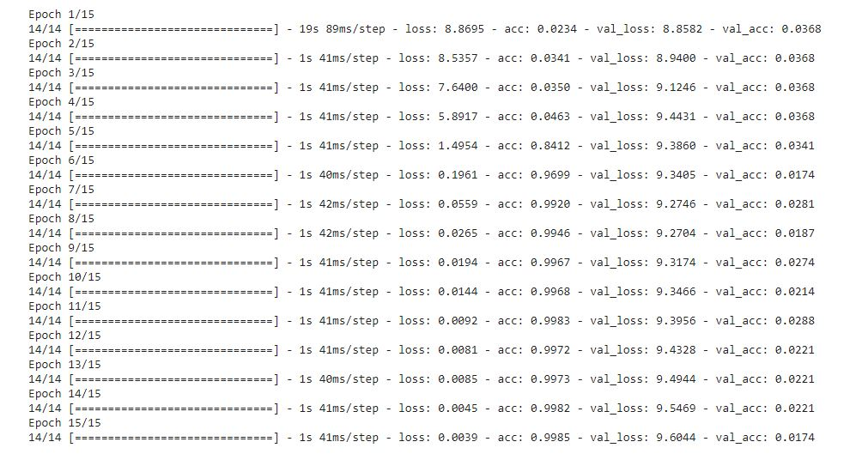
Model setup and results

Slide 7
References
https://www.kaggle.com/shivamb/netflix-shows
Class PowerPoints

Slide 8
Srikanth contribution to the project:
Creating BOW (using Rake)
Cosine Similarity for recommendation

Slide 9
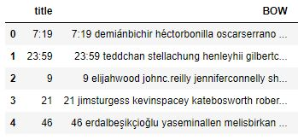
NETFLIX MOVIE RECOMMENDATION USING COSINE SIMILARITY
Preprocessed Data of Netflix titles csv
The BOW column contains combination of title and description column in lower case.
Two columns are combined to make search more efficient based on title as well as description column.

Slide 10
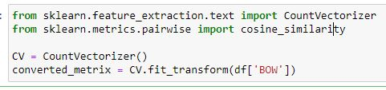
Cosine similarity model is used for training the data and getting recommendations.
Cosine Similarity calculates the similarity between two things.
After computing the similarity, we further use those computed values for recommendations.

Slide 11
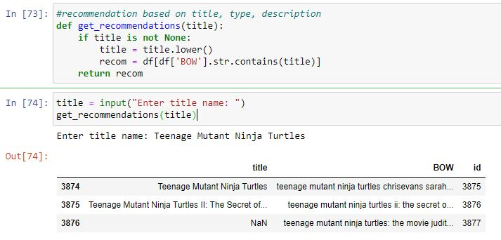
We pass the title and get all the recommendations that matches the title
After taking the input from the user the input is converted to lower case to make search more efficient.
Each row of BOW checks if the input string is present in that column and returns matching rows of that title.

Slide 12
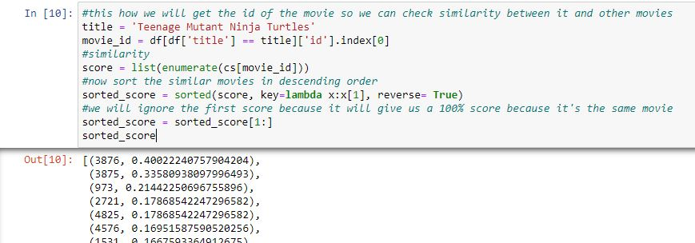
Once the data is trained, we pass the title to the model and will get all the similar movie ids related to the title and the accuracy of movie ids with respect to the title given as an input.

Slide 13
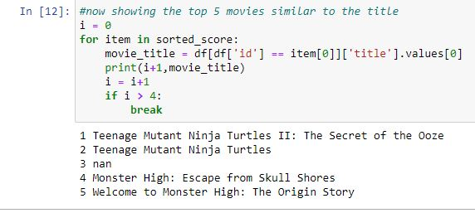
After getting similar movie ids for the title, we now get the movie titles for the recommended ids.

