Slide 1
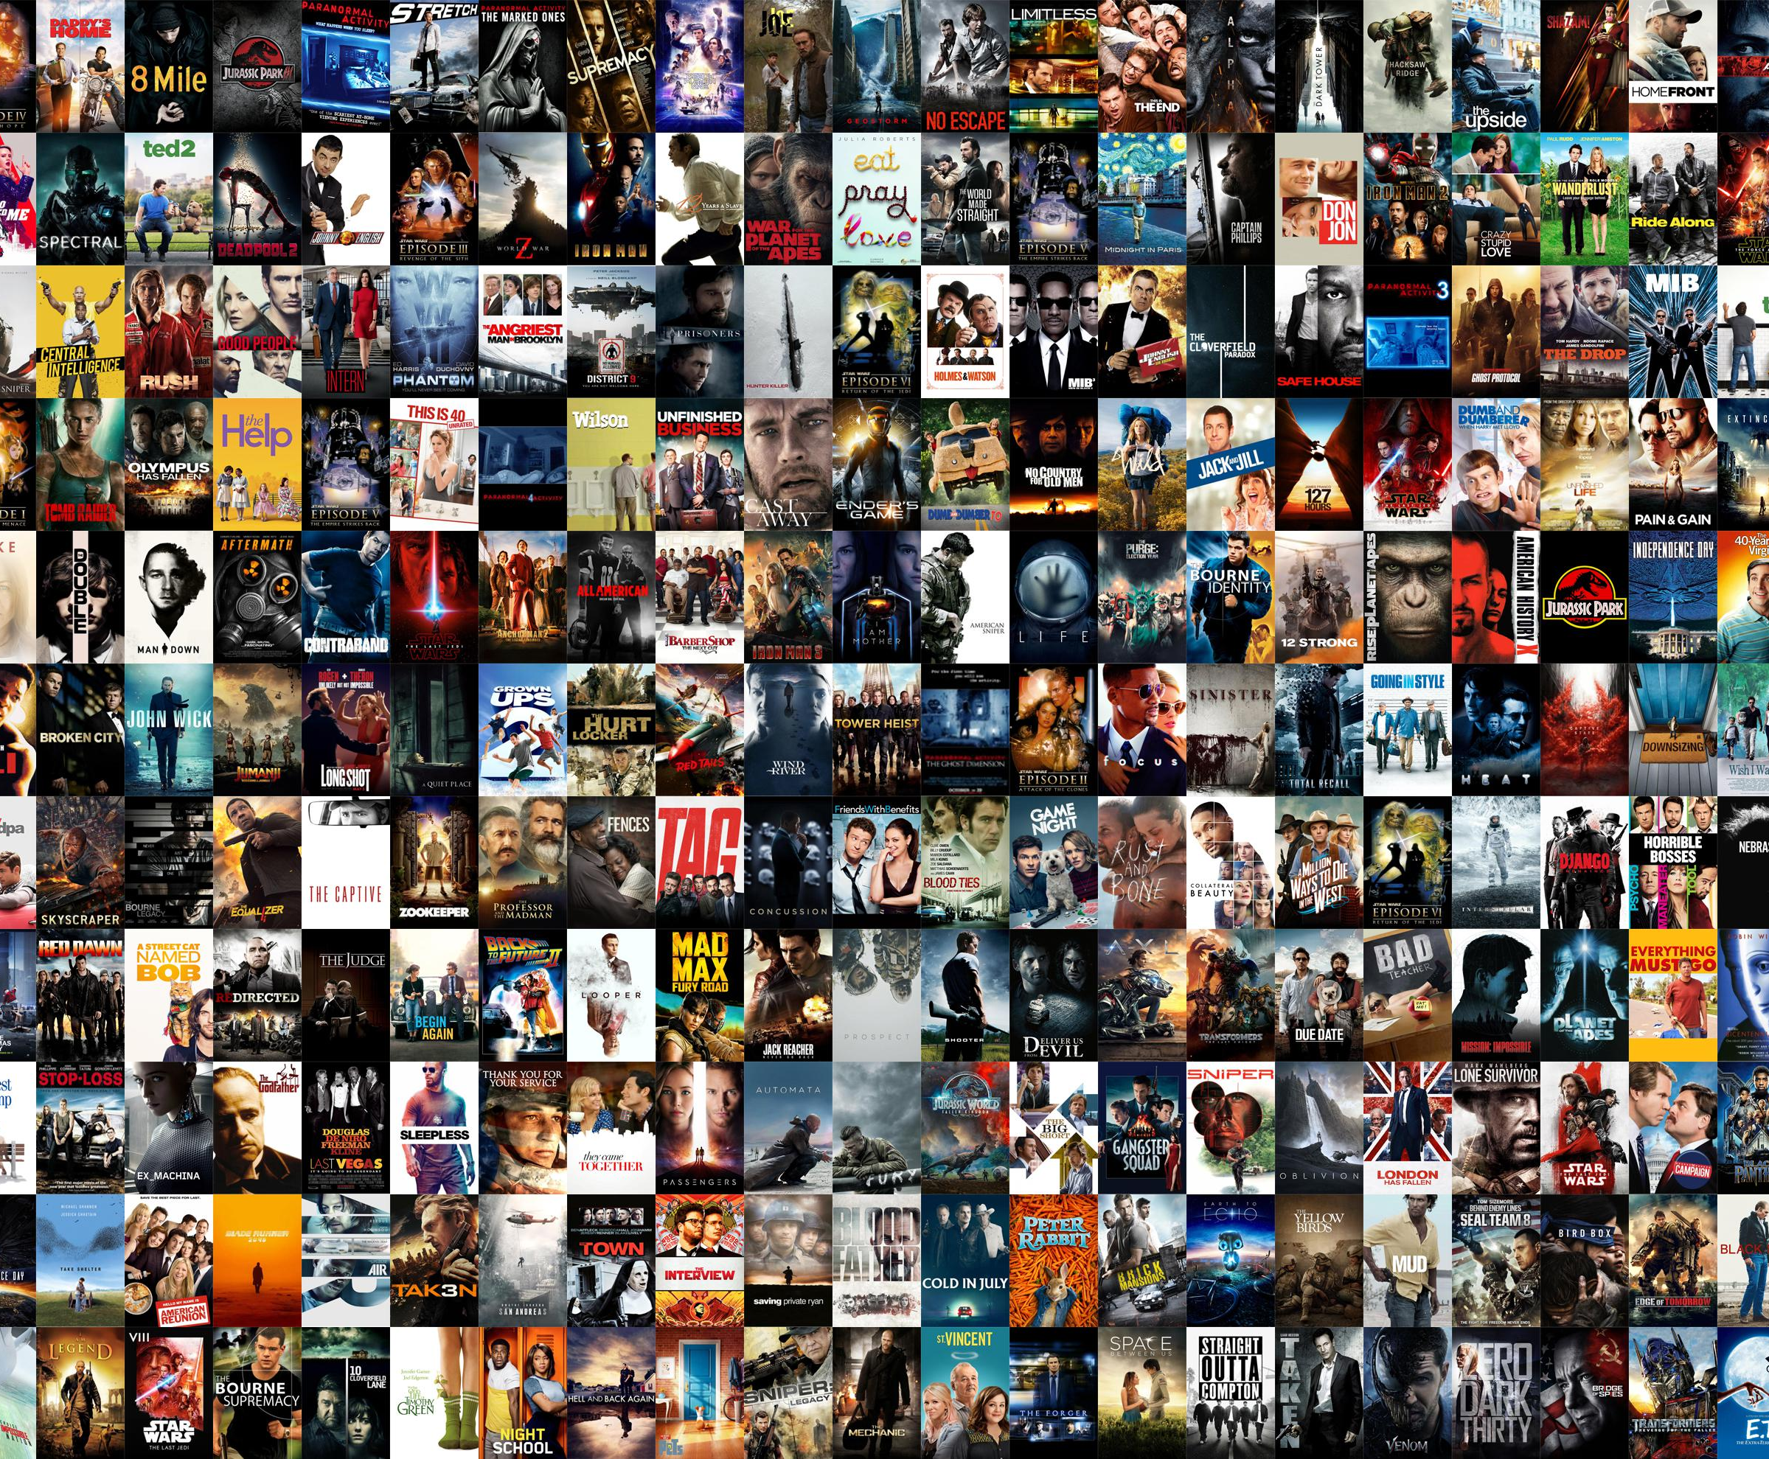

NETFLIX Movies/Shows Search
Team Members:
Irfan Ahmed
Srikanth Yelem
Divyanshi Kothari

Slide 2
Irfan contribution to the project:
Creating BOW (using Rake)
Linear Kernel for recommendation
Creating Deep Learning Model using LSTM

Slide 3
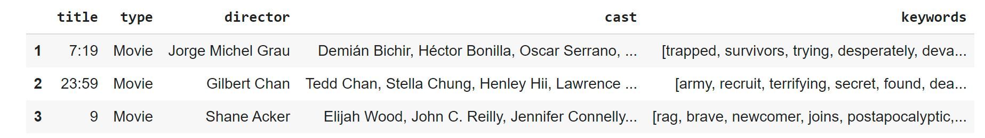
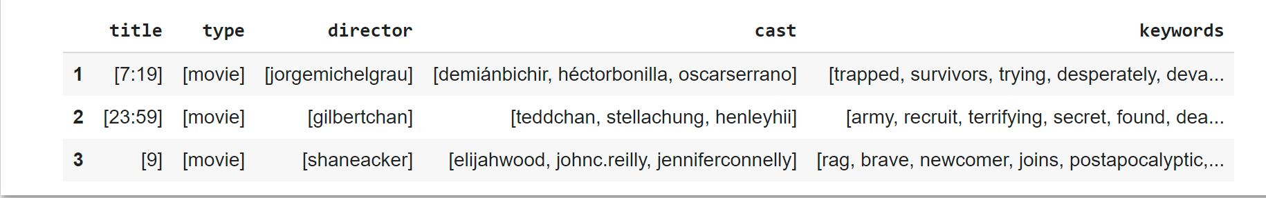
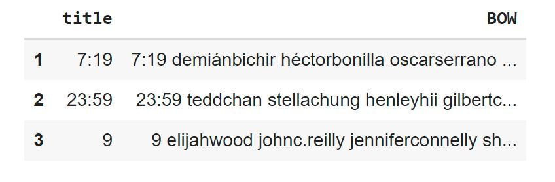
Rake: Rake Automatic Keyword Extraction
RAKE is keyword extraction algorithm. The algorithm uses stopwords and key phrases in a text/sentence to determine word frequency and its occurrence relating to other words in the document.
The Netflix dataset was used which was obtained from Kaggle:
For the purpose of this project only the title, type, director, cast, description columns were used.
For each of the description the keywords were extracted using rake and saved into a new column.
Then the other columns were mapped so they cold be combined with the keyword.

Slide 4
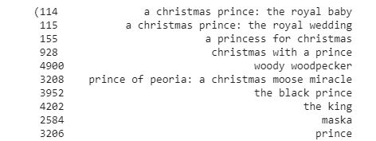
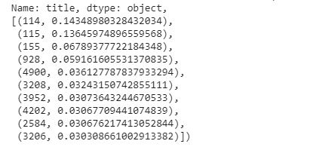
SVM Linear Kernel used for movie recommendation
Linear Kernel is used for linearly separable data using a line. This is often good to use when there are greater quantity of features in a dataset, such as text datasets.
The dataset created with RAKE was used to see if this method would improve the movie recommendations or not.

Slide 5
Keras model with LSTM layer
It a s feedforward artificial network.
Consists of three-layer nodes.
Input, hidden, output layer.
Consists of artificial neurons .
The units have weighted input signals and an activation function is used to produce an output.
The API style that I decided to use was Sequential Model:
- It is simple to use and great for 70% of the use cases.
For the complier optimizer ‘adam’ used used, and loss function ‘sparse_categorical_crossentropy’

Slide 6
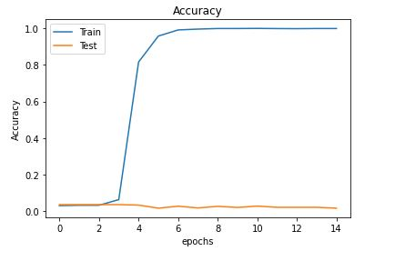
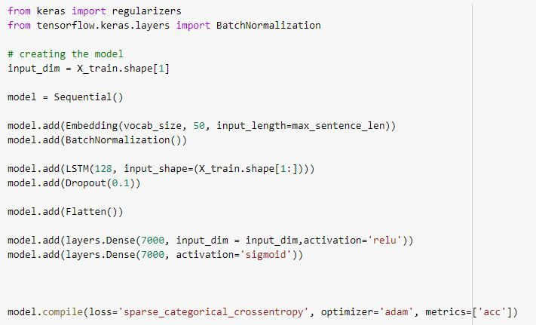
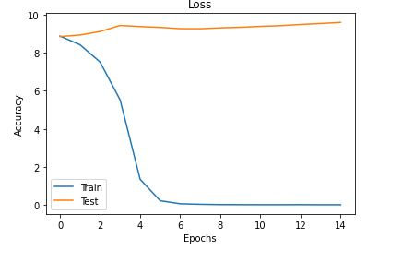
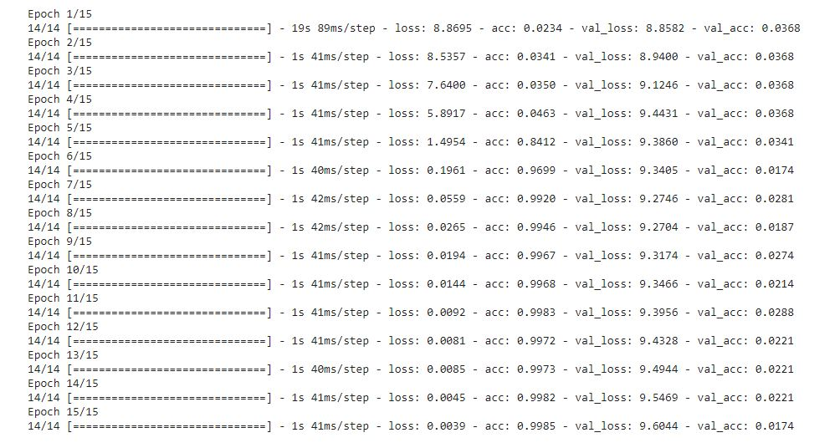
Model setup and results

Slide 7
References
https://www.kaggle.com/shivamb/netflix-shows
Class PowerPoints

