Slide 1
ExtenShield
A Malicious Browser Extension Detection System
Muhammad Irfan Danial Bin Reza Rosdee
Faculty of Artificial Intelligence and Cybersecurity
Universiti Teknikal Malaysia Melaka • Final Year Project

Slide 2
Presentation Outline
1
Chapter 1: Introduction Background, problem, objectives & scope
2
Chapter 2: Literature Review Threats and detection approaches
3
Chapter 3: Methodology Approach, requirements & schedule
4
Chapter 4: Design Architecture, data flow, modules & UI
5
Chapter 5: Implementation Development environment and modules
6
Chapter 6: Testing Test plan and results
7
Chapter 7: Conclusion Contribution, limitations & future work

Slide 3
CHAPTER 1
Introduction
Background, problem statement, objectives and scope

Slide 4
Background & Motivation
CHAPTER 1
Browser extensions are everywhere, but they are powerful.
An extension can read pages, cookies and keystrokes, and send data out.
Most are over-privileged and request more access than they need.
Malicious extensions still pass the store review and reach users.
Users have no easy way to judge safety before installing.
200,000+
extensions in the Chrome Web Store
39.8%
comply with least privilege
400,000
users hit by the Cyberhaven attack (2024)

Slide 5
Problem Statement
CHAPTER 1
PS1 • Awareness
PS2 • Reactive
PS3 • No explanation
Users install extensions without understanding the access they are granting. Permission prompts are short and technical, and are usually accepted without reading.
Existing browser protections (store review, blacklists, removal) act only AFTER a malicious extension is discovered and reported.
Current tools give a single safe / unsafe verdict with no reason, so users cannot judge or trust the result and learn to ignore warnings.

Slide 6
Research Questions & Objectives
CHAPTER 1
Research Questions
Research Objectives
RQ1: Which permissions and code behaviours signal malicious extensions?
RQ2: How can suspicious behaviour be detected by static analysis before installation?
RQ3: How can results be presented so an ordinary user understands the risk?
PO1: Investigate permissions, threats and code patterns of malicious extensions.
PO2: Develop ExtenShield using rule-based static analysis.
PO3: Evaluate it on benign and malicious samples with clear, explained results.

Slide 7
Scope & Contribution
CHAPTER 1
Project Scope
Contribution
Analyses Google Chrome extensions.
Static analysis of manifest, permissions and JavaScript (never runs the extension).
Rule-based scoring, not machine learning.
Input by Web Store link or .zip / .crx upload.
Built with Python and Streamlit.
A lightweight, pre-installation safety check.
Proactive: inspects an extension before it is installed.
Explainable: every point traces to a named rule.
Available as a CLI tool and a public web dashboard.

Slide 8
CHAPTER 2
Literature Review
Threats and detection approaches (2019–2026)

Slide 9
Browser Extensions & Permissions
CHAPTER 2
Extensions are built with HTML, CSS and JavaScript plus a manifest file.
Permissions unlock features: cookies, tabs, history, clipboard, scripting.
Host permissions decide which sites; <all_urls> means every website.
Many extensions break the principle of least privilege.
Manifest V3 removes ~87.8% of abusable APIs, but static analysis is still needed.

Slide 10
Threats from Malicious Extensions
CHAPTER 2
Credential & session theft
Keystroke logging
Data exfiltration
Steal passwords and session cookies
Record everything typed via key listeners
Send stolen data to external servers
Browser hijacking
Ad fraud & cryptojacking
Phishing & supply-chain
Change homepage and search engine
Inject ads, mine cryptocurrency
Fake forms; poisoned auto-updates

Slide 11
Detection Approaches
CHAPTER 2
Approach | Needs dataset | Runs extension | Explainable | Pre-install
Static analysis | No | No | Moderate | High
Dynamic analysis | No | Yes | Moderate | Low
Machine learning | Yes (large) | No | Low | Moderate
Rule-based / heuristic | No | No | High | High
ExtenShield uses a rule-based static approach: fast, safe, no dataset, and fully explainable.

Slide 12
CHAPTER 3
Methodology
Development approach, requirements and schedule

Slide 13
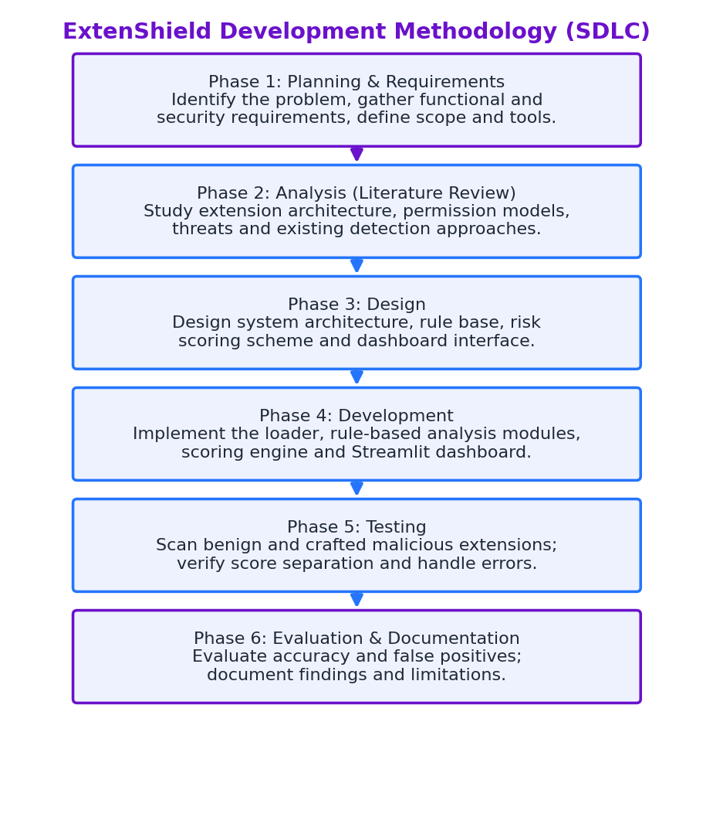
Development Methodology (SDLC)
CHAPTER 3

Slide 14
Project Requirements
CHAPTER 3
Functional
Non-functional
Accept a Web Store link or .zip / .crx file.
Read the manifest and JavaScript.
Apply permission, host and code rules.
Compute a 0–100 score and risk level.
Show each finding with reason and evidence.
Safe: never executes the extension.
Transparent: every point traces to a rule.
Usable by a non-technical user.
Fast: a scan finishes in seconds.
Maintainable: rules separate from logic.

Slide 15
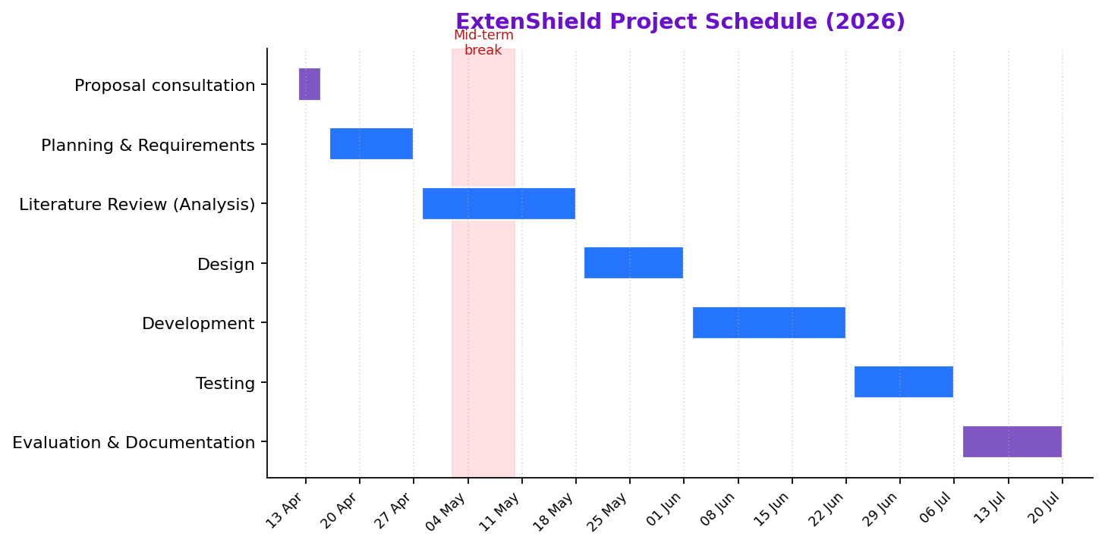
Project Schedule
CHAPTER 3

Slide 16
CHAPTER 4
Design
Architecture, data flow, modules and interface

Slide 17
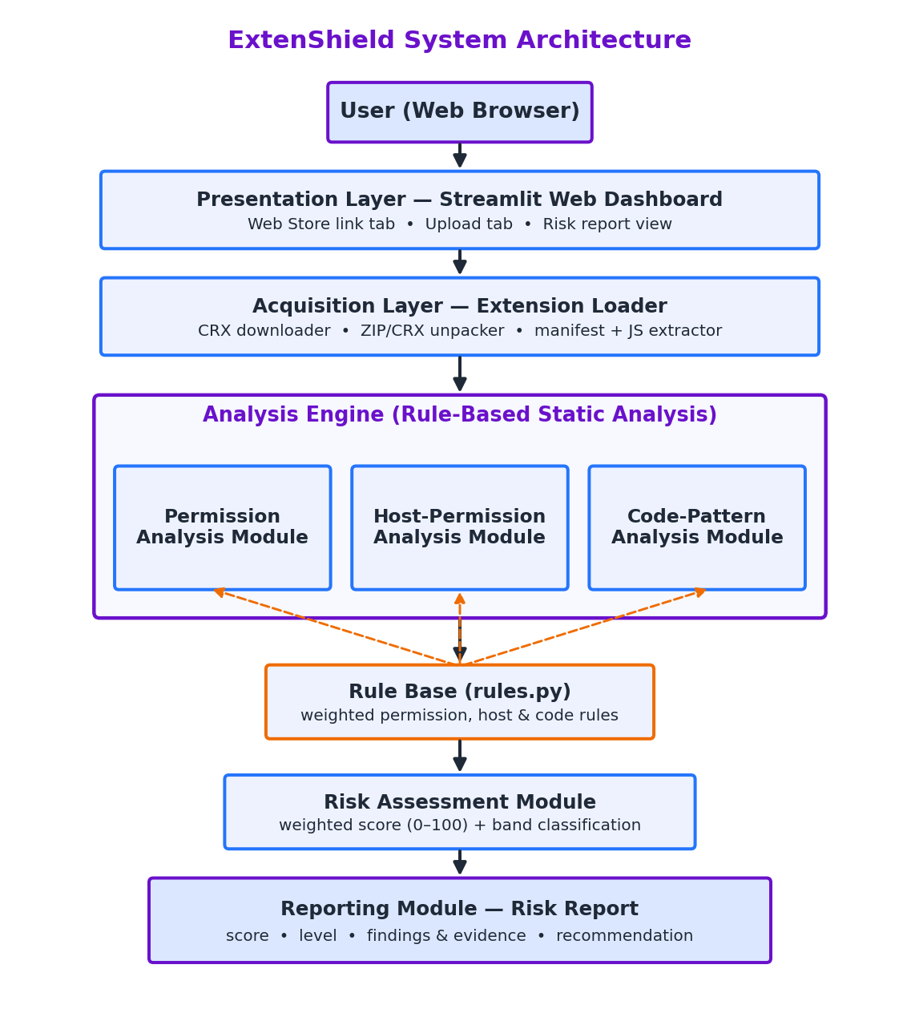
System Architecture
CHAPTER 4

Slide 18
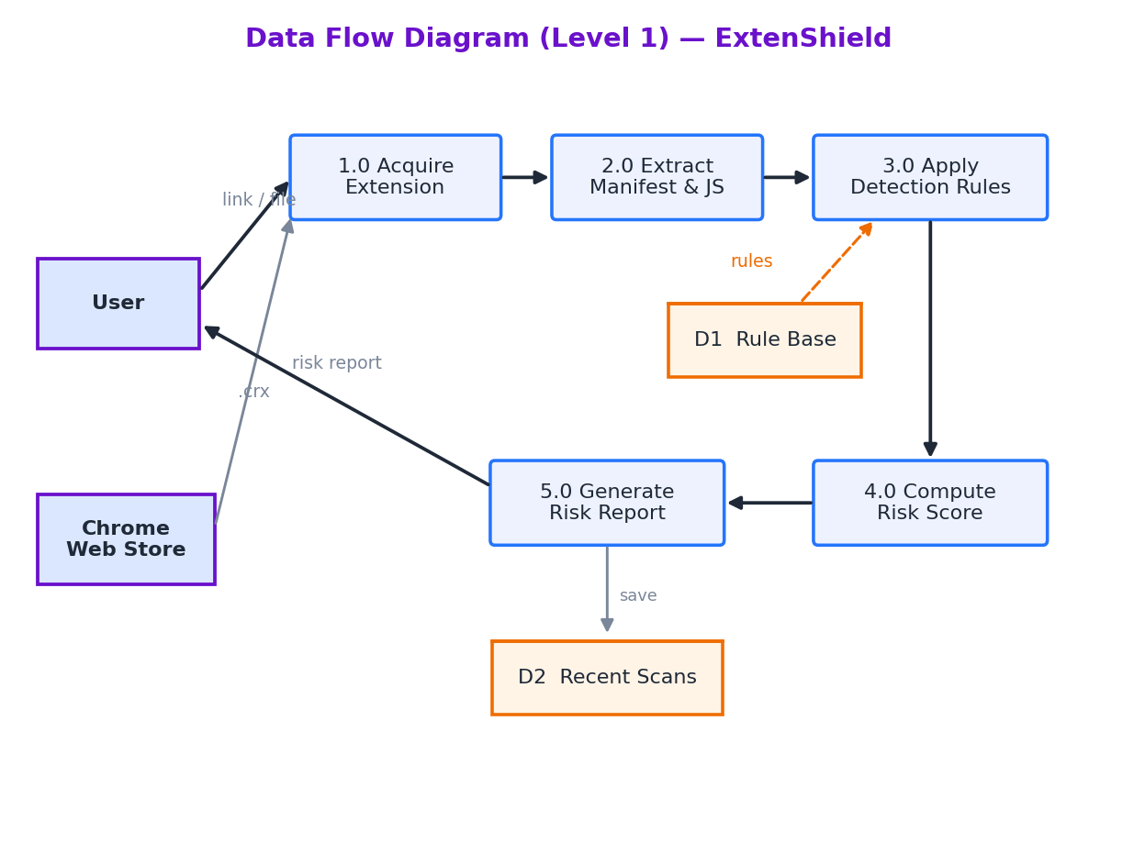
Data Flow Diagram
CHAPTER 4

Slide 19
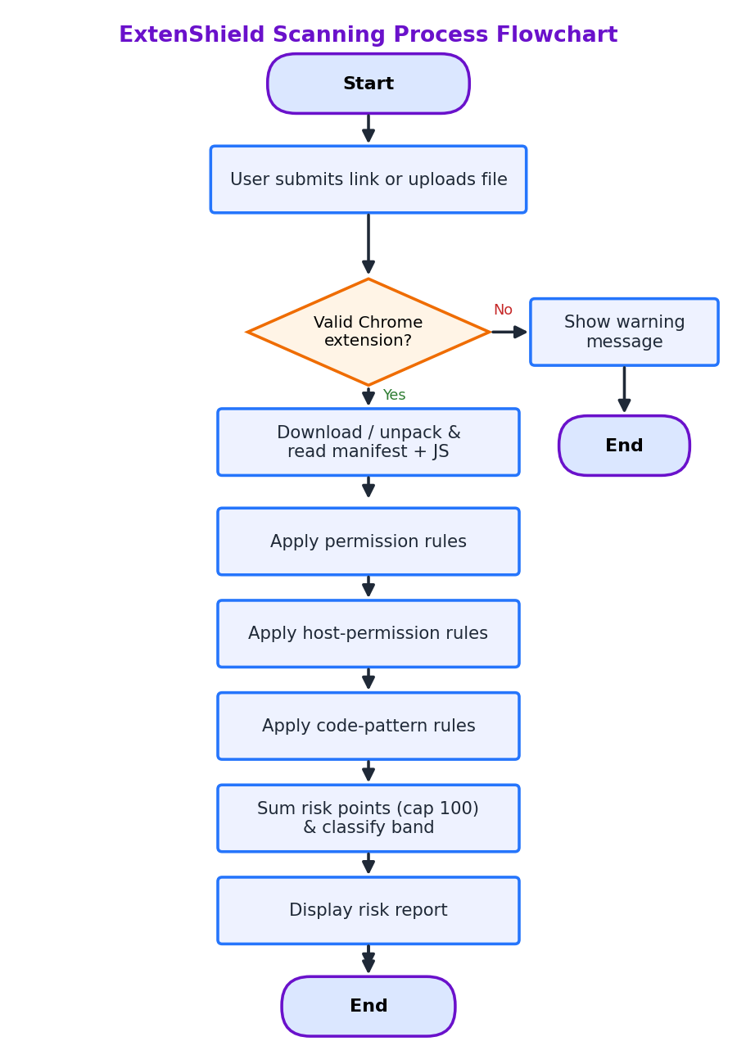
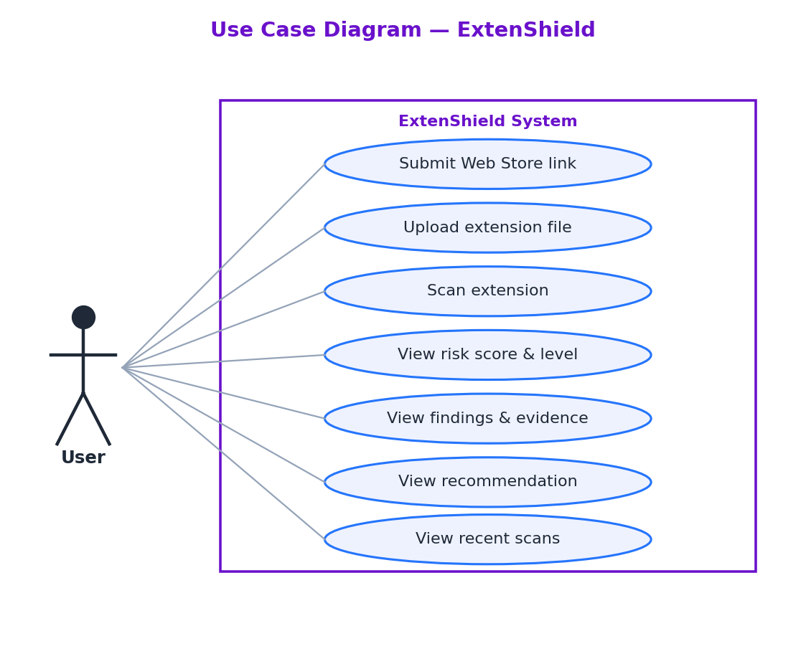
Use Case & Scanning Flow
CHAPTER 4

Slide 20
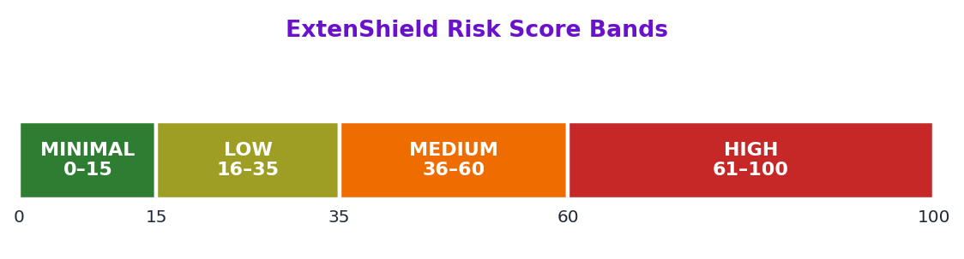
Modules & Risk Scoring
CHAPTER 4
Extension Loader — downloads / unpacks and reads manifest + JS.
Permission Analysis — flags dangerous permissions.
Host-Permission Analysis — flags broad site access.
Code-Pattern Analysis — scans JavaScript for risky patterns.
Risk Assessment — sums weighted rules into a 0–100 score.
Score is mapped to four bands: Minimal, Low, Medium, High.

Slide 21
CHAPTER 5
Implementation
Development environment and how the modules were built

Slide 22
Development Environment
CHAPTER 5
Tools Used
Why This Setup
Python 3 (mainly the standard library).
Streamlit for the web dashboard.
Visual Studio Code as the editor.
Git and GitHub for version control.
Streamlit Community Cloud for hosting.
Free and open-source; no licence needed.
No database or dataset to maintain.
Streamlit turns Python into a web app quickly.
Runs locally and online from the same code.

Slide 23
Implementation of the Modules
CHAPTER 5
loader.py — downloads / unpacks the extension and reads the manifest and JS.
rules.py — holds the permission, host and code-pattern rules.
analyzer.py — applies the rules and produces findings.
report.py — sums the weights into a 0–100 score and risk band.
webstore.py — fetches an extension from a Web Store link.
app.py / cli.py — the web dashboard and the command-line tool.
Deployed on GitHub + Streamlit Cloud (extenshield.streamlit.app) and also runs on localhost.

Slide 24
CHAPTER 6
Testing
Test plan and results

Slide 25
Test Plan
CHAPTER 6
Functional Tests
Detection Tests
Web Store link is accepted and scanned.
.zip / .crx upload is accepted and scanned.
Manifest and JavaScript are read correctly.
Score, level and findings are displayed.
Wrong input shows a clear error message.
Benign sample should score low (Minimal).
Malicious sample should score high (High).
Each finding matches the correct rule.
Tested with black-box and white-box cases.

Slide 26
Test Results
CHAPTER 6
Benign sample
Malicious sample
1 / 100
100 / 100
MINIMAL
HIGH
All test cases passed — the tool clearly separates safe from malicious extensions.

Slide 27
CHAPTER 7
Conclusion
Contribution, limitations and future work

Slide 28
Conclusion
CHAPTER 7
All three objectives (PO1–PO3) were achieved.
ExtenShield checks an extension before installation using rule-based static analysis.
It gives an explainable 0–100 risk score with reasons and evidence.
It clearly separated the benign sample from the malicious one in testing.
Delivered as a command-line tool and a public web dashboard.

Slide 29
Limitations & Future Work
CHAPTER 7
Limitations
Future Work
Static only — it cannot see runtime behaviour.
Rule-based — may miss brand-new tricks.
Weights are set by expert judgement.
Add dynamic analysis to observe behaviour.
Tune the weights using a labelled dataset.
Expand the rule set over time.
Offer it as a browser plug-in.

Slide 30
Thank You
Questions & live demo • extenshield.streamlit.app

