Slide 1
Composite
DESIGN PATTERN

Slide 2
Type of Design Pattern
Creational Design Patterns
Structural Design Patterns
Behavioral Design Patterns

Slide 3
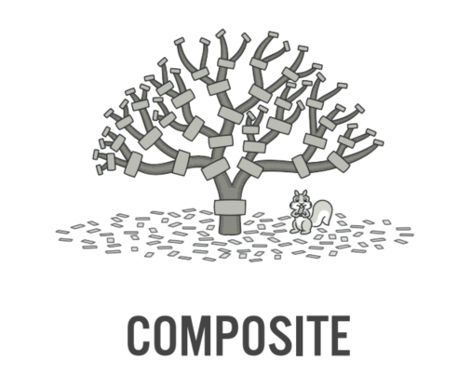
Composite Design Patterns

Slide 4

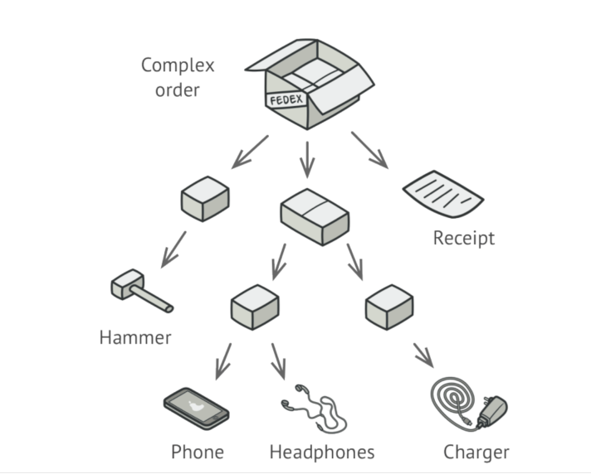
Composite Design Patterns

Slide 5
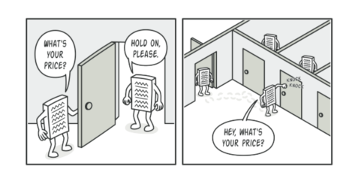

Slide 6
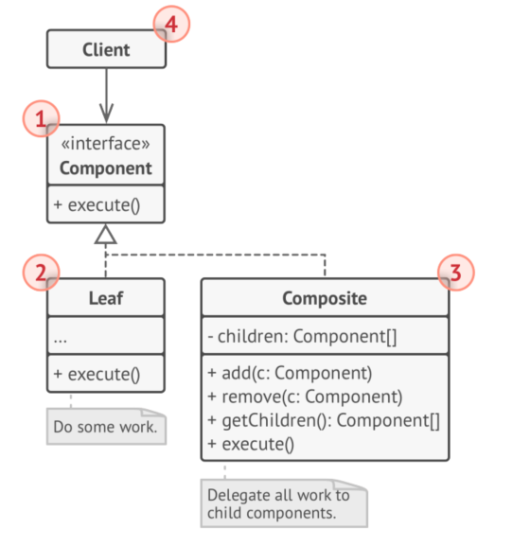
Structure
Component
Leaf
Composite (Container)
Client

Slide 7
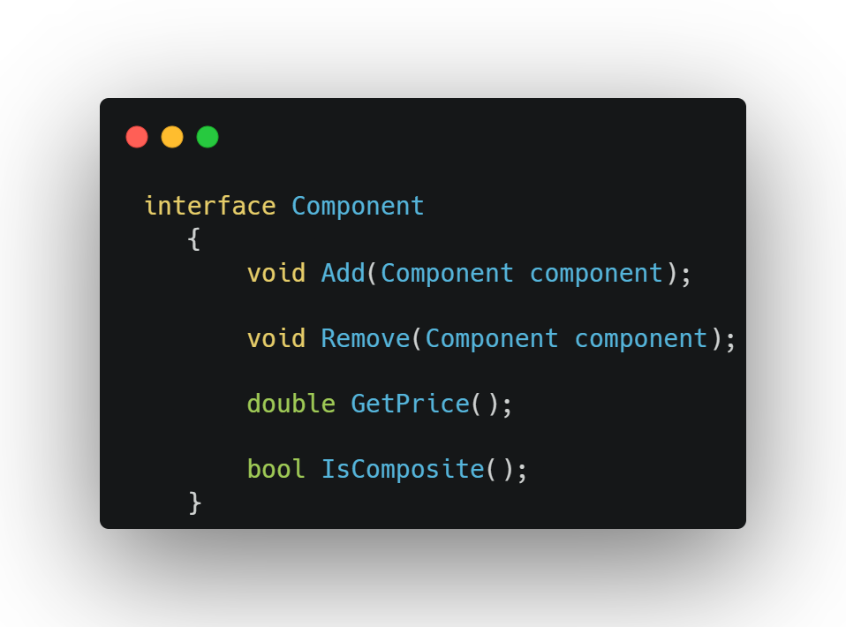
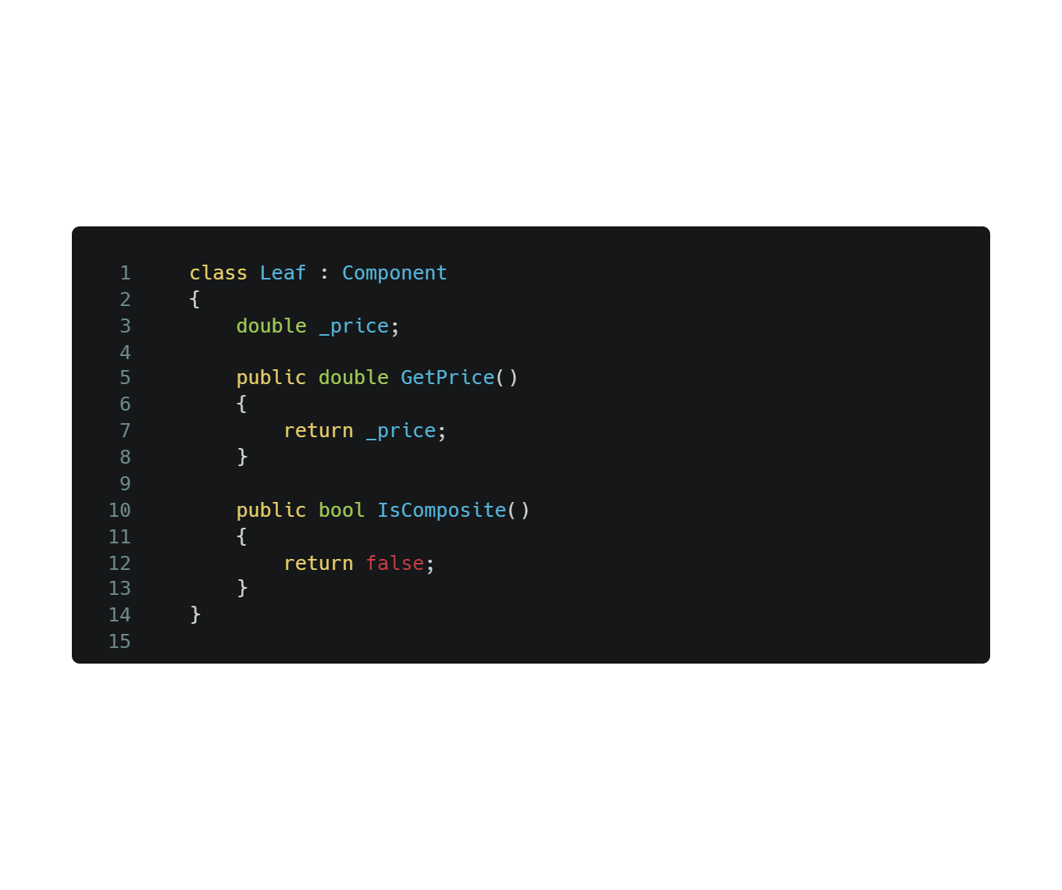

Slide 8
