Slide 1
“Web Soft Overview”
Training Road Map
Documented By : Irfan Fazal

Slide 2
Introduction
MTBC WebSoft
WebSoft is a web based solution built on Angular 6 designed, hosted and maintained by MTBC.
It’s a billing platform for employees in Operations who perform billing practice in their routine work.
Maintain the work efficiency of the users.
Makes the user’s work easier.

Slide 3
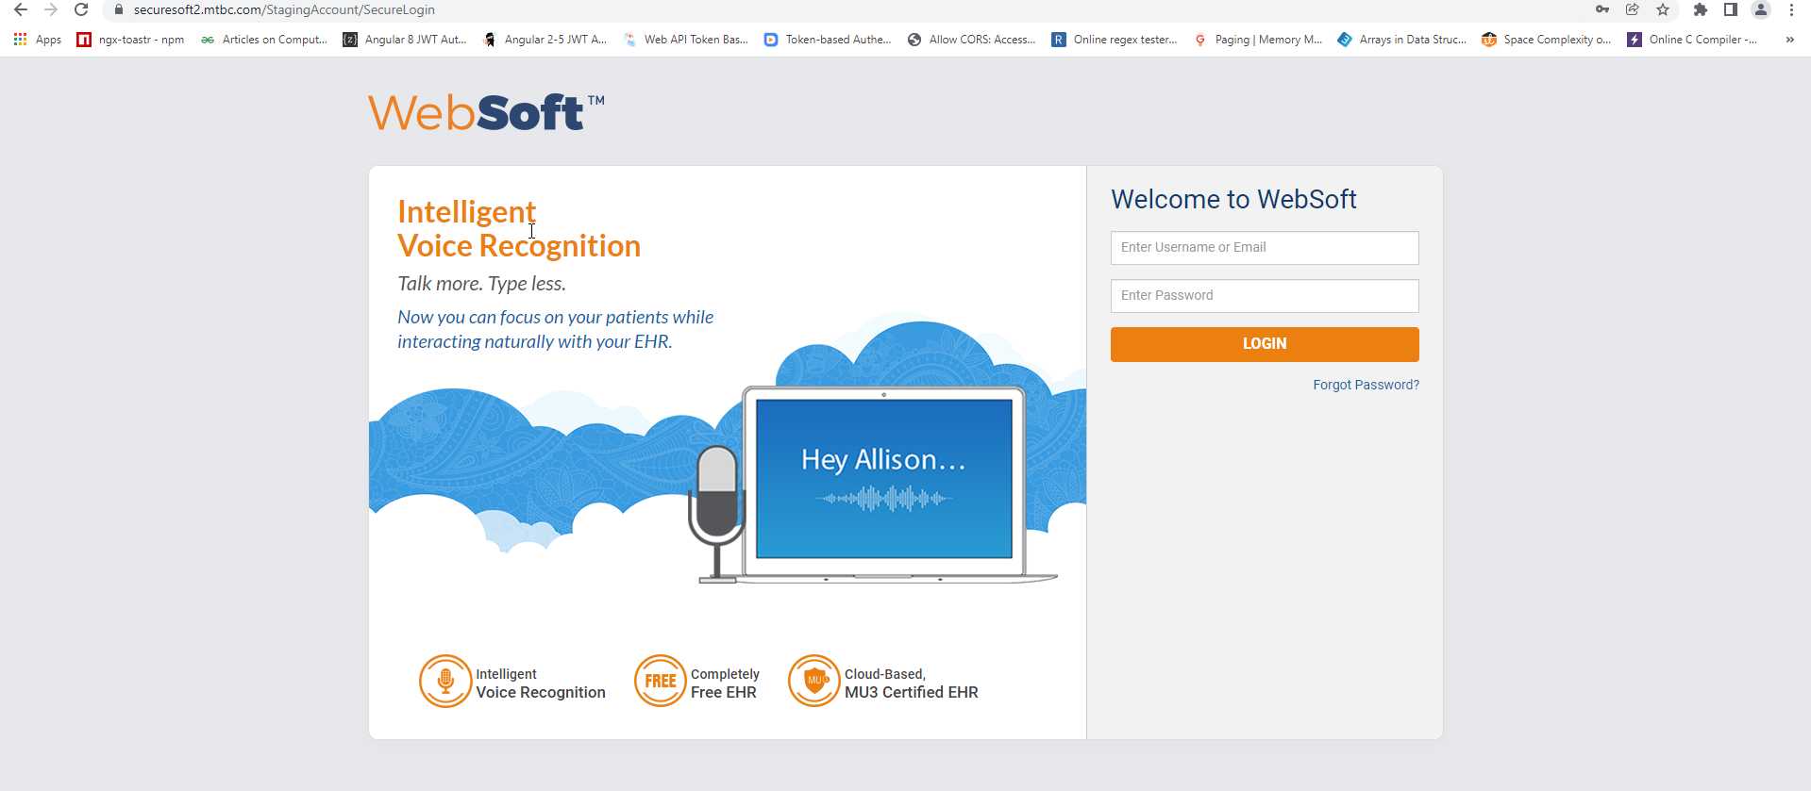
Front Page OF WebSoft

Slide 4
TalkEHR(Unification) Introduction
Currently two platforms are operational
Websoft: In use of Billing Teams
TalkEHR: In use of providers/clients.

Slide 5
What is in it?
Its Angular 6 (Up-to-date technology)
MU-3 Certified (Certified of EHR (technology)
Minimize Replication issues
Maintenance became easy - One Maintenance Team--Reduced human resource
Reduced cost-Addition/Modification of features to be done at a single application
Availability of all fields to both end-users – Unified data
State maintain
Tagging of most used modules
Customized Taskbar (Users can pin settings )

Slide 6
MTBC Securesoft
https://securesoft.mtbc.com/
Web server
10.20.25.34
DB server
10.10.30.76
CLNJDB7

Slide 7
WebSoft Team Work/Duty
OR
Responsibilities

Slide 8
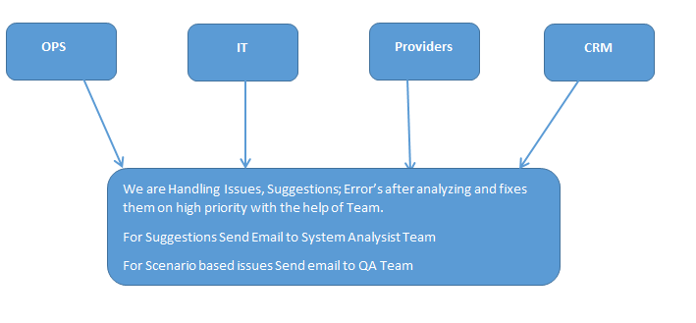
WebSoft Team Work With

Slide 9
What is Practice Code
A practice code in MTBC is a unique numeric identified assigned by MTBC to its client.
Each client has its own unique practice code through which they’re identified.
Examples:
100, 133, 274, 2710012
Each account manager, Lead Account manager and Assistant director is assigned with numbers of practices and they job is to perform billing activity, analysis and related tasks.

Slide 10
What is Account Number
Account number is a unique numeric identifier assigned to a patient’s profile in MTBC system.
A patient’s account contains complete information regarding a patient including personal and insurance information (If any)
Example:
101146253511817
101146251010005

Slide 11
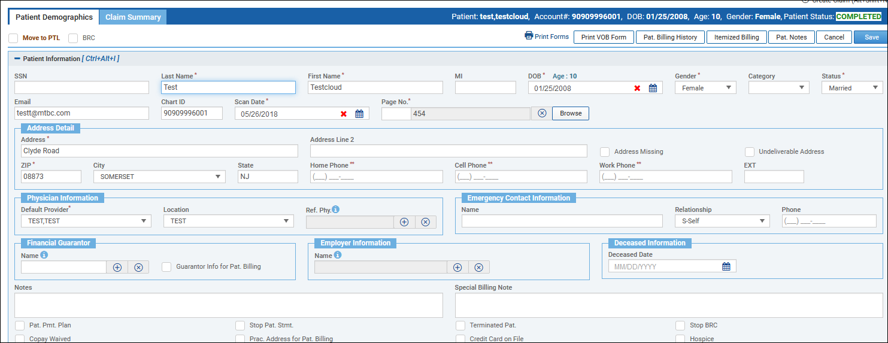

Slide 12
What Is a Claim and Claim#?
Medical claims are medical bills submitted to health insurance carriers and other insurance providers for services rendered to patients by providers of care. When you go to the doctor, hospital or other provider, your service generates a bill. A claim contains information such as;
Dos
CPT code
DX code
Claim Notes
Every claim is generated a with a unique numeric identifier which is known as claim number.

Slide 13
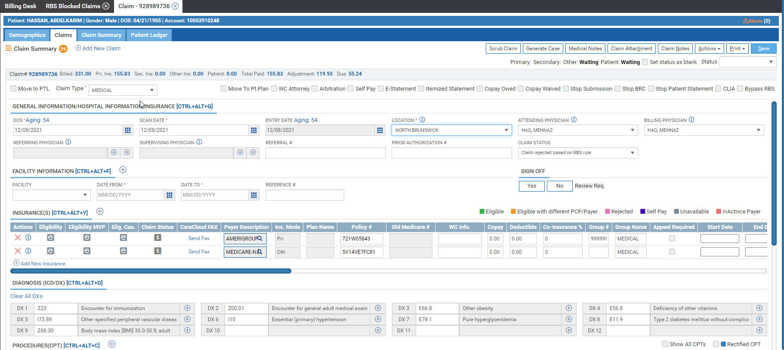

Slide 14
What is Practice Provider Profile
Practice provider profile is a module where we can see information related to provider and practices.(Clients)
Practice Provider Profiles contains important information that is used for claim submission, such as practice name, NPI and tax and related information.
NASD (New Account Setup Dept. creates, maintains these profiles.

Slide 15
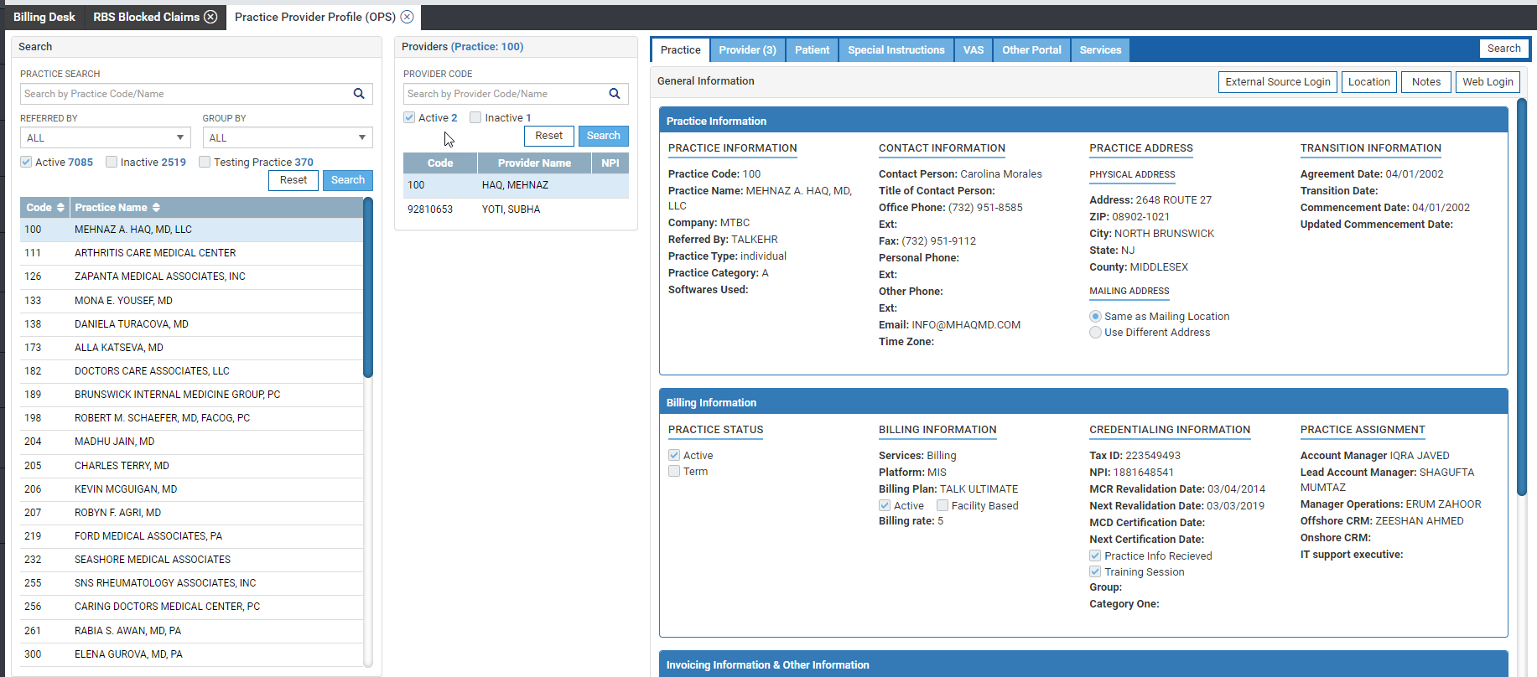

Slide 16
What is Dashboard
Dashboard is a console at the main homepage of websoft that shows statistics of different variables used in the billing practice.
This dashboard provides numbers for each variable that how much work is pending which pending at account manager’s end, Lead account manager and their supervisors.
On daily basis users work on it and resolve the pending numbers.
Variables are shown aging wise .
Data is showing with Practice wise, Mo wise, Lead Wise .
Dash board job run by Data base Team and it runs after every one hour.
Time and date is showing on Top .

Slide 17
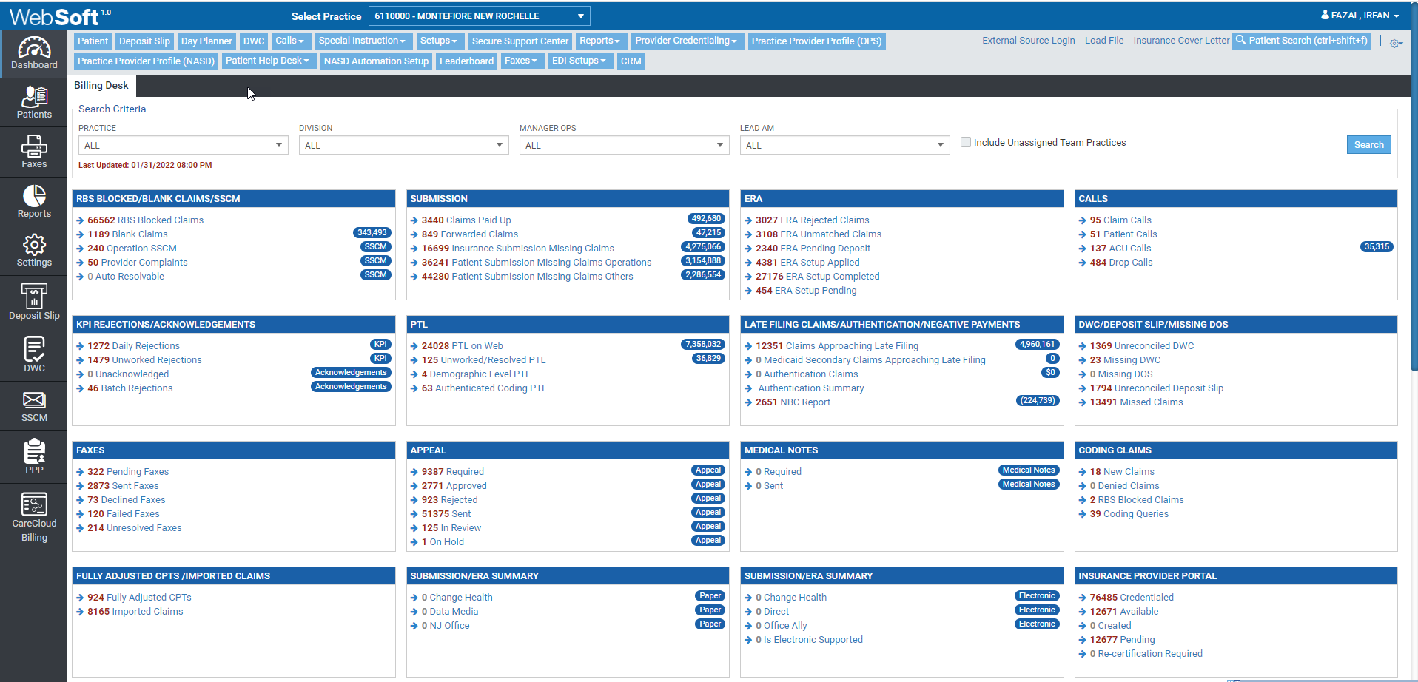
Dashboard

Slide 18
What is User Profile
User profile is also a module, where user related information is showing
User name
User Id
Employee Id
Designation
Department
Team Name
Assign practices
Active or Inactive

Slide 19
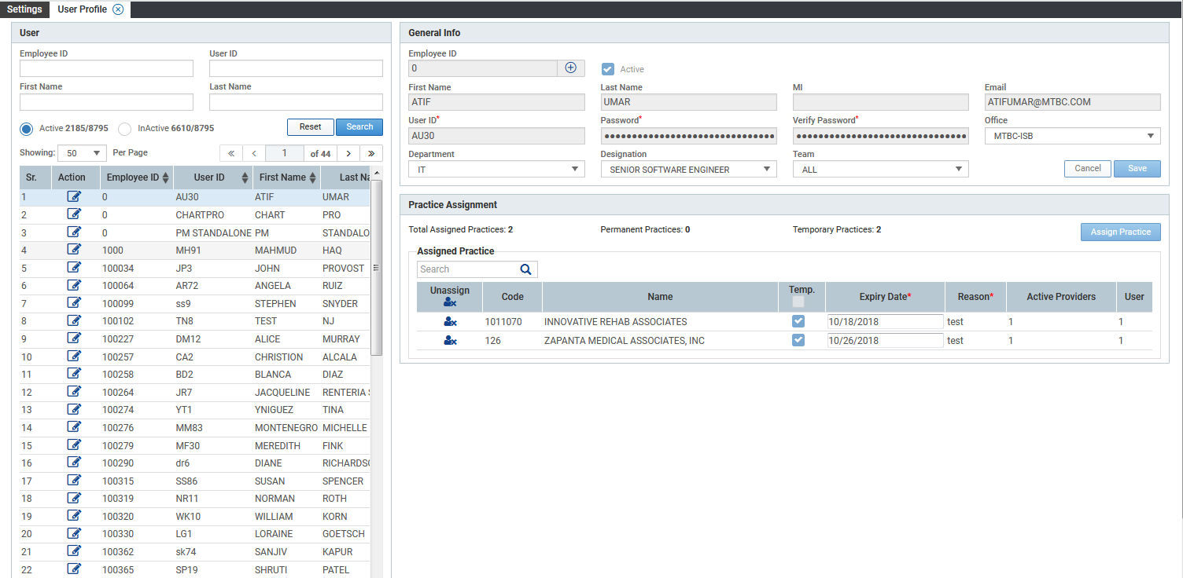

Slide 20
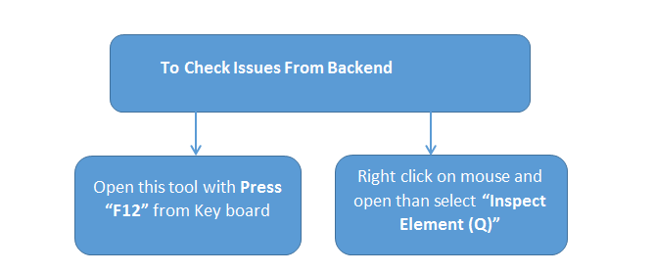
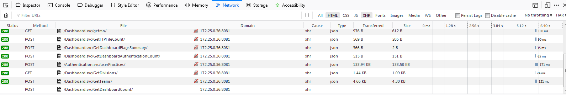
What Is Customize Developers Tools?

Slide 21
Most Common Issues Are Received
Slowness Issue
Attachment Issues
Scan Path Issues
Violation of primary Key code
Payment source is Missing
Fax Generation Issue
Move to PTL Issue
Dayplanner assignment issues
I have discussed 3, or 4 issues which are most common .

Slide 22
Slowness

Slide 23
Slowness Issue
Slowness issue is the most important issue where we receive concerns from OPS Department or Other departments who work in Websoft or TalkEHR.
1st priority of our team to fix slowness issue because due it affect performance and user will not be able to complete their work, and it will go pending which causes frustration for end users.
Slowness complaints are received of two types
Individual User Slowness
Over all slowness

Slide 24
Individual User Slowness Issue
Most of the time individual user complain that soft is stuck or slow, but over all users for others its working fine, then first of all we should check what’s the issue, it is the system level or soft level issue .
Stop a Currently Running Program. Right-click the taskbar and click "Start Task Manager." Click the "Processes" tab. ...
Disable Startup Programs. Click the Start button and type "system." ...
Uninstall Programs. Click the Start button and type "programs." ...
Disk Cleanup. Click the Start button and type "disk.

Slide 25
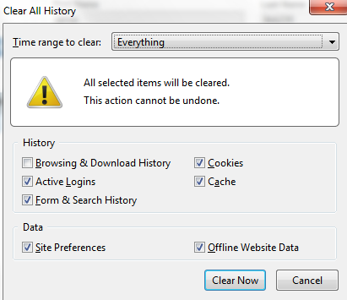
Clear history with press short cut key
CTR+Shift+Delete and clear .
Its up to users to clear with select time range as everything, Today , Last hour or 4 hour .

Slide 26
Check Connection Setting/Proxy
Websoft only works on IP 172.25.0.11 but sometime they change and add a different proxy 192.168.0.22 to access portals such Availity or Navinet and they forget to change back to original IP. Without 172.25.0.11 Websoft or TalkEHR shall not work and users shall not be able to login Websoft or TalkEHR and if Websoft is already login than it will not work properly or slow, Need to check from connection and set correct proxy .

Slide 27
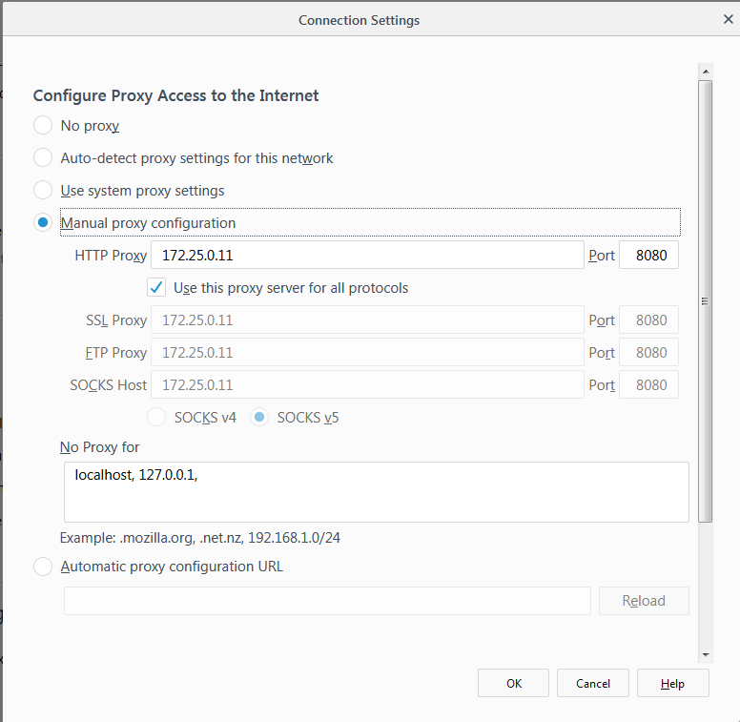

Slide 28
Over All Slowness Issue Reported
When we receive concern from all over shifts and they’re unable to save any claims or soft gets unresponsive, it may happen due to a role function in any of the following departments.
Due to Network Issue
Due to Data base Issue
Due to Application level issue

Slide 29
Network Issue
Most common error received in slowness “Timeout "or Internal server error
Hover over Settings, and select Permalinks. Scroll down to the bottom of the page, and click Save Changes. Open your website or soft in your browser. If the 500 internal server error is gone, it was caused by a corrupted .
A server connection timeout means that a server is taking too long to reply to a data request made from another device. ... Timeout errors can happen for a number of reasons. The server, the requesting device, the network hardware and even an Internet connection can be at fault.
Due to connectivity issue , its cause problem communicate with network Team .

Slide 30
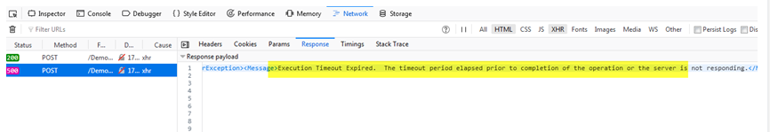
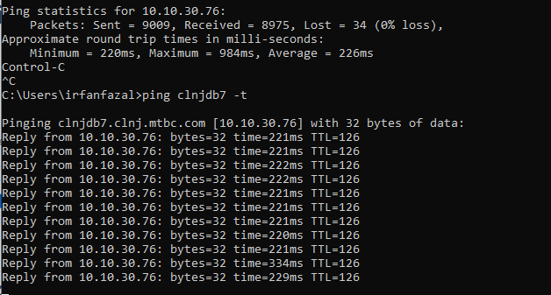
In console “Time out” Showing with below details
We can check server response and net work response with ping

Slide 31
Data Base End
Mostly slowness issue reported at DB team end .
Dead lock occur between quires due to this issue slowness occurred
When replication take time due
Need to communicate with DB team on urgent basis they will check this issue on priority
As like below response will be received .

Slide 32
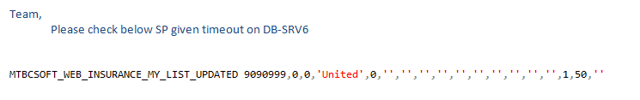
Application Level Issue
Application level issue mean slowness issue reported against some modules as like ERA Rejected report, SSCM or some specific report When we receive these type of slowness concerns than we should need to check our SP it take time then we need to check SP and optimize data with the help of DB team.
As like
Reply received with remarks :
SP has been optimized and returning result in 6 second from 3.42 mint, so please verify. Verify and than it will be “OK” and issue has been fixed.

Slide 33
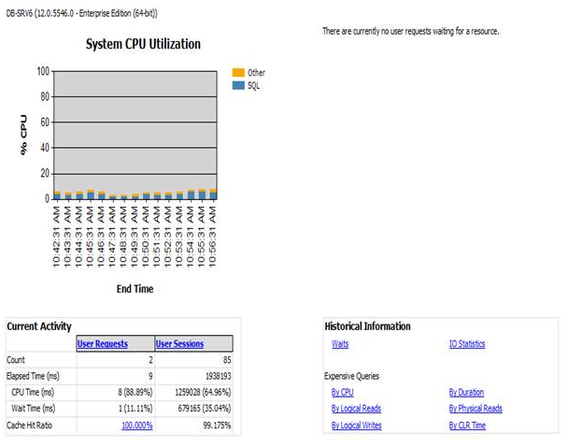
If No Slowness Observed
If no slowness observer by DB end than response received by DB team
There is no slowness observed on DB-SRV6, pl. check below image:

Slide 34
Attachments

Slide 35
Attachment Issues
Attachment issues are reported in different modules due to different reasons.
Attachment issue in Cases level\PTL
Attachment issue in Claim level

Slide 36
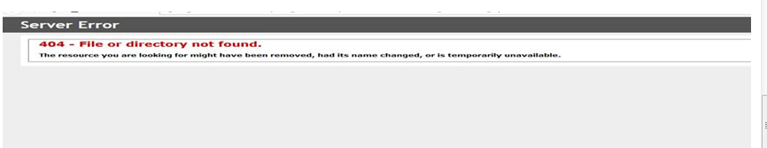
If we received concern in SSCM against provider cases, with the attachment of any file that we couldn’t open.
If these files are not opening from PMS site than the issue will be of PMS site and should report to concerned Team .
Example below (Case # 554531447)

Slide 37
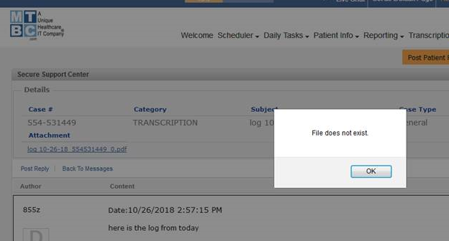
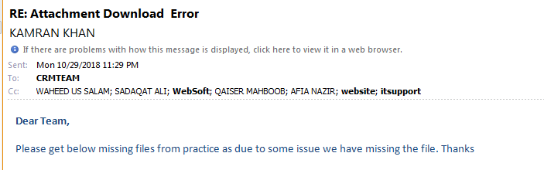
If files are not opening and error showing as below;
Than we should need to send email to concerned dept. to check either is of provider level issue or replication issue.

Slide 38
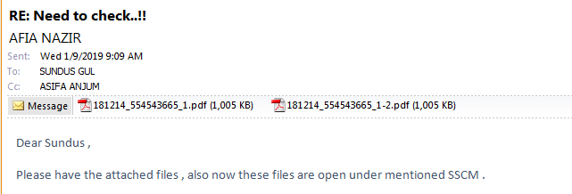
If files are opening from PMS site and not replicated on any server , than need to check job’s why these files are missing and fix this issue .
For time being need to place missing files in respective folders from one server to other and reply on email accordingly .

Slide 39
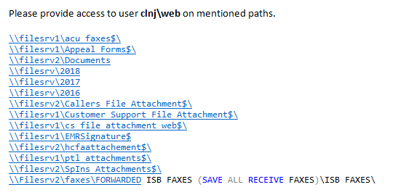
Attachment Issue In Claim Level
1st type: Attachment in claim level issue received when users have no access on mentioned paths ,
1st of all we should need to give access to users with the help of network Team , Than they will able to attached files in claim level .

Slide 40
Server Path for Claims
ISB
Bagh
\\filesrv2\hcfaattachement$\2019
\\bfilesrv1\hcfaattachement$\2019\

Slide 41
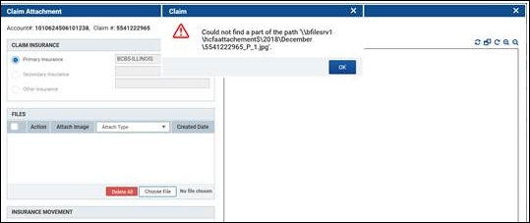
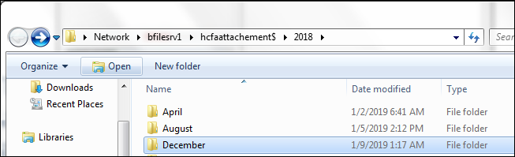
In months start, we are unable to attach file with below error message;
For that, we need to add directory against mentioned servers than one can attach the file.

Slide 42
Scan Path Related Issue

Slide 43
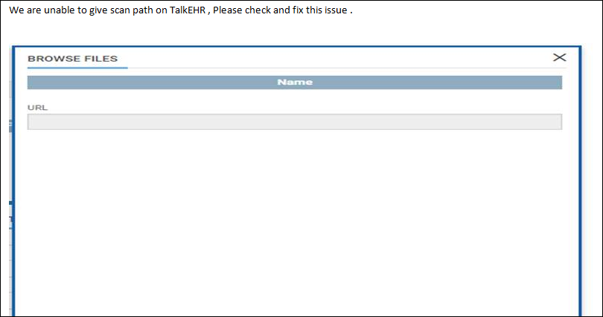
Scan Path Not Found
Most of the time issues received from OPS regarding scan path with below reason.

Slide 44
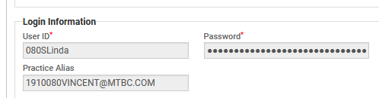
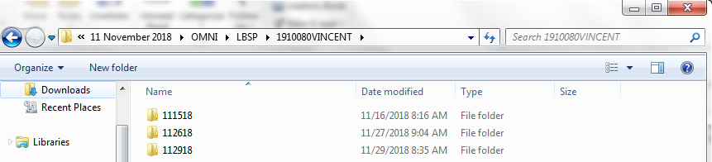
Soft pick scan path according to practice alias which is updated in Practice provider profile .
1st of all should compare scan folder with practice provider profile with practice alias .
As like

Slide 45
If scan folder mismatch with practice alias or Referred by is different than send email to Network and EDI team to correct the scan folder.
If Referred by is changed than we should need to update alias according to Refereed name with the help of network and EDI Team .
Soft pick the path from below server
\\clnjfilesrv1\\2021\\02 February 2021\\

Slide 46
Issue no #:2
If scan path and practice alias name is match but system also not pic the scan files then check the scan date format
E.g may be scan files are placed in wrong date format like 01252019,01262019,01272019
Correct date format should be 012519,012619,012719
When correct format is used system automatically pic the scan files .
Correction can be done by networking team.

Slide 47
JIRA

Slide 48
What is JIRA
Jira is a tool commonly used for project management and issue tracking. Developed by Atlassian, Jira’s core function is to track bugs and issues related to your products, software and apps. When it was first launched in 2002 Jira's main use was as an issue tracking platform for software developers. Over time, this has developed to become a powerful tool for project management, IT, customer support and more.

Slide 49
Most Common Things which are used on TFS
What is Task
Any work which is planned as part of development of your project, either as result of bug, or issue or requirements, including requirement analysis or development, or testing. etc.

Slide 50
Most Common Things which are used on JIRA
What is BUG
What Is Issues
Any problem in existing functionality, or missing functionality. Defect in code or requirement, error which is not designed to be and user did not work .
Any problem which might block the development process, example : a third party driver you identified as dependency is not releasing on time, so it is an issue in your development process .

Slide 51
What Is Suggestion
If any one put forward an idea or plan for someone to think about or want to change which is already implemented is called Suggestion.
A suggestion is something that a person says which implies that something is the case.
If we received such type of email regarding suggestions than forward email to System Analysis Team for analysis .

Slide 52
What is Iteration
The action or a process of iterating or repeating: such as a a procedure in which repetition of a sequence of operations yields results successively closer to a desired result.
Time period set for one week or two week to done or complete assign task under current Iteration .

