Slide 1
Memory VIP
CRV Methodology

Slide 2
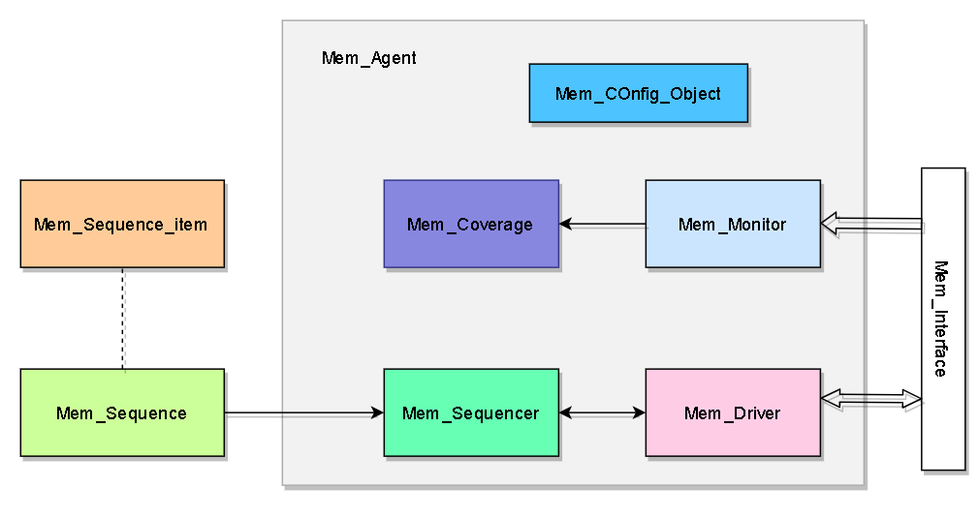
Memory UVC

