Slide 2
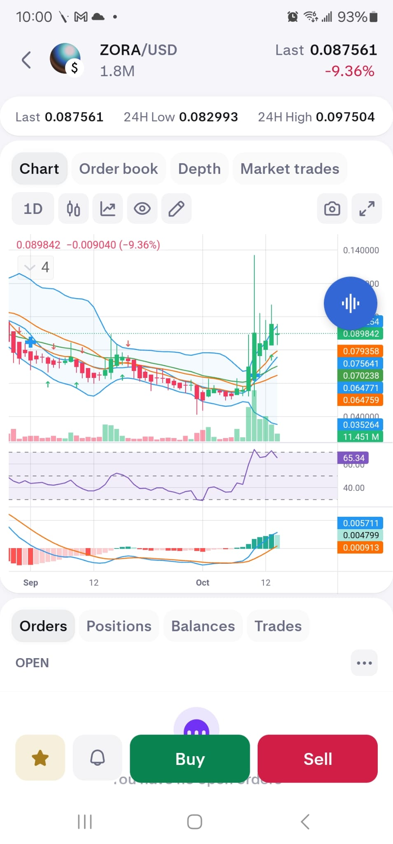
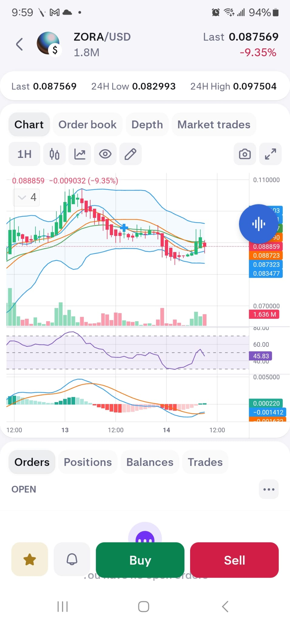
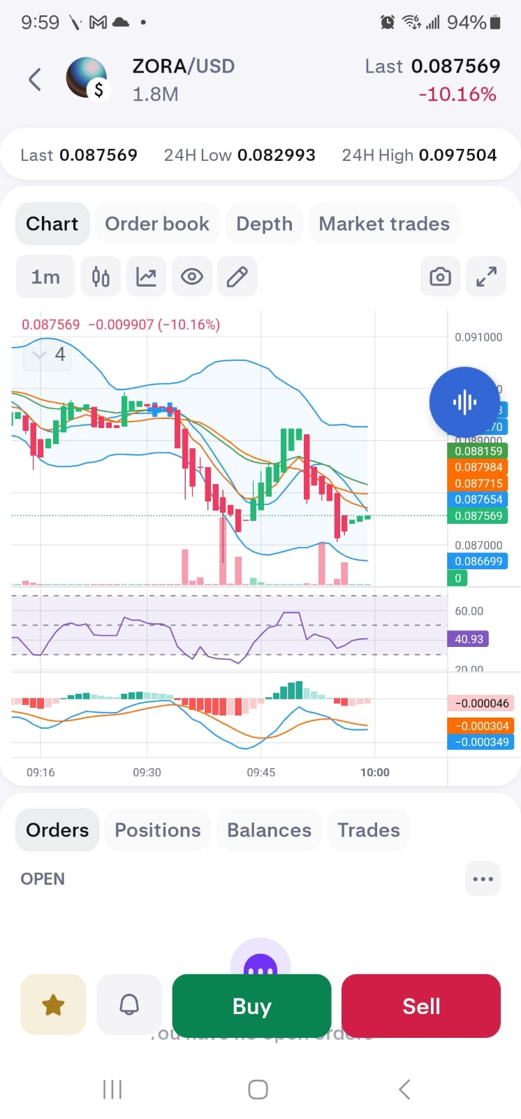
AI
LOGO
AIAlgoTradeHits.com
Cryptos
Stocks
Left Menu Bar
Right Menu Bar
Top 10 Cryptos/Stocks
Portfolio
Display user portfolio cryptos/Stocks with Current value, Number of days > 10%, TP/LS values
Display top 10 cryptos/Stocks with Current value, Number of days > 10%, TP/LS values
Orders
News
Display user Orders with Trade, value, gain, Time since order,
Top news for Cryptos/Stocks from CoinMarketcap.com, X.com, Specially Trump Announcements

