Slide 1

Business Requirements Document and High-Level Design : UrbanCart
BCA Final Year | SMSG Jain Degree College
Guide: Ms. Suchitra Mishra
Team: Irfan (TL), Nagaraj, Tanvi, Bhubaneswari, Mukunth
Notes:
Introduce the project and team. UrbanCart is our final-year project: a web-based e-commerce marketplace. This deck covers the business requirements (Part 1) and the high-level design (Part 2).

Slide 2
Business Requirements
01
Why we are building UrbanCart and what it must do
Notes:
Part 1 explains the business need, the scope, the people involved and the requirements for each role.

Slide 3



From shops and phone orders to one platform
Existing system
Proposed system
Purchases happen mainly in physical shops or through phone and messaging orders.
A web platform where customers search and buy online, sellers manage their own listings, and admins oversee everything.
Limited reach
Manual record keeping
No automatic stock updates
No order history
No easy price comparison
Available anytime, from anywhere
Automatic stock and order tracking
Faster, more accurate order processing
Searchable, filterable catalogue
Centralised reporting
Notes:
Today buying and selling relies on shops and phone or messaging orders, which have real limits. The proposed web platform tracks stock, orders and payments automatically in one central database.

Slide 4



Purpose and scope
An online platform where customers browse, search and buy products, and sellers and administrators manage products, orders and users. This document is the basis for the SRS, design and development phases.
In scope
Out of scope (this version)
User registration and login
Product catalogue and search
Shopping cart, wishlist and checkout
Simulated online payment
Order tracking, reviews and ratings
Seller product management and admin reports
Mobile native apps
Real payment gateway with live money
Logistics or courier API integration
Multi-language and multi-currency support
AI recommendations
Notes:
The system has three parts: a customer storefront, a seller panel and an admin panel. Payment is simulated, so no real money moves. Items out of scope can come in later versions.

Slide 5
Who is involved
Stakeholder | Role | Interest
Customer | End user | Easy browsing, safe payment, fast delivery tracking
Seller | Vendor | List products, manage stock, receive orders
Administrator | System manager | Control users, catalogue, orders, reports
Project Guide | Evaluator | Quality of analysis, design and implementation
Developer (Student) | Builder | Deliver a working, documented system
Notes:
Five stakeholder groups. The three user groups (customer, seller, administrator) shape the requirements; the guide evaluates quality; the student team builds the system.

Slide 6
User (customer) requirements
11
Must have
3
Should have
Register and log in securely
Reset a forgotten password
Browse by category
Search and filter products
View full product details
Manage the shopping cart
Manage profile and addresses
Place an order (COD or simulated payment)
Order confirmation and invoice
Order history and tracking
Works on mobile, tablet and desktop
Wishlist for later
Cancel an order before it ships
Rate and review purchased products
1
Could have
Email notifications for orders and account activity
Notes:
These are requirements UR-1 to UR-15 from the BRD, grouped by priority. Must = needed for the first working version, Should = important if time allows, Could = optional extra.

Slide 7
Admin requirements
6
Must have
4
Should have
Secure admin login, separate from customers
Dashboard with user, order and sales totals
View, block and delete user accounts
Manage categories and sub-categories
View, edit and remove any product listing
View all orders and update their status
Approve or reject seller registrations
Monitor stock with low-stock alerts
Moderate and remove reviews
Reports: sales, top products, user growth
2
Could have
Payment and refund records (simulated)
Audit log of key admin actions
Notes:
These are requirements AR-1 to AR-12. The six Must items give the admin full control of users, catalogue and orders in the first version.

Slide 8
Objectives and success criteria
Provide a 24x7 online store for browsing and buying products
Success criteria
1
3 s
Pages load within 3 seconds under normal load
2
Let multiple sellers list and manage their products
3
Reduce manual order handling with automated cart, checkout and orders
E2E
A user can register, search, add to cart, check out and track the order
4
Give administrators control and visibility over users, products and orders
0
Critical open defects after functional testing of core modules
5
Build a secure, scalable base that can be extended later
Notes:
Five business objectives. Success is judged on performance, a complete end-to-end shopping flow, and no critical defects in the core modules.

Slide 9







28 functional requirements across 9 modules
User Management
Catalogue and Search
Cart and Wishlist
FR-1 to FR-4
FR-5 to FR-8
FR-9 to FR-11
Register, log in, reset password, profile
Categories, product pages, filters, sorting
Cart totals with taxes; save for later
Checkout and Payment
Order Management
Reviews and Ratings
FR-12 to FR-15
FR-16 to FR-18
FR-19 to FR-20
Address, COD or test payment, stock check
History, tracking, cancel before shipping
Verified buyers review; average rating shown
Seller Module
Admin Module
Notifications
FR-21 to FR-23
FR-24 to FR-27
FR-28
Approval, product management, sales summary
Manage users and orders; approvals; reports
Email on sign-up, orders and status changes
Notes:
The 28 functional requirements are grouped into 9 modules. Each module maps to the requirement IDs shown (FR-1 to FR-28).

Slide 10








Non-functional requirements
Performance
Security
Usability
Responsiveness
Pages in about 3 s or less; search results in under 2 s
bcrypt passwords, JWT, HTTPS, SQL injection / XSS / CSRF protection, role-based access
Clean, intuitive interface with consistent navigation
Works on desktop, tablet and mobile browsers
Reliability
Scalability
Maintainability
Compatibility
Database transactions keep orders and stock consistent; regular backups
Modular design: add features without rewriting the system
Clean code, API documentation, Git version control
Latest Chrome, Firefox, Edge and Safari
Notes:
Eight quality attributes. Security and reliability matter most for an e-commerce system because it handles accounts, orders and payments.

Slide 11



Six business rules the system enforces
BR-1
BR-2
BR-3
A product cannot be ordered if stock is zero.
An order can be cancelled only before it is shipped.
Only customers who bought a product may review it.
BR-4
BR-5
BR-6
Sellers can modify only their own products and orders.
Seller accounts become active only after admin approval.
Email addresses must be unique per account.
Notes:
These rules are enforced in the backend so that stock, orders, reviews and seller access stay consistent no matter what the frontend does.

Slide 12


Assumptions and constraints
Assumptions
Constraints
Users have internet access and a modern web browser
Payment is simulated; no real money is processed
Product data is entered by sellers or loaded as sample data
The project must be completed within the academic schedule
Only the approved technologies may be used
Built by a small student team with a limited budget
Notes:
Because payment is simulated, we do not handle real money. The main constraints are time, the approved tech stack and a student budget.

Slide 13





Why build one more e-commerce site?
Large platforms already exist, so the project is justified by its purpose and focus, not by trying to replace them.
Academic and skill value
Support for small sellers
Simpler, focused experience
Covers authentication, roles, database design, transactions and security end to end.
A simple, low-cost way to list and sell, without big-marketplace fees and competition.
A smaller catalogue and cleaner workflow than a general-purpose giant.
Full control and customisation
Proven demand, lower risk
Extensible foundation
Local-language support, delivery rules and reports without depending on a third party.
A proven model with clear user needs, scoped to suit a student team.
Modular design allows a real payment gateway, recommendations or a mobile app later.
Notes:
If asked why build another e-commerce site: we are not competing with Amazon. The project shows we can build a complete system, focuses on small sellers and a simpler experience, and is designed to grow.

Slide 14
High-Level Design
02
How the system is structured and how data and orders flow
Notes:
Part 2 turns the requirements into a high-level design: architecture, modules, data, workflow and technology.

Slide 15



System architecture
Customer
Presentation layer
Application layer
Data layer
HTTPS
React, HTML5, CSS3, JavaScript
REST / JSON
Python and FastAPI
SQL
MySQL
Seller
Customer storefront
Seller panel
Admin panel
REST endpoints
Business logic
Authentication and roles
Email notifications
Users, products
Orders, payments
Reviews, wishlists
Admin
Security built in
Passwords hashed with bcrypt | JWT issued by the backend and verified on every protected request | HTTPS | role-based access control
Notes:
Three layers: a React frontend, a FastAPI backend that holds all business logic and security, and a MySQL database. The frontend talks to the backend only through REST APIs in JSON. Authentication tokens are issued by the backend and checked on every protected request.

Slide 16
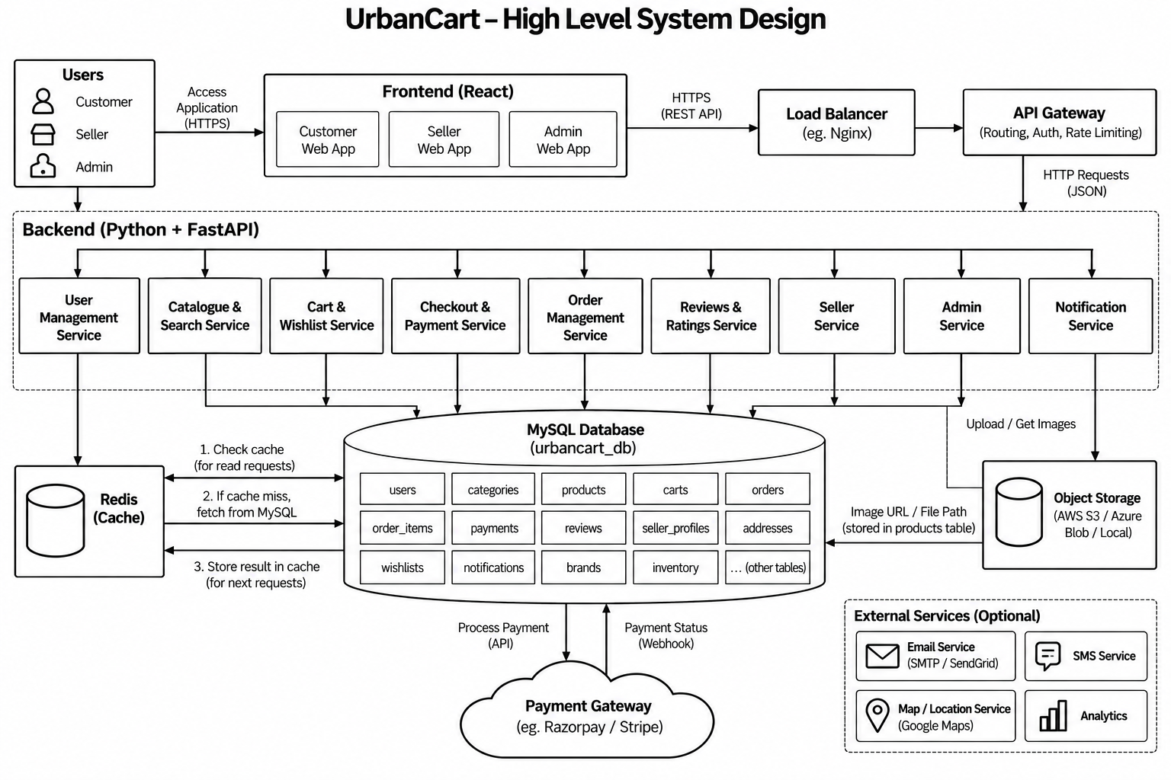

Slide 17
How an order moves through the system
Browse and search
Add to cart
Checkout
Order placed
Seller processes
Delivered
Find products by category, keyword and filters
Choose items and quantities
Pick address; pay by COD or test payment
Stock validated; confirmation and invoice
Seller confirms and ships the order
Customer tracks status until delivery
Order statuses
Placed
Confirmed
Shipped
Delivered
Cancelled
only before shipping
Notes:
Walk through one order: browse, add to cart, checkout, stock is validated and the order is placed, the seller processes it, and the customer tracks it to delivery. Statuses are Placed, Confirmed, Shipped, Delivered, and Cancelled is allowed only before shipping (business rule BR-2).

Slide 18


Technology stack
Frontend
Backend
Database
Authentication
Tools
HTML5
CSS3
JavaScript
React
Python
FastAPI (REST APIs)
MySQL
JWT
bcrypt
Git and GitHub
VS Code
Flow
Browser (React) -> REST API (FastAPI) -> MySQL Database
Notes:
All the technologies are within the approved list. React for the interface, Python with FastAPI for the REST backend, MySQL for data, JWT and bcrypt for security, and Git, VS Code and Postman as tools.

Slide 19
Thank you
Questions and feedback are welcome
Team UrbanCart
Irfan (TL), Nagraj, Tanvi, Bhubaneswari, Mukunth
Guide: Ms. Suchitra Mishra
Notes:
Close by summarising: the business need, the requirements for each role, and the high-level design. Invite questions.

