Slide 1
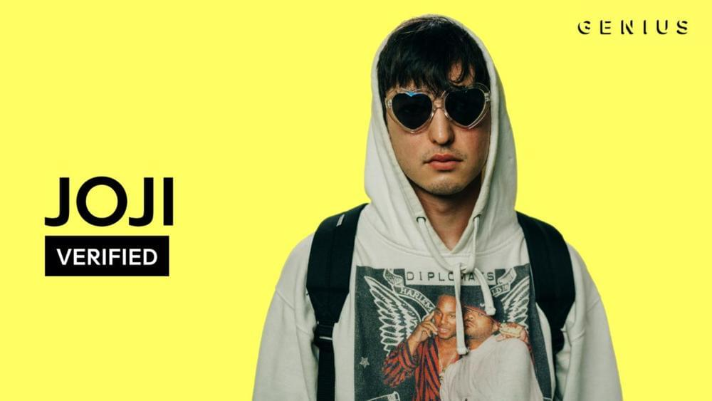

Slide 2
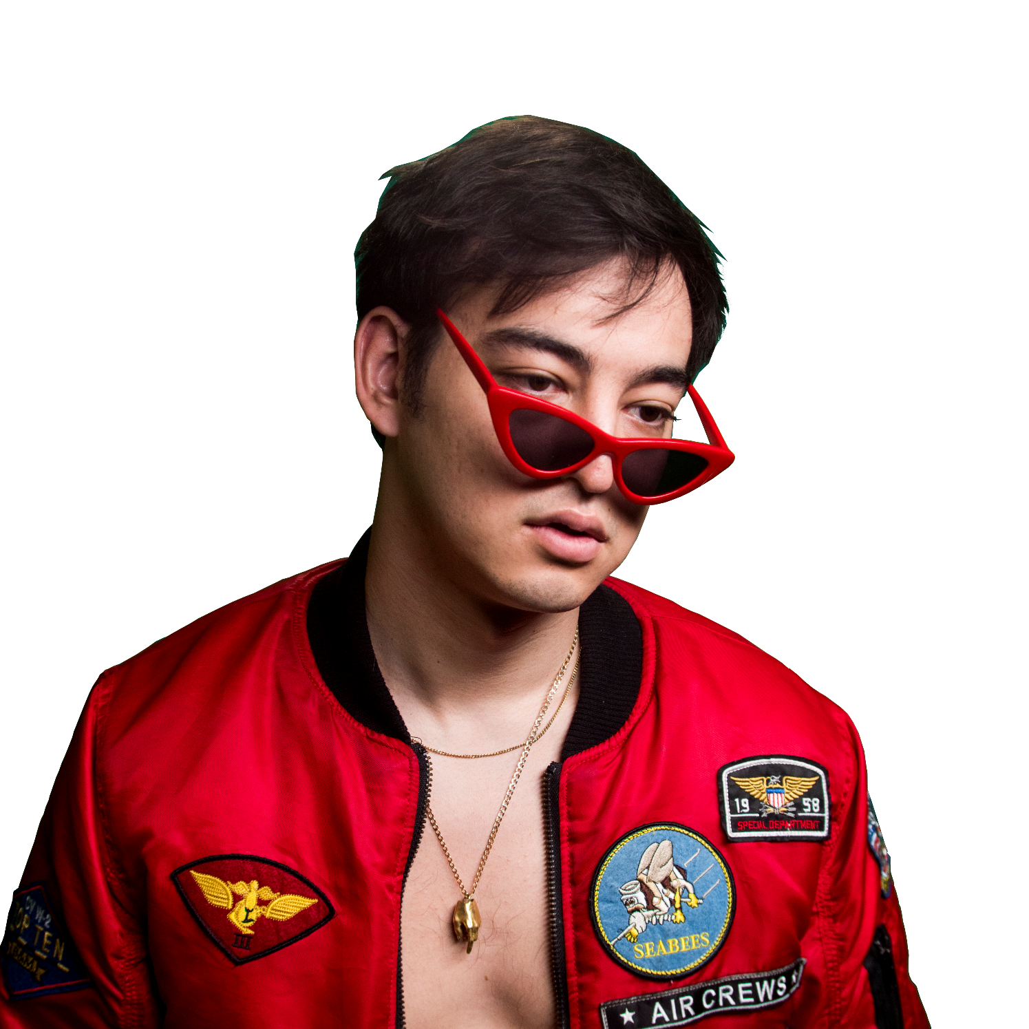
Name : George Miller (Joji)
Born : 18 September 1992, (Osaka, Japan)
Nationally : Japanese, Australian
Occupation : Singer, rapper, record producer,
songwriter, entertainer, comedian

Slide 3
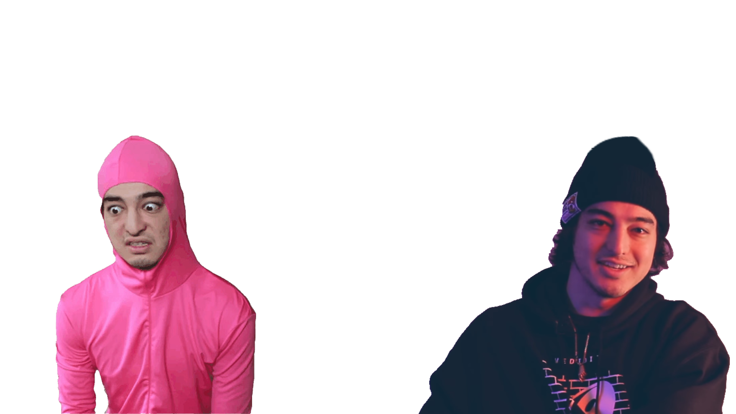
CAREER
Pink Guy
Joji
(2014–2017)
(2014 – Present)

Slide 4
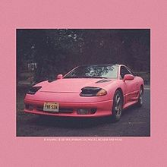
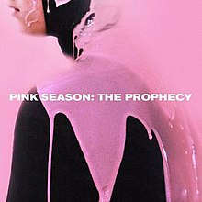
Album as Pink Guy
Pink Guy
(2014–2017)
Pink Season
Pink Season: The Prophecy

Slide 5
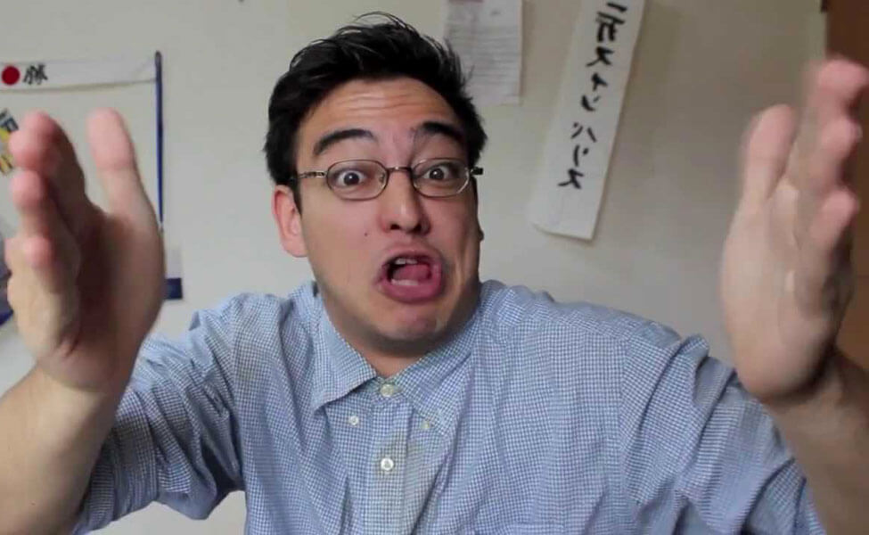
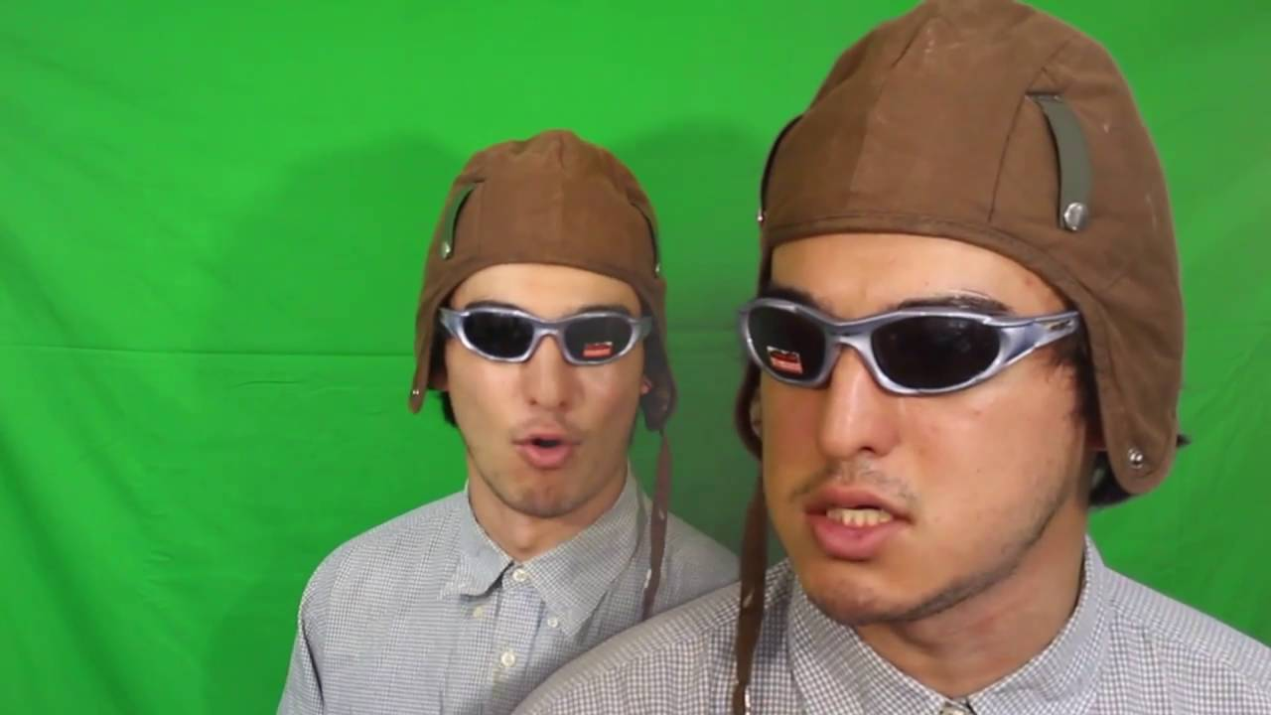
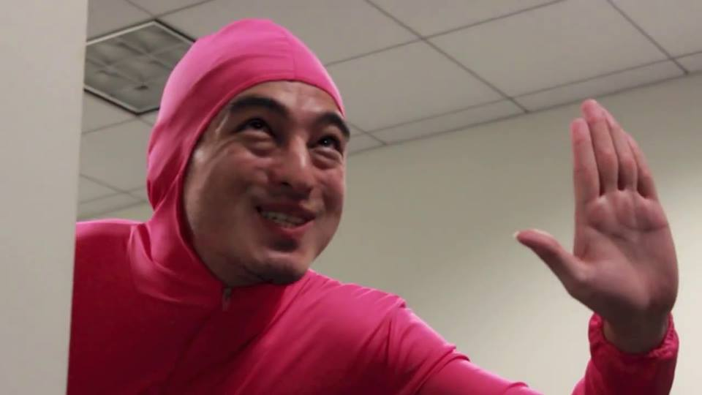
Pink Guy
(2014–2017)

Slide 6
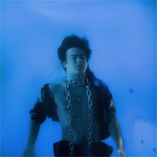
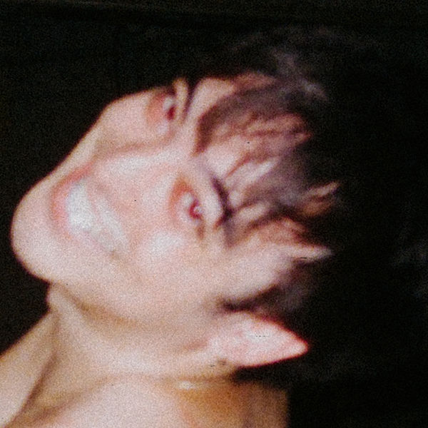
asd
Album as Joji
Joji
(2014 – Present)
In Tongues
Ballads 1

Slide 7
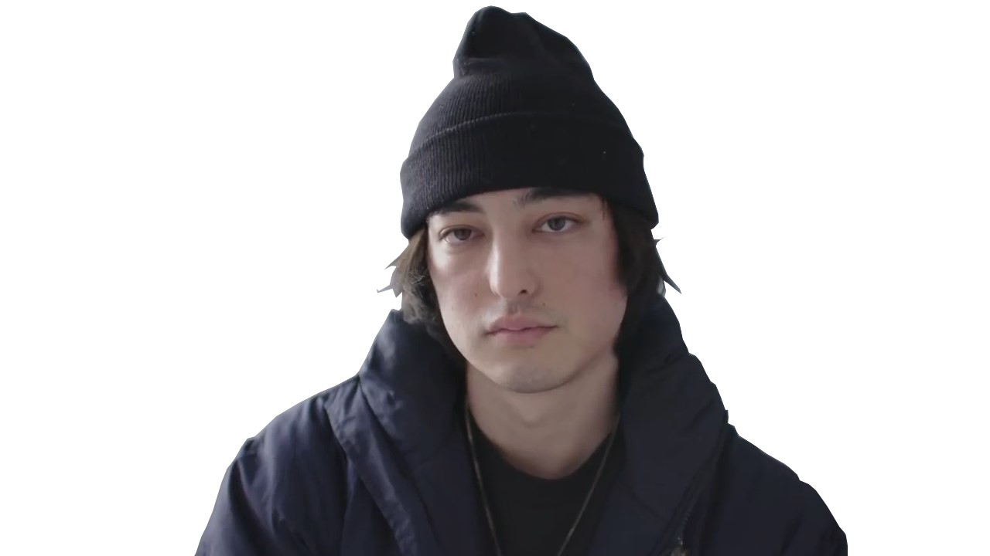


88 Rising

