Slide 1



Topic 1
1.2 Making System Operational

Slide 2

Objectives
Describe implementation activities.
Describe various types of software tests and explain how and why each is used.
Explain the importance of the configuration and
change management | discipline to |  | the
implementation, testing, | and deployment | of | a
system.

Slide 3
Objectives (continued)
List various approaches to data conversion and system deployment and describe the advantages and disadvantages of each.
Describe training and user support requirements for new and operational systems.

Slide 4
Overview
Activities from additional UP disciplines are
needed to bring a system into being the following:
Implementation
Testing
Deployment
Configuration and change management
Describe each activity in isolation and then discuss the interrelationships among the disciplines.

Slide 5
Implementation
Implementation activities are concerned with software components.
Software modules that are fully assembled, ready to use, and have well-defined interfaces.
Choose a component interaction standard to describe how components interact.
CORBA, J2EE, COM, SOAP
Implement classes, package them into executable units, and install application software.

Slide 6
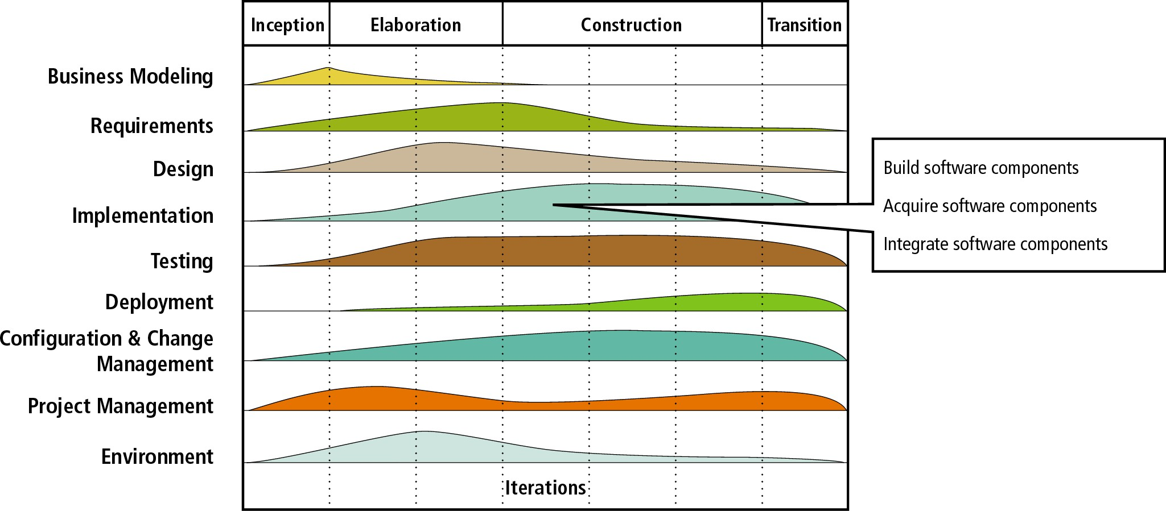
Figure 13-1
Implementation discipline activities

Slide 7
Testing
Testing is a process of identifying defects.
Develop test cases and test data.
A test case is a formal description of the following:
A starting state
One or more events to which the software must respond
The expected response or ending state
Test data is a set of starting states and events used to test a module, group of modules, or entire system.

Slide 8
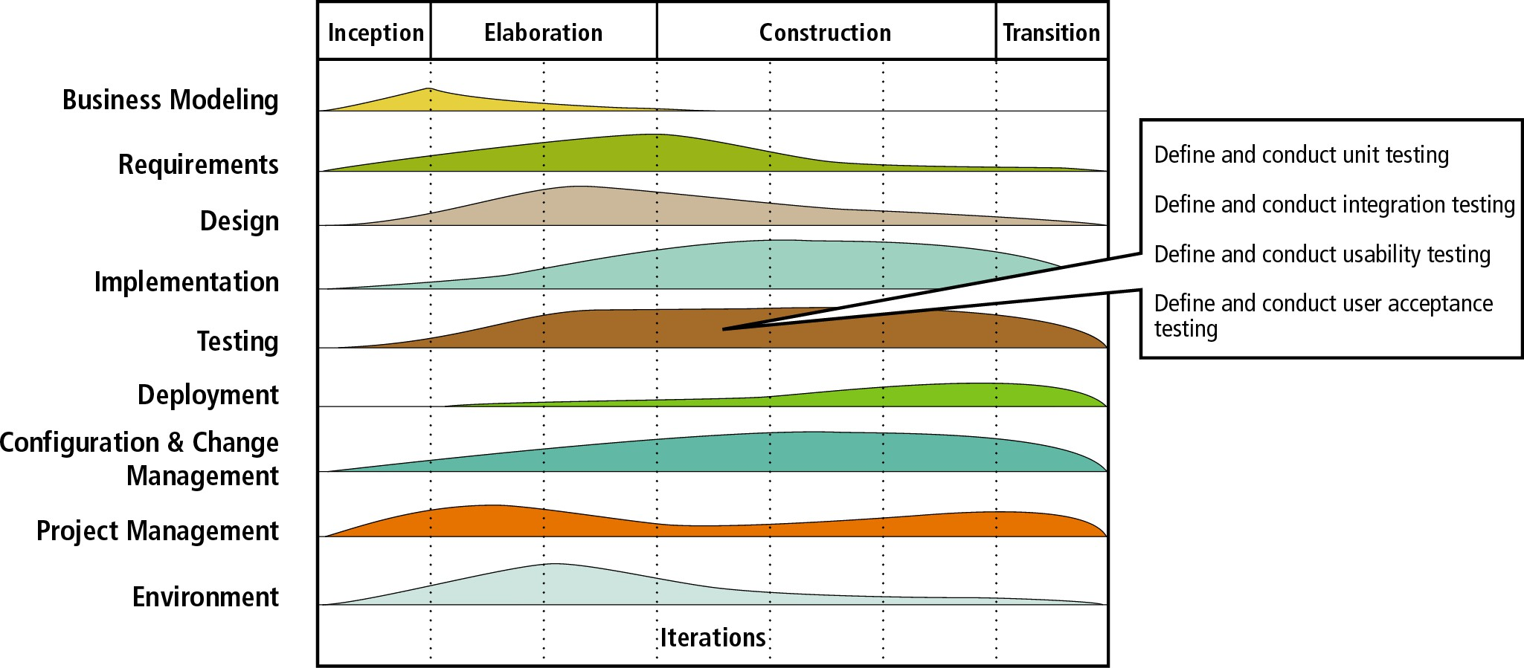
Figure 13-2
Testing discipline activities

Slide 9
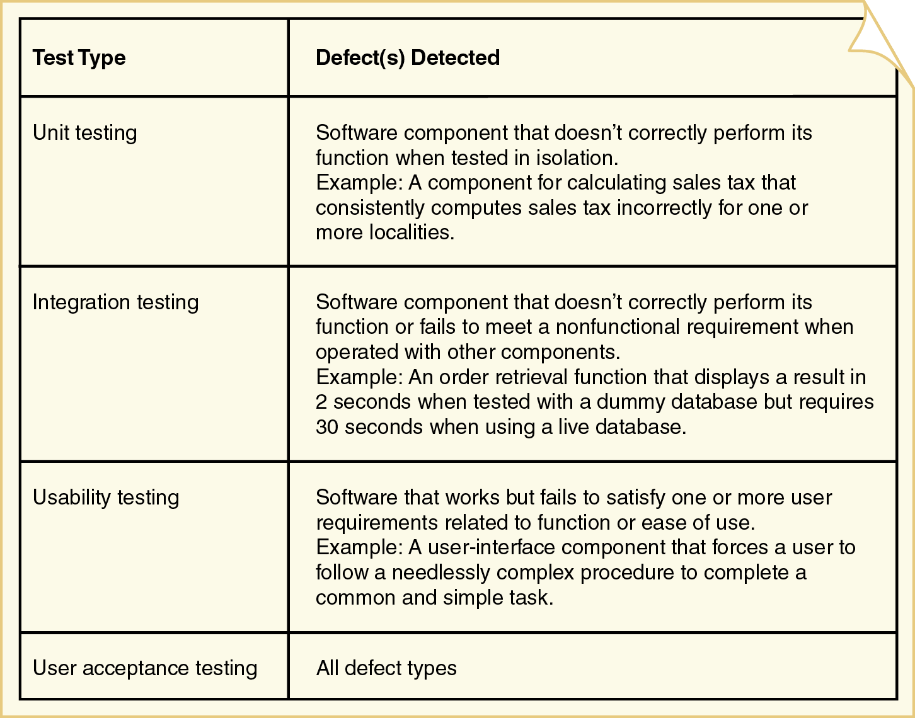
Figure 13-3: Test types and detected defects

Slide 10
Unit Testing
The process of testing individual methods, classes, or components before they are integrated with other software.
Two methods for isolated testing of units
Driver
Simulates the behavior of a method that sends a message to the method being tested.
Stub
Simulates the behavior of a method that has not yet been written.

Slide 11
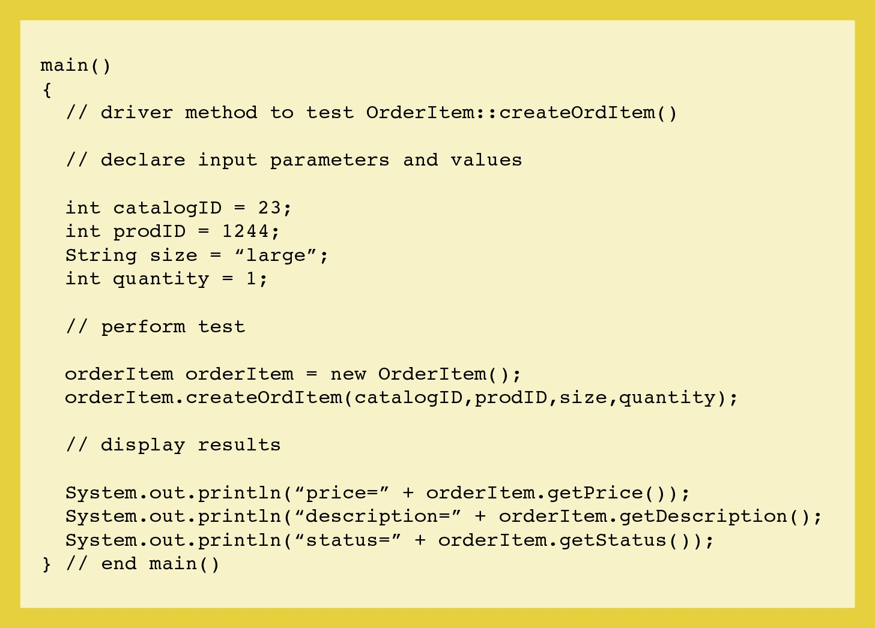
Figure 13-5: A driver module to test createOrdItem()

Slide 12
Figure 13-5: A driver module to test createOrdItem()
12

Slide 13
Integration Testing
Evaluates the behavior of a group of methods or classes.
Identifies interface compatibility, unexpected parameter values or state interaction, and run-time exceptions.
System test
Integration test of the behavior of an entire system or independent subsystem.
Build and smoke test
System test performed daily or several times a week.

Slide 14
Usability Testing
Determines whether a method, class, subsystem, or system meets user requirements.
Performance test
Determines whether a system or subsystem can meet time-based performance criteria.
Response time specifies the desired or maximum allowable time limit for software responses to queries and updates.
Throughput specifies the desired or minimum number of queries and transactions that must be processed per minute or hour.

Slide 15
User Acceptance Testing
Determines whether the system fulfills requirements.
user
Involves the end users
Acceptance testing is a very formal activity in most development projects.

Slide 16
Who Tests Software?
Programmers
Unit testing
Testing buddies can test other’s programmer’s code
Users
Usability and acceptance testing
Volunteers are frequently used to test beta versions
Quality assurance personnel
All testing types except unit and acceptance
Develop test plans and identify needed changes

Slide 17
Configuration and Change Management
Controls the complexity associated with testing and supporting a system through multiple development and operational versions.
Integrally related to project management, implementation, testing, and deployment activities.
Change control procedures are typically developed in the first iteration before development.
Need for formal procedures depends on size and cohesiveness of project.

Slide 18
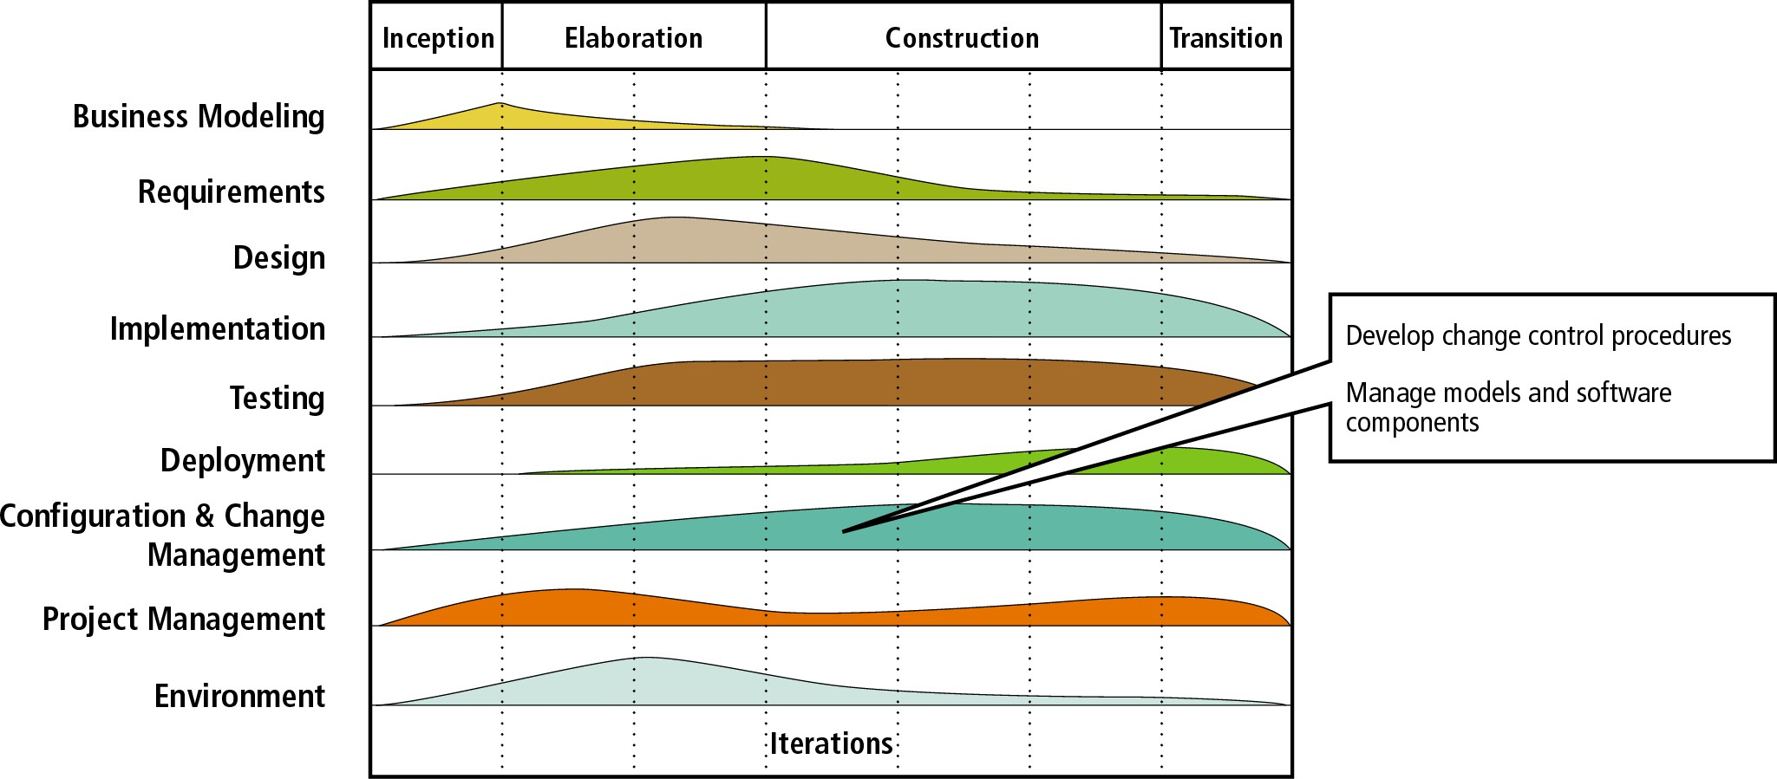
Figure 13-7
Configuration and change management discipline activities

Slide 19
Versioning
Alpha version
Test version that is incomplete but ready for some level of rigorous integration or usability testing.
Beta
Test version that is stable enough to be tested by end users for an extended period of time.
Production version
System version that is formally distributed to users or made operational for long-term use.
Maintenance release
System update that provides bug fixes and small changes to existing features.

Slide 20
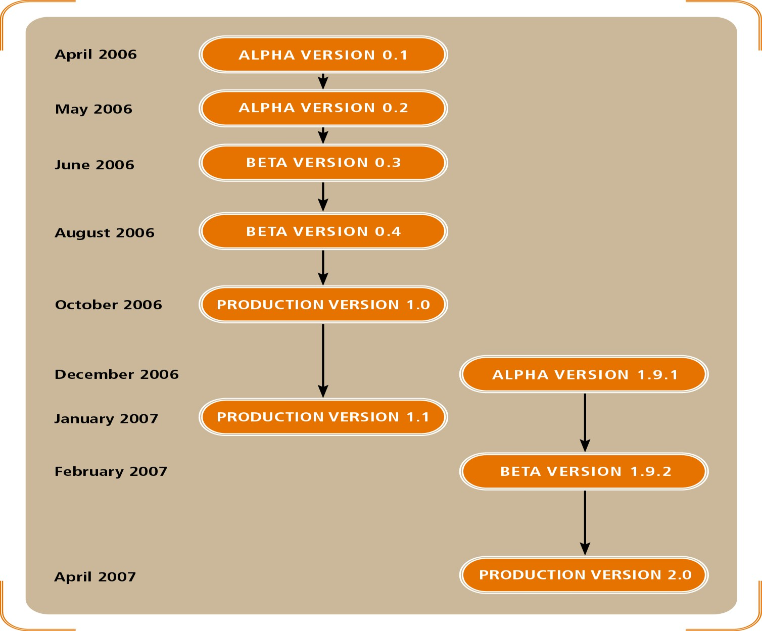
Figure 13-8: A time line of test and production versions for the RMO customer support system (CSS)

Slide 21
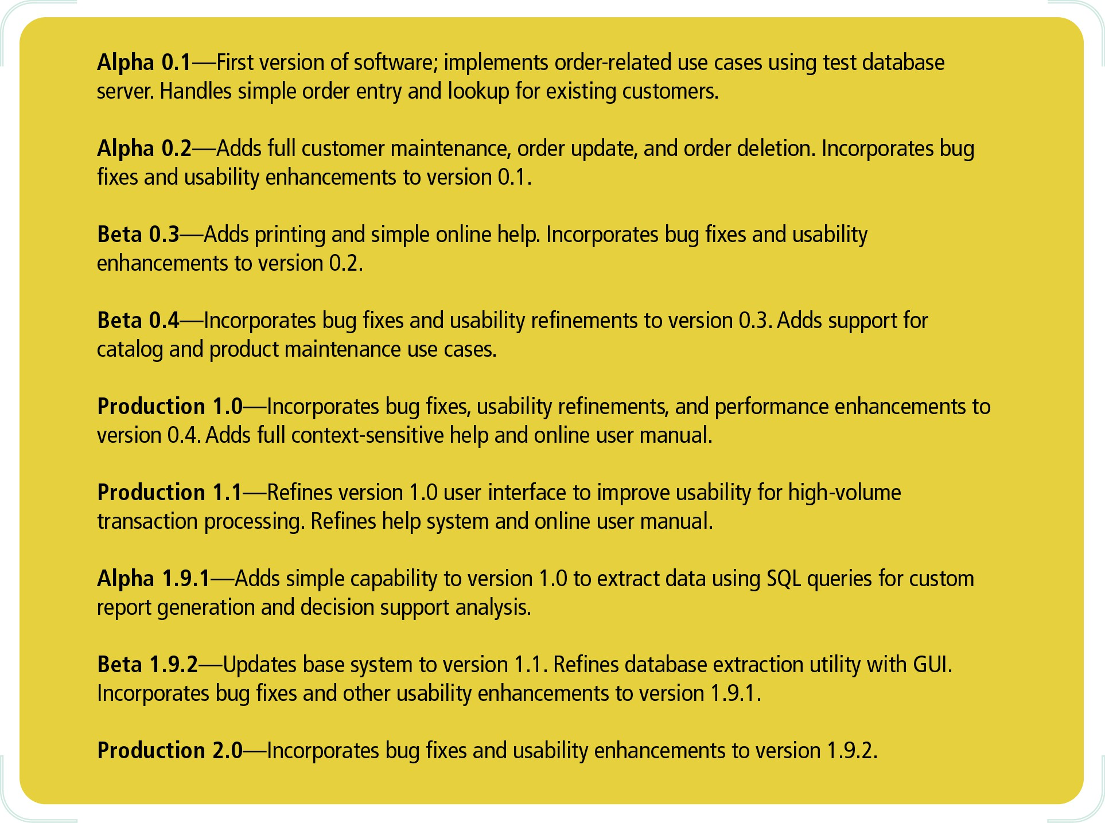
Figure 13-9 Description of RMO CSS versions

Slide 22
Submitting Change Requests and Error Reports
Typical change control procedures include
Standard change request forms
Completed by a user or system owner.
Review of requests by a change control committee
Assess impact on system, security, and budget.
Extensive planning for design and implementation
Bugs reports are often reported separately because of the need for an immediate fix.

Slide 23
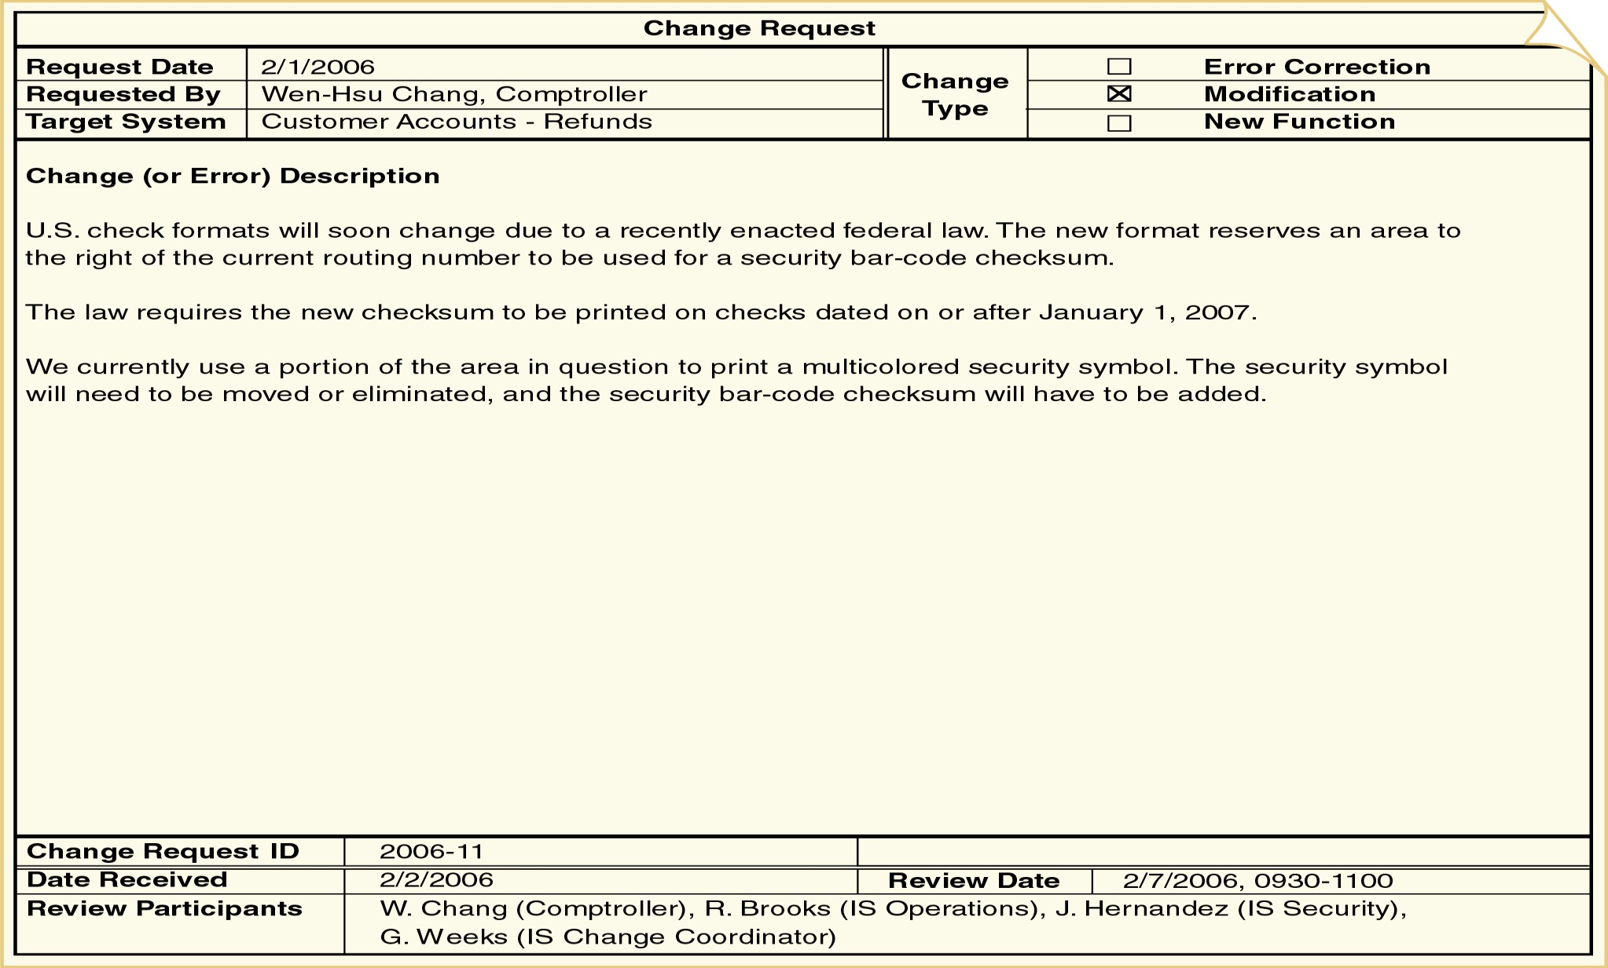
Figure 13-11: A sample change request form

Slide 24
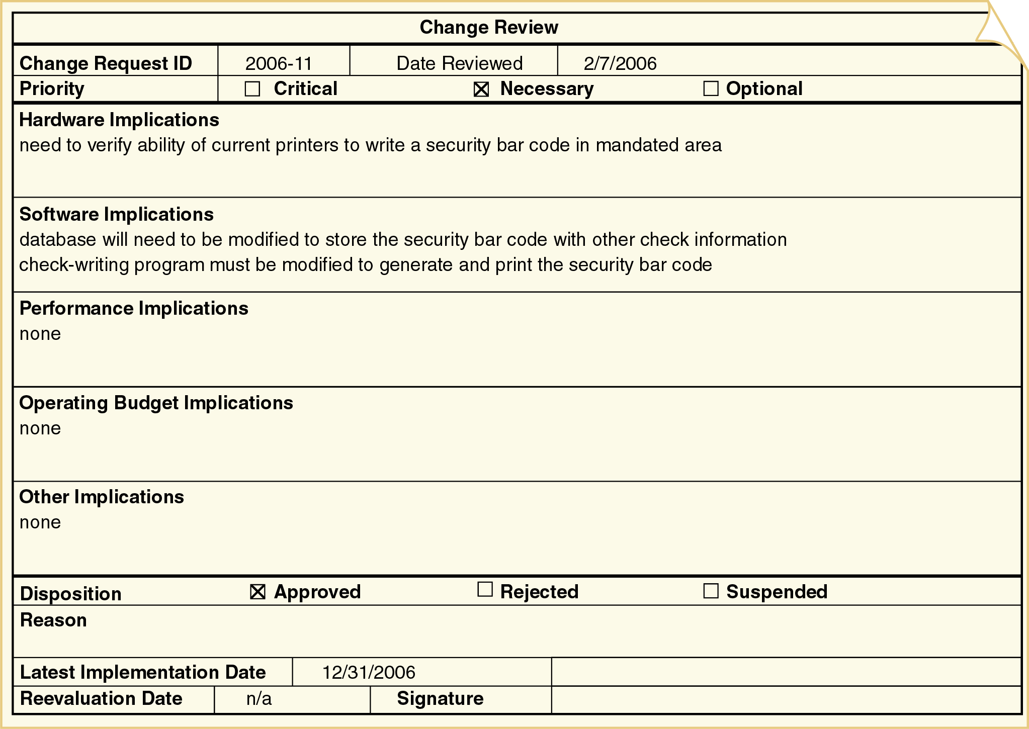
Figure 13-12: A sample change review form

Slide 25
Implementing a Change
Change implementation follows a miniature version of the UP life cycle.
One or two iterations with reduced business modeling, requirements, and design activities.
When possible, changes are implemented on a copy of the production system.
The production system is the version of the system used from day to day.
The test version is a copy of the production system that is modified to test changes.

Slide 26
Upgrading Computing Infrastructure
Computer hardware, system software, and networks must be periodically upgraded due to following reason:
Software maintenance releases
Software version upgrades
Declining system performance
Best practice for upgrades
If an operational system isn’t broken, don’t fix it!
Performance upgrades require research, careful diagnosis, and technical expertise.

Slide 27
Deployment
Activities to make a new system operational.
Involves many conflicting constraints as follows:
Costs
Need to main positive customer relations
Need to support employees
Logistical complexity
Overall risk to the organization

Slide 28
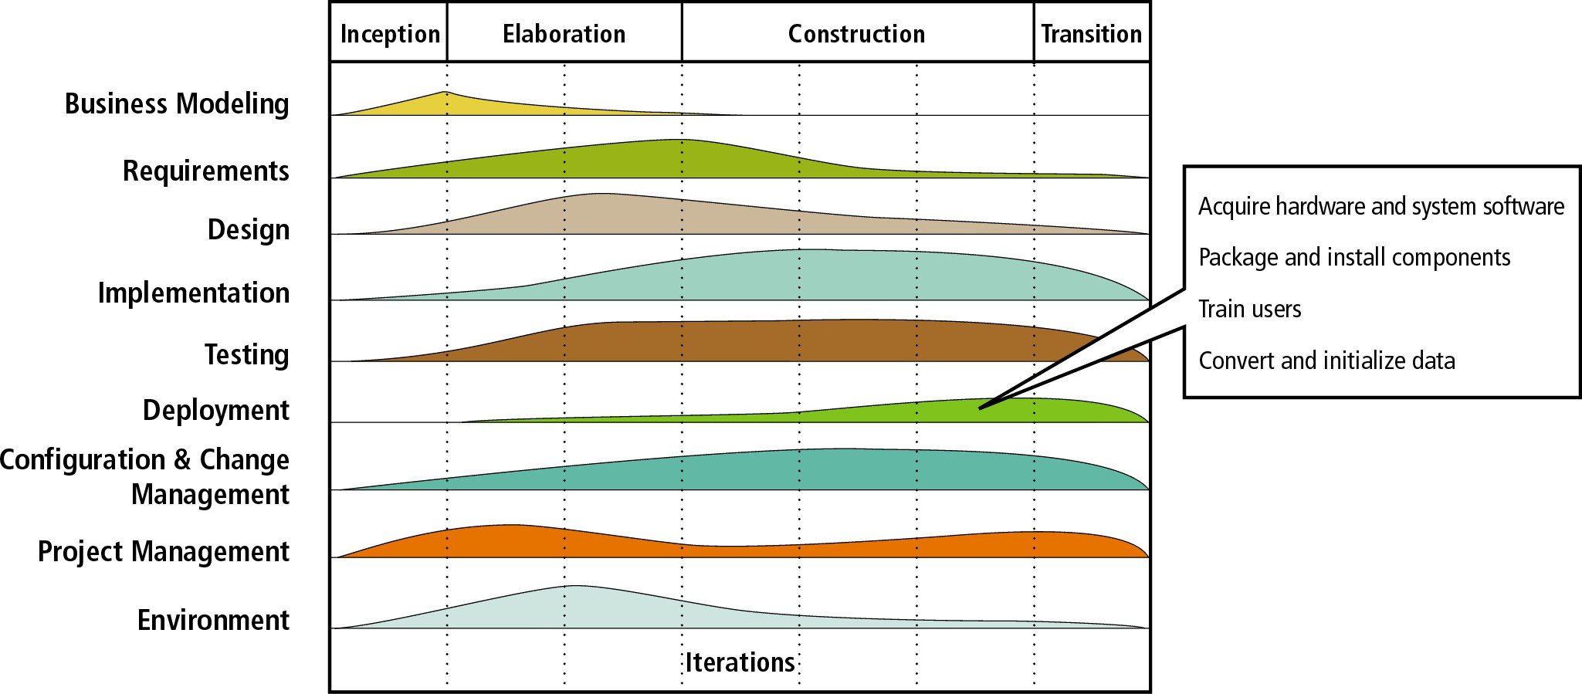
Figure 13-13 Deployment discipline activities

Slide 29
Acquiring Hardware and System Hardware
Application software must have a supporting infrastructure (which may already be in place).
Acquisition of an entirely new includes the following:
Planning
Developing a request for proposal
Evaluating results
Choosing one or more vendors
Installation and configuration
infrastructure

Slide 30
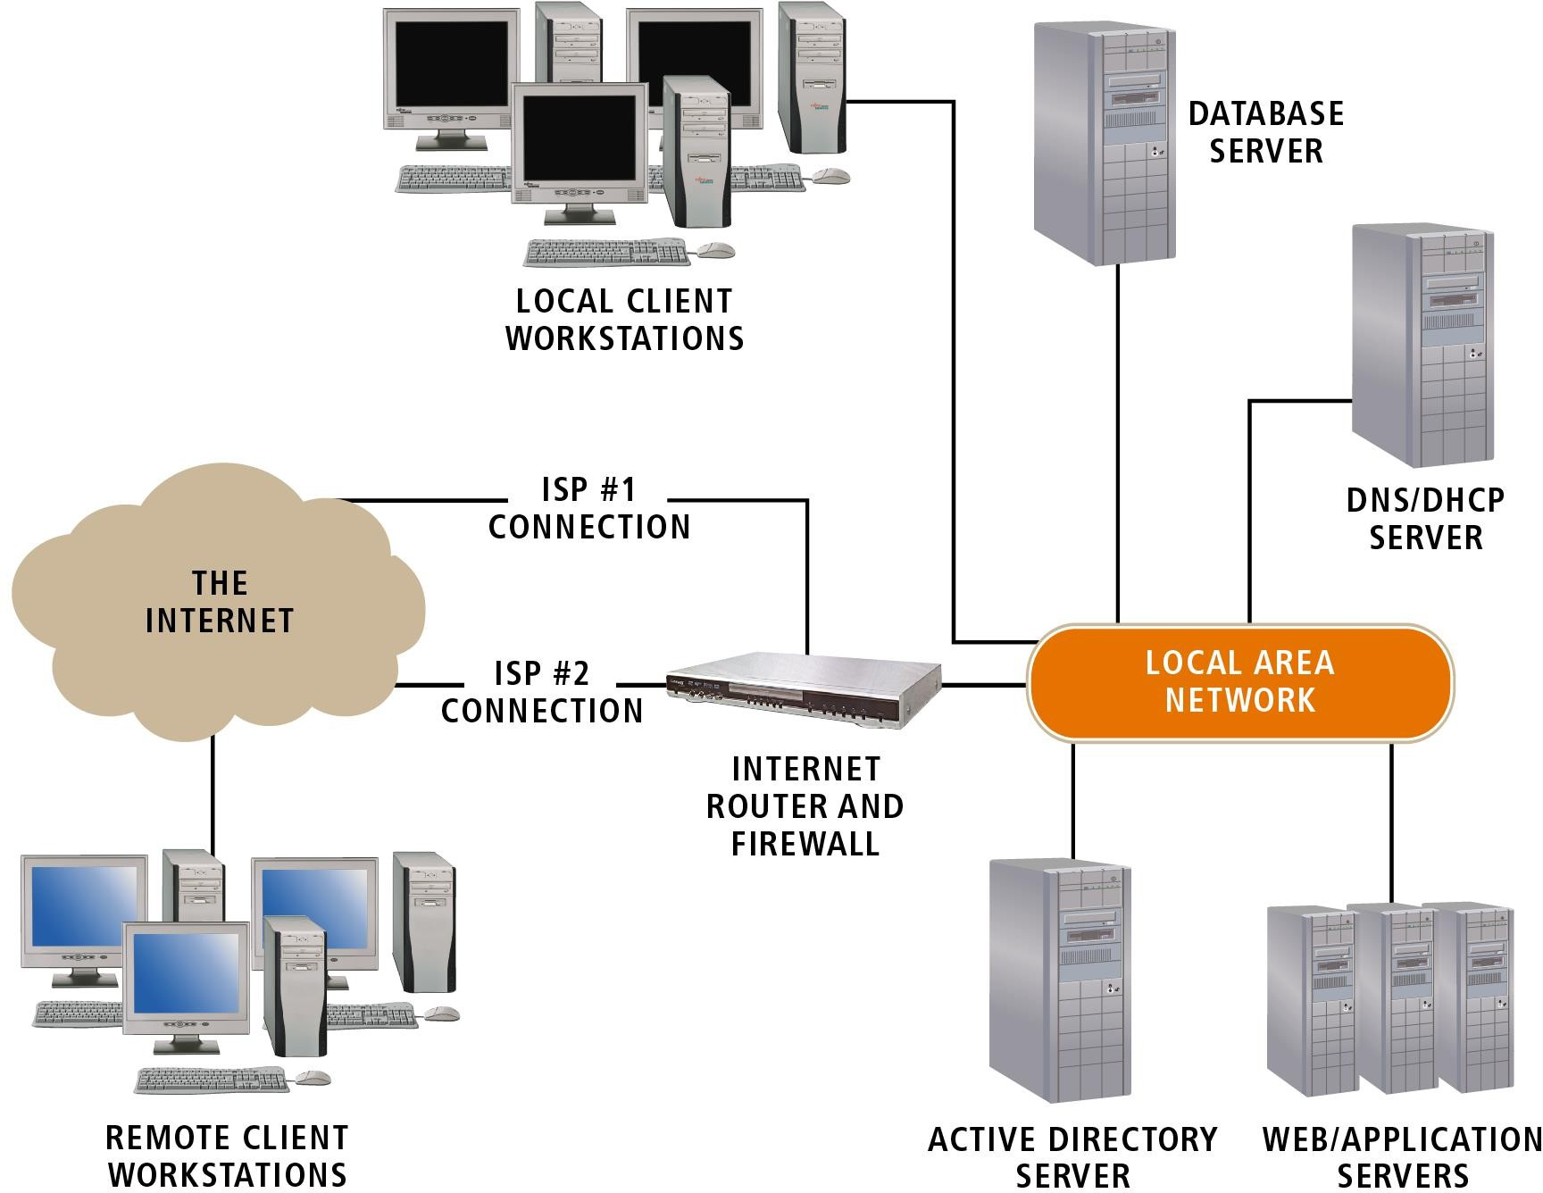
Figure 13-14
Infrastructure and clients of a typical .NET application

Slide 31
Packaging and Installing Components
Components must be
Installed on a host server
Added to a component registry
Assigned one or more network addresses
May include XML files to store registration and access information.
Developers can package and install components using development tools and utilities.

Slide 32
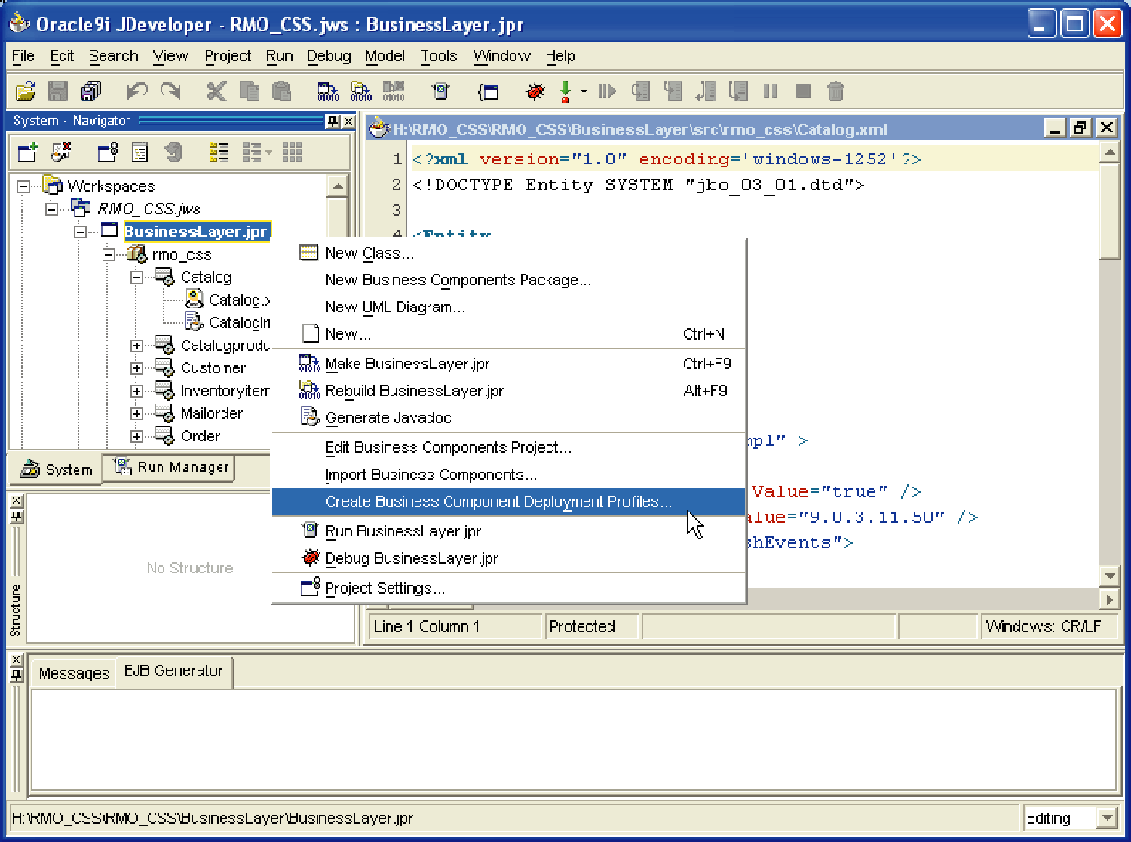
Figure 13-15
Automated component deployment with Oracle Developer

Slide 33
Training Users
End users and system operators need training.
End user training
Hands-on training and tutorials
Group tutorials
System operator training
Less formal
Self-study
Training materials are developed as soon as the interfaces are reasonably stable.

Slide 34
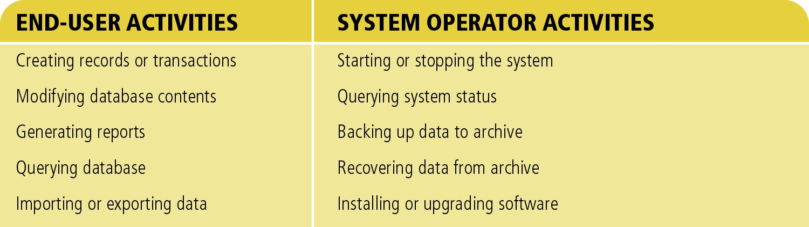
Figure 13-16
Typical activities of end users and system operators

Slide 35
Converting and Initializing Data
Data needed at system startup can be obtained from the following:
Files or databases of a system being replaced
Manual records
Files or databases of other systems in the organizations
User feedback during normal system operation
Existing databases are commonly modified for reuse in new or upgraded systems.

Slide 36
Reloading Database
Complex changes to a database may require reloading the data after the change.
Two approaches of reloading database
Initialize a new database and copy the contents of the old database to it.
Use a program or DBMS utility to extract and delete data from an existing database and store it in a temporary data store.
□ Many DBMSs provide import/export utilities to extract and load data.

Slide 37
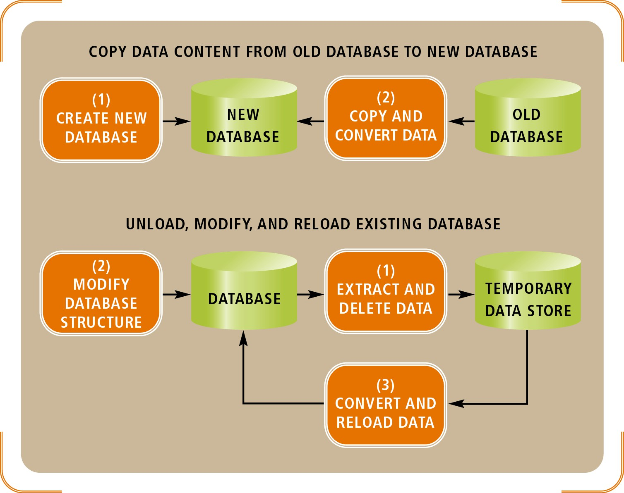
Figure 13-17
Two approaches to reloading database content after a structural modification

Slide 38
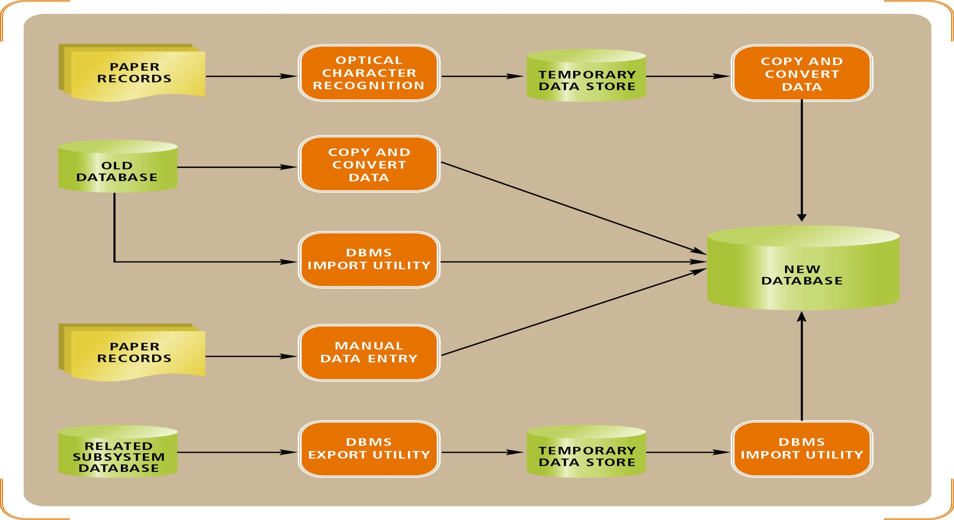
Figure 13-18
A complex data-conversion example

Slide 39
Planning and Managing Testing
Testing activities must be distributed throughout the project.
Unit and integration testing occur whenever software is developed, acquired, or combined with other software.
Usability testing occurs whenever requirements or design decisions need to be evaluated.
User acceptance tests are conducted as a final
and
validation of the requirements, design,
implementation activities.

Slide 40
Development Order
Input, process, output (IPO) development
Implements input modules first, process modules next, and output modules last.
Important user interfaces are developed early.
Top-down
Implements top-level modules first.
There is always a working version of the program.
Bottom-up
Implements low-level detailed modules first.
Programmers can be put to work immediately.

Slide 41
Framework Development
Foundation classes
Object framework that covers most or all of the domain and data access layer classes.
Reused in many parts of the systems and across applications.
Whenever possible, developers choose use cases for early iterations that rely on many foundation classes.
Testing early finds bugs before dependent code is developed.

Slide 42
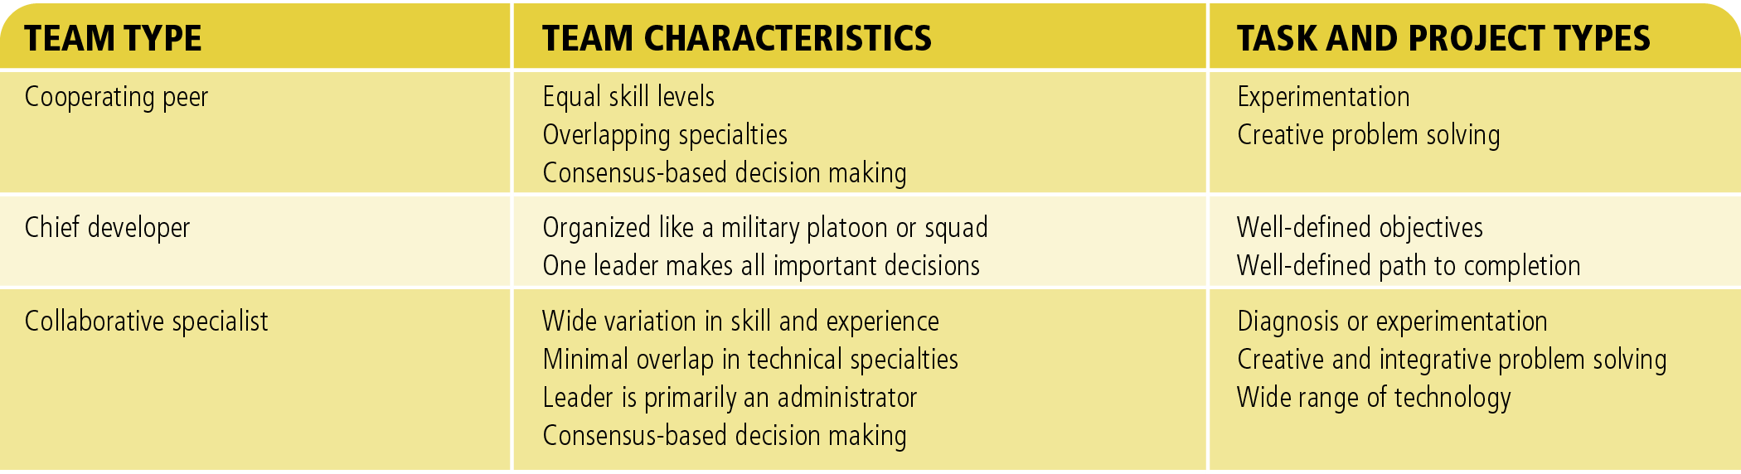
Figure 13-21
A comparison and summary of development team types

Slide 43
Source Code Control System (SCCS)
Automated tool for tracking source code files and controlling changes to those files.
Stores files in a repository.
Prevents inconsistent change and automates coordination.
Programmers can manipulate files in three modes.
Check out a file in read-only mode.
Check out a file in read/write mode.
Check in a modified file.

Slide 44
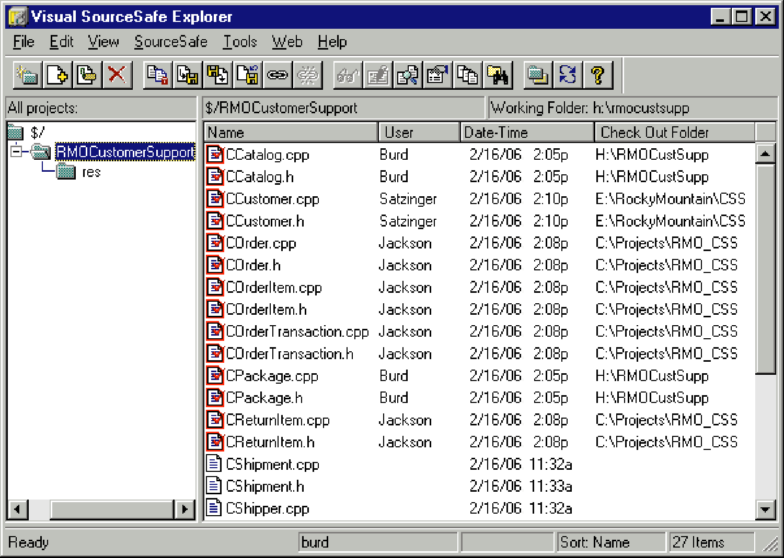
Figure 13-22
Project files managed by a source code control system

Slide 45
Deployment
Considerations when planning deployment
Incurring costs of operating both systems in parallel.
Detecting and correcting errors in the new system.
Potentially disrupting the company and its IS operations.
Training personnel and familiarizing customers with new procedures.
Each deployment approach has strengths and weaknesses.

Slide 46
Direct Deployment
Installs a
new system, quickly and immediately turns
makes it off any
operational,
overlapping systems.
Advantages
Simplicity
Disadvantages
Risk of system unavailability
Used when a new system is not replacing an old system and/or downtime can be tolerated.

Slide 47
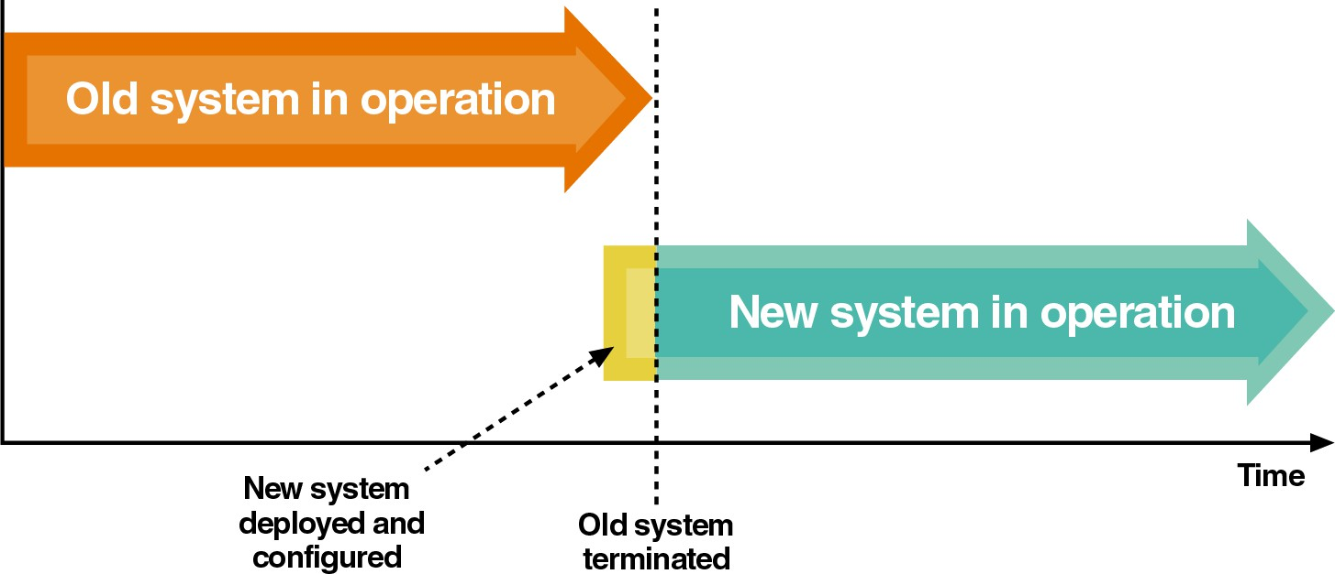
Figure 13-23
Direct deployment and cutover

Slide 48
Parallel Deployment
Operates both old and new systems for an extended time period.
Advantages
Relatively low risk of system failure
Disadvantage
Cost to operate both systems
Used for mission-critical applications.
Partial parallel deployment can be implemented with increased risk of undetected errors.

Slide 49
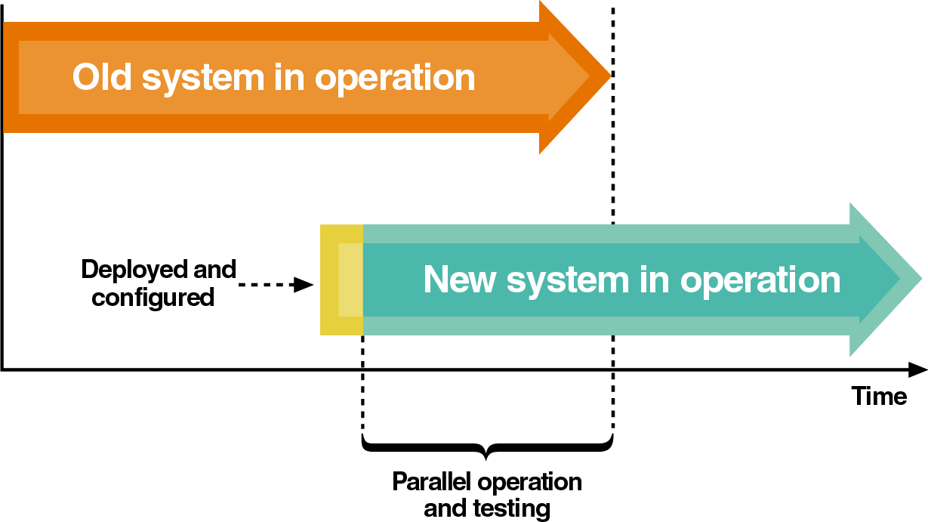
Figure 13-24
Parallel deployment and operation

Slide 50
Phased Deployment
Installs a new system and makes it operational in a series of steps or phases.
Advantages
Reduced risk
Disadvantages
Increased complexity
Useful when a system is large, complex, and composed of relatively independent subsystems.

Slide 51
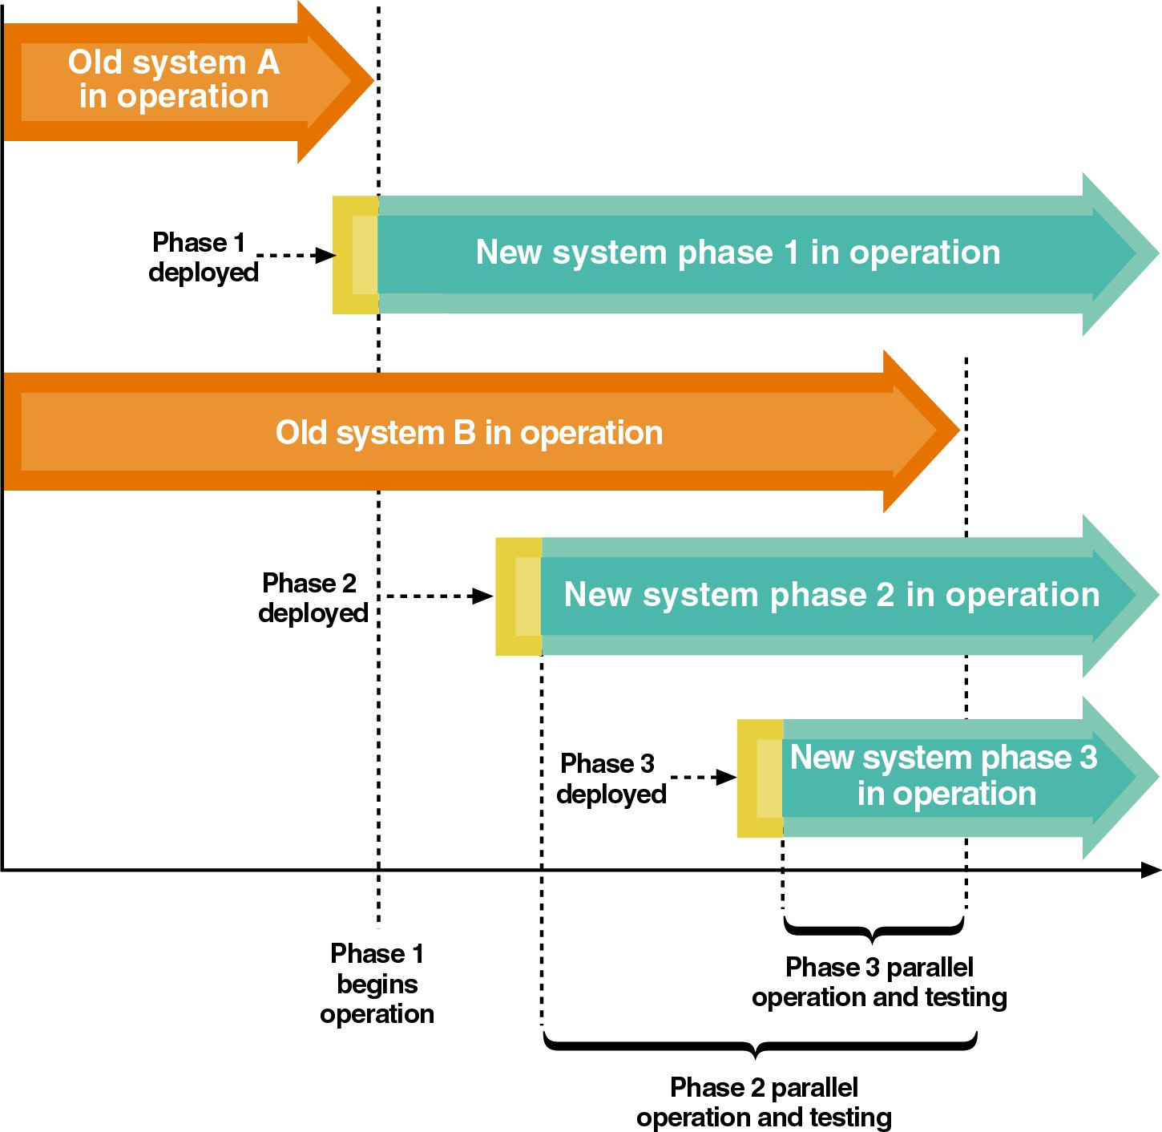
Figure 13-25
Phased deployment with direct cutover and parallel operation

Slide 52
Personnel Issues
New system deployment places significant demands on personnel.
Temporary and contract personnel may be hired to increase manpower, especially during a parallel deployment.
System operators
Personnel with experience in hardware or software deployment and configuration
Employee productivity decreases temporarily with a new system due to the learning curve.

Slide 53
RMO Revisited
Deals with highest risks in early iterations.
Acquire new infrastructure
Develop use cases involving Web-based interfaces
Tests high-risk elements early.
Uses phased deployment with the highest risk portion of the system deployed first (in parallel).
Spreads training activities throughout later iterations.

Slide 54
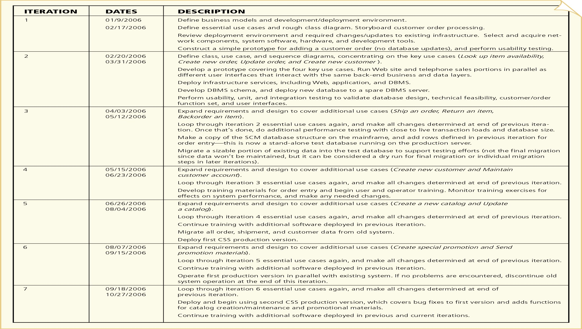
Figure 13-26: RMO CSS iteration plan

Slide 55
Summary
Implementation is complex, difficult to manage, and risky.
Implementation and testing are two of the most interdependent UP disciplines.
A program development plan is a trade-off among available resources, available time, and desire to detect and correct errors prior to system development.

Slide 56
Summary (continued)
Configuration and change management discipline is most applicable to projects that are too large to deploy in a single version.
Use versioning to manage large projects.
Deployment activities
Acquiring hardware and system software
Packaging and installing components
Training users
Converting and initializing data

