Slide 1
Classification of cost

Slide 2
Definitions
Cost: Cost is the amount of resource given up in exchange for some goods or services. The resources given up are money or money’s equivalent expressed in monetary units.
The Chartered Institute of Management Accountants, London defines cost as “the amount of expenditure (actual or notional) incurred on, or attributable to a specified thing or activity”.
Costing: It is the process of ascertaining the cost. It consists of principles and rules, governing the procedure of finding out the costs of goods/ services.
Cost Accounting: It is a specialized branch of accounting, involving classification, accumulation, assignment and control of costs.
CIMA’s definition: “The establishment of budgets, standard costs and actual costs of operations, processes, activities or products, and the analysis of variances, profitability or the social use of funds”.

Slide 3
Cost Accountancy “the application of costing and cost accounting principles, methods and techniques to the science, art and practice of cost control and the ascertainment of profitability. It includes the presentation of information derived there from for the purpose of managerial decision making.”
Objective of Cost Accounting:
Cost accounting aims at systematic recording of expenses and analysis of the same so as to ascertain the cost of each product manufactured or service rendered by an organization.
To arrive at the cost of production of every unit, job, operation, process, department or service and to develop cost standard. To provide actual figures of cost for comparison with estimates and serve as a guide for future estimates.
Analyzing the causes of unsatisfactory results, indicating remedies.
To provide data for periodical profit and loss accounts and balance sheets at such intervals, e.g., weekly, monthly or quarterly, not only for the whole business but also by departments or individual products.

Slide 4
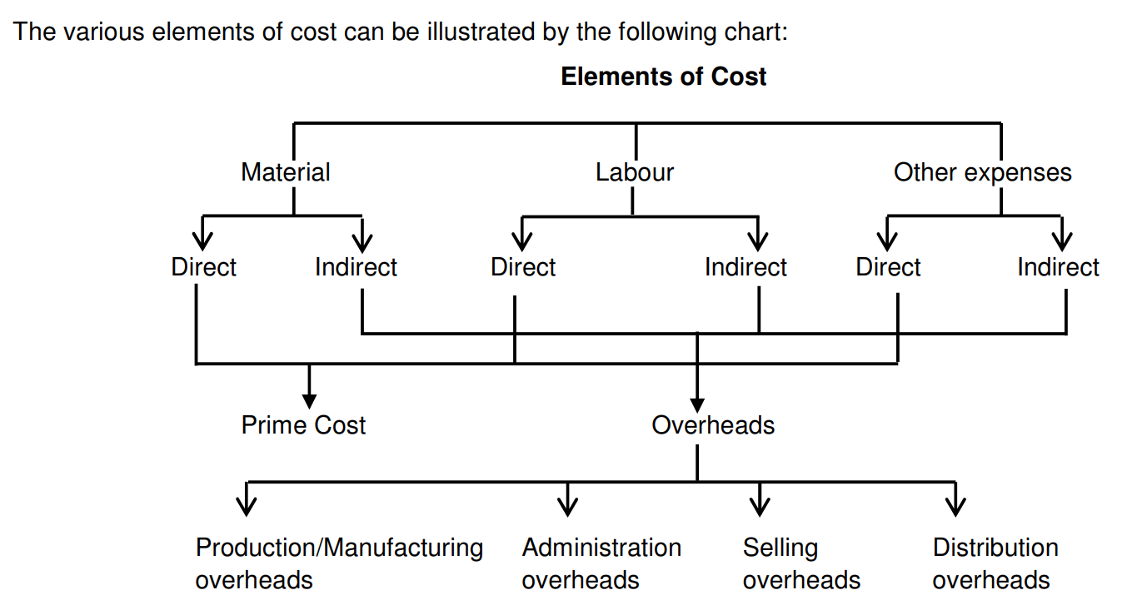

Slide 5
Classification of costs
By time (Historical: These costs are ascertained after they are incurred; Pre-determined: These costs are calculated before they are incurred on the basis of a specification of all factors affecting cost.):
2. By nature or elements (Material, Labor and Overhead).
3. By degree of traceability to the product
(Direct/traceable: Costs which can be easily traceable to a product or costing unit or cost center or some specific activity. Indirect/Common Costs: These costs are difficult to trace to a single product since they are common to several products, e.g. salary of a factory manager.)
4. Association with the product (Product: Product costs are those which are traceable to the product and included in inventory values. Product cost is a full factory cost. Period: Costs incurred on the basis of time such as rent, salaries, etc., include selling and administrative costs essential to keep the business running. Though they are necessary to generate revenue, they are not directly associated with production.

Slide 6
5. By changes in activity or volume (Fixed, Variable, Semi-variable).
6. By function (Manufacturing, Administrative, Selling, Research and development, Pre-production(trial runs)).
7. Relationship with accounting period (Capital expenditure provides benefit to future period; revenue expenditure benefits only the current period).
8. Controllability (Controllable cost: which can be influenced by its budget holder. Non-Controllable Cost: which is not subject to control at any level of managerial supervision).
9. Cost for analytical and decision-making purposes: (Opportunity, Sunk, Differential, Joint, Common, Replacement, etc).
10. Others (Conversion, Traceable, Normal, Avoidable, Unavoidable, Total).

Slide 7
Sunk cost
It is the cost that has already been incurred and cannot be avoided by decisions taken in the future. It refers to past costs, thus is also called as unavoidable cost.
CIMA defines it as the past cost not taken into account in decision making. ( since all past costs are irrelevant)
It has also been defined as the difference between the purchase price of an asset and its salvage value.
Example: Training costs for employees who’ve left the company.
Example: ABC Ltd. spends ₹10 lakhs developing a new mobile app. Before launching, market research reveals the app is unlikely to succeed. Option A: Spend ₹3 lakhs more to launch it. Option B: Cancel the project.
(The sunk cost fallacy: We’ve already spent so much, let’s not waste it)

Slide 8
Relevant cost
It is the cost which influences a particular decision and is influenced by the decision.
Relevant costs are future costs that differ between alternatives. They are costs that are directly impacted by a decision and hence should be included in the decision-making process.
Example: if a manufacturer wants to close down his shop, wages paid to workers will disappear. Thus, it is a relevant cost.
Example: A company makes a part in-house for ₹120 per unit. The cost breakdown:
Direct Materials: ₹40; Direct Labor: ₹30; Variable Overhead: ₹20
Fixed Overhead: ₹30. A supplier offers to sell the part for ₹100 PU
Question: Should the company make or buy the part?
Relevance cost = 40 + 30 + 20 = 90.
(variable cost is only related to the production, but relevant may or may not be related to the production)

Slide 9
Shut-down cost
Shut-down costs are the fixed costs which an undertaking will have to incur during the period of temporary closer of the production activity.
Even if there is no production, certain costs/expenses such as factory rent, insurance of plant and machinery etc. have to be incurred.
This cost is considered when there is a choice between to continue or to shut down the business.
Example: Pandemic

Slide 10
Out of pocket cost
Out-of-pocket cost refers to actual cash expenditures made by a company or individual. These are real, direct payments made for goods, services, or obligations — unlike notional costs, which do not involve cash flow.
It involves payment to outsiders i.e. gives rise to cash expenditure as opposed to such costs as depreciation or opportunity cost which don’t involve any cash expenditure.
Such costs are relevant for price fixation during recession or when make or buy decision is to be made.
Example: Payment for materials, wages, insurance, salaries etc.
Out of pocket cost will vary depending upon the nature of decision made.

Slide 11
Opportunity cost
Opportunity cost is the cost of selecting one course of action and the losing of other opportunities to carry out that course of action.
It is the amount that can be received if the asset is utilized in its next best alternative.
Edwards, Hermanson and Salmonson define it as “the benefits lost by rejecting the best competing alternative to the one chosen. The benefit lost is usually the net earnings or profit that might have been earned from the rejected alternative.”

Slide 12
Imputed cost
Imputed costs are hypothetical or notional costs that represent the potential cost of using a company’s own resources, rather than renting or purchasing them from outside sources.
Some costs are not incurred and are useful while taking decision pertaining to a particular situation. These costs are known as imputed or notional costs, and they do not enter into traditional accounting systems.
Examples: Interest on internally generated funds; the forgone rent income if a company uses its own building for production instead of renting it out (notional rent); the forgone salary if a business owner chooses to work in their own business instead of taking a job elsewhere.

Slide 13
Differential cost
Differential cost has been defined as “the difference in total cost between alternatives, calculated to assist decision making”.
Differential cost is the increase or decrease in total costs resulting out of:
Producing and distributing a few more or few less of products;
A change in the method of production/distribution;
An addition or deletion of a product or a territory; and
The selection of an additional sales channel.
Differential costs is useful in planning and decision making and helps to choose the best alternative.

Slide 14
Marginal cost
It is the aggregate of variable costs, i.e., prime cost plus variable overheads.
According to CIMA, “marginal cost means the amount at any given volume of output by which aggregate costs are changed if the volume of output is increased or decreased by unit”.
It represents the incremental cost associated with producing one more unit of output.
Marginal cost is also termed as variable cost and is sum total of direct material costs, direct labour costs, direct expenses and all variable overheads.

Slide 15
Replacement cost
This is the cost of replacing an asset at current market value.
When the cost of replacing an asset is considered, it means the cost of purchasing the asset at the current market price is important and not the cost at which it was purchased.
Example: A company owns a machine that it purchased 10 years ago for $50,000. Its book value is now $10,000 after depreciation. However, the current market price to buy a similar machine is $75,000. The replacement cost is $75,000

Slide 16
Conversion cost
It is the cost of a finished product comprising direct labor and manufacturing overhead.
Conversion cost refers to the expenses incurred in transforming raw materials into finished goods, encompassing direct labor costs and manufacturing overhead costs, essentially everything except the direct materials used in production.
It is production cost less the cost of raw material but including the gains and losses in weight or volume of direct material arising due to production.
It is crucial for businesses to understand their production costs, make informed decisions, and set appropriate product prices.

Slide 17
Committed cost
These costs are incurred to maintain certain facilities and cannot be quickly eliminated.
The management has little or no discretion in this cost, e.g., rent, insurance etc.
Committed cost refers to a fixed cost arising from the use of facilities or services that are locked in due to contractual agreements or strategic investments, and that continue regardless of the level of activity or output.

Slide 18
Discretionary Costs
Expenses that management can choose to incur or not incur in a given period, without significantly impacting the company’s core operations or profitability in the short term.
These are not related to the operations and can be controlled by the management.
These costs result from special policy decisions, new researches etc., and can be eliminated or reduced to a desirable level at the discretion of the management.

