Slide 1






A World Away:
HUNTING FOR EXOPLANETS WITH AI
NASA: SPACEAPPS CHALLENGE - KIGALI

Slide 2
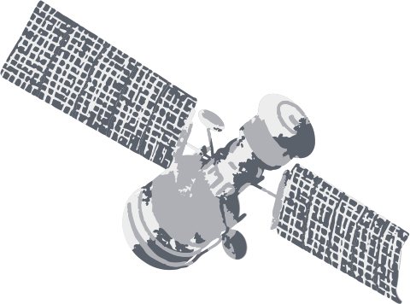
1
No schools that teach astronomy.
Problems
2
Astrophysics is not a beginner-friendly field.
Lack of public intelligent systems specific to Astronomy for research.
3
4
Lack of Customized Learning Platforms

Slide 3

Solution Architecture

Slide 4

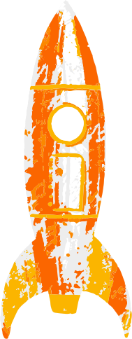


Solution Demo!

Slide 5
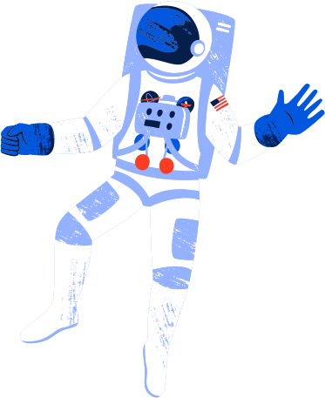

Impact
Time efficiency.
Attract More People.
Knowledge Accessibility.

Slide 6
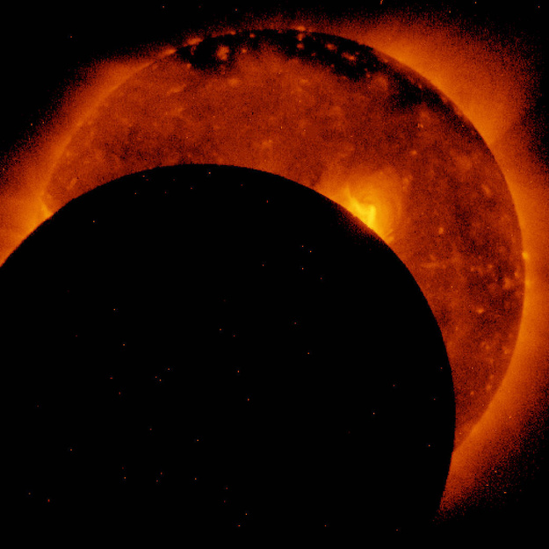
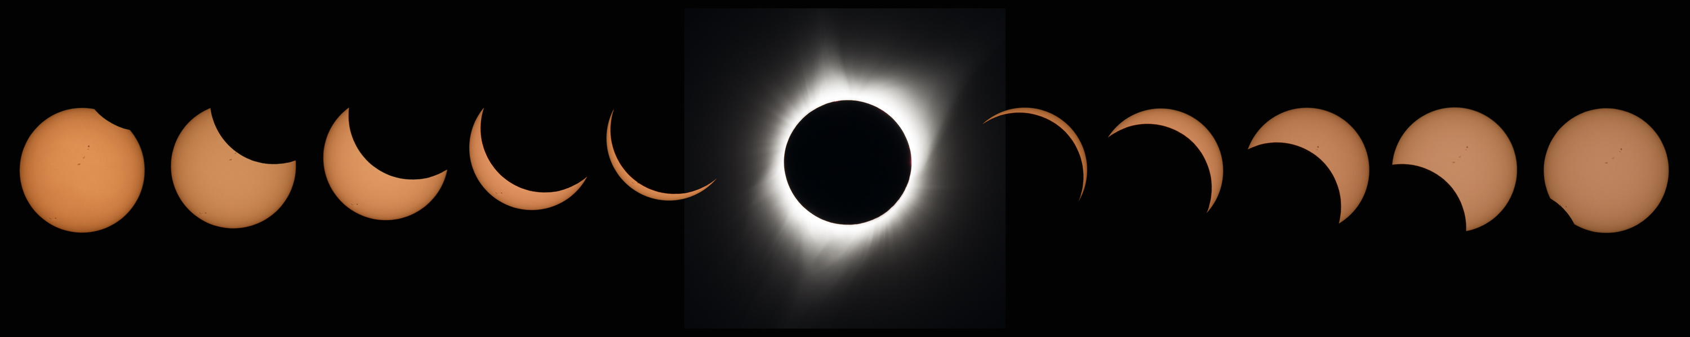

Next Steps
LEARNING
1
RESEARCH
2
OTHERS
3
Add video learning (doom scrolling).
More Customization.
Make Frontend better.
Add analytics tools.
Code execution.
Reinforcement Learning.
Downloading resources.
Image Credit: NASA/JAXA
Image Credit: NASA/Aubrey Gemignani
Image Credit: NASA/Bill Ingalls

