Slide 1
Modeling Presentation
Muhammad Egi Irfian Akbar

Slide 2
List of Content
Exploratory Data Analysis
Multinomial Logistics Regression
XGBoost
Artificial Neural Network
API Docs

Slide 3
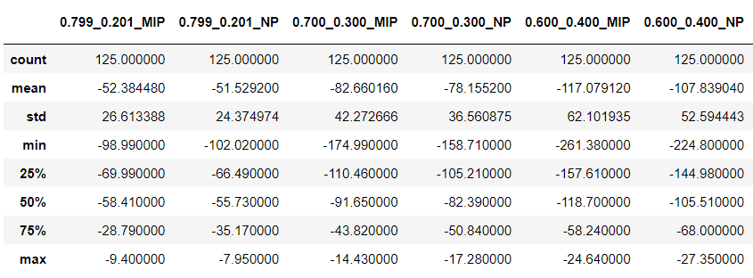
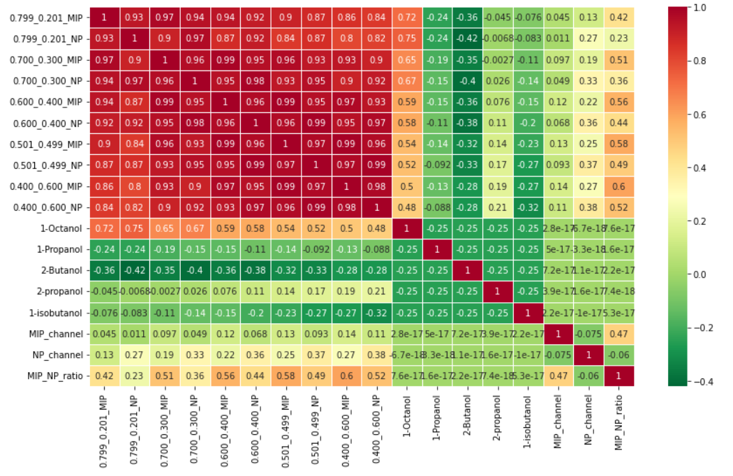
Exploratory Data Analysis
Preprocessing Steps:
1. Concat all Data into 1 DataFrame
2. Create MIP_channel, NP_channel and MIP_NP_ratio columns from given description
3. Check Label Distribution, Duplicated Data, Features Distribution, Outlier, Features Correlation
Insight:
1. Each QCM File has 25 records with 5 records for each target class
2. Dataset has balance label
3. No Duplicates Data
4. Each feature has shape (almost) Gaussian distribution & has (almost) linear trend
5. Each feature is highly correlated from each other
6. There are some outlier, but not necessary Anomaly Data. Considering data has small records, we will keep all records
Action:
1. Apply StandarScaling
2. Since we have linear Data trend (suitable for using multinomial logistic regression) But has highly correlated (violates one of the assumptions of logistic regression) we will comparing 2 algorithm result (multinomial logistic regression & XGBoost)

Slide 4
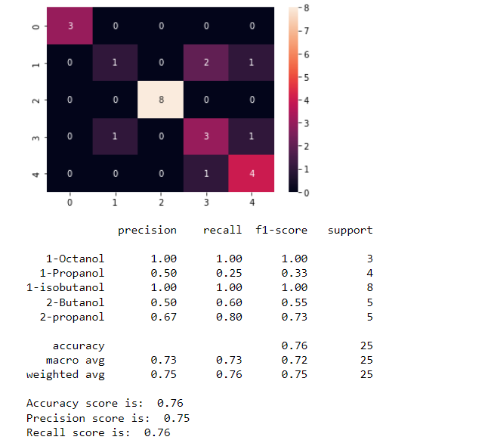
Multinomial Logistics Regression
Confusion Matrix
Classification Report

Slide 5
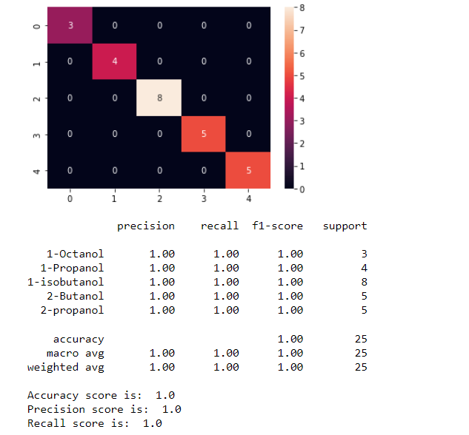
XGBoost
Confusion Matrix
Classification Report

Slide 6
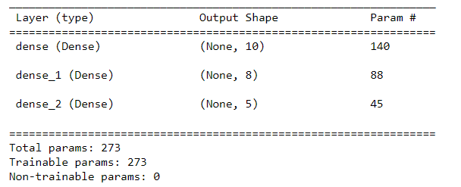
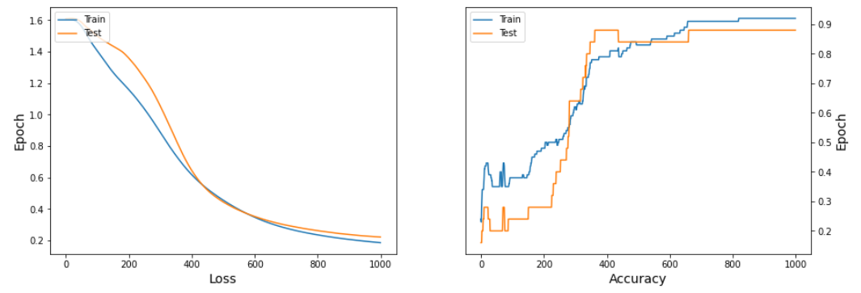
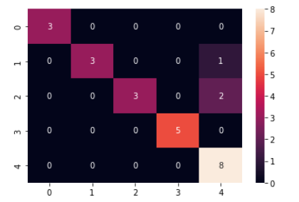
Artificial Neural Network
Model Summary
Model Accuracy
Confusion Matrix

Slide 7
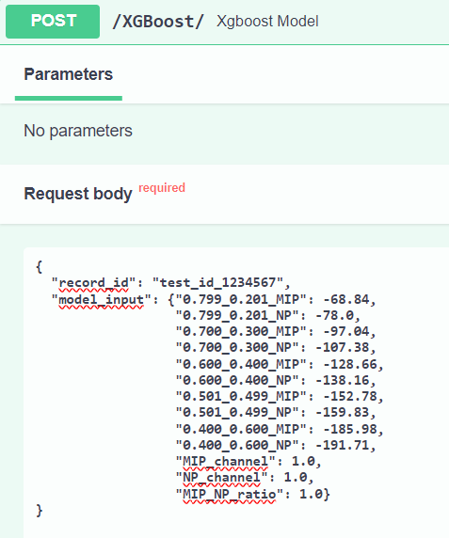
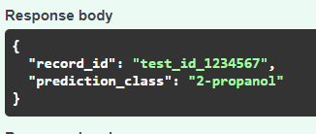
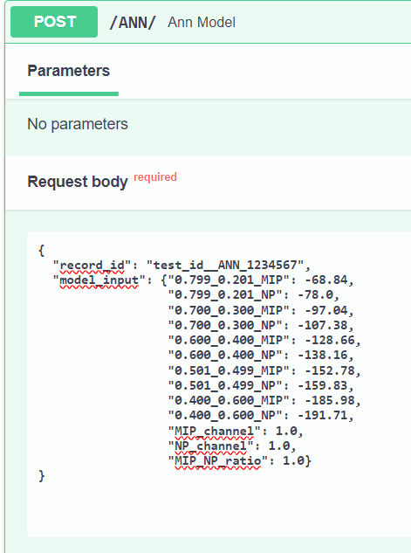
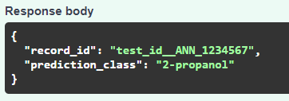
API
XGBoost API EndPoint
ANN API EndPoint

