Slide 1
Particle distributions

Slide 2
Overview
Particle distributions show how particles are distributed as a function of energy and direction (or pitch angle).
Useful for identify plasma boundaries, e.g. magnetopause.
Provide kinetic evidence of magnetic reconnection.
Unstable or anisotropic particle distributions generate waves.

Slide 3
Data
Electron data from PEACE instrument
C?_CP_PEA_PITCH_SPIN_DEFlux – Spin resolution
C?_CP_PEA_PITCH_3DXL_DEFlux – Subspin resolution LEEA
C?_CP_PEA_PITCH_3DXH_DEFlux – Subspin resolution HEEA
C?_CP_PEA_PITCH_3DRH_DEFlux – Subspin resolution HEEA (reduced)
Ion data from CIS-HIA
C?_CP_CIS-HIA_HS_1D_PEF – 1D ion distribution
C?_CP_CIS-HIA_PAD_HS_MAG_IONS_PF – 2D pitch angle (particle flux)
C?_CP_CIS-HIA_HS_MAG_IONS_PEF – 3D distribution, subspin resolution

Slide 4
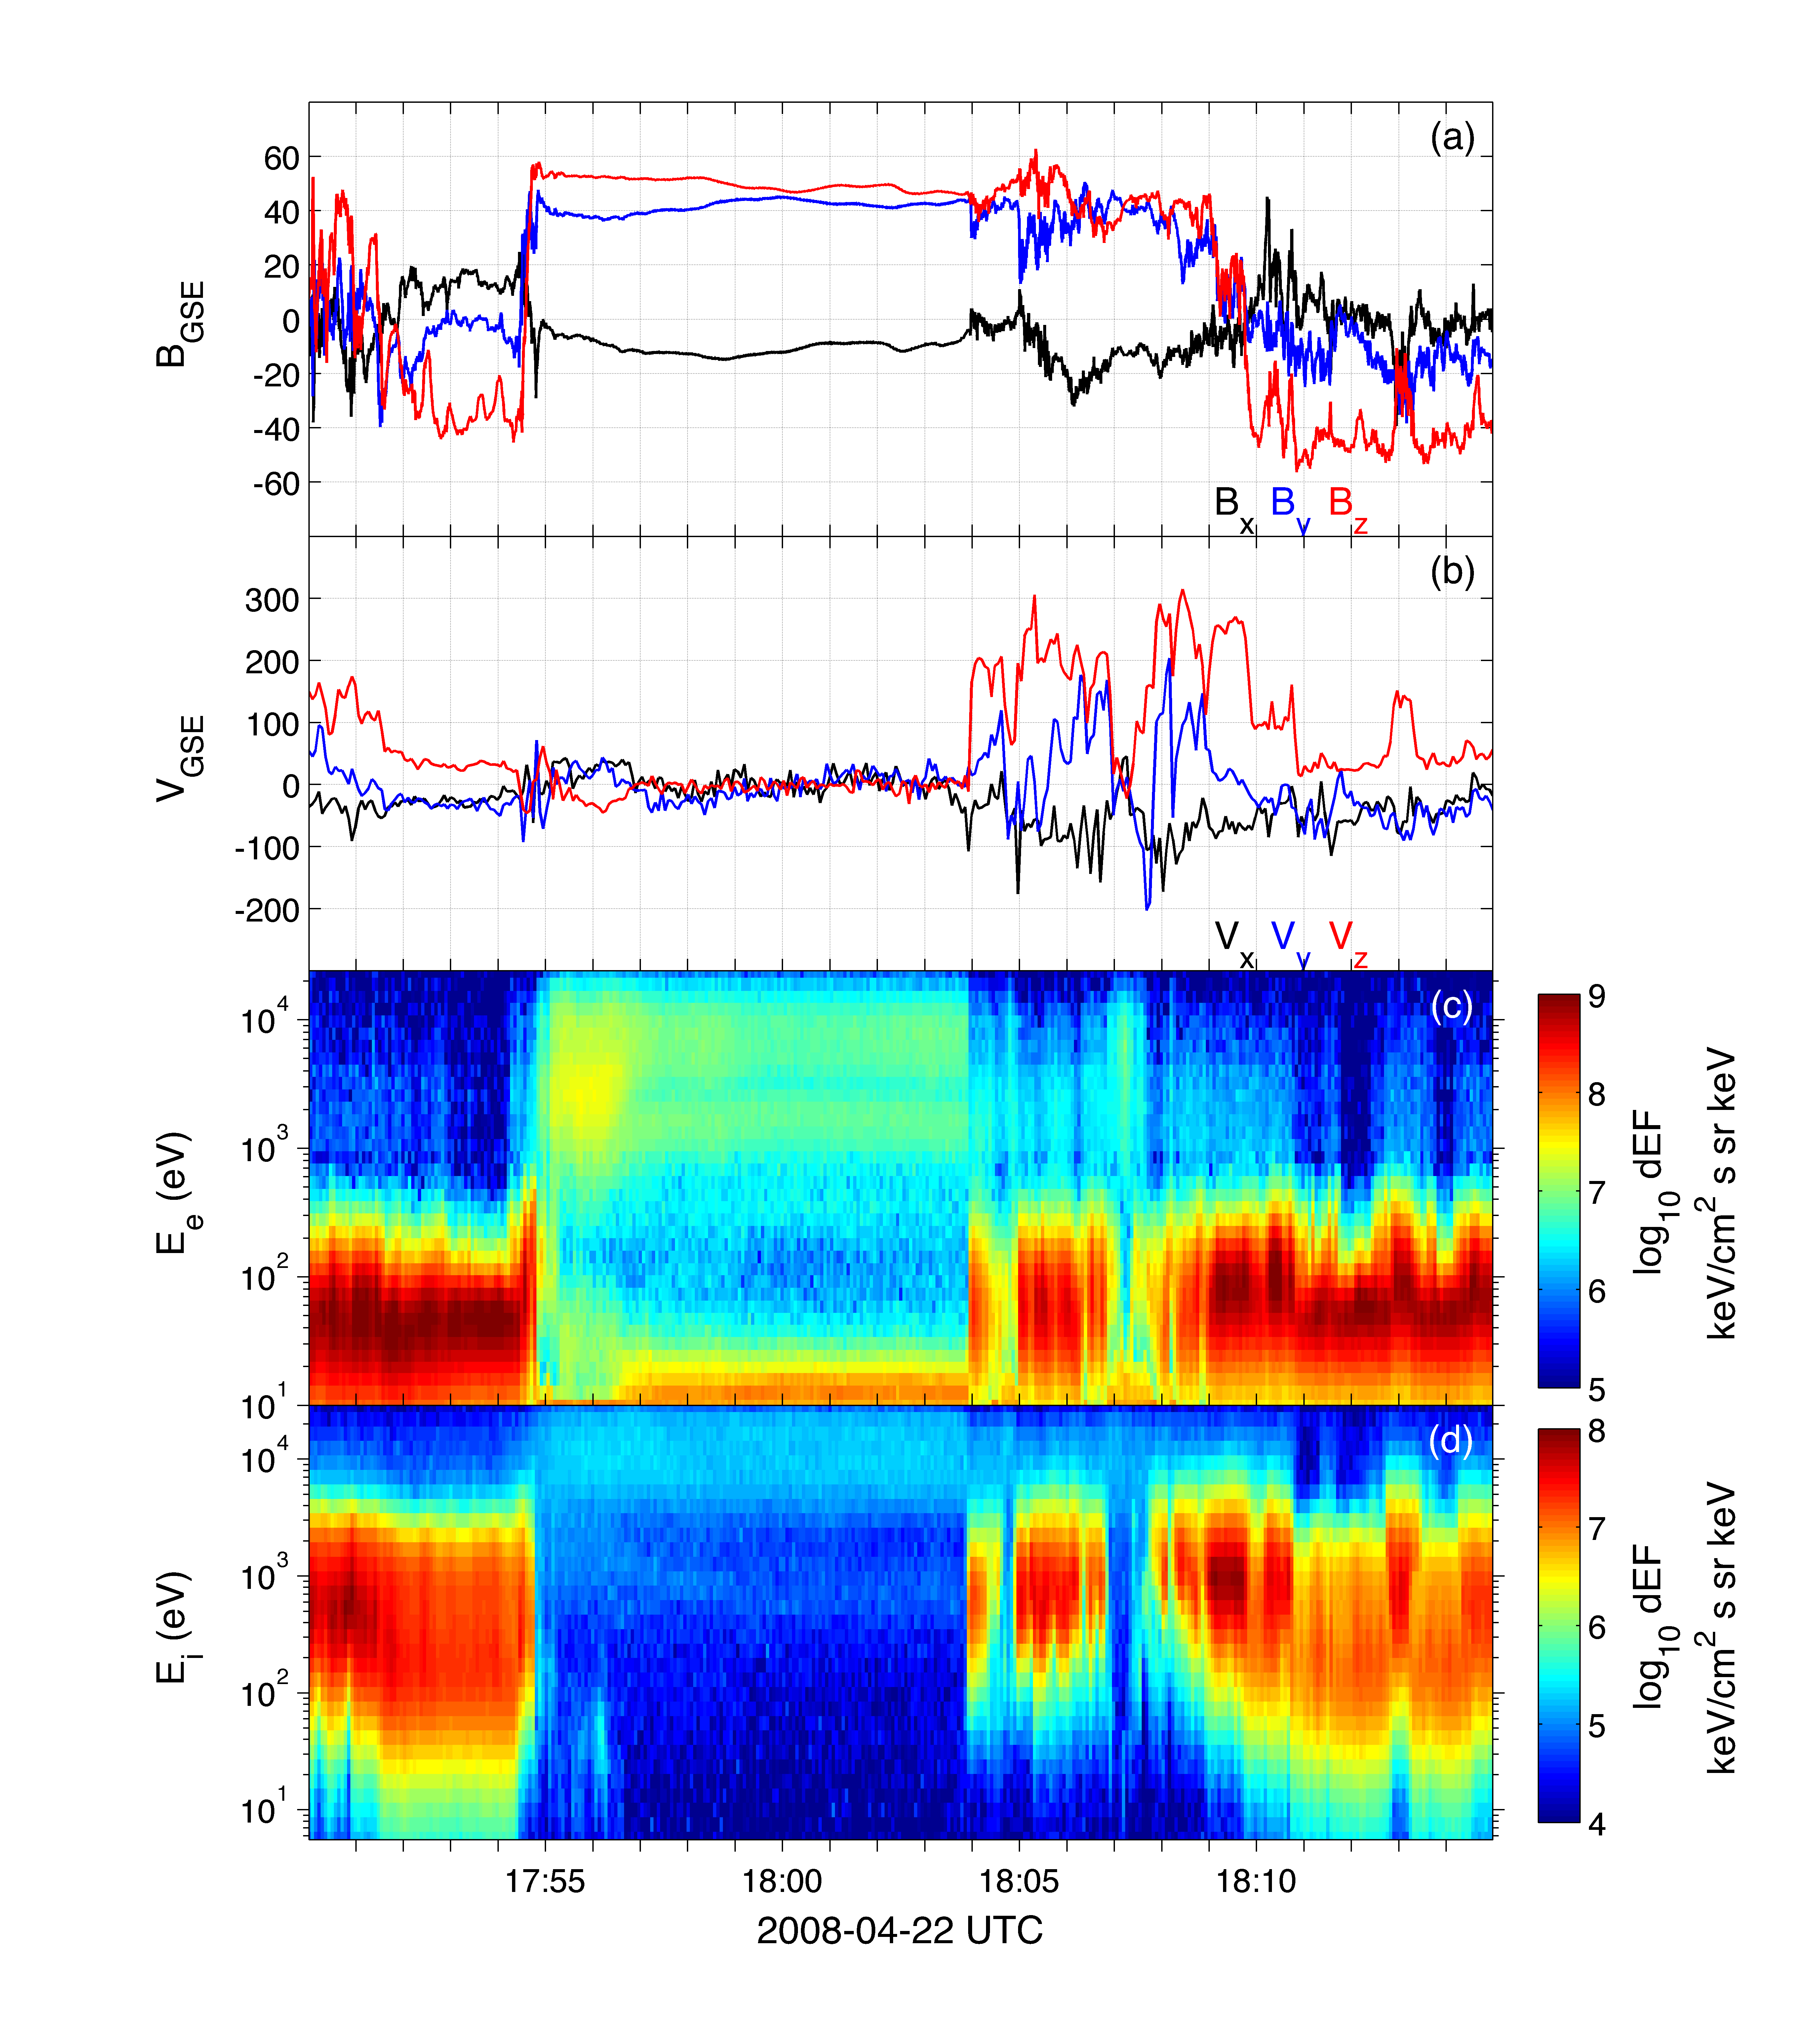
Plotting energy spectrograms
Magnetosphere
Magnetic field
Reconnection outflows
Ion speed
Electron differential energy flux
Photoelectrons
Ion differential energy flux

Slide 5
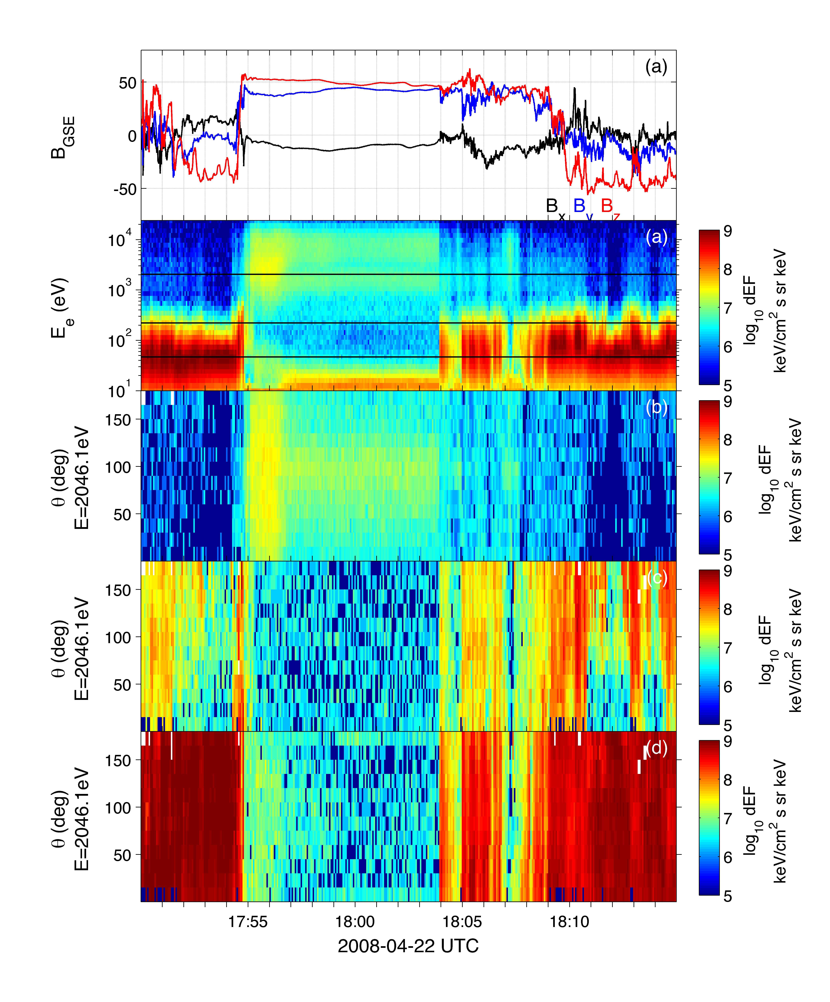
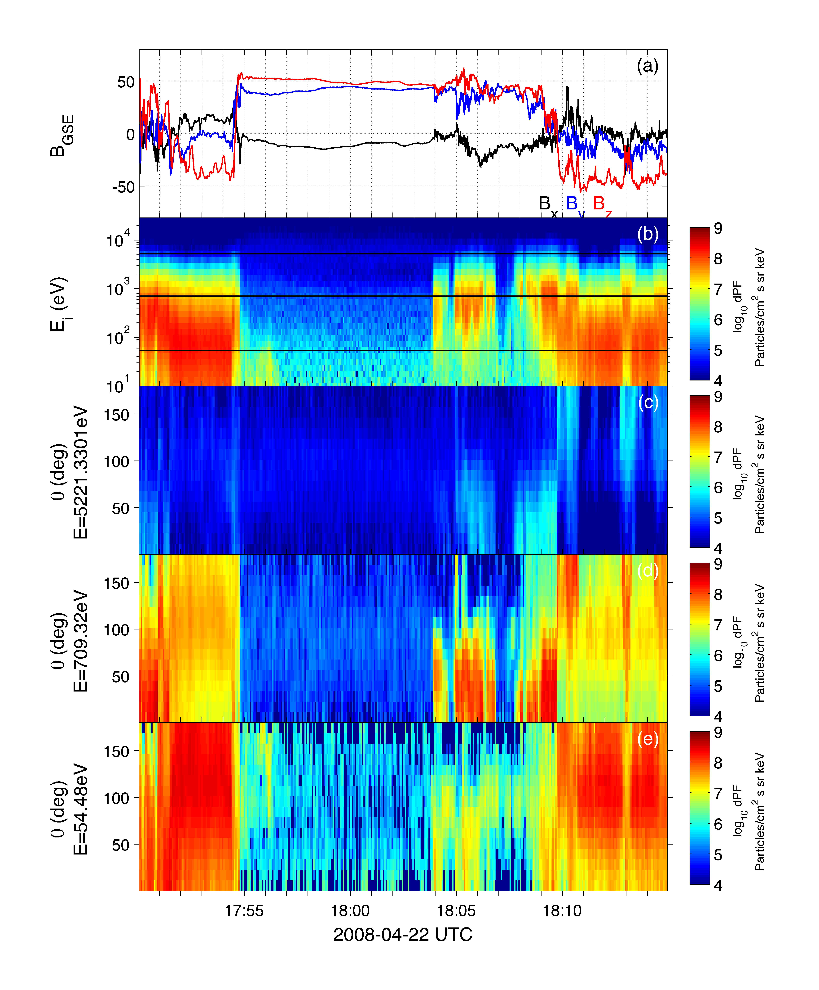
Pitch angle spectrograms
Particle fluxes can be plotted versus pitch angles
Electrons Ions
Spin resolution data

Slide 6
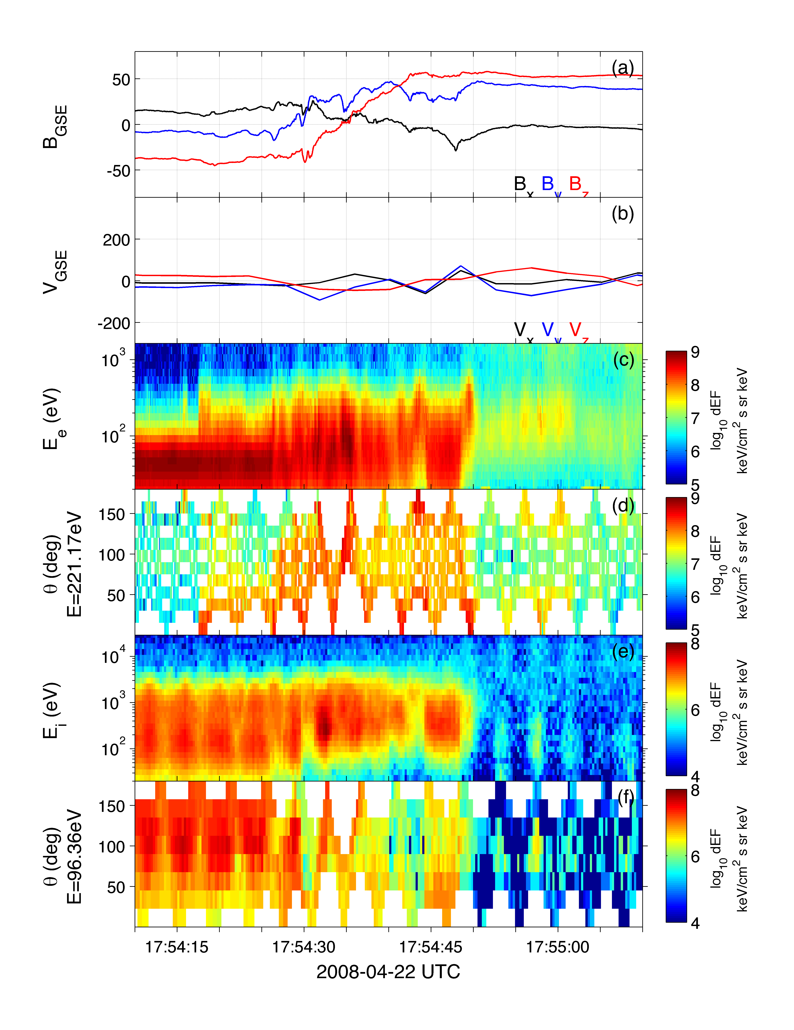
Cluster burst mode data
Current sheet
Electron Omnidirection differential energy flux subspin resolution
Pitch angle distribution subspin resolution
Ion Omnidirection differential energy flux subspin resolution
Ion Pitch angle distribution subspin resolution

Slide 7
Scripts & Exercises
Scripts:
Download data: getdata.m
For plotting time series: energyspec.m (spin resolution), energyspecbm.m (subspin resolution), electronpitchangle.m (pitch angle time series, spin resolution), ionpitchangle.m (spin resolution).
For plotting distributions: idpfluxpad.m (ion pitch angle distribution), ePSDpad.m (electron phase-space density, spin resolution), ePSDpadbm.m (electron PSD, subspin resolution), edefluxpad.m, edefluxpadbm.m (electron DEFluxes).
Exercises
Use scripts to plot particle data. Are there any anisotropic regions, DEFluxes that differ with pitch angle.
Use scripts to download and analyze a new event, e.g., a magnetopause crossing from previous session, could check csa quicklook plots.

Slide 9
Distribution functions
Often single particle distributions are plotted instead of a time series (spectrogram).
Distributions provide kinetic evidence for reconnection.
Unstable distributions, which generate waves, can be identified.

Slide 10
3DX & 3DR versus PITCH_SPIN data
When available use 3DX & 3DR products.
Spin resolution – 2 energy sweeps
Energy sweep – max. 8/second.
C1_CP_PEA_PITCH_3DXL_DEFlux & C1_CP_PEA_PITCH_3DRH_DEFlux
C1_CP_PEA_PITCH_SPIN_DEFlux

Slide 11
Electron pitch angle distributions
Differential energy fluxes can be plotted as a function of pitch angle and energy.
Magnetospheric distribution
Magnetosheath distribution

Slide 12
Ion pitch angle distributions
Ion pitch angle distributions can be obtained from C?_CP_CIS-HIA_PAD_HS_MAG_IONS_PF
Magnetosheath distribution
Ion outflow – D-shape distribution

Slide 13
Electron Phase-space densities
Electron beam
Often particle distributions are plotted as phase-space densities.
One count level (dashed line).
Magnetospheric electrons

Slide 14
Scripts & Exercises
Scripts
For plotting distributions: idpfluxpad.m (ion pitch angle distribution), ePSDpad.m (electron phase-space density, spin resolution), ePSDpadbm.m (electron PSD, subspin resolution), edefluxpad.m, edefluxpadbm.m (electron DEFluxes).
Exercises
Plot pitch angle distributions of anisotropic electrons. Find an interesting interval using time series.
Compare burst mode 3DX, 3DR data with spin resolution data.
Try downloading a different magnetopause crossing and investigate.

